Slide 1
Business Deliverabales
E-Shop Pro Customer Churn and Retention Analysis

Slide 2
Problem:Customer Renetention Rate
Customer turnout keeps declining
Reduction in Revenue/Sales

Slide 3
Datasets
Load dataset
Explore and perform EDA(Exploratory Analysis)
Draw insights to understand Data Features in relation to the problem

Slide 4
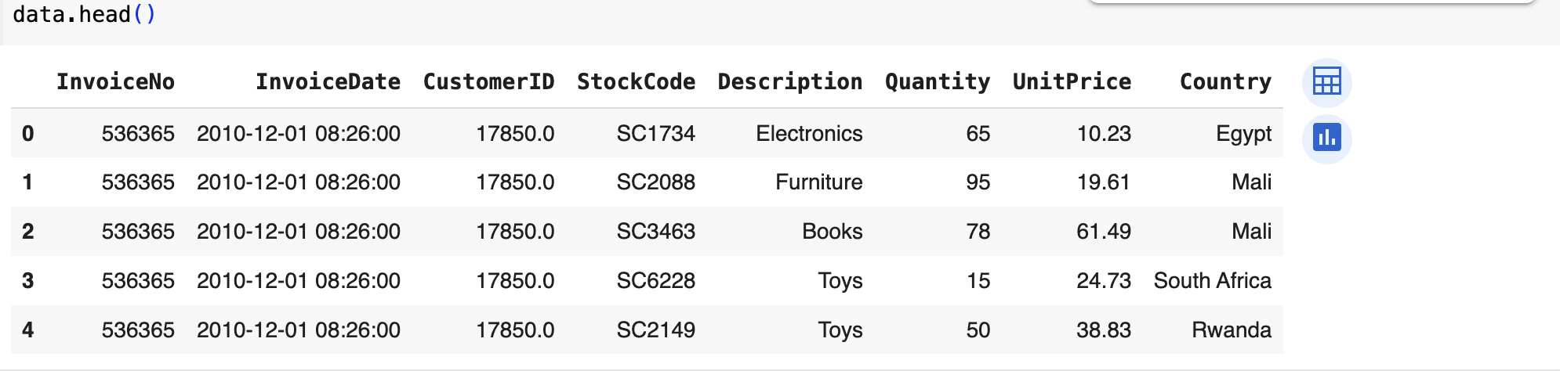
Exploratory Data Analysis (EDA )
The dataset has details that indicate features as shown above

Slide 5
Data Cleaning
The feature “InvoiceDate ” needs to be formatted to a datetime framework rather than an object so that the numpy libraries can work effectively, as in Fig.2
The data needs to be cleaned as it contains some null values, as in Fig.3
Format the feature “CustomerID” as a string (str) instead of a float in Fig.4

Slide 6
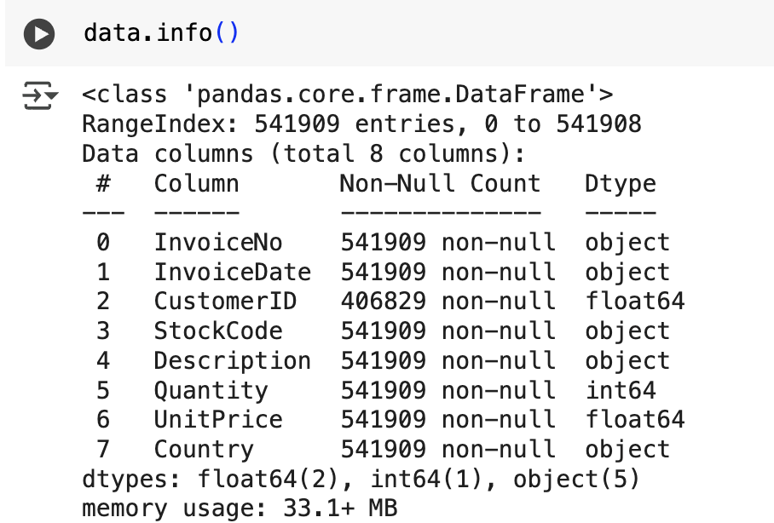
Fig.2

Slide 7
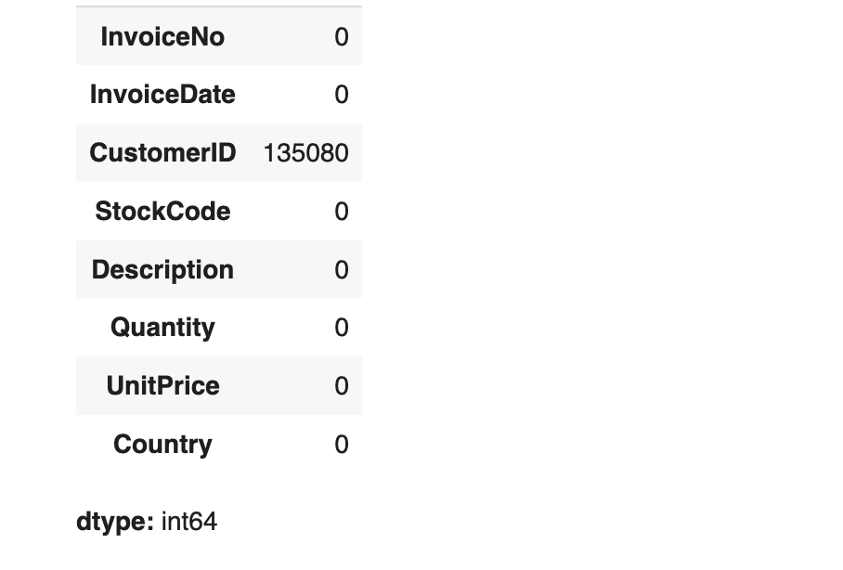

Fig.3

Slide 8
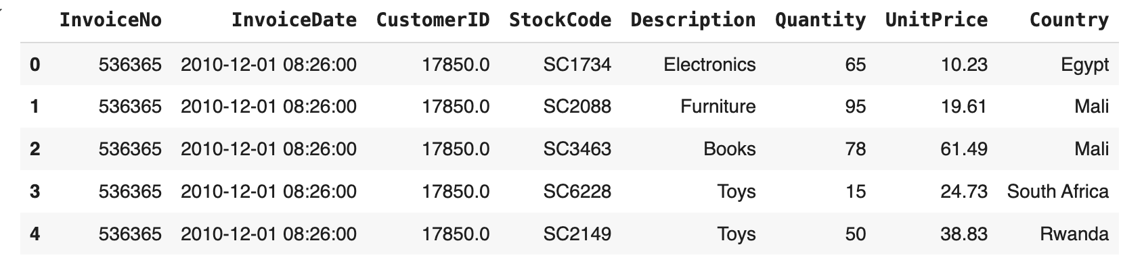

Fig.4

Slide 9
Further Analysis
There are 28 countries in total, but the countries with the highest purchases per country are 10 in Fig.5
Narrow the 10 countries to 5 for better analysis in Fig.6

Slide 10
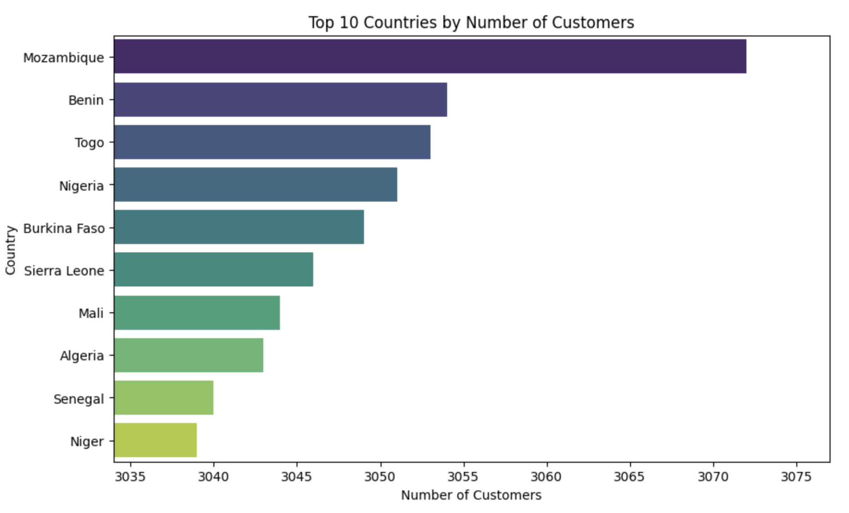
Fig.5

Slide 11
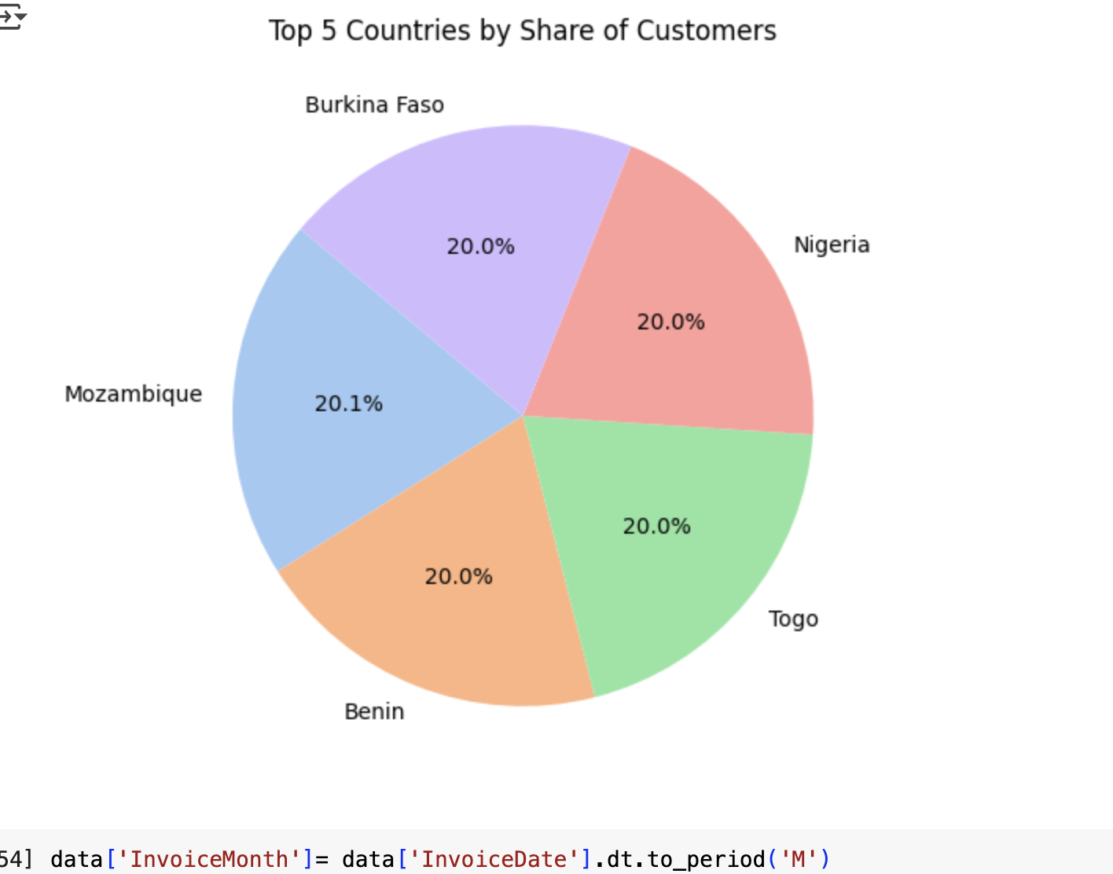
Fig.6

Slide 12
Cutomer Trends
Group customers per purchase over time in Fig.7

Slide 13
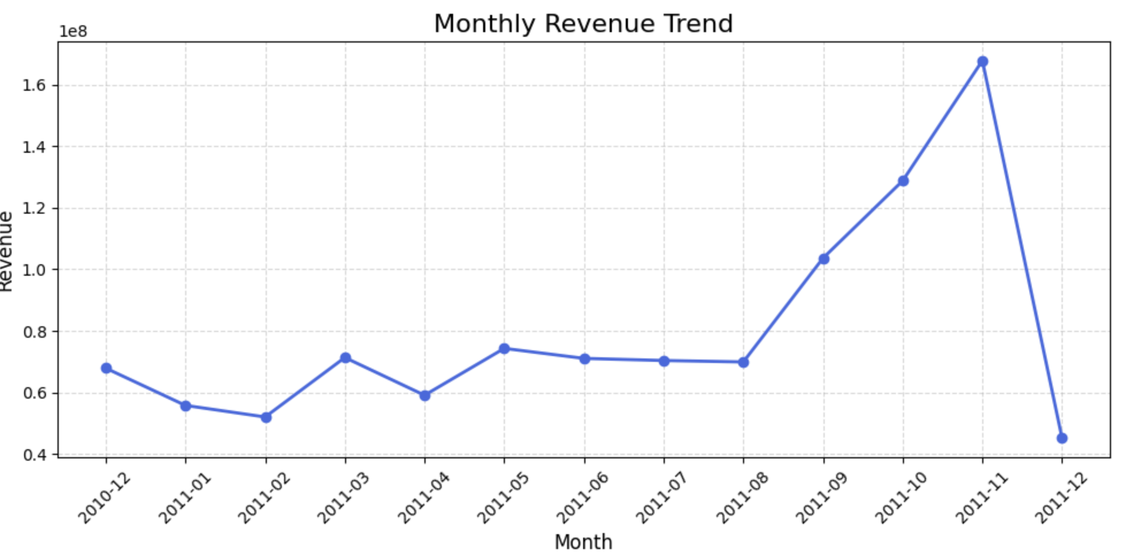
Fig.7

Slide 14
Cohort. Analysis
Analyse customer patterns by grouping them as seen in fig.7, which have high spikes in t some months.
Fig.8 shows how customers behave, thus churn, and the number of counts to better understand patterns to ascertain retention.

Slide 15
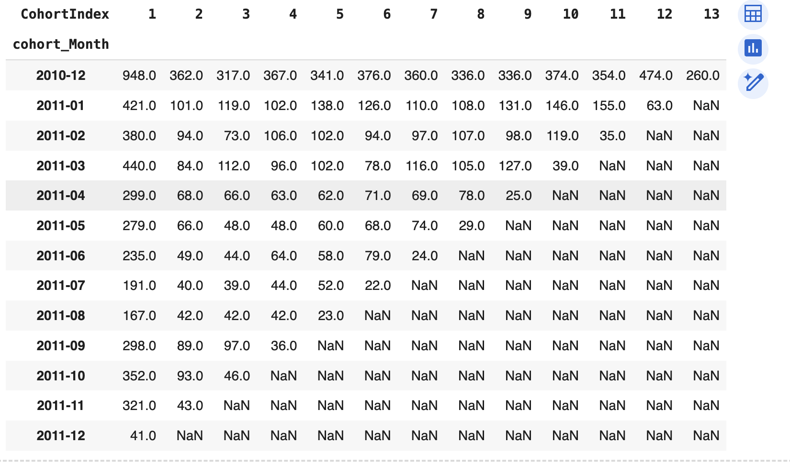
Fig.8

Slide 16
Cohort Insights
The total number of customers does repetitive customers over the entire period is 13
The number of customers keeps decreasing over a period of time, with high turnover in the early stages

Slide 17
Further Development
Customer Retention analysis should help investigate customers' turnover and churn
Feasibility study of customers per country to know what strategies increase retention and reduce churn to boost revenue.

