Slide 1
Customer Segmentation and rentation rate

Slide 2
Segmentaion
Group customers by Recency, Frequency and Monetry in Fig.1
Recency- how recent in days customers purchase
Frequency - how often in terms of flow
Monerty - how much money was spent in terms of buying

Slide 3
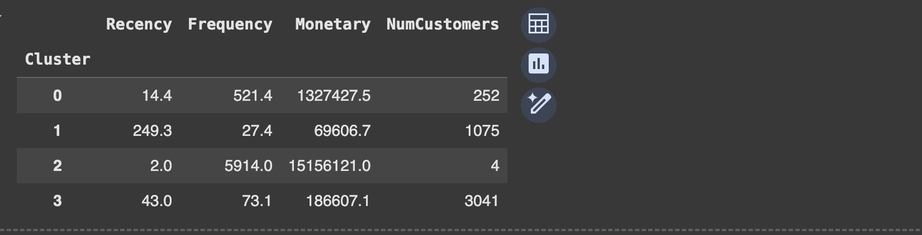
Fig.1

Slide 4
Clustering K-means
3 main methods were used, namely: Elbow, Silhouette score, and Calinksi index.Fig.2
Yellow brick was used to determine the optimal K for the above three methods. Figure.3

Slide 5
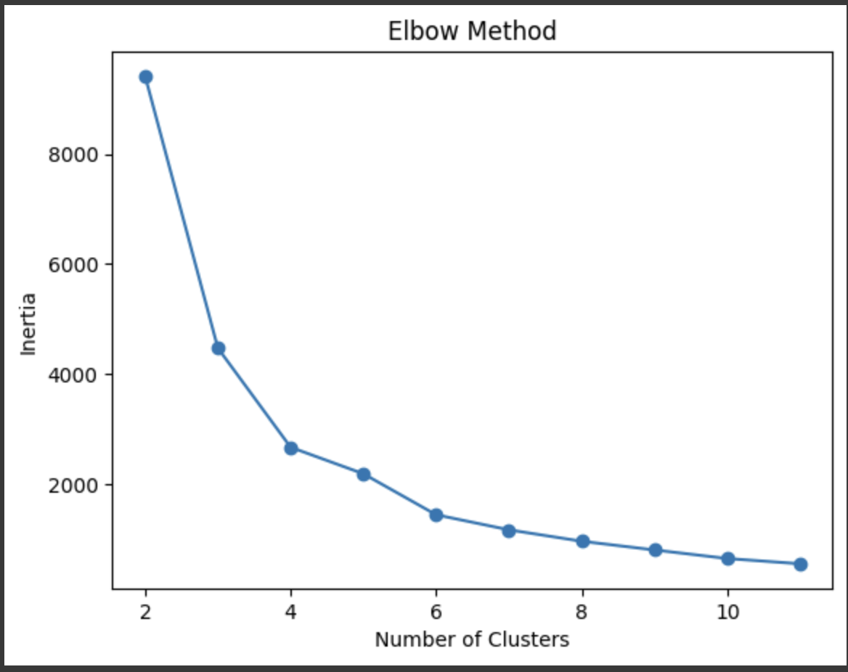
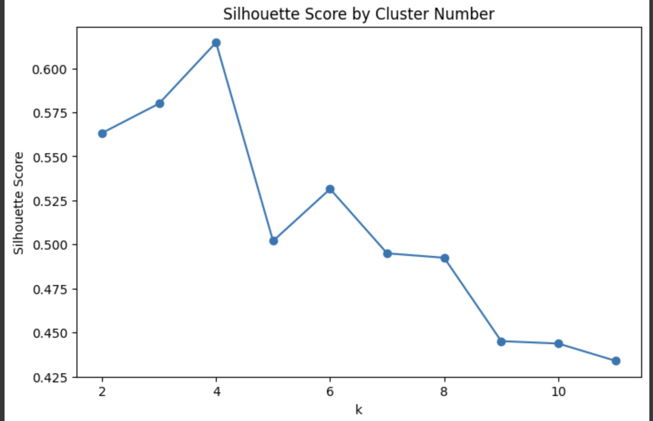
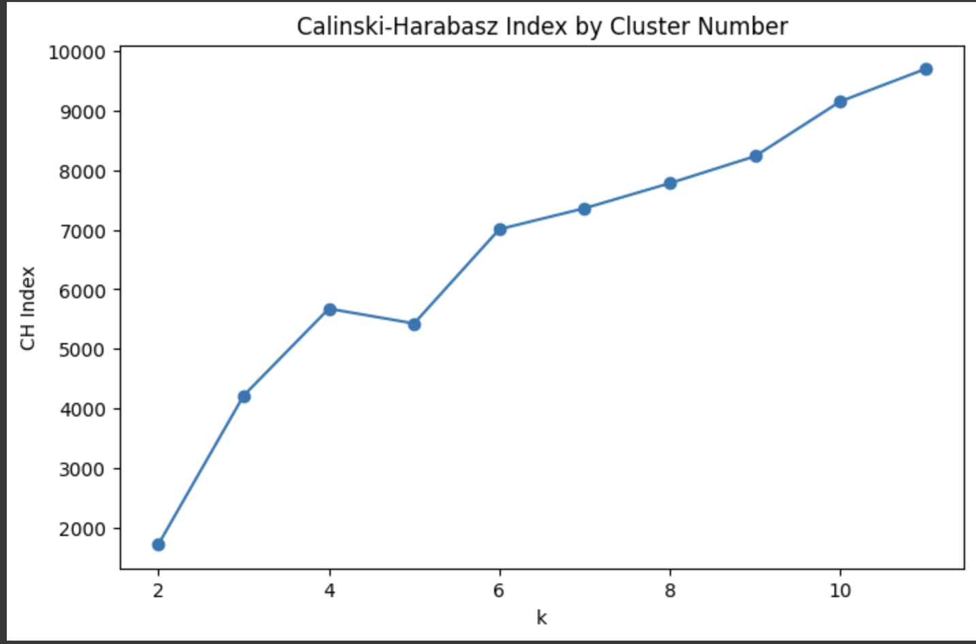
Fig.2

Slide 6
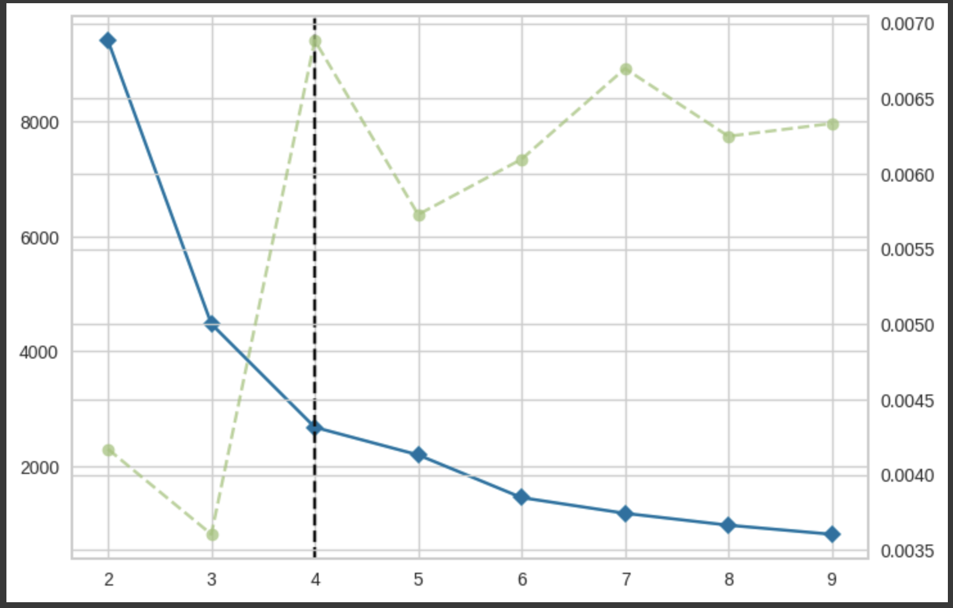
Fig.3

Slide 7
Analysis and insights
The best k was 4, thus customers were grouped into 4 clusters
Customer clusters were grouped according to RFM(recently, frequency,monistery)
Clusters were categorised according to retention.

Slide 8
Retention Analysis
Clusters were labelled according to RFM in Figure 4

Slide 9
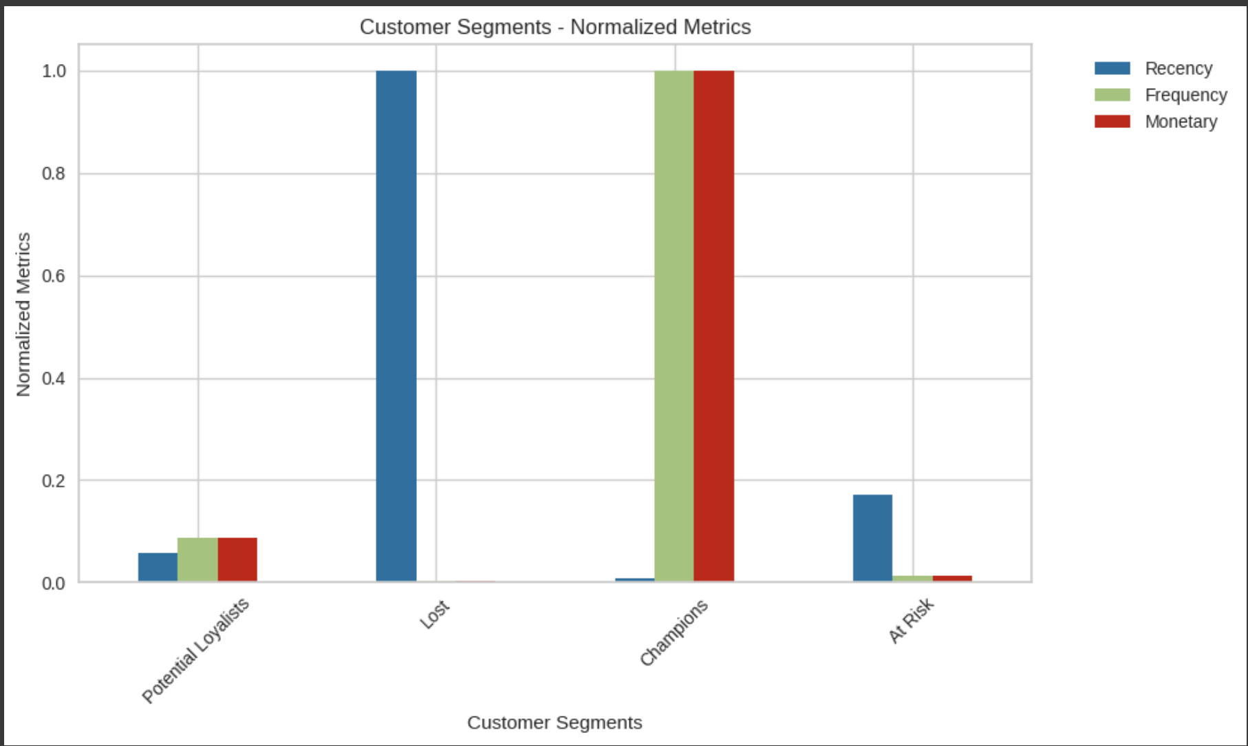
Fig.4

Slide 10
Business Rention Strategies
Customers with cluster labelled as “champions” should be appointed managers to give VIP treatment to retain them. Fig.5
Customers in the cluster labelled “At Risk ” should be given discounts and promos to draw them closer.6
Customers with cluster labelled “Petention Loyalties “should be encouraged to buy more with 50% discounts, Fig.7
Customers with cluster labelled “lost” Should have a dedicated team to put in measures to win them back with advertisements and loyalty for returning customers. Fig 8

Slide 11
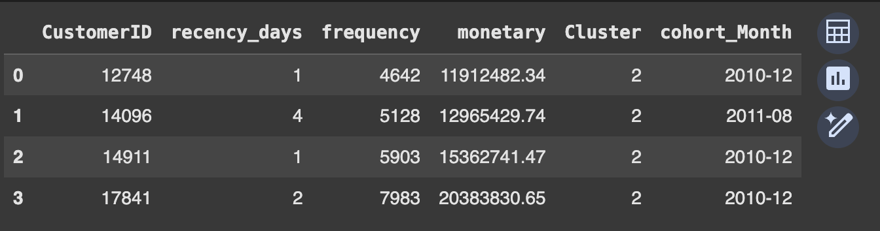
Fig.5

Slide 12
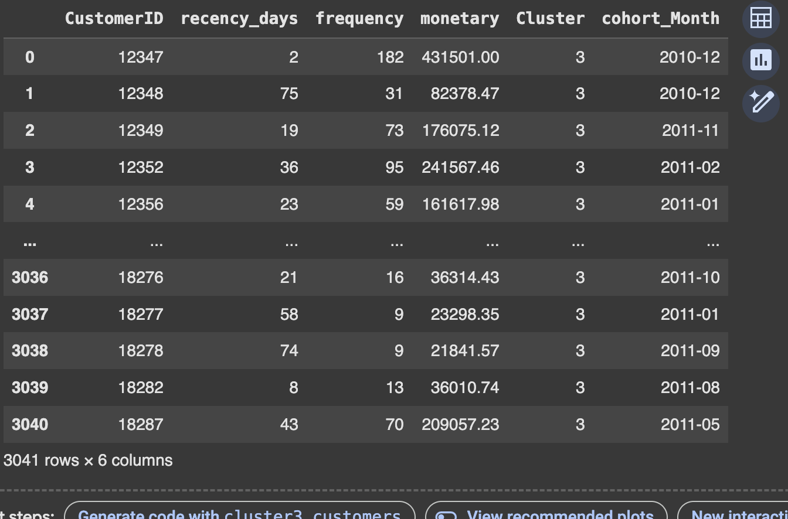
Fig.6

Slide 13
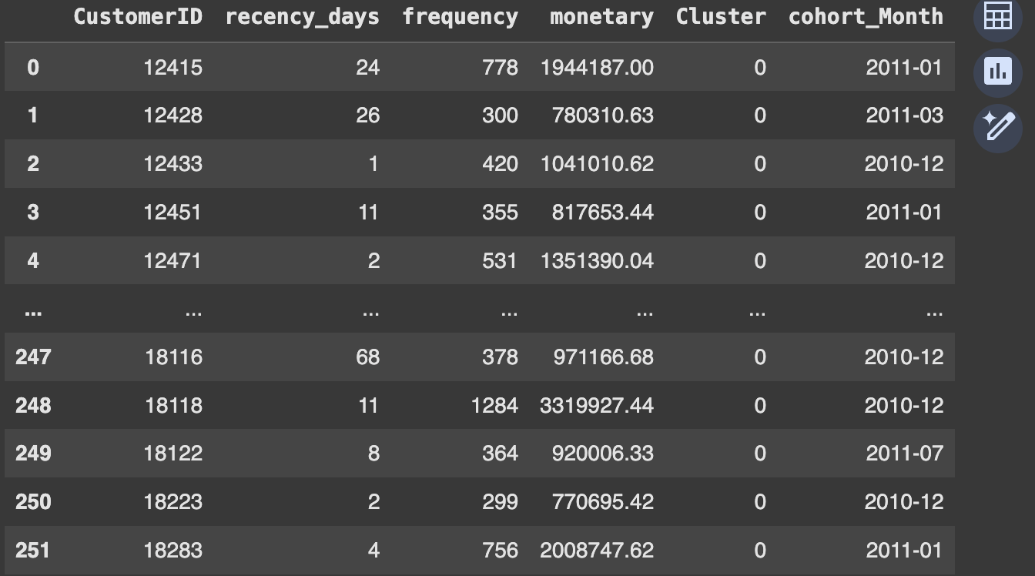
Fig .7

Slide 14
Further Investigation
Customers to be grouped by clusters with respective countries to gain more insights
How much revenue is generated on a customer-cluster basis
How much revenue is lost/gained over a period of time relative to retention

Slide 15
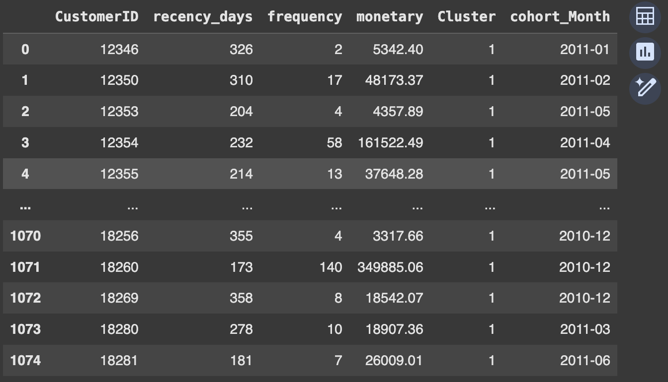
Fig 8

