Slide 1
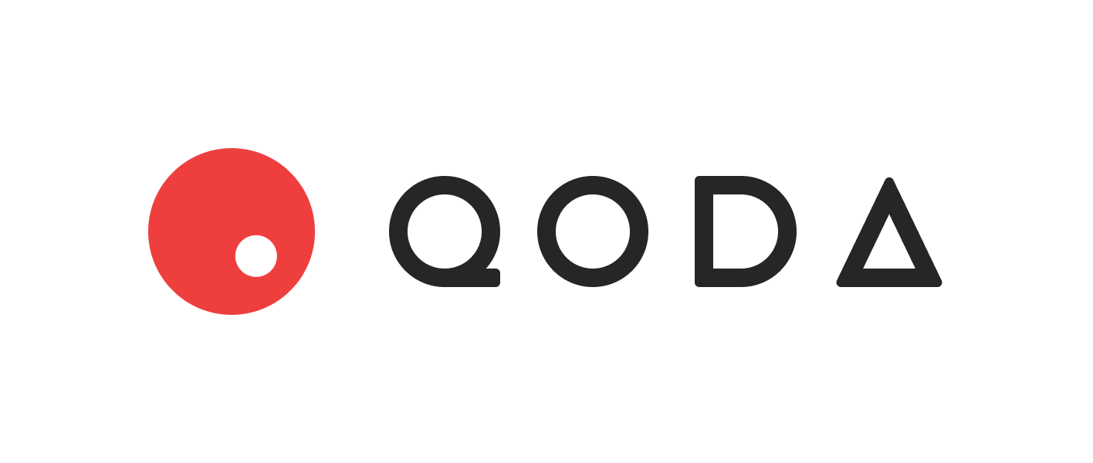
Qoda is a DeFi lending/borrowing protocol with fixed interest rates for fixed periods, where terms are set by the users themselves.

Slide 2
Team

