Slide 1
HV28 SRAM ANALYSIS
How WAT Electrical Data Becomes 6T SRAM Stability Metrics
Core equations, device relationships, and final interpretation
WAT inputs Vt / Idsat
Drive strength β calibration
6T device competition PU / PG / PD
Inverter VTC Vin → Vout
Ratios and SNM stability assessment
Purpose: compare Lot/Wafer trends with the WAT Target; not a PDK / BSIM sign-off model.
HV28 SRAM Analysis · WAT-calibrated trend model
1

Slide 2
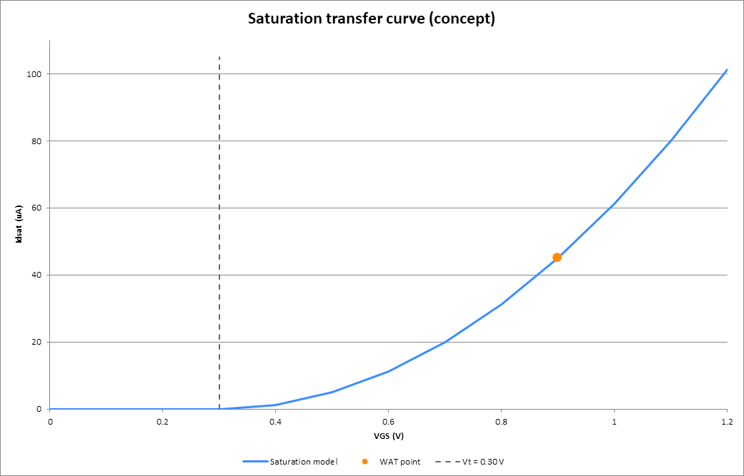
Idsat Calibration Uses Saturation; the Full VTC Does Not
WAT calibration point: saturation
Idsat = ½β(VGS − Vt)²
Condition: VDS ≥ VGS − Vt; VGS = V_WAT
Full VTC: switch by operating region
Linear: β[(VGS−Vt)VDS − ½VDS²] Saturation: ½β(VGS−Vt)²
The PU / PG / PD region is re-evaluated at every Vin.
Therefore: calibration uses saturation; VTC and SNM are not saturated throughout.
Example: Vt=0.30 V and Idsat@VGS=0.90 V=45 μA; shown only to explain calibration.
HV28 SRAM Analysis · WAT-calibrated trend model
2

Slide 3
Cell and Pull-up Ratios Reflect 6T Device Competition
WL
VDD
CELL RATIO
CR = βPD / βPG
PUL PU
PUR PU
Read: PD must hold the stored 0 against disturbance through PG and the bitline.
PGL PG
PGR PG
BLB
QB
Q
BL
PULL-UP RATIO
PR = βPG / βPU
PDL PD
PDR PD
Write 0: PG must overpower PU and pull the storage node low to flip the cell.
GND
β = 2·Idsat / (V_WAT − |Vt|)²
CR ↑ generally improves read-disturb tolerance | PR ↑ generally makes writing 0 easier
V_WAT is the Idsat measurement bias (calibration VGS), not Vt.
HV28 SRAM Analysis · WAT-calibrated trend model
3

Slide 4
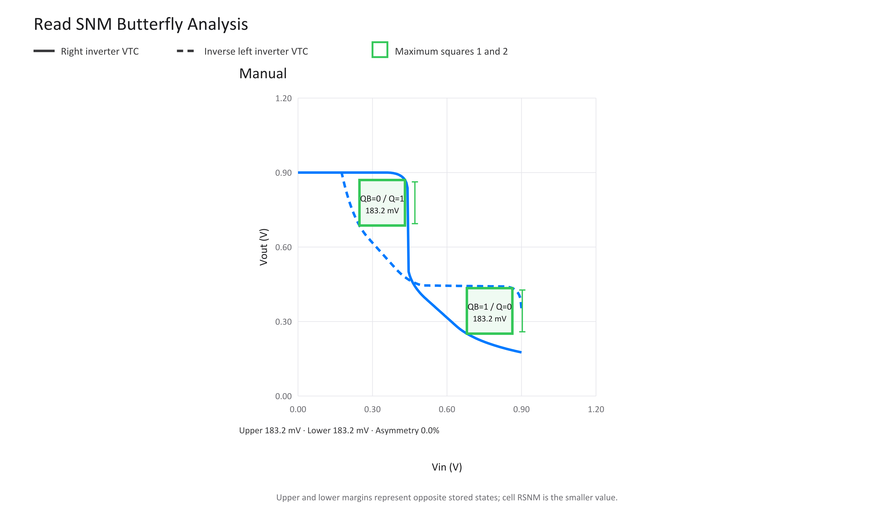
Read SNM: From Read VTCs to the Limiting Eye
1
① Read bias WL=VDD，BL=BLB=VDD
2
② Current balance F_R = I_PU − I_PD + I_PG = 0
3
③ Solve and mirror Vout=f_R(Vin)，Vout=f_R⁻¹(Vin)
4
④ Limiting square RSNM = min(S_upper，S_lower)
Chart map: ① applies to the whole plot; ② solid VTC; ③ mirrored dashed VTC; ④ eye squares, with cell RSNM set by the smaller side.
HV28 SRAM Analysis · WAT-calibrated trend model
4

Slide 5
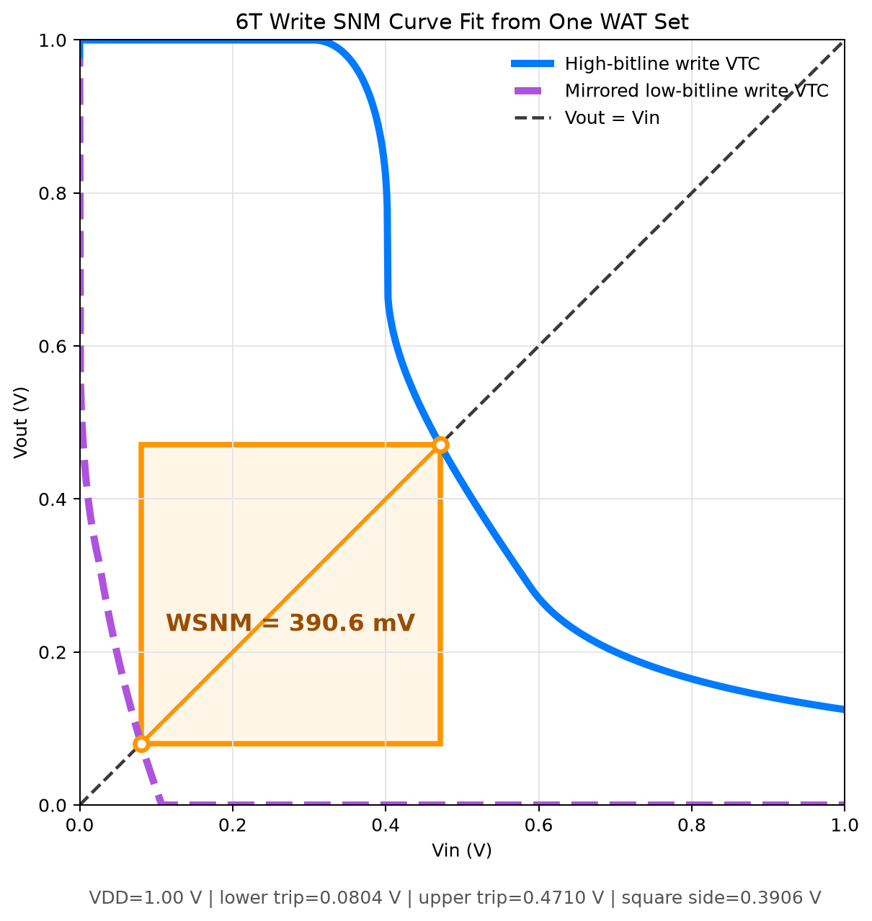
Write SNM: Write VTCs Define the Square and Trip Boundary
1
① Write-0 bias WL=VDD，BL=0，BLB=VDD
2
② Two write VTCs Vout=f_W(Vin；BL / BLB)
3
③ Diagonal crossings f_low(V_L)=V_L，f_high(V_H)=V_H
4
④ Write margins WSNM=V_H−V_L WSNM(BL_trip)=0
Chart map: ① applies to the whole plot; ② write-VTC pair; ③ diagonal crossing; ④ square side is WSNM, and its closure to zero is Write Trip.
HV28 SRAM Analysis · WAT-calibrated trend model
5

