Slide 2
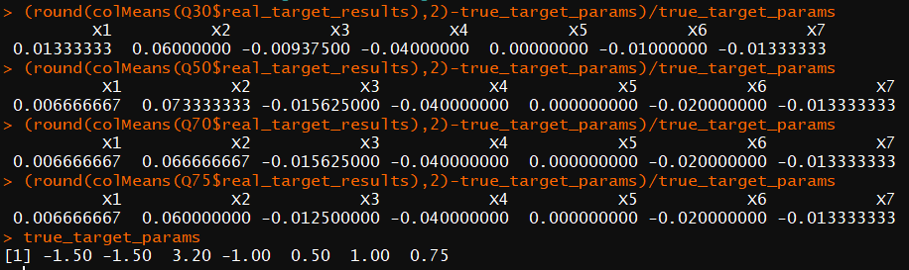

Slide 3
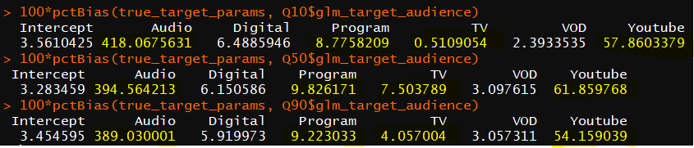
Influence of insignificant parameters
Using target parameters derived from the Pointlogic data
N = 7500, replications = 1000
Q = 10%
Q = 50%
Q = 90%
Does this make sense?

Slide 4
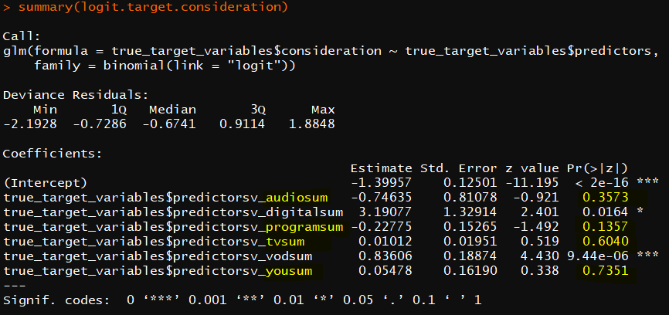
Influence of insignificant parameters
Which of these parameters were significant to begin with?

Slide 5
Influence of the marginal distribution of X

Slide 6
Valid parameter estimation check

Slide 7
Valid variance check

Slide 8
Bias-variance tradeoff

