Slide 1
Team 4 - Pointlogic
Oversampling
Meeting 8

Slide 2

Influence insignificant parameters
Using target parameters derived from the Pointlogic data
N = 7500, replications = 1000
Does this make sense?

Slide 3
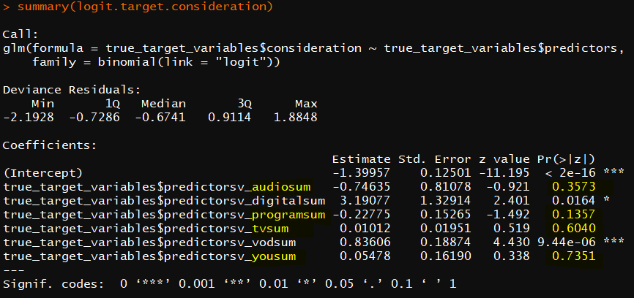
Influence insignificant parameters
Which of these parameters were significant to begin with?

Slide 4
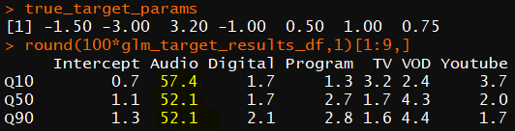
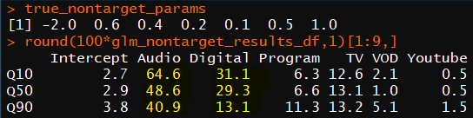
Influence insignificant parameters
What if we force significant parameters?
N = 7500, replications = 1000
Target results improve…
… but non-target still not great

Slide 5
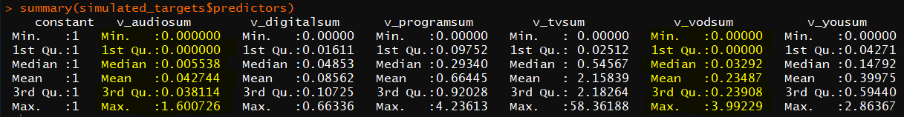
Influence of marginal distribution of X
Inaccuracy caused by the shape of the exposure variables?
Main difference between target group and non-target group is ‘resampling’
Problems:
For the target group, Audio parameter is still highly inaccurate, but its marginal distribution of Audio is not meaningfully different from e.g. Digital or VOD
Logit maximises conditional likelihood, so the marginal distribution should not matter anyway

Slide 6
Influence of marginal distribution of X
If shape of X’s is the cause, it could be:
Correlation structure – ignored for targets, but not for non-targets
Proportion of zeros – up to 70% for the non-targets (Audio, VOD)
‘Long tail’ – given cell is non-zero, range is quite large
Or any combination hereof
Test:
Model/code: X ~ MVN with uncorrelated X’s
Correlation: X ~ MVN with same correlation structure as non-targets
Shape of distribution: X ~ IG uncorrelated, same proportion zeros as non-targets
Shape of distribution: resampling of non-targets as with targets
Compare to original target data

Slide 7
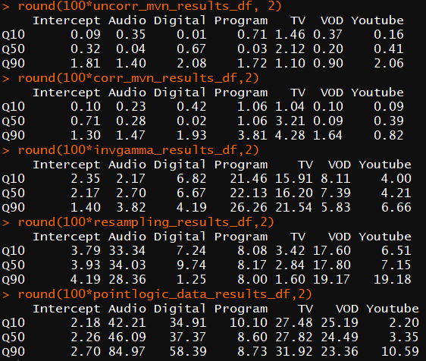
Influence of marginal distribution of X

Slide 8
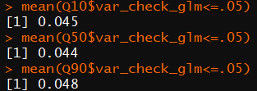
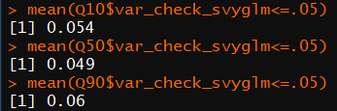
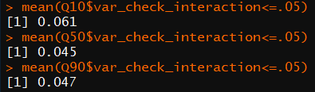
Variance check
Logit – targets only
HT – entire sample
Logit – interaction model

Slide 9
Simulatie studie - LR
Van wald test naar LR test omdat het accuratere resultaten geeft.
Target is om het aantal verwerpingen zo hoog mogelijk krijgen (dus dat het zin heeft).

Slide 10
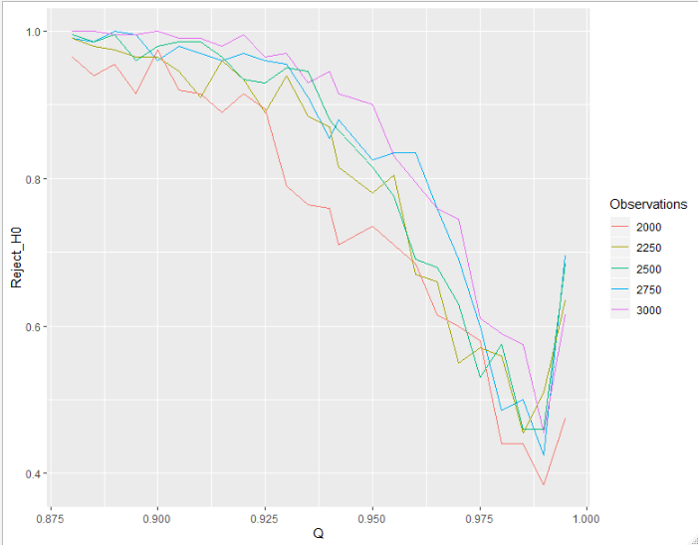
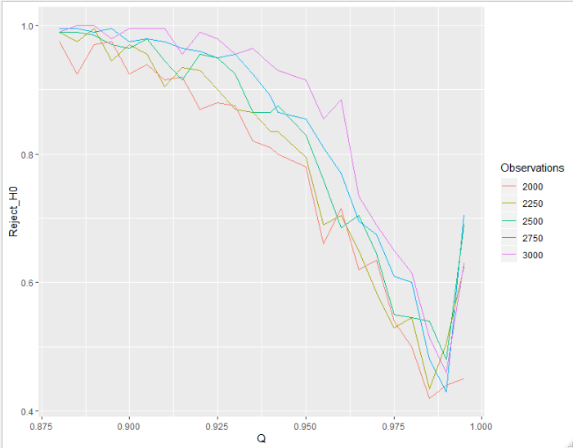
Simulatie studie – LR
Target links: Female 45-54, target rechts: male 25-34 kpi: Awareness
Y-as = procent verworpen H0 -> target audience <> nontarget audience beta.

Slide 11
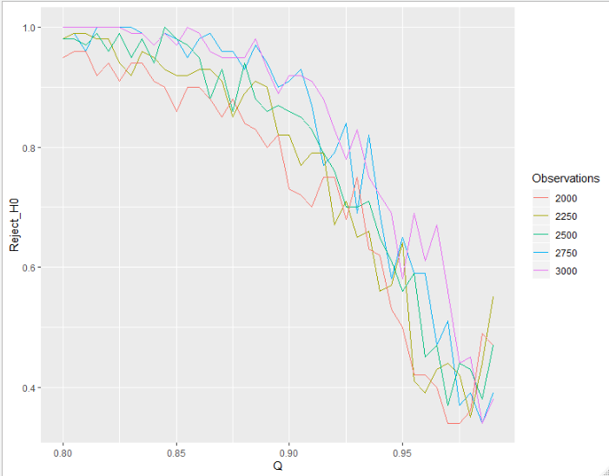
Simulatie studie – LR
Als je de kpi verandert krijg je andere resultaten. Hier : consideration
Dus het ‘breek punt’ verschilt per kpi.

Slide 12
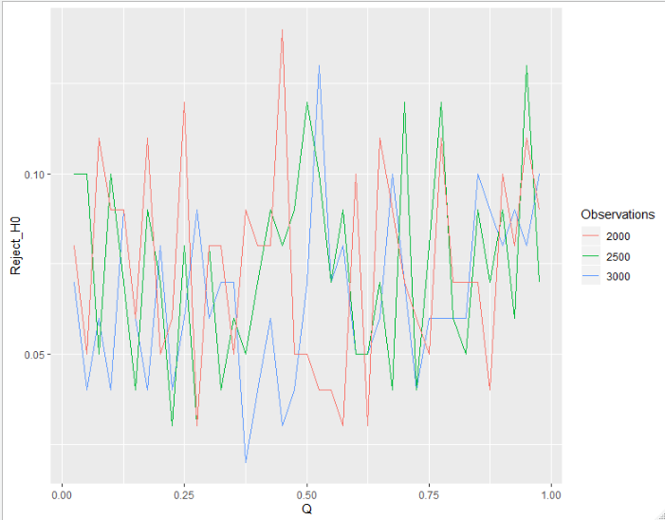
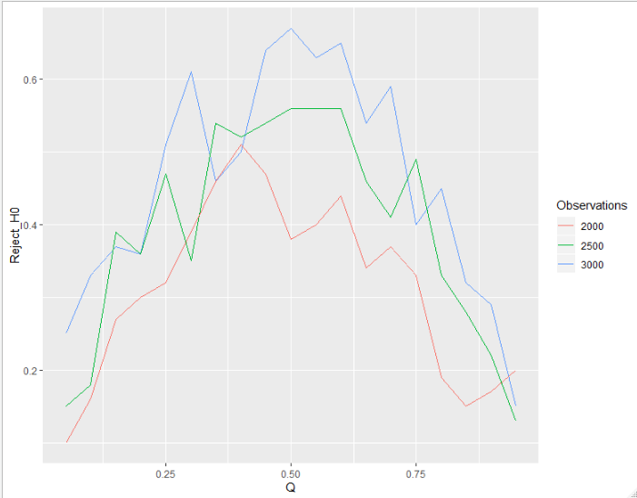
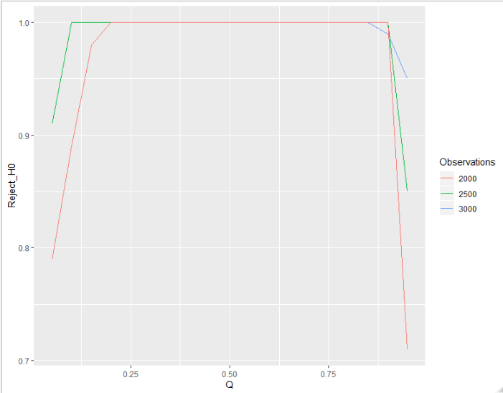
Simulatie studie – opgegeven parameters.
Links: nontarget audience 1.01x target audience
Midden: nontarget audience 1.3x target audience
Rechts: nontarget audience 2x target audience

Slide 13
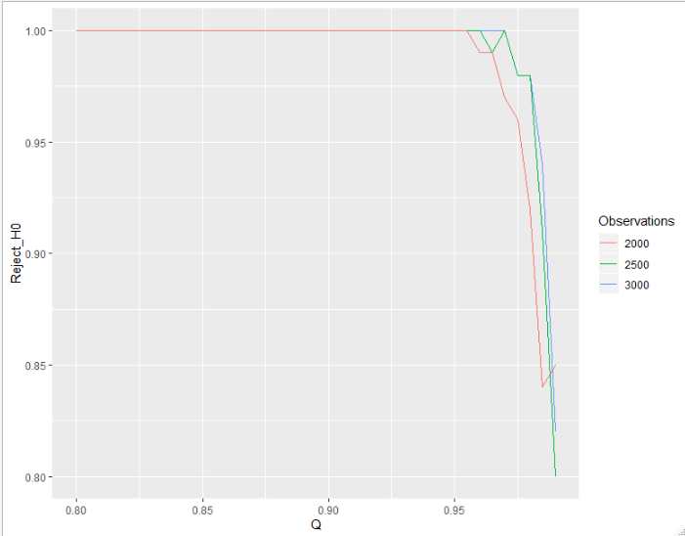
Simulatie studie – opgegeven parameters.
target audience verschilt nog erger met nontarget audience

Slide 14
Extra opmerkingen
Pointlogic wil het o.a. meer op economisch vlak toegepast hebben:
Focus op implicaties voor marketing campaign ipv. alleen bias (media effects) – meten mbv marginal effects en relative costs van marketing channels
Machine Learning – prediction

