Slide 1
And another thing… Parsers
The storm had now definitely abated, and what thunder there was now grumbled over more distant hills, like a man saying 'And another thing...' twenty minutes after admitting he's lost the argument.
Wiebe-Marten Wijnja

Slide 2


Overview
Why parsers?
Comparison of the different ways of parsing
Building a Parser Combinator
Parsing is not hard

Slide 3
Why parsers?
Regular Expressions
  Limited Scope
\A(?:[a-z0-9!#$%&'*+/=?^_`{|}~-]+(?:\.[a-z0-9!#$%&'*+/=?^_`{|}~-]+)*
| "(?:[\x01-\x08\x0b\x0c\x0e-\x1f\x21\x23-\x5b\x5d-\x7f]
| \\[\x01-\x09\x0b\x0c\x0e-\x7f])*")@(?:(?:[a-z0-9](?:[a-z0-9-]*[a-z0-9])?\.)+[a-z0-9](?:[a-z0-9-]*[a-z0-9])?
| \[(?:(?:25[0-5]|2[0-4][0-9]|[01]?[0-9][0-9]?)\.){3}
(?:25[0-5]|2[0-4][0-9]|[01]?[0-9][0-9]?|[a-z0-9-]*[a-z0-9]:
(?:[\x01-\x08\x0b\x0c\x0e-\x1f\x21-\x5a\x53-\x7f]
| \\[\x01-\x09\x0b\x0c\x0e-\x7f])+)
\])\z
Notes:
Set: group of things
Bag: group of things with duplicate
String: ordered bag.
Grammar:
Language:

Slide 4
Why parsers?
Regular Expressions
  Limited Scope
  'mini parser'. Someone built them?!
Parsers are useful:
  Compiling/Interpreting
  Semantical Analysis (Linting)
  Understanding user input
They are fun!
Notes:
Set: group of things
Bag: group of things with duplicate
String: ordered bag.
Grammar:
Language:

Slide 5
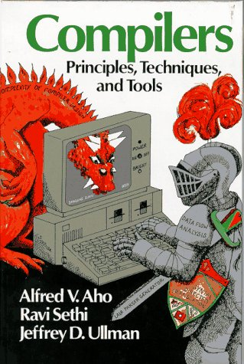
What is a Parser?
Set: Collection of distinct objects
Bag: Set with duplicates
String: Bag with order.
Language: Set of strings following a grammar.
  Alphabet: Digits, A-Z, Unicode.
  Language examples:
    Calculator arithmetic
    English
Grammar: Set of rules
  what is part of a language (and what is not)
  what the different elements structurally represent.

Slide 6
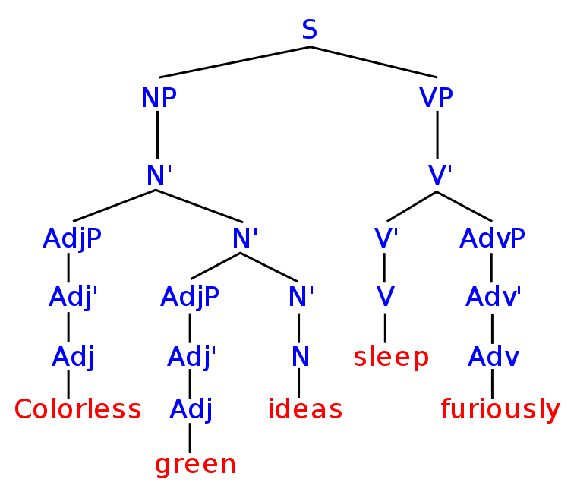
Grammar
Syntax vs Semantics
Terminals/Nonterminals
Syntax Tree

Slide 7
Parser
String → *magic* → Syntax Tree
Two methods:
  Top Down (Left-to-right, leftmost derivation, LL)
    Recursive function calls.
  Bottom Up (Left-to-right, rightmost derivation, LR)
    Finite State Automaton
Side Note: Lexers
  'dumb parser to make your clever parser simpler'.

Slide 8
Parsing Example
grammar:
  expression := expression '+' expression | int
  int := 1-9 | 1-9 digits
  digits := digit | digit digits
  digit := 0-9
  (start rule: expression)
input: “42+10+2”

Slide 9
Top Down
grammar:
  expression := expression '+' expression | int
  int := 1-9 | 1-9 digits
  digits := digit | digit digits
  digit := 0-9
  (start rule: expression)
input: “42+10+2”
Parse expression
Parse int
Parse 1-9: 4
Parse digits
Parse digit: 2
Parsing next digit fails, so the first result of 'digits' returns.
We've found an int! `int 42`
We've found an expression! `expr (int 42)`
Parse '+'
Parse expression
...
We've found an int! `int 10`
We've found an expression! `expr (int 10)`
We have an expression! `expr (expr (int 42)) + (expr (int 10))`
parse '+'
parse expression
...
We've found an int! `int 2`
We've found an expression! `expression (int 2)`
We have an expression! `expr (expr ((expr (int 42)) + (expr (int 10)))) + (expr (int 2))`
Done!

Slide 10
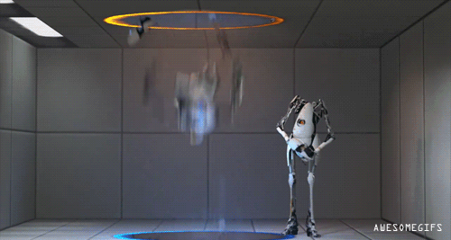
Top Down
grammar:
  expression := expression '+' expression | int
  int := 1-9 | 1-9 digits
  digits := digit | digit digits
  digit := 0-9
  (start rule: expression)
input: “42+10+2”
Parse expression
Parse expression
Parse expression
Parse expression
Parse expression
Parse expression
Parse expression
….
Whoops!

Slide 11
Bottom Up
grammar:
  expression := expression '+' expression | int
  int := 1-9 | 1-9 digits
  digits := digit | digit digits
  digit := 0-9
  (start rule: expression)
input: “42+10+2”
next char digit? yes! Put '4' on stack.
next char digit? yes! Put '2' on stack.
Reduce '4' and '2' to 'int 42'
next char digit? no!
next char '+'? yes! Put `+` on stack.
next char digit? yes! Put '1' on stack
next char digit? yes! Put '0' on stack.
next char digit? no!
reduce '1' and '0' to 'int 10'
reduce 'int 42' `+` 'int 10' to 'expr (int 42) (int 10)'
next char '+'? yes! Put `+` on stack.
...
reduce 'expr (int 42) (int 10)', '+', 'int 2' to 'expr (expr (int 42) (int 10)) (int 2)'
Done!

Slide 12
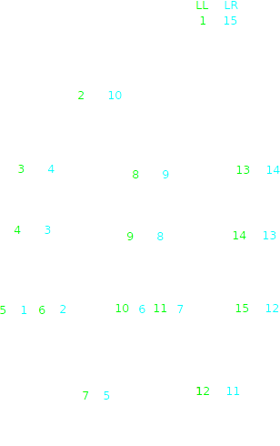

Slide 13
Naming for parsers
LL: Left-To-Right, Leftmost derivation. (Top Down)
LR: Left-To-Right, Rightmost Derivation. (Bottom Up)
LL(1), LR(1): One token of lookahead.
LL(k), LR(k): `k` tokens of lookahead.
LL(*), LR(*): A varying amount of tokens lookahead, AKA backtracking.
LALR: 'Look Ahead LR'
  Reduced amount of states by introducing lookahead checks.

Slide 14
Problems of LL parsing
Problems of LR parsing
Left Recursion
Backtracking
Impossible to manually program
  Finite State Automaton with exponential amount of states + transitions.

Slide 15
Solution: Parser Generators
Grammar still written top-down
Bottom-up Parser Automaton generated from grammar
New problems:
  Writing/maintaining Parser Generators hard.
  Impossible to adapt parsers 'on the fly'.

Slide 16
Is LR-parsing enough to parse C++?
a * b;
if (condition)
if (condition2)
x = 1;
else
x = 2;
if (condition)
if (condition2)
x = 1;
else
x = 2;
Unfortunately, no!
(The only 'solution' is to hack in a symbol table into the parser)

Slide 17
50 years of research...
Parser Combinator Libraries → boost::spirit
Parser Expression Grammar → No conflicts, hides ambiguities
Parser Generators making LL parsers → ANTLR
Generalized LR → Elkhound, Elsa
Generalized LL → No Left-recursion problems. We've come Full Circle

Slide 18
Building a GLL Parser Combinator
Trust me, it's simple

Slide 19
What is a (top down) parser?
Input string → *magic* → (match, rest of string)
match
a string
Parser
Rest of string

Slide 20
What is a (top down) parser?
Input string → *magic* → (match, rest of string)
“1”
“123 foo”
Digit Parser
“23foo”

Slide 21
What is a (top down) parser?
Input string → *magic* → (match, rest of string)
????
“hello”
Digit Parser
“hello”

Slide 22
What is a (top down) parser?
Input string → *magic* → [(match, rest of string)]
“123foo”
[(1, “12foo”)]
Digit Parser
“hello”
[]
Digit Parser

Slide 23
Let's see some code
template <typename Content>
class ParseResult
{
Content d_content;
std::string d_unparsed_rest;
public:
ParseResult(Content const &content, std::string const &rest)
:
d_content(content),
d_unparsed_rest(rest)
{};
inline std::string unparsed_rest() const
{
return d_unparsed_rest;
}
inline Content content() const &
{
return d_content;
}
};
template <typename Result>
using ParseResults = std::vector<ParseResult<Result>>;

Slide 24
The Parser class
template <typename Result>
class Parser
{
typedef std::function<ParseResults<Result>(std::string const &)> ParseFunction;
// A parser wraps a function.
ParseFunction d_fun;
public:
Parser(ParseFunction fun)
:
d_fun(fun)
{};
// Runs the parser on some input
ParseResults<Result> run(std::string const &in) const
{
return d_fun(in);
}
// (Some more member functions will be added later)
};

Slide 25
What is the simplest parser?
// Does not consume input, returns given value.
template <typename TAnything>
Parser<TAnything> unit(TAnything const &value)
{
auto lambda = [value](std::string const &in){
return ParseResults<TAnything>{ParseResult<TAnything>{value, in}};
};
return Parser<TAnything>{lambda};
}

Slide 26
More simple parsers
// Returns matched character if given predicate function returns true.
template <typename Fun>
Parser<char> satisfies(Fun const &fun)
{
auto lambda = [fun](std::string const &in)
{
if(in.empty())
return ParseResults<char>{};
char ch = in[0];
if(!fun(ch))
return ParseResults<char>{};
return ParseResults<char>{ParseResult<char>{ch, in.substr(1, in.size())}};
};
return Parser<char>{lambda};
}

Slide 27
More simple parsers
// Matches if input starts with given character.
Parser<char> ch(char the_char)
{
return satisfies([the_char](char real_char){return the_char == real_char;});
}
// Matches if input starts with given string.
Parser<std::string> string(std::string const &str)
{
auto lambda = [str](std::string const &in)
{
if(in.find(str) == 0)
return ParseResults<std::string>{ParseResult<std::string>{str, in.substr(str.size(), in.size())}};
return ParseResults<std::string>{};
};
return Parser<std::string>{lambda};
}

Slide 28
More simple parsers
Parser<char> space = satisfies([](char ch){return ch == ' ';});
Parser<char> whitespace = satisfies([](char ch){return ::isblank(ch);});
Parser<char> digit = satisfies([](char ch){return ::isdigit(ch);});
Parser<char> alpha = satisfies([](char ch){return ::isalpha(ch);});

Slide 29
Combining Parsers
parser_a or parser_b
parser_a and then parser_b
apply parser zero or more times
transform return result to something else.

Slide 30
parser_a | parser_b
template <typename Result>
class Parser
{
// … (Stuff shown previously)
// Return the results of applying parser_a or parser_b
Parser<Result> operator|(Parser<Result> const &parser_b) const
{
auto parser_a = *this;
auto lambda = [parser_a, parser_b](std::string const &in)
{
ParseResults<Result> a_results = parser_a.run(in);
ParseResults<Result> b_results = parser_b.run(in);
ParseResults<Result> results = a_results;
results.insert(results.end(), b_results.begin(), b_results.end());
return results;
};
return Parser<Result>{lambda};
}
}

Slide 31
Boilerplate: Concatenating tuples
// Concatenate two datatypes to a tuple.
// If one or both already is a tuple, prepend/append the other.
// If both are tuples, combine them.
template <typename A, typename B>
inline std::tuple<A, B> concatenateToTuple(A const &elem_a, B const &elem_b)
{
return std::make_tuple(elem_a, elem_b);
}
template <typename A, typename... Bs>
inline std::tuple<A, Bs...> concatenateToTuple(A const &elem_a, std::tuple<Bs...> const &elem_b)
{
return std::tuple_cat(std::make_tuple(elem_a), elem_b);
}
template <typename... As, typename B>
inline std::tuple<As..., B> concatenateToTuple(std::tuple<As...> const &elem_a, B const &elem_b)
{
return std::tuple_cat(elem_a, std::make_tuple(elem_b));
}
template <typename... As, typename... Bs>
inline std::tuple<As..., Bs...> concatenateToTuple(std::tuple<As...> const &elem_a, std::tuple<Bs...> const &elem_b)
{
return std::tuple_cat(elem_a, elem_b);
}
template <typename A>
inline A concatenateToTuple(A const &elem_a, std::tuple<> const &)
{
return elem_a;
}
template <typename B>
inline B concatenateToTuple(std::tuple<> const &, B const &elem_b)
{
return elem_b;
}
template <typename... As>
inline std::tuple<As...> concatenateToTuple(std::tuple<As...> const &elem_a, std::tuple<> const &_elem_b)
{
return elem_a;
}
template <typename... Bs>
inline std::tuple<Bs...> concatenateToTuple(std::tuple<> const &_elem_a, std::tuple<Bs...> const &elem_b)
{
return elem_b;
}

Slide 32
parser.transform(&function)
template <typename Result>
class Parser
{
// … (Stuff shown previously)
// Transforms return value of this parser by calling `fun` on it.
template<typename Function>
auto transform(Function fun) const
{
auto parser_a = *this;
auto lambda = [parser_a, fun](std::string const &in)
{
ParseResults<Result> a_results = parser_a.run(in);
ParseResults<decltype(fun(std::declval<Result>()))> results;
for(ParseResult<Result> result_a : a_results)
{
results.push_back(ParseResult<decltype(fun(std::declval<Result>()))>{
fun(result_a.content()),
result_a.unparsed_rest()
});
}
return results;
};
return Parser<decltype(fun(std::declval<Result>()))>{lambda};
};
}

Slide 33
Transformation boilerplate:
template <typename Result>
class Parser
{
// … (Stuff shown previously)
template <bool IsTuple = is_specialization_of<Result, std::tuple>::value>
auto tup2deq() const
{
auto lambda = [](Result content){
return concatDequeTuple(content);
};
return this->transform(lambda);
};
template <bool IsTuple = is_specialization_of<Result, std::tuple>::value>
auto concat2deq() const
{
auto lambda = [](Result content){
return combineTupleToDeque(content);
};
return this->transform(lambda);
};
Parser<std::deque<Result>> singletonDeque() const
{
return this->transform(&::singletonDeque<Result>);
};
}

Slide 34
many(parser)
// Returns an empty deque.
template <typename A>
Parser<std::deque<A>> nothing()
{
return unit(std::deque<A>{});
};
// Combines (a, [a...]) to [a,a...]
template <typename A>
std::deque<A> combineTupleToDeque(std::tuple<A, std::deque<A>> tuple)
{
std::deque<A> vec = std::get<1>(tuple);
vec.push_front(std::get<0>(tuple));
return vec;
}
// Returns all results of running `parser_a` zero or more times.
template <typename A>
Parser<std::deque<A>> many(Parser<A> const &parser_a)
{
auto lambda = [parser_a](std::string const &in)
{
return many(parser_a).run(in);
};
auto one_or_more = (parser_a >> Parser<std::deque<A>>{lambda}).transform(&combineTupleToDeque<A>);
return one_or_more | nothing<A>();
}

Slide 35
many1(parser)
template <typename A>
Parser<std::deque<A>> many1(Parser<A> const &parser_a)
{
return (parser_a >> many(parser_a)).transform(&combineTupleToDeque<A>);
}

Slide 36
New Parsers we can now build
Parser<std::deque<char>> whitespaces = many(whitespace);
Parser<char> alnum = digit | alpha;
Parser<std::deque<char>> digits = many1(digit);
Parser<int> digit_num = digit.transform([](char ch){ return ch - '0';});

Slide 37
New Parsers we can now build
// Runs parser A, but returns an empty tuple
// (which is discarded when sequenced together with other parsers)
template <typename A>
Parser<std::tuple<>> skip(Parser<A> const &parser_a)
{
auto transformation = [](A const &)
{
return std::tuple<>{};
};
return parser_a.transform(transformation);
}
// Returns the result of running parser_a followed by zero or more whitespaces.
template <typename A>
Parser<A> lexeme(Parser<A> const &parser_a)
{
return parser_a >> skip(whitespaces);
}

Slide 38
New Parsers we can now build
// Checks for a single character. Returns a deque (either empty or containing one element)
Parser<std::deque<char>> chd(char the_char)
{
return ch(the_char).singletonDeque();
}

Slide 39
New Parsers we can now build
Parser<std::deque<char>> integer_str()
{
return (maybe(ch('-')) >> digits).transform([](auto tuple){return concatDequeTuple(tuple);});
}

Slide 40
New Parsers we can now build
Parser<std::deque<char>> float_str()
{
auto float_exponent = ( (chd('e') | chd('E')) >> maybe(chd('+') | chd('-')) >> digits ).tup2deq();
return ( integer_str >> chd('.') >> digits >> maybe(float_exponent) ).tup2deq();
}

Slide 41
Possible Improvements
Memoization to increase efficiency.
  The 'memoist' gem works well.
  Or roll your own using a simple hashmap.
Return lazy Enumerators instead of arrays, since often we're only interested in the first result.
Nice error reporting.
  Give parsers 'names'.
  When not matching anything, return a 'ParseError' that contains an error message with the given name.
  Parsers higher up might discard these error messages or further embellish them. (building a stack trace)

Slide 42
Congratulations!
We've now built a full-fledged Generalized Left-Recursive Top Down Parser

Slide 43
When to use what?
YMMV
Naïve top-down parsers:
  easy to implement and extend.
  Have some problems (left recursion, backtracking).
Parser Generators
  Themselves hard to maintain.
  Separate generation and parsing step.
Generalized Algorithms
  Support more grammars.
  Again relatively easy to implement/maintain.
  On unambiguous grammars, slower (by a constant factor).
Optimize for:
  Time efficiency?
  Memory efficiency?
  Developer efficiency?

Slide 44
Congratulations!
Parsing is not hard

Slide 45
Questions?

