Slide 1
A little bit about Parsers

Slide 2
Why parsers?
Regular Expressions
Limited Scope
\A(?:[a-z0-9!#$%&'*+/=?^_`{|}~-]+(?:\.[a-z0-9!#$%&'*+/=?^_`{|}~-]+)*
| "(?:[\x01-\x08\x0b\x0c\x0e-\x1f\x21\x23-\x5b\x5d-\x7f]
| \\[\x01-\x09\x0b\x0c\x0e-\x7f])*")@(?:(?:[a-z0-9](?:[a-z0-9-]*[a-z0-9])?\.)+[a-z0-9](?:[a-z0-9-]*[a-z0-9])?
| \[(?:(?:25[0-5]|2[0-4][0-9]|[01]?[0-9][0-9]?)\.){3}
(?:25[0-5]|2[0-4][0-9]|[01]?[0-9][0-9]?|[a-z0-9-]*[a-z0-9]:
(?:[\x01-\x08\x0b\x0c\x0e-\x1f\x21-\x5a\x53-\x7f]
| \\[\x01-\x09\x0b\x0c\x0e-\x7f])+)
\])\z
Notes:
Set: group of things
Bag: group of things with duplicate
String: ordered bag.
Grammar:
Language:

Slide 3
Why parsers?
Regular Expressions
Limited Scope
'mini parser'. Try building them youself!
Parsers are useful:
Compiling/Interpreting
Semantical Analysis (Linting)
Understanding user input
They are fun!
Notes:
Set: group of things
Bag: group of things with duplicate
String: ordered bag.
Grammar:
Language:

Slide 4
What is a Parser?
Set: Collection of distinct objects
Bag: Set with duplicates
String: Bag with order.
Language: Set of strings following a grammar.
Alphabet: Digits, A-Z, Unicode.
Language examples:
Calculator arithmetic
English
Grammar: Set of rules explaining what is part of a language (and what is not), and what the different elements represent.

Slide 5
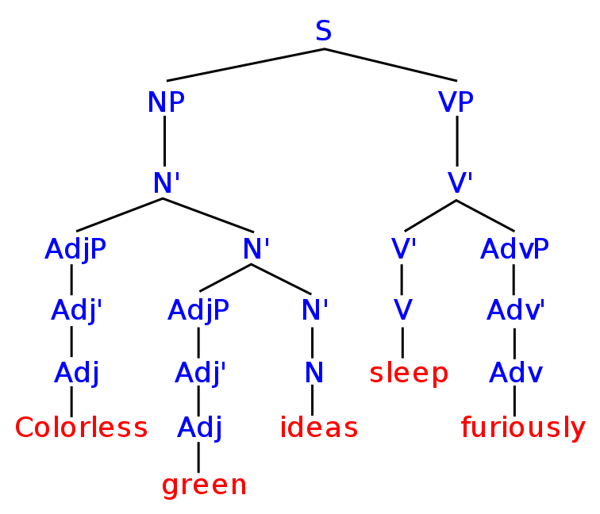
Grammar
Syntax vs Semantics
Terminals/Nonterminals
Syntax Tree

Slide 6
Parser
String → *magic* → Syntax Tree
Two methods:
Top Down (Left-to-right, leftmost derivation, LL)
Recursive function calls.
Bottom Up (Left-to-right, rightmost derivation, LR)
Finite State Automaton

Slide 7
Parsing Example
grammar:
expression := expression '+' expression | number
number := 1-9 digits
digits := digit | digit digits
digit := 0-9
(start rule: expression)
input: “42+10+2”

Slide 8
Top Down
grammar:
expression := expression '+' expression | number
number := 1-9 digits
digits := digit | digit digits
digit := 0-9
(start rule: expression)
input: “42+10+2”
Parse expression
Parse number
Parse 1-9: 4
Parse digits
Parse digit: 2
Parsing next digit fails, so the first result of 'digits' returns.
We've found an int! `int 42`
We've found an expression! `expr (int 42)`
Parse '+'
Parse expression
...
We've found an int! `int 10`
We've found an expression! `expr (int 10)`
We have an expression! `expr (expr (int 42)) + (expr (int 10))`
parse '+'
parse expression
...
We've found an int! `int 2`
We've found an expression! `expression (int 2)`
We have an expression! `expr (expr ((expr (int 42)) + (expr (int 10)))) + (expr (int 2))`
Done!

Slide 9

Top Down
grammar:
expression := expression '+' expression | number
number := 1-9 digits
digits := digit | digit digits
digit := 0-9
(start rule: expression)
input: “42+10+2”
Parse expression
Parse expression
Parse expression
Parse expression
Parse expression
Parse expression
Parse expression
….
Whoops!

Slide 10
Bottom Up
grammar:
expression := expression '+' expression | number
number := 1-9 digits
digits := digit | digit digits
digit := 0-9
(start rule: expression)
input: “42+10+2”
next char digit? yes! Put '4' on stack.
next char digit? yes! Put '2' on stack.
Reduce '4' and '2' to 'int 42'
next char digit? no!
next char '+'? yes! Put `+` on stack.
next char digit? yes! Put '1' on stack
next char digit? yes! Put '0' on stack.
next char digit? no!
reduce '1' and '0' to 'int 10'
reduce 'int 42' `+` 'int 10' to 'expr (int 42) (int 10)'
next char '+'? yes! Put `+` on stack.
...
reduce 'expr (int 42) (int 10)', '+', 'int 2' to 'expr (expr (int 42) (int 10)) (int 2)'
Done!

Slide 11
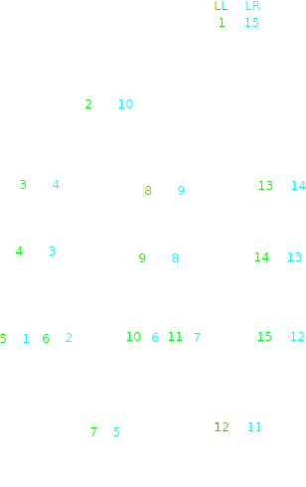

Slide 12
LL(*): Top-down parsing

Slide 13
LL parsing
Whoops!

Slide 14
LR(*): Bottom-up parsing

