Slide 1
Rge’s platforms Logo Designs
ACE Digital, Created By: Jean Lim & Aqeel Safwan

Slide 2














DIGITAL MANUFACTURING PLATFORM
Logo definition
Papers, leaf resemblance, fuel, palm oil and colour variants derived from the business nature of the respective BGs. Both solid and gradient designs.
Results

Slide 3

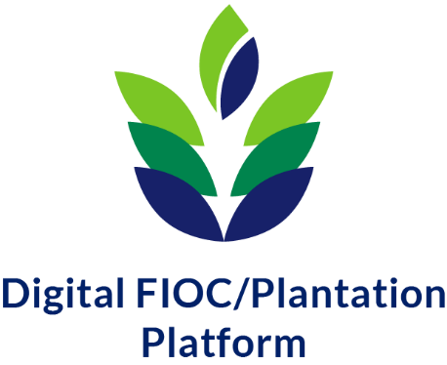
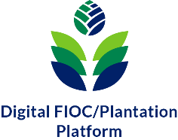
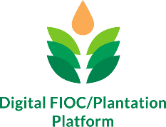
DIGITAL FIOC/PLANTATION PLATFORM
Logo definition
Upright plant resemblance, symbol on the top representing each company, colours taken from blend of company theme
Results

Slide 4
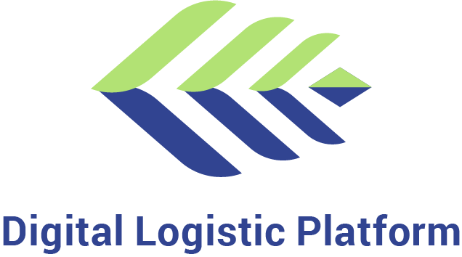
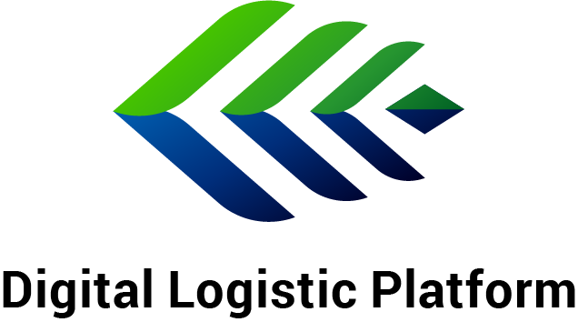

DIGITAL LOGISTICS PLATFORM
Logo definition
Wing-bladed design to represent speedy logistic process, and a global widespread of business coverage. Dual tone symbolize partnership between the corporate and our business partners. Box in the end representing packages.
Results

Slide 5
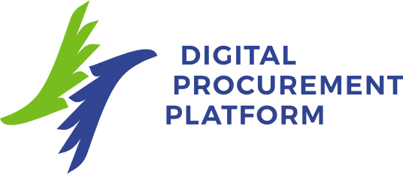
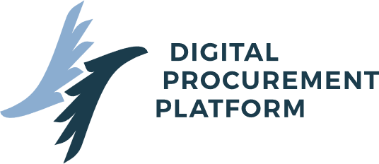
DIGITAL PROCUREMENT PLATFORM
Logo definition
Two wings imitating the letter ‘d’ and ‘p’ for Digital Procurement. Colours are taken from individual company’s theme.
Results
Forindo

Slide 6



CUSTOMER & SALES PLATFORM
Logo definition
A mouth-talking shape indicating communication-centric within the business. It is also representing the letter “C” for customer.
Results

Slide 7
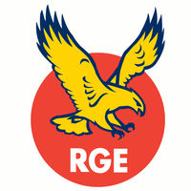


EMPLOYEE PRODUCTIVITY PLATFORM
Logo definition
An employee with arms up signifying dedications, progressions and productions under the wings of RGE/Apical.
Results

Slide 8
The End.
The above logo artworks are produced by Aqeel Safwan.
Comments / suggestions / critics are all welcome.

