Slide 1
Security Control Existing Menu

Slide 2
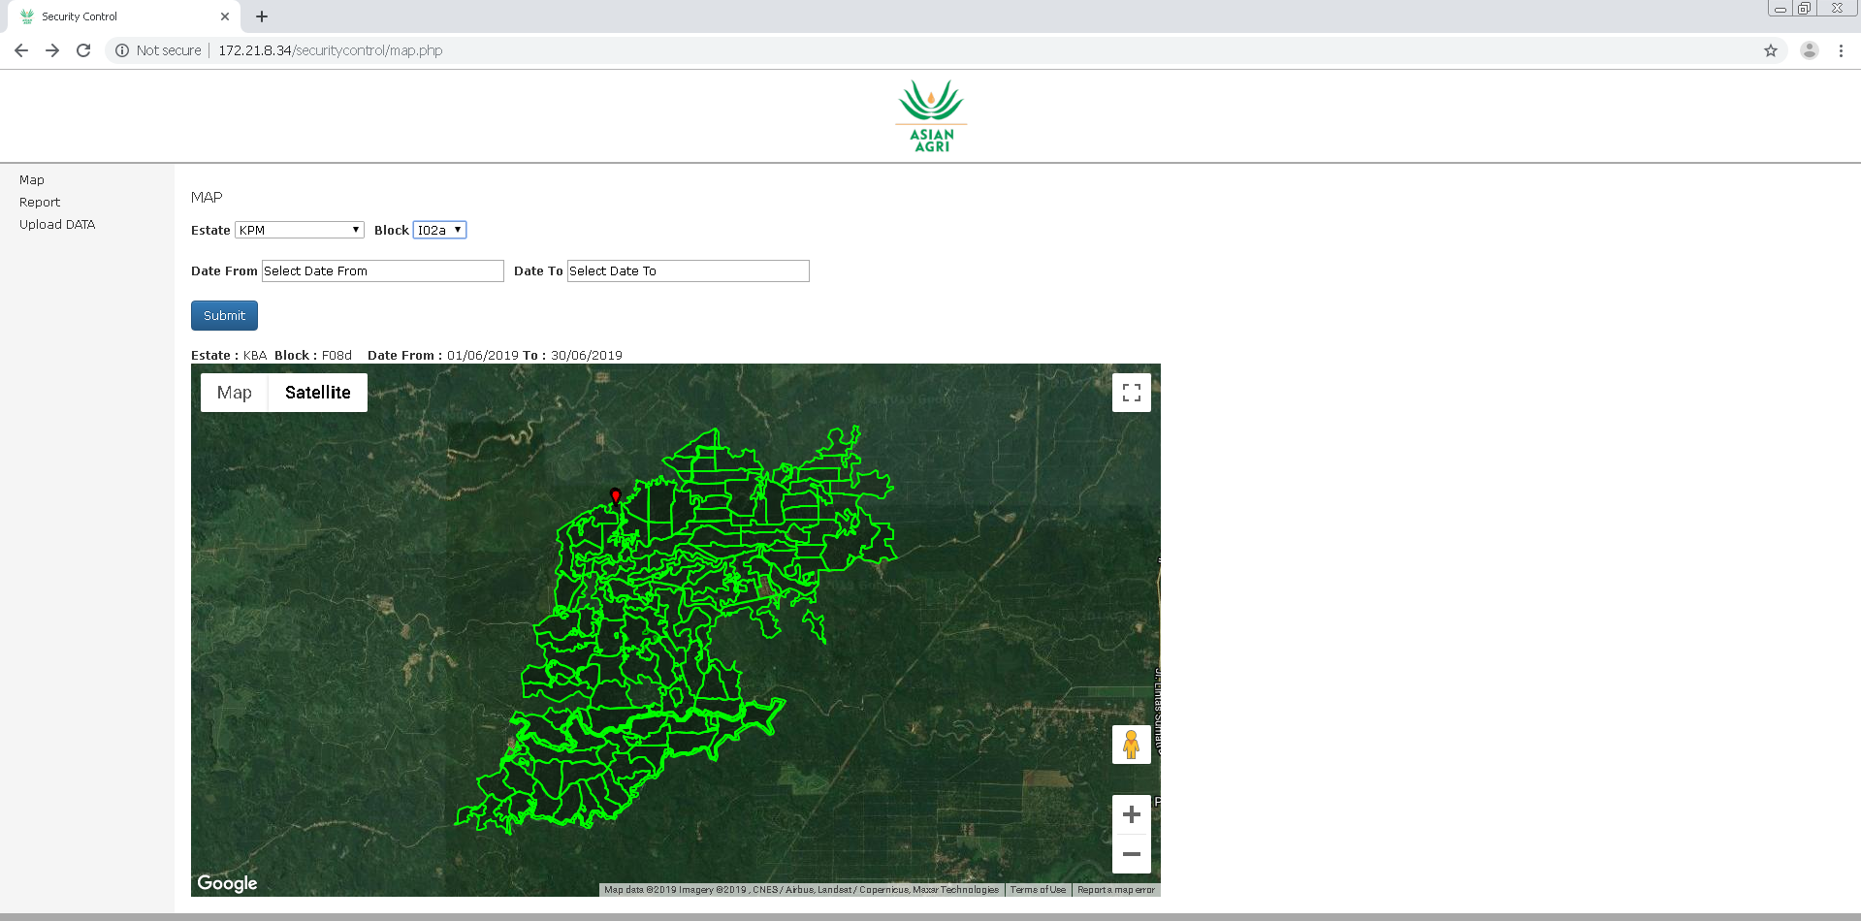
Reporting Menu with Mapview

Slide 3
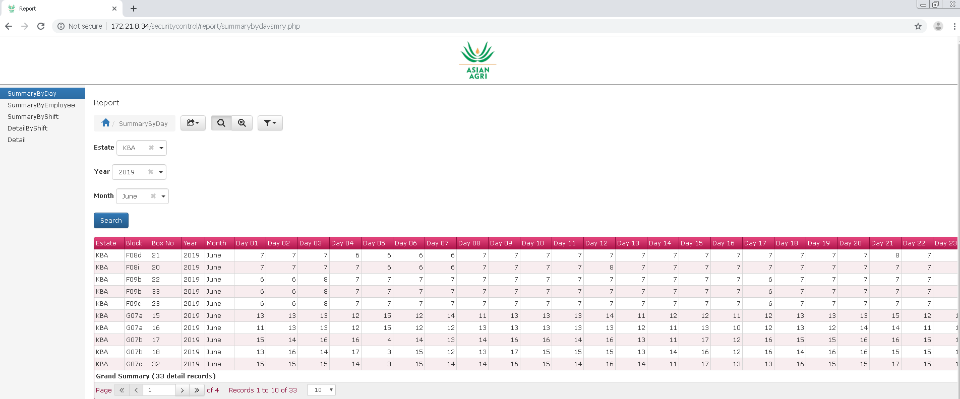
Reporting Menu with Grid view

Slide 4
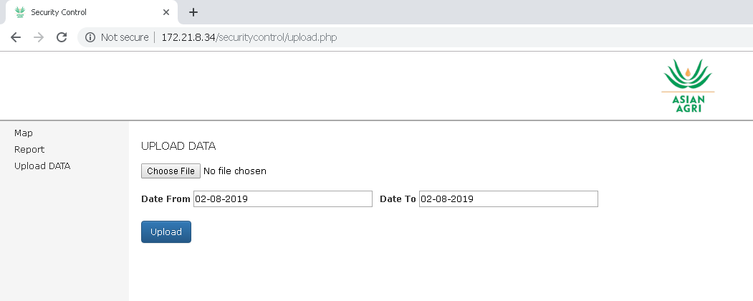
Upload Menu

Slide 5
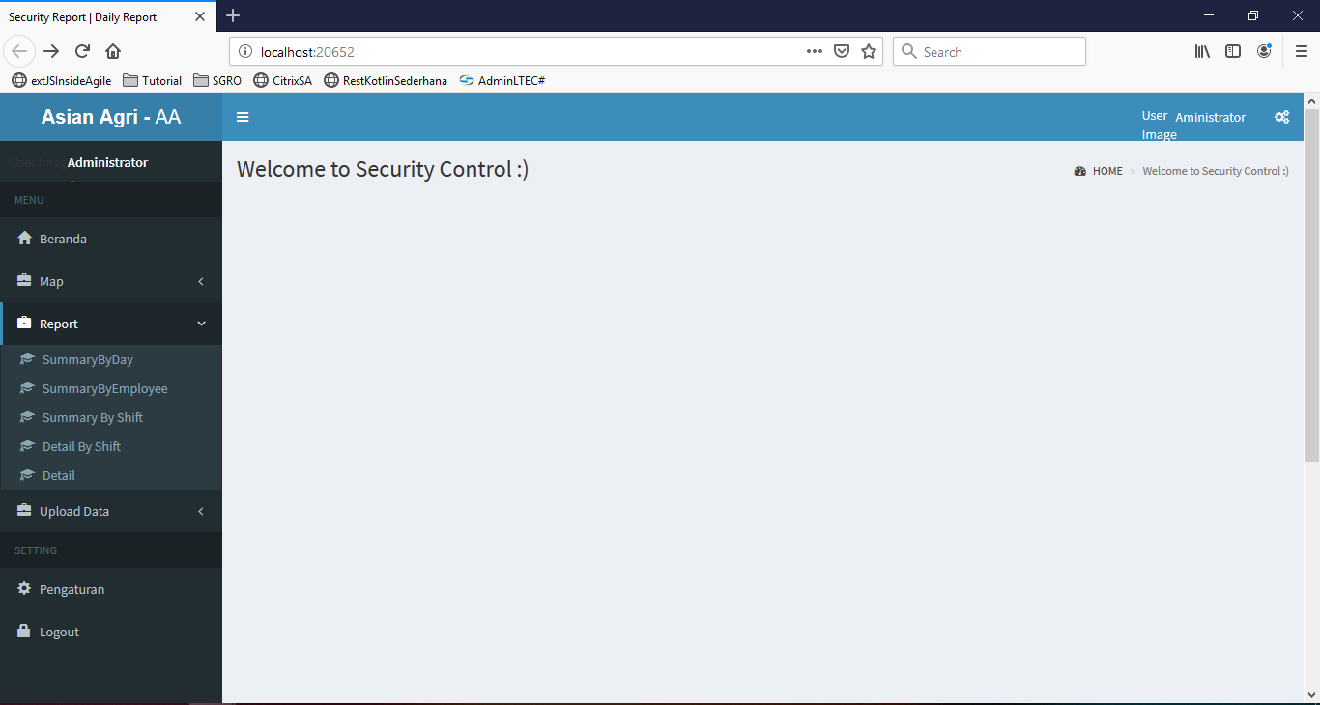
New Template Design (Still in sketch)

