Slide 1




Slide 2
Outlines
The main idea
Presentation
Conception choices
Demonstration

Slide 3
Introduction
Goals :
Helping people improving their English culture
Create an application : “Learning without Learning”
Enjoy the development

Slide 4
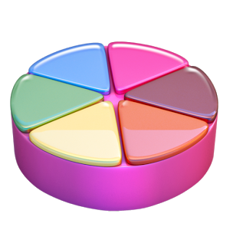

The main idea
Take the two concepts
Mix them together
Specific topic for questions
Questions belongs to categories
Bonus available

Slide 5

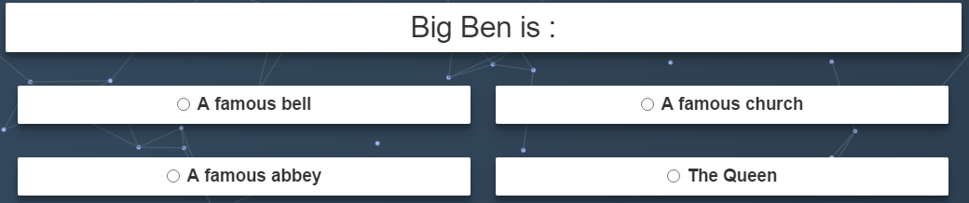

Presentation
The game
Climb level’s scale
Each level increase the difficulty
Bonus available

Slide 6
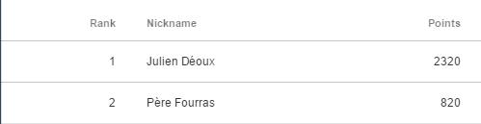
Presentation
Get higher score
Play each category
Improve your score
Challenge yourself

Slide 7
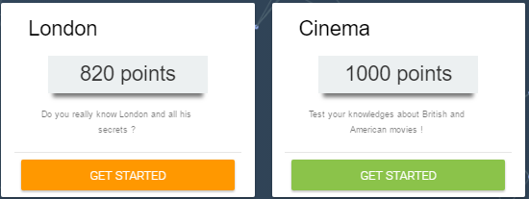
Presentation
What’s addictive ?
The scores can decrease
A bet on your capacity
A part of randomness

Slide 8
Conception choices
NodeJS – Javascript - SQL
Very fast
Interactivity with the player
Easy to work with

Slide 9
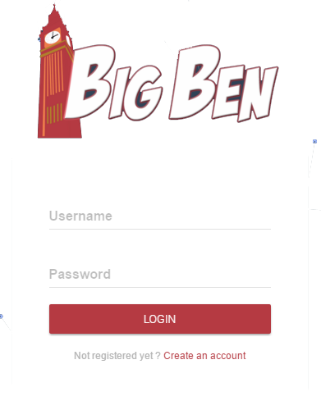
Conception choices
Secure Application
Username
Password (Hashage)

Slide 10

demonstration
BigBen Project

Slide 11
CONCLUSion
The game is fully working
Improvements
Administrator Panel
More categories
Multiplayers (1 vs 1)
More bonus (call Garou)

Slide 12
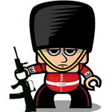
Thank you for your time !

