Slide 1




Slide 2
Outlines
The main idea
Presentation
Conception choices
Demonstration

Slide 3
Introduction
Goals :
Helping people improving their English culture
Create an application : “Learning without Learning”
Enjoy the development

Slide 4
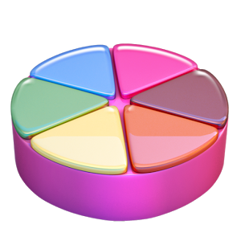

The main idea
Take the two concepts
Mix them together
Specific topic for questions
Questions belongs to categories
Bonus available

Slide 5

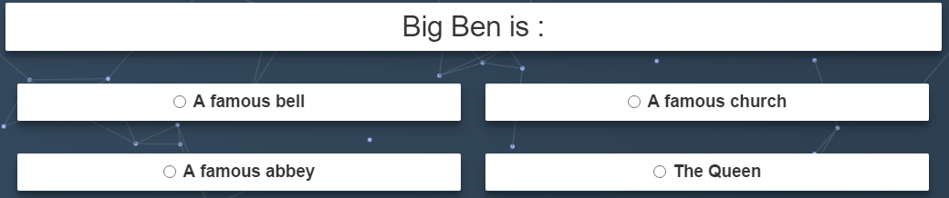

Presentation
The game
Climb level’s scale
Each level increase the difficulty
Bonus available

Slide 6
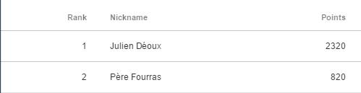
Presentation
Get higher score
Play each category
Improve your score
Challenge yourself

Slide 7
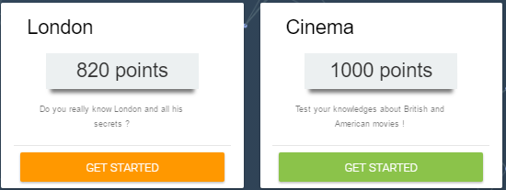
Presentation
What’s addictive ?
The scores can decrease
A bet on your capacity
A part of randomness

Slide 8
Conception choices
NodeJS – Javascript - SQL
Very fast
Interactivity with the player
Easy to work with

Slide 9
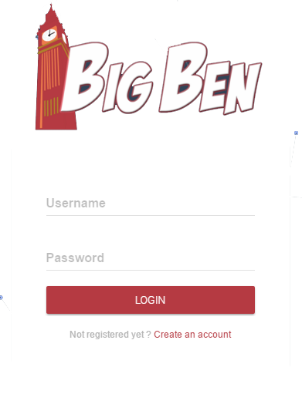
Conception choices
Secure Application
Username
Password (Hashage)

Slide 10

demonstration
BigBen Project

Slide 11
CONCLUSion
The game is fully working
Improvements :
Administrator Panel
More categories
Multiplayers (1 vs 1)
More bonus (call the audience)

Slide 12

Thank you for your time !

