Slide 1

Final Exam Practical
FOL username: y_shah142873

Slide 2
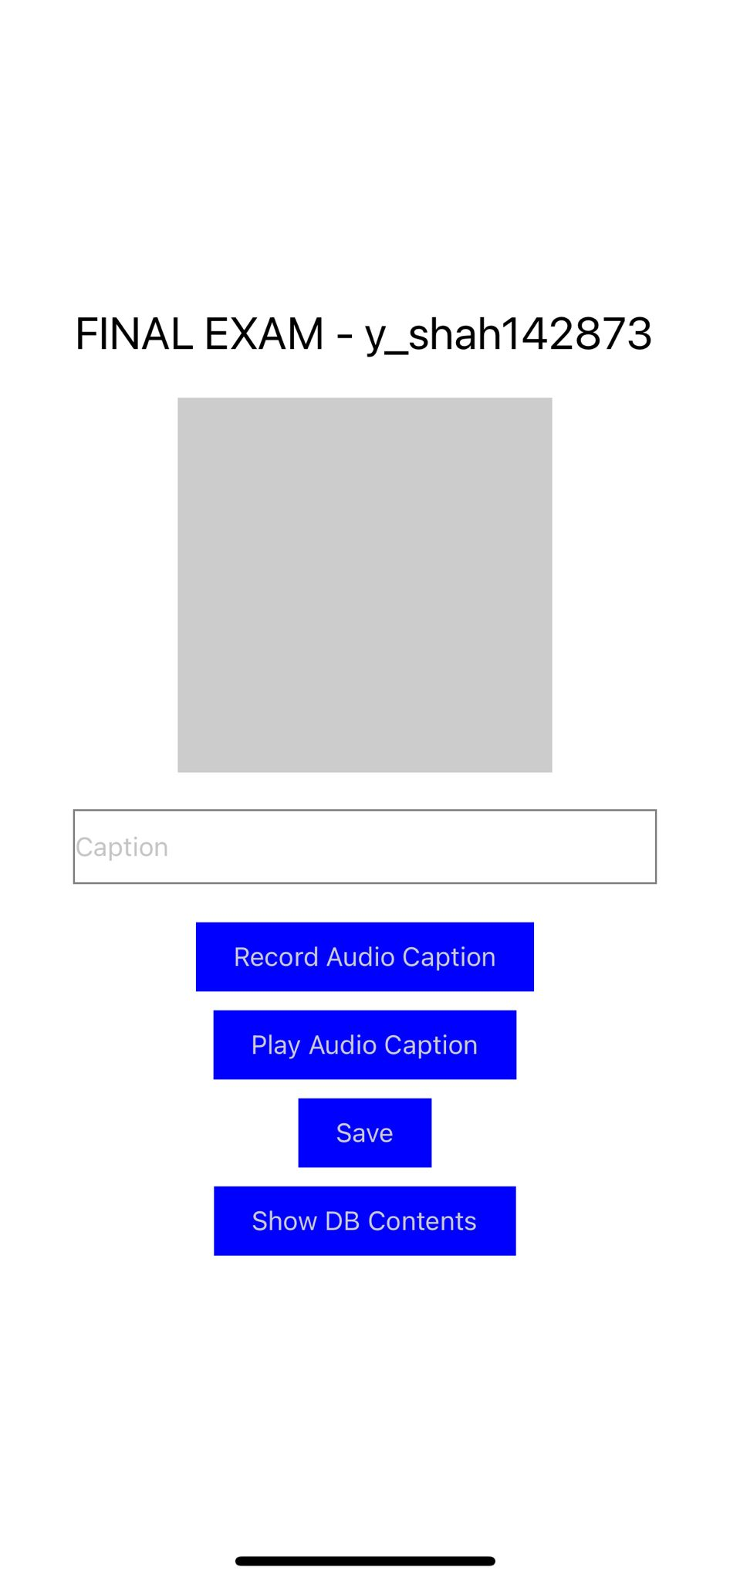
Slide #1 – Main screen with Initial State

Slide 3
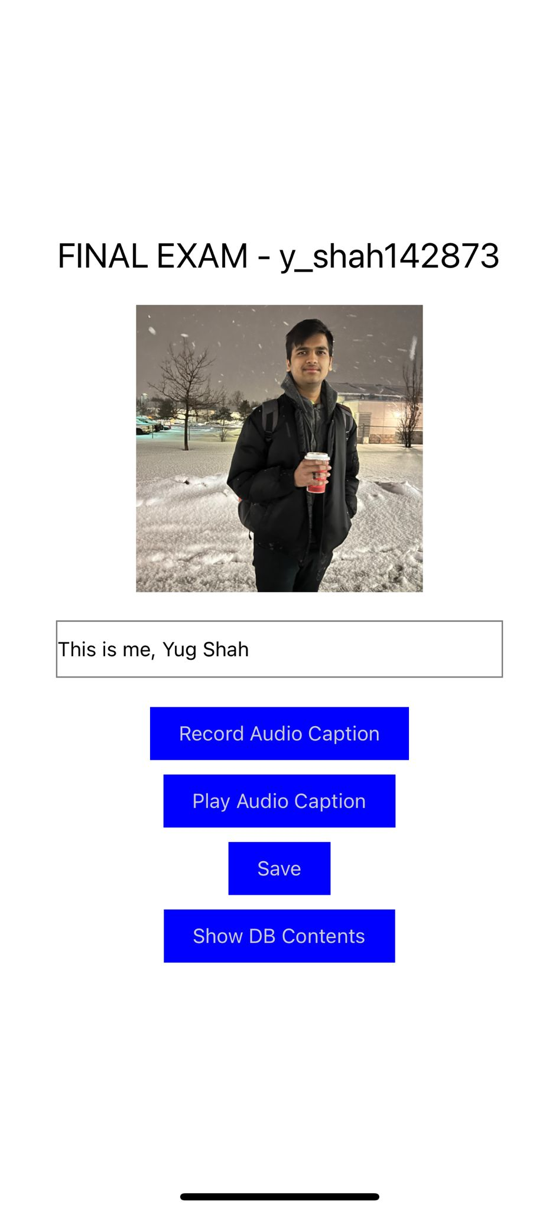
Slide #2 – Main screen with picture selected and displayed

Slide 4
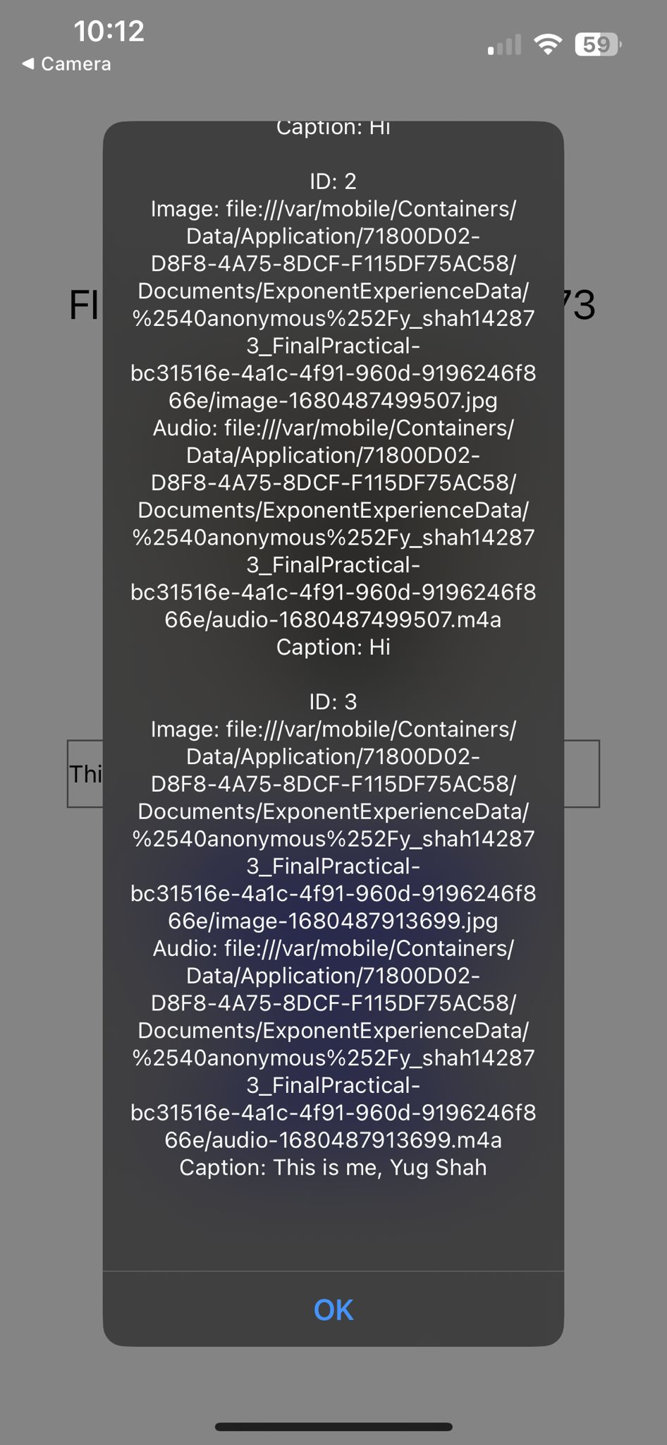
Slide #3 – DB Contents
Note: I have 3 IDs in the DB contents because I checked twice before uploading. The one I am inserting in the slide has ID of 3

