Slide 1

Lab #4
FOL username: y_shah142873

Slide 2
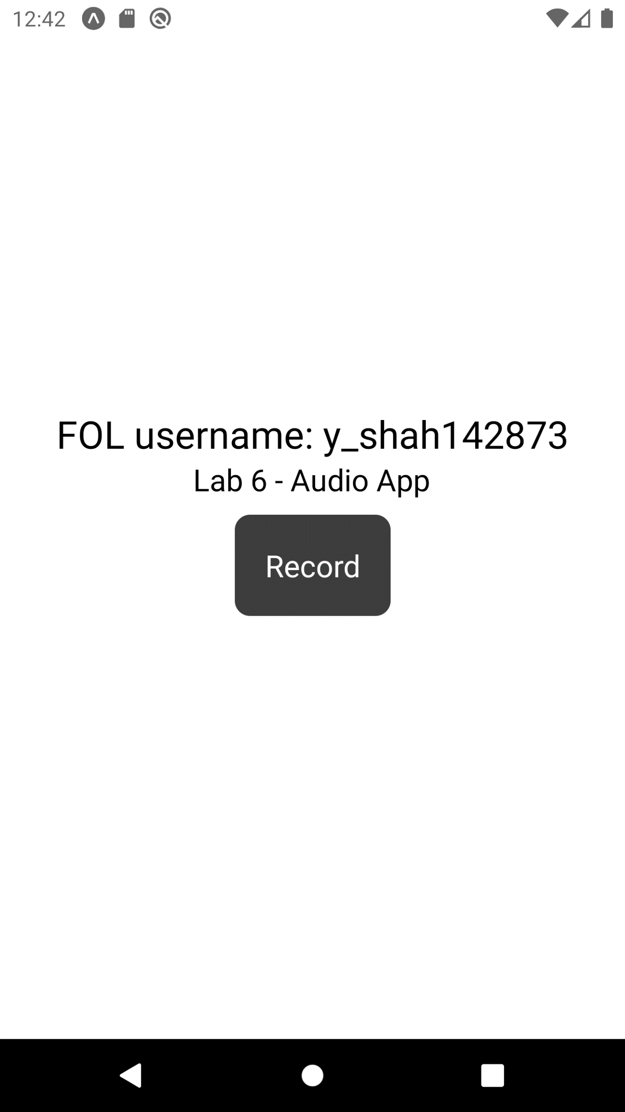
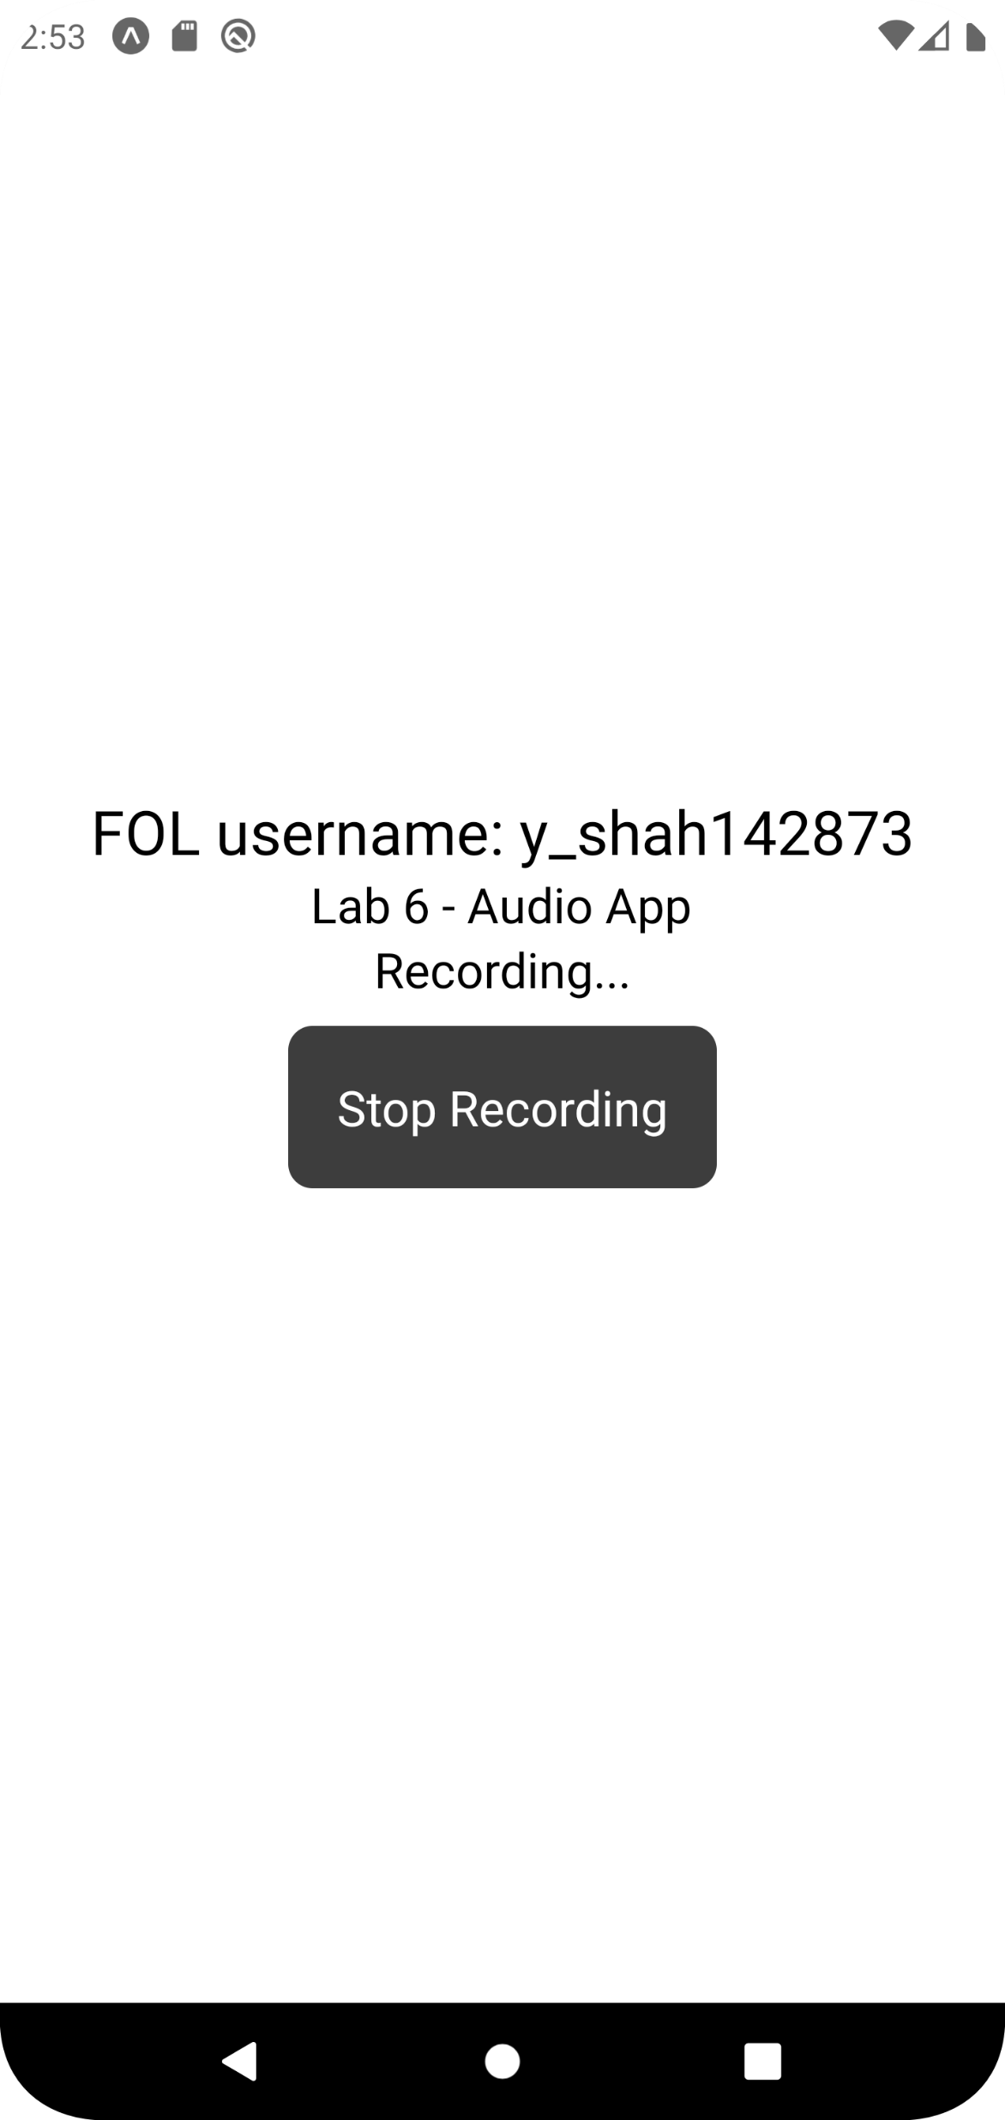
Slide #1 – The page where we start the recording
Before clicking the recording button
After clicking the recording button

Slide 3
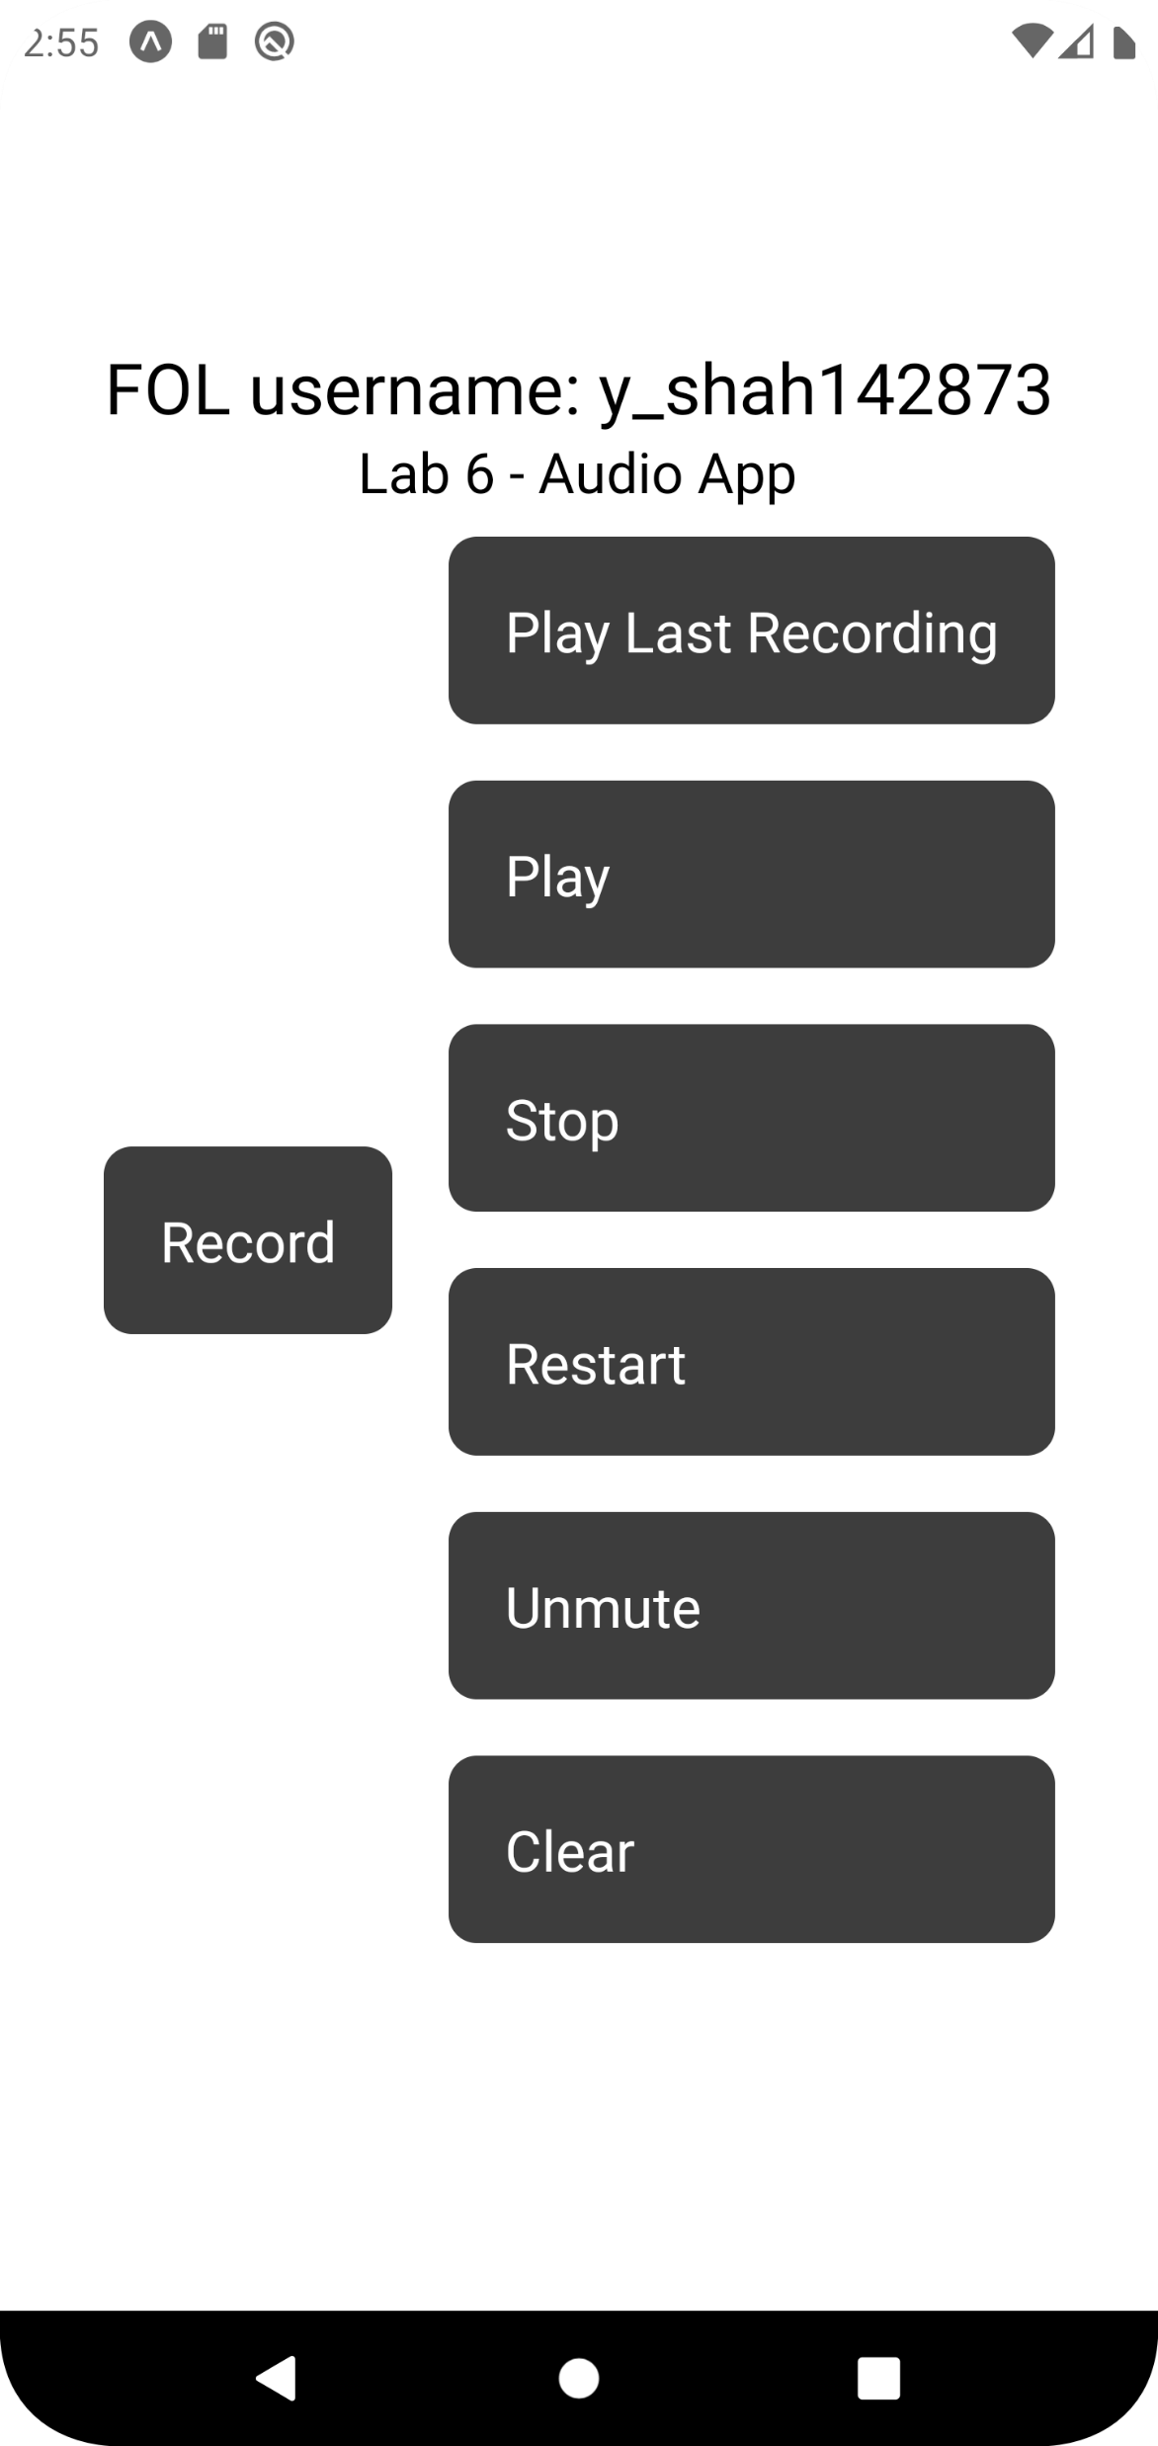
Slide #2 – After clicking the “Stop Recording” button

Slide 4
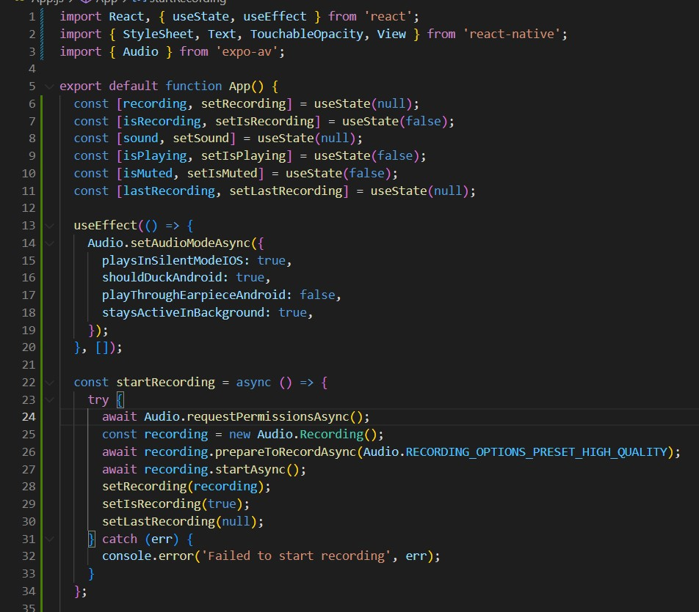
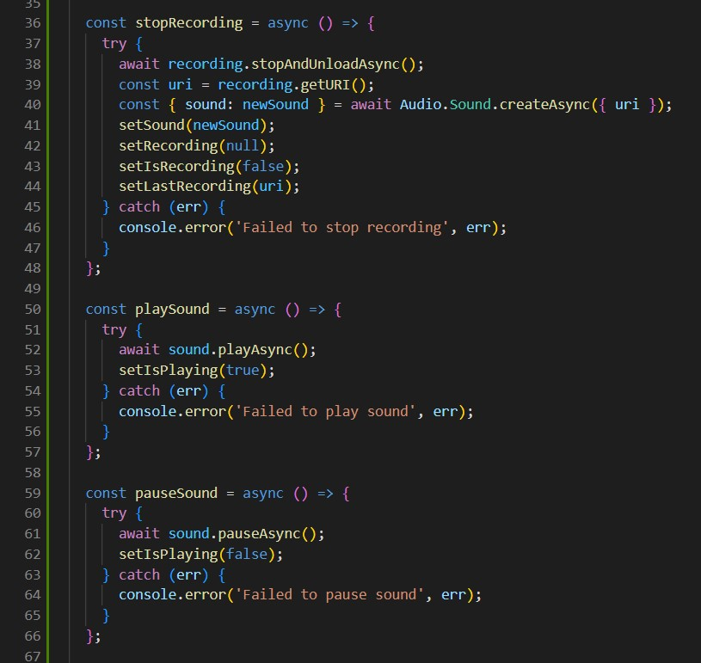
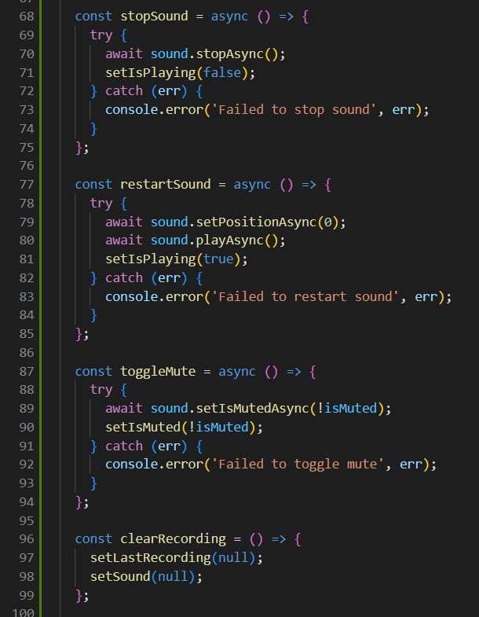
Slide #3 - Code Snippets (A)

Slide 5
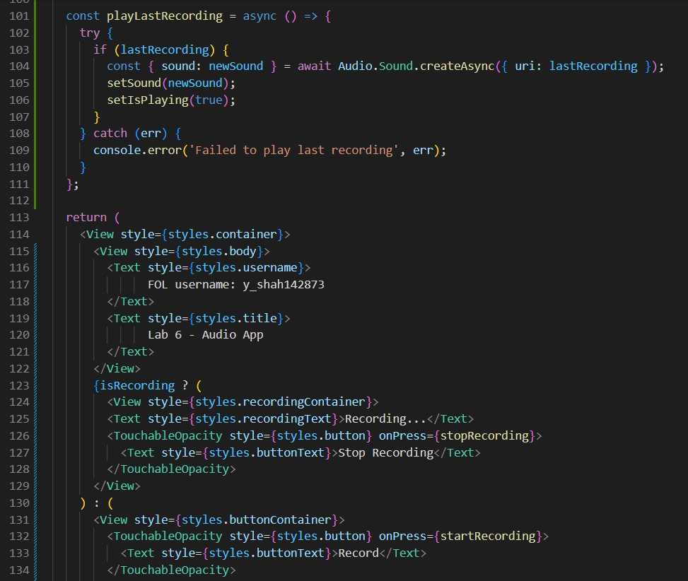
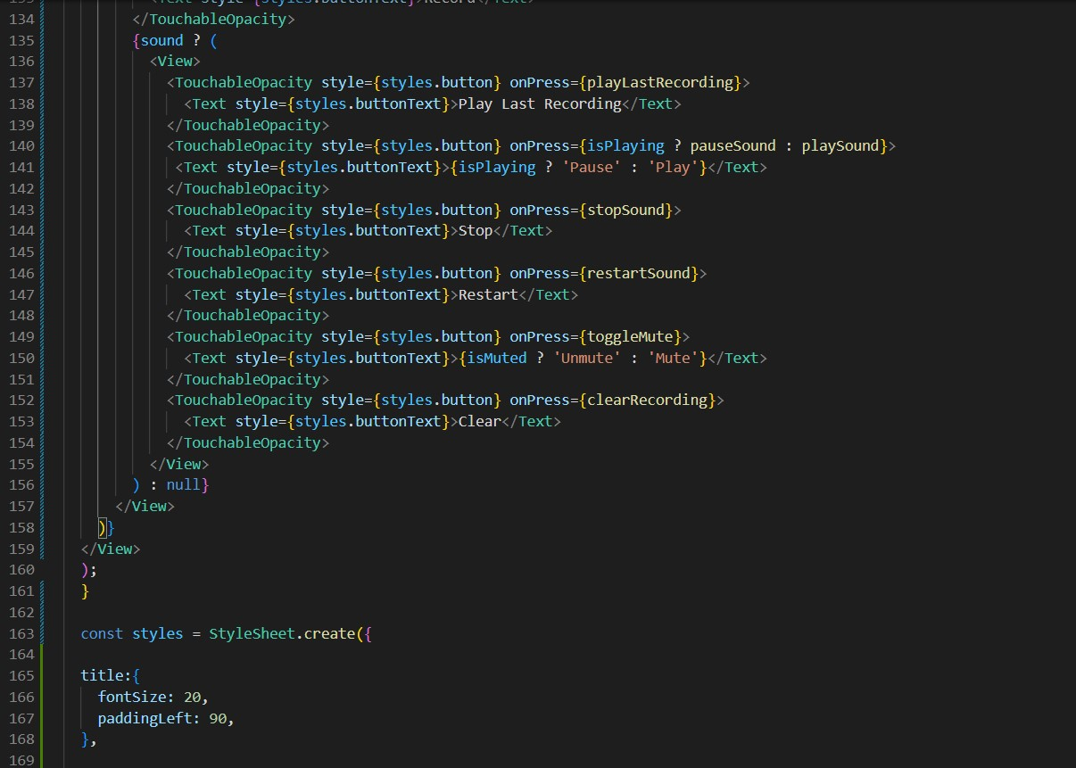
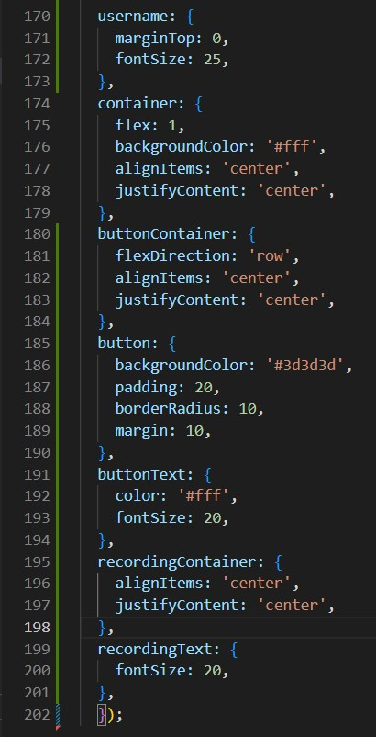
Slide #4 – Code Snippets (B)

