Slide 1

Lab #7
FOL username: y_shah142873

Slide 2
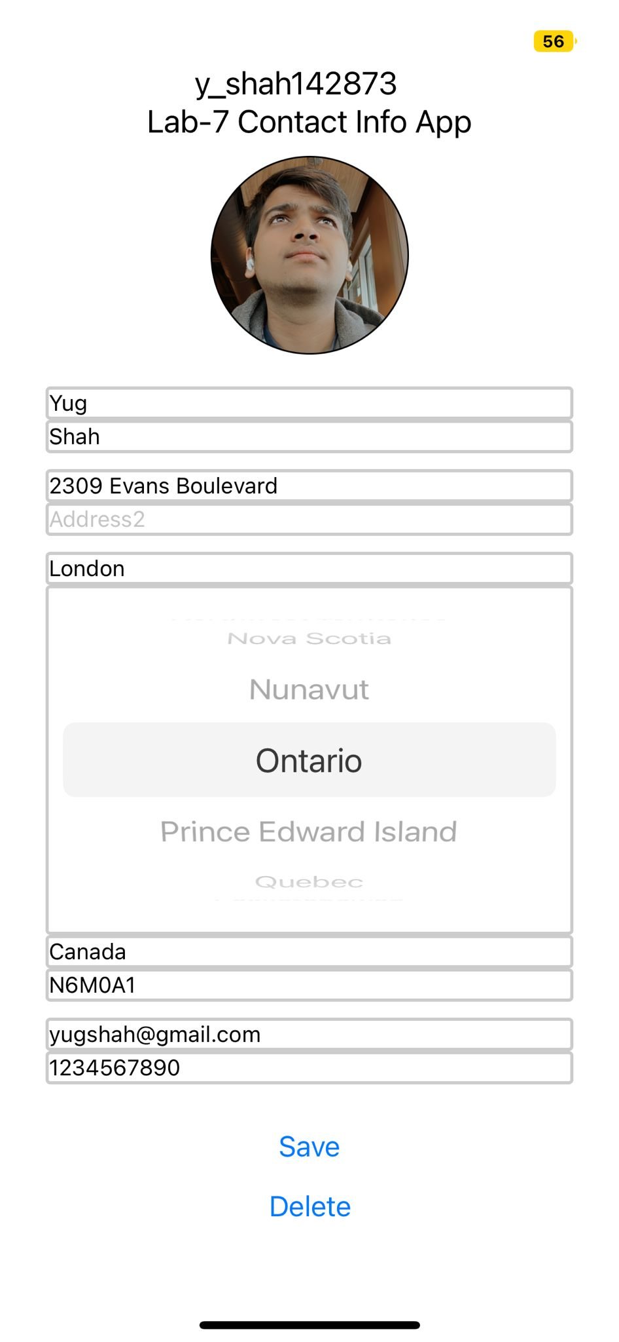

Slide #1 – Wireframes Screenshots
Before clicking Save Button After clicking Save Button

Slide 3
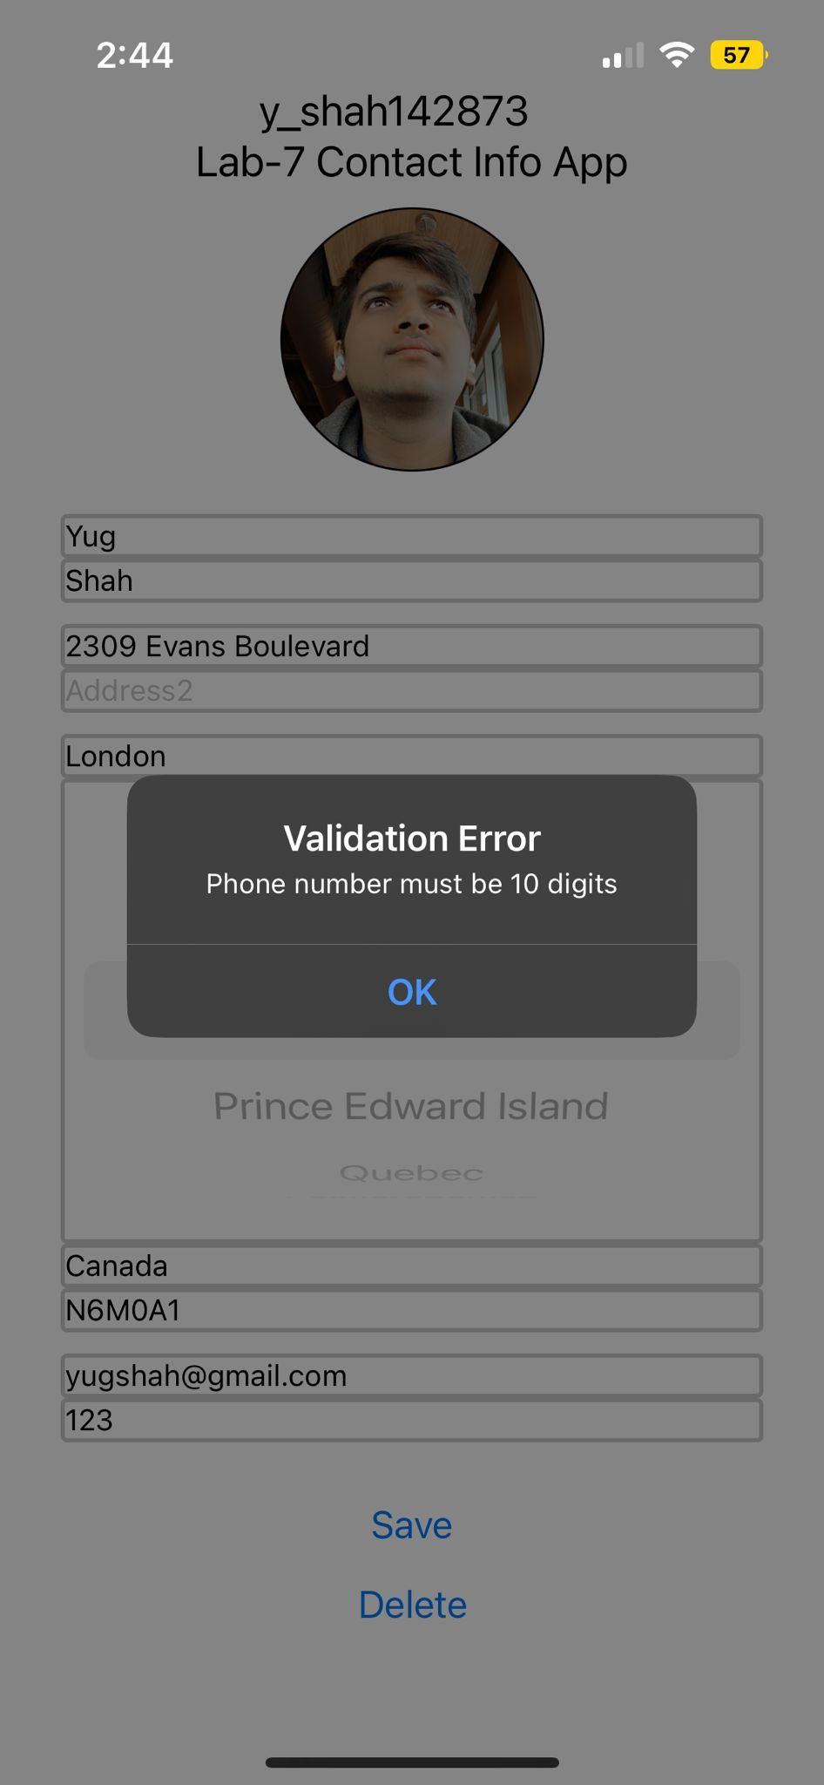
Slide #2 – Validation Error

Slide 4
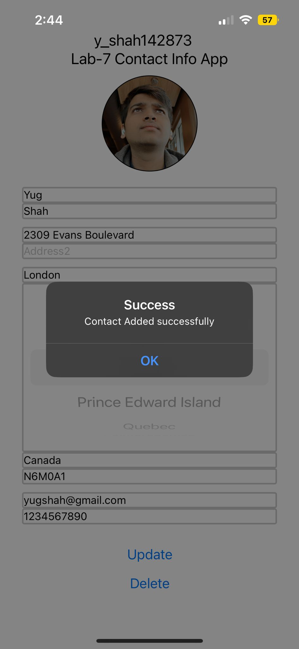
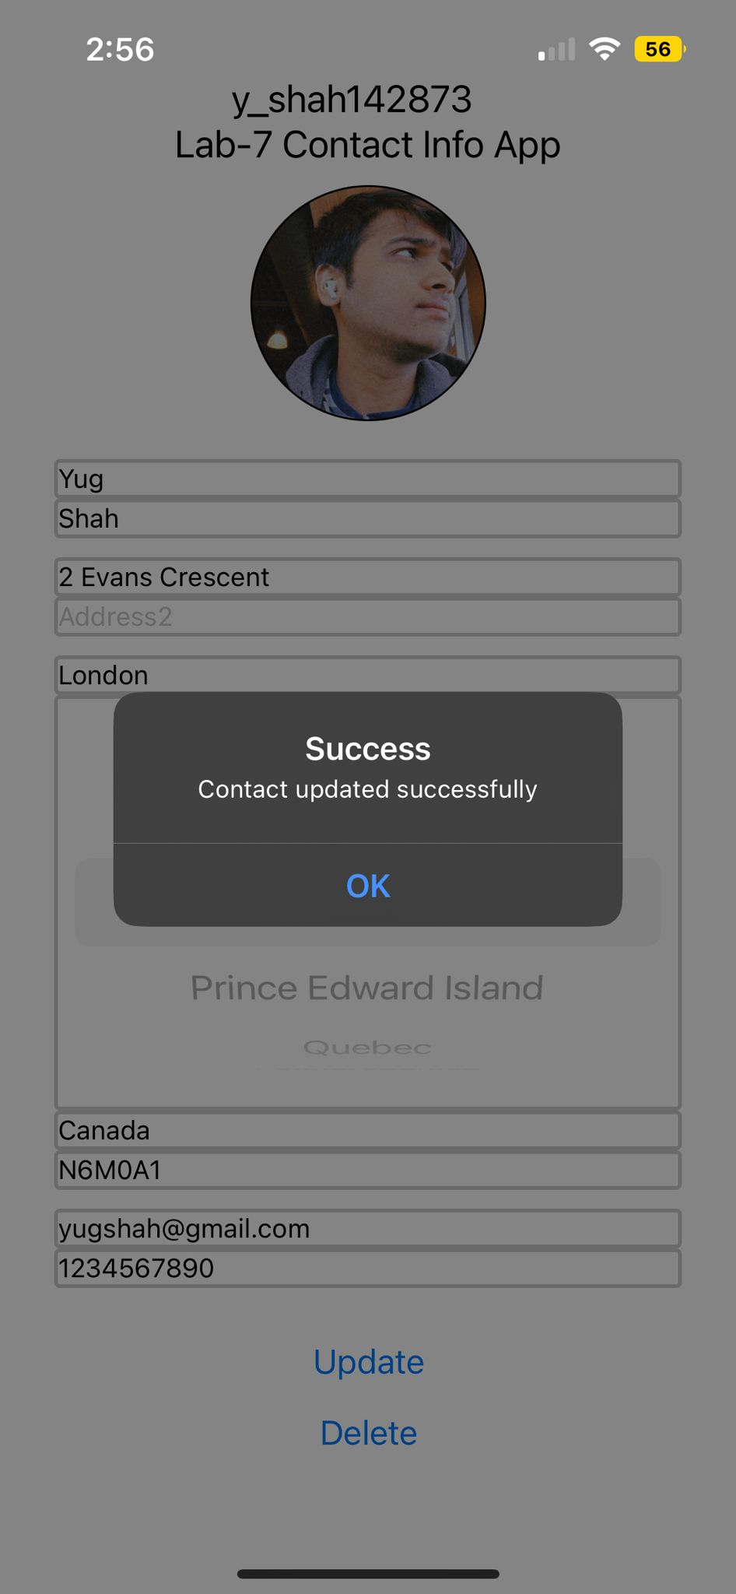
Slide #3 – Alerts after Save and Update

Slide 5
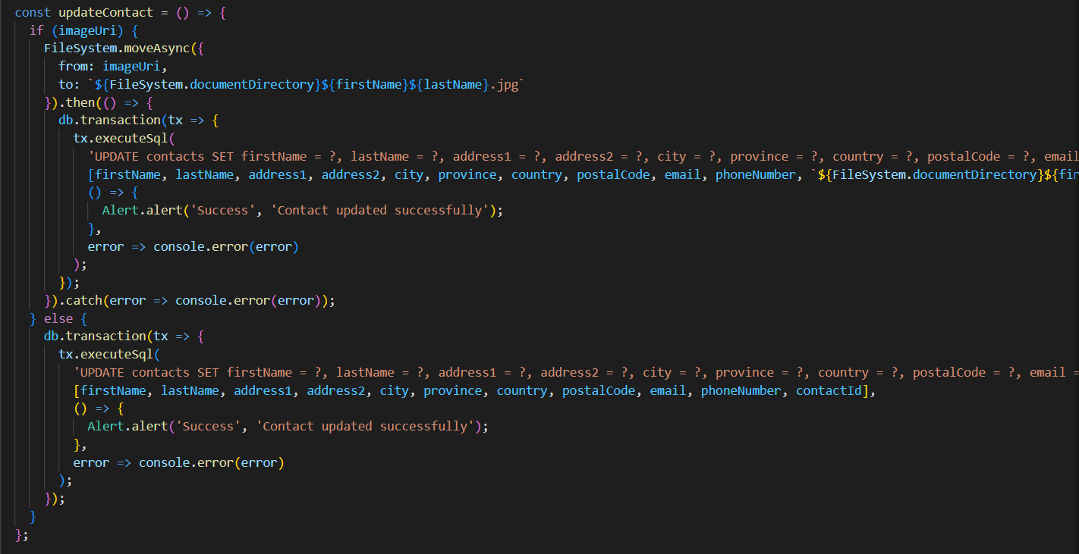
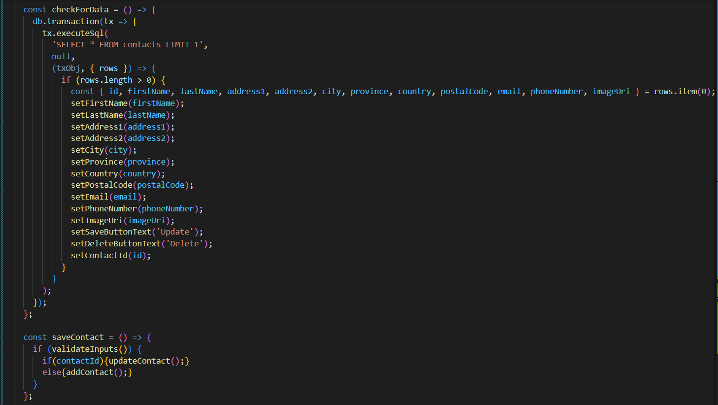
Slide #4 - Code Snippets(A)

Slide 6
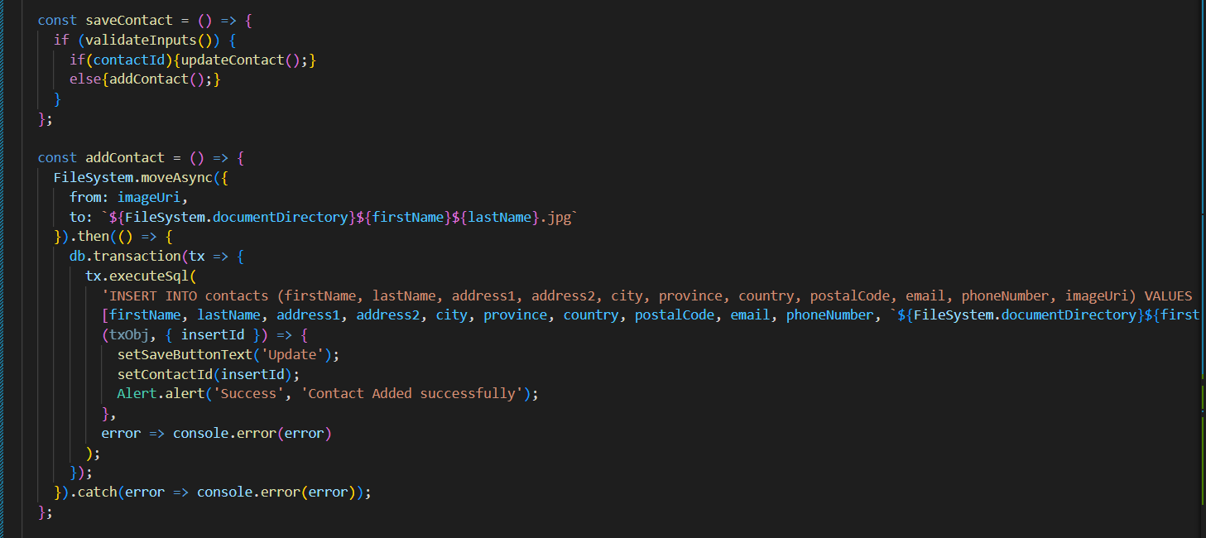
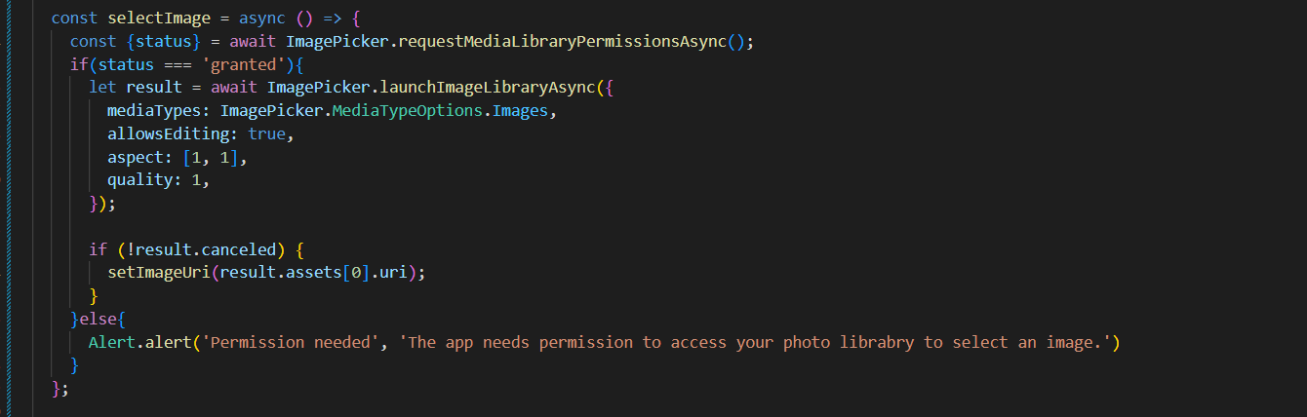
Slide #5 – Code Snippets (B)

