Slide 1
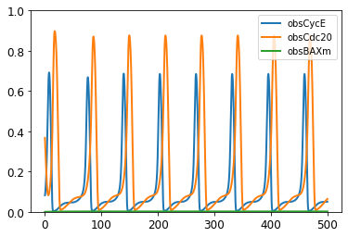
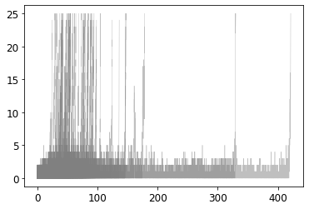
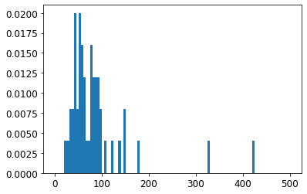
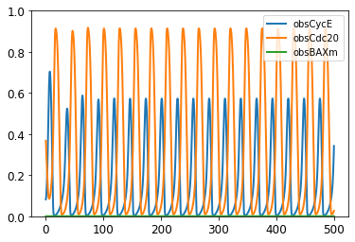
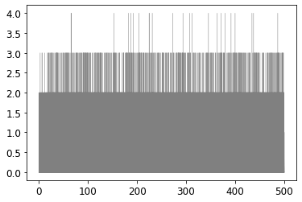
AKT: 0.3, ERK: 0.2, FAK: 0.4
Dead Fraction: 1.00
AKT: 0.6, ERK: 0.2, FAK: 1
Dead Fraction: 0.00

Slide 2
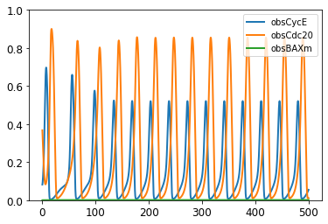
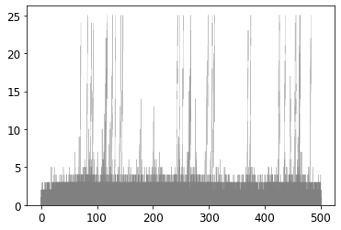
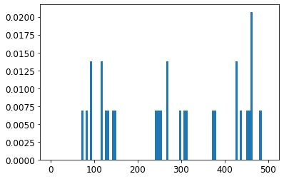
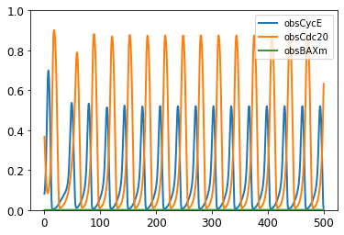
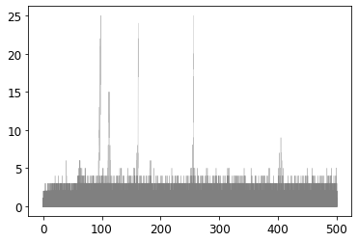
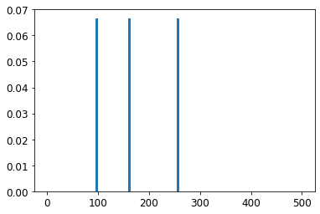
AKT: 0.4, ERK: 0.2, FAK: 0.4
Dead Fraction: 0.58
AKT: 0.45, ERK: 0.2, FAK: 0.4
Dead Fraction: 0.06

Slide 3
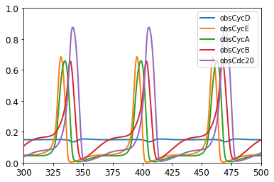
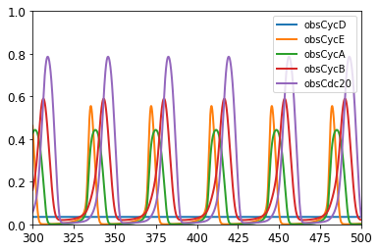
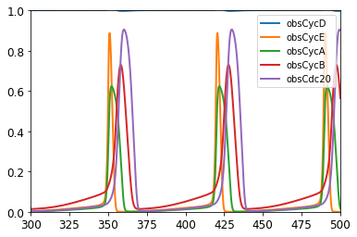
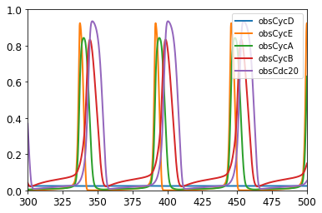
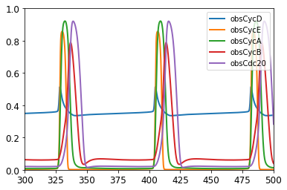
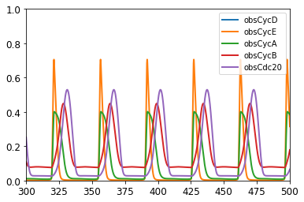
Original Params

Slide 4
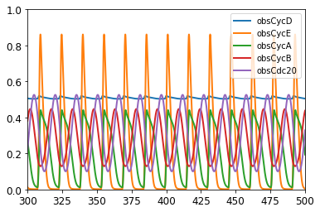
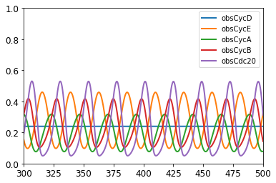
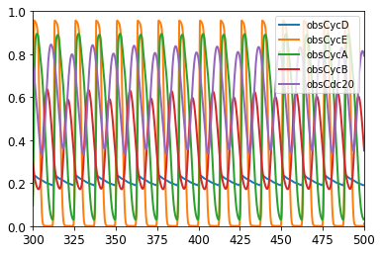
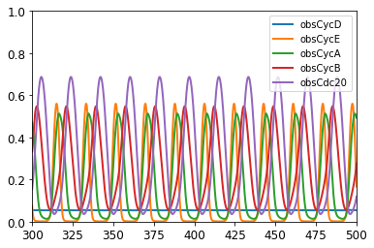
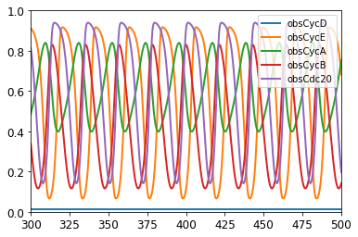

Slide 5
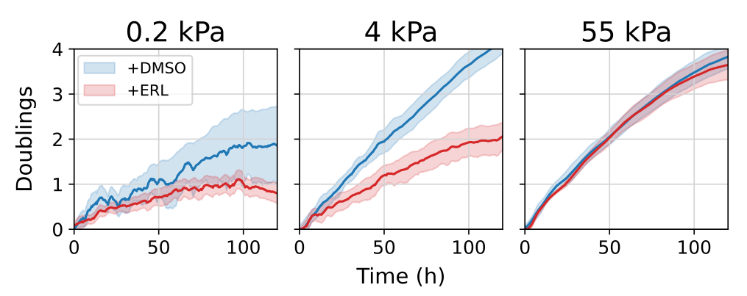
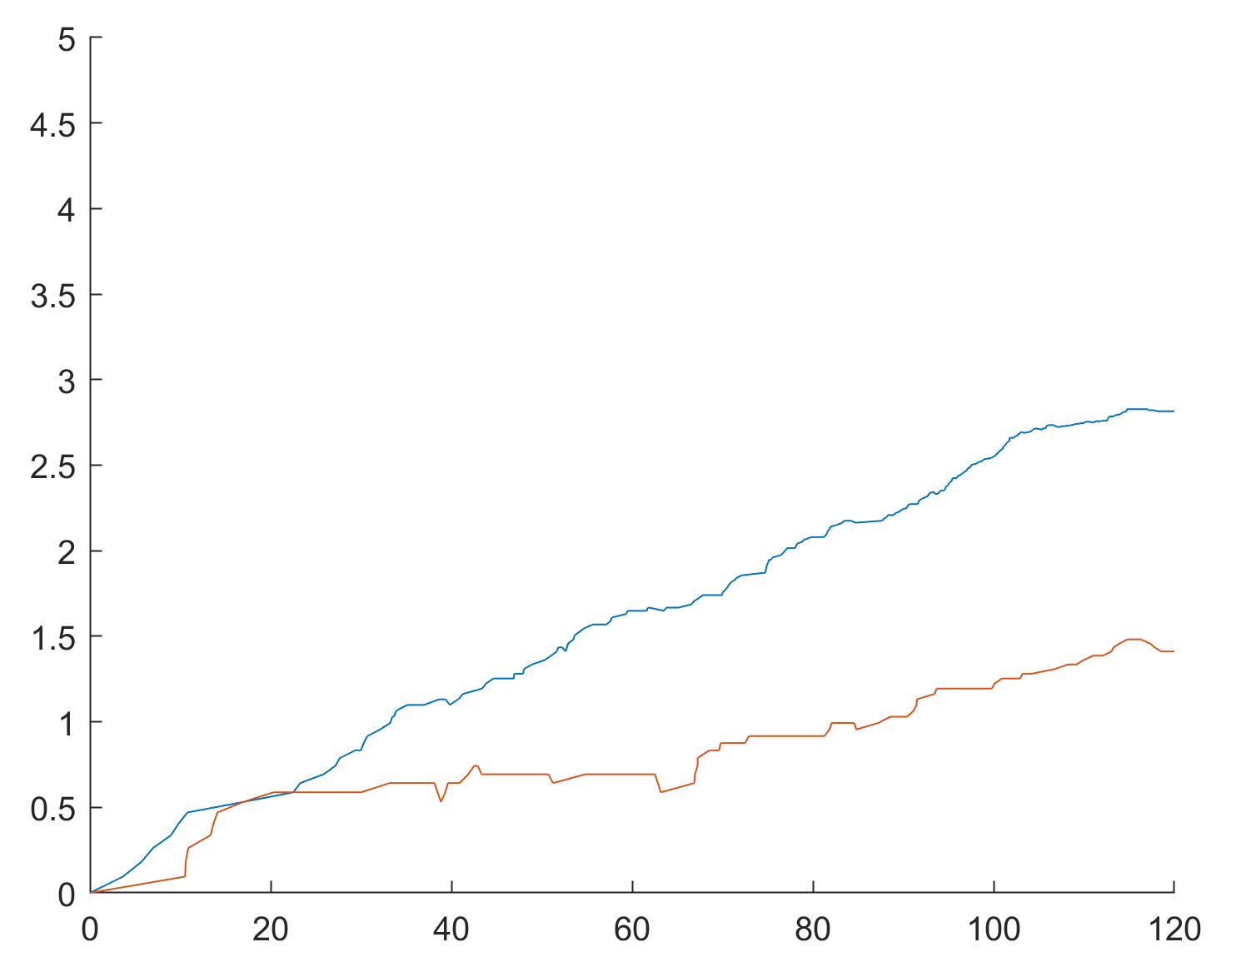
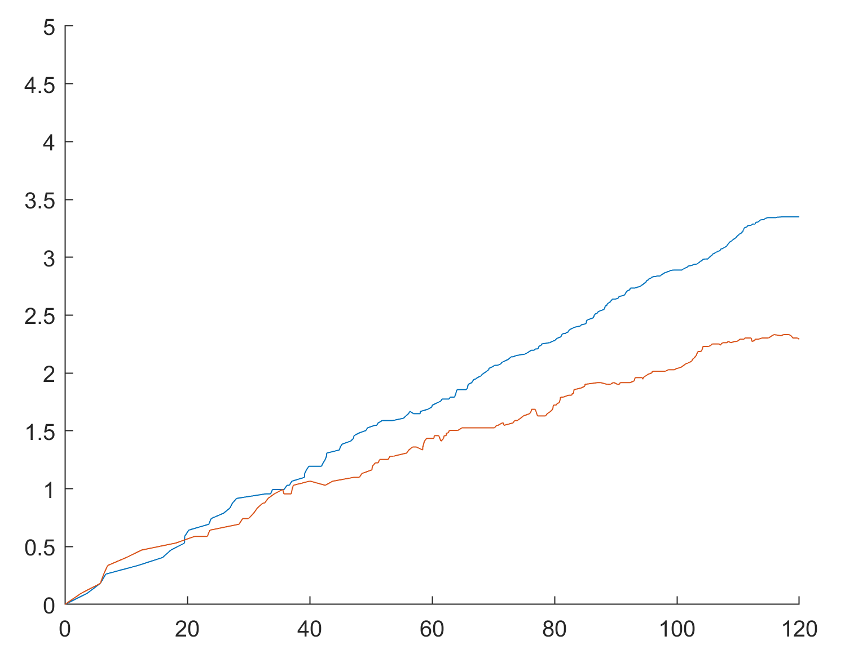
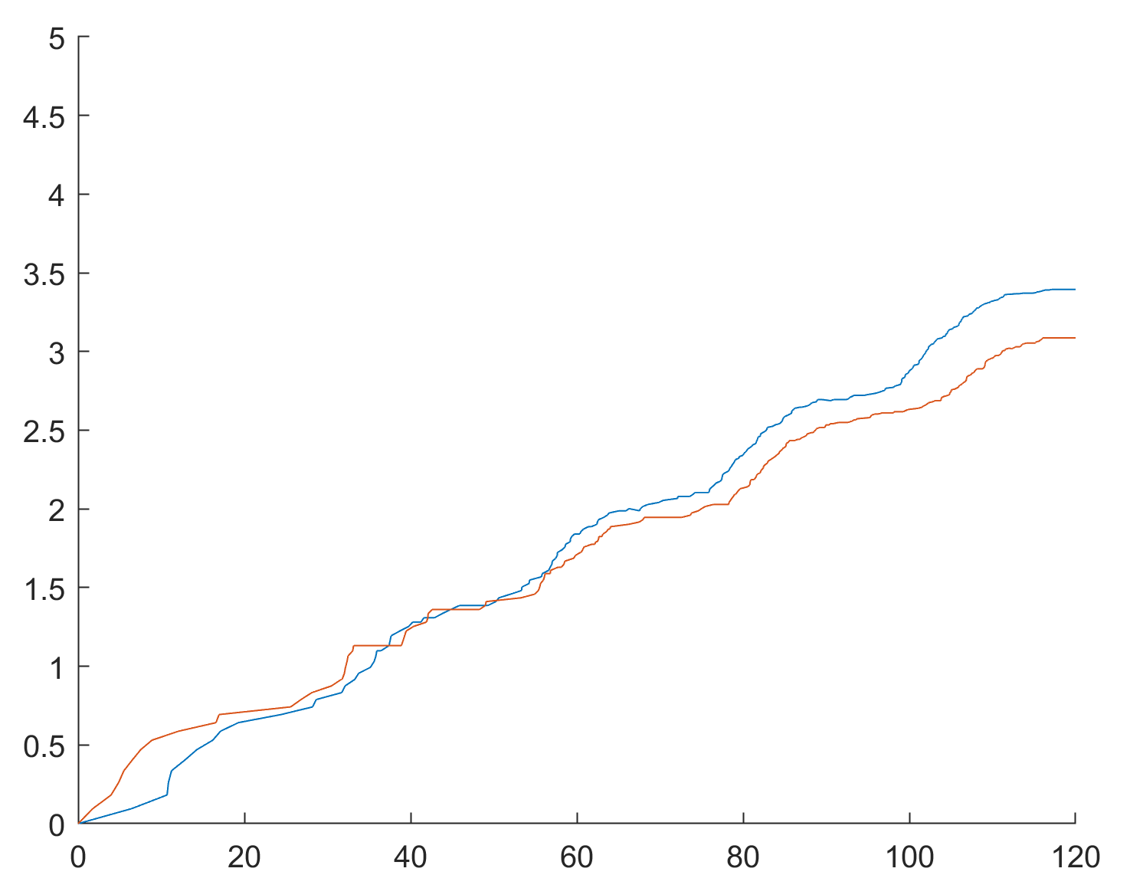

Slide 6
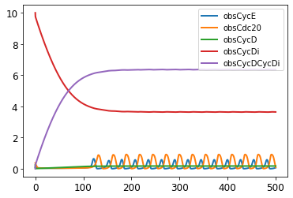
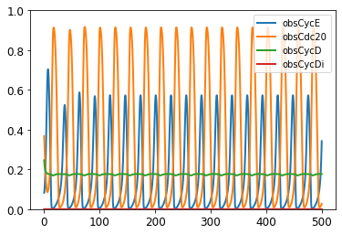
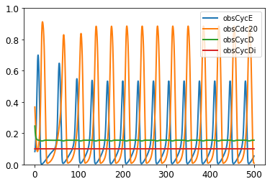
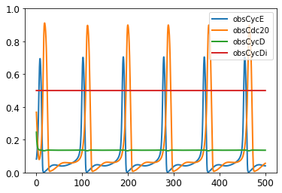

Slide 7
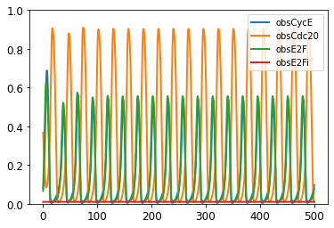
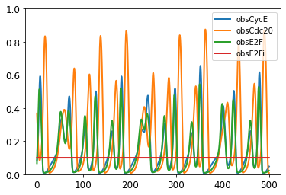
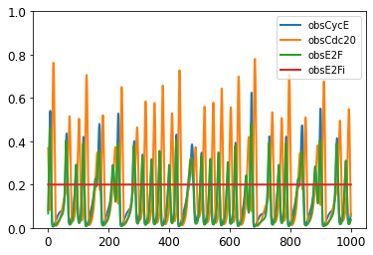

Slide 8
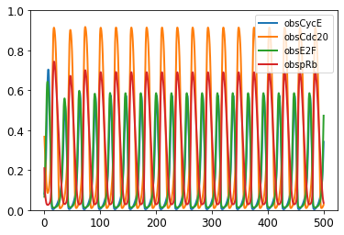
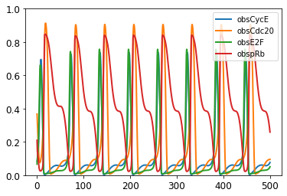
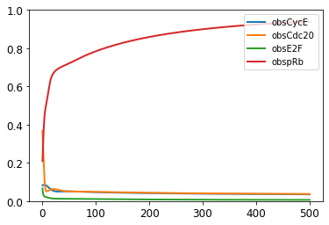
Rb -> pRb : CycD
((p.k_P1*CycD*Rb)/((p.K_CD)+Rb))
K_P1 = 18
K_P1 = 15
K_P1 = 10

Slide 9
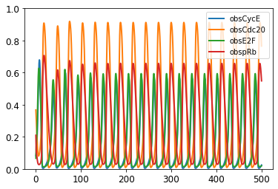
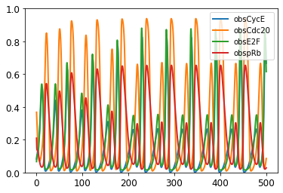
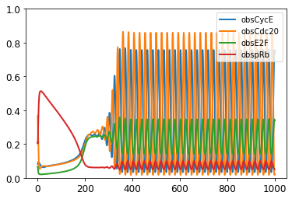
Rb -> pRb : CycE
K_P2 = 18
K_P2 = 15
K_P2 = 10
K_P2 = 1

Slide 10

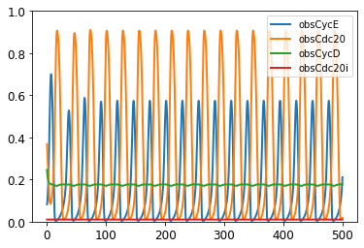
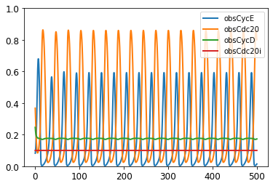
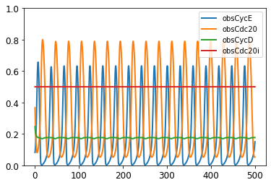

Slide 11
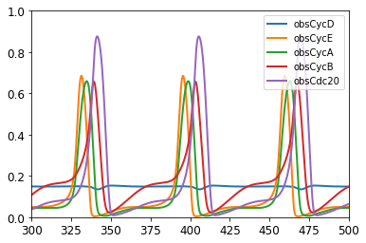
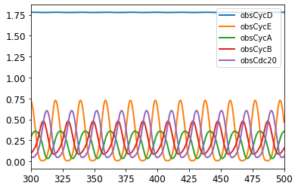
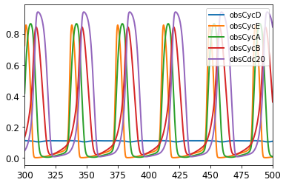
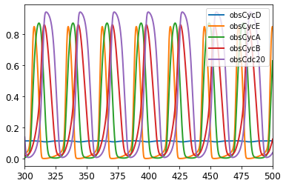
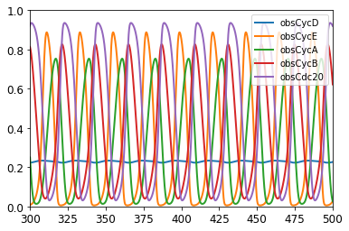
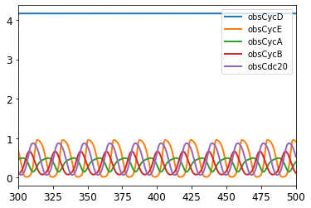
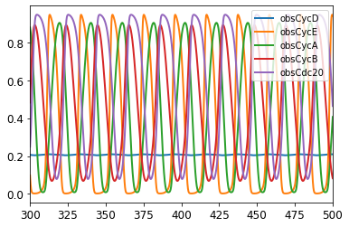
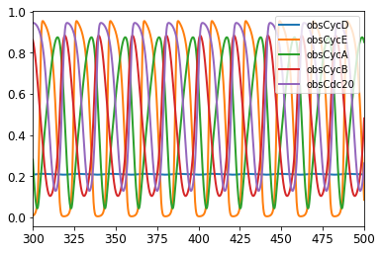
Initial Params
PSO 1
PSO 2
PSO 3
Low Stiff.
+ERL
High Stiff.
-ERL

Slide 12





0 µm cycDi
0.2 µm cycDi
0.4 µm cycDi
1 µm cycDi
DIP Rate
[cycDi]

Slide 13




0 µm E2Fi
0.2 µm E2Fi
0.4 µm E2Fi
1 µm E2Fi
DIP Rate
[E2Fi]

Slide 14





18: cycD + Rb -> pRb
17: cycD + Rb -> pRb
16: cycD + Rb -> pRb
13: cycD + Rb -> pRb

Slide 15






BAX
BAXm
BH3
High Stiffness
+ERL
Low Stiffness
+ERL

Slide 16






BCL2
BAXmBCL2
BH3BCL2
High Stiffness
+ERL
Low Stiffness
+ERL

Slide 17






AKT: 0.4, ERK: 0.2, FAK: 0.4
AKT: 0.6, ERK: 0.2, FAK: 0.6
Stress: 0.56
Stress: 0.6
Stress: 0.7

Slide 18


Proportion of dead cells after 120 hours
Average time to death
Proportion of dead cells after 120 hours
Stress
Stress
Stress

Slide 19



Slide 20



Lyapunov Exponent
Stiffness Parameter

Slide 21
CycDi
E2Fi
DIP
[Inhibitor]

Slide 22


Orig
CycDi

Slide 23



Orig
CycDi
CycBi

