Slide 1

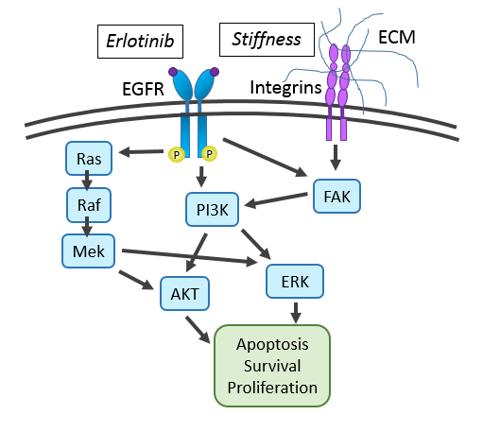
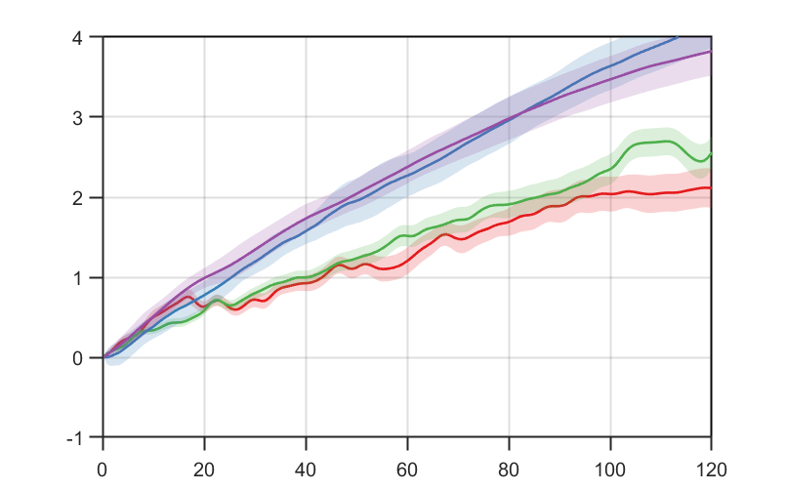
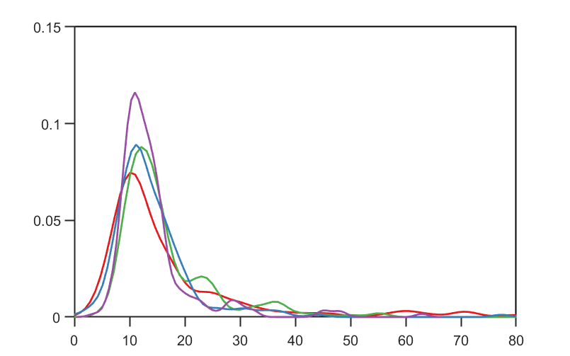

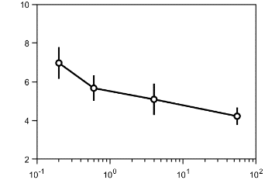
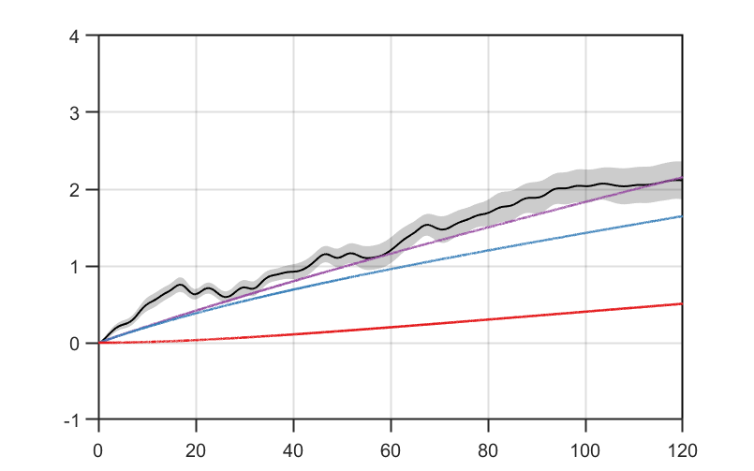
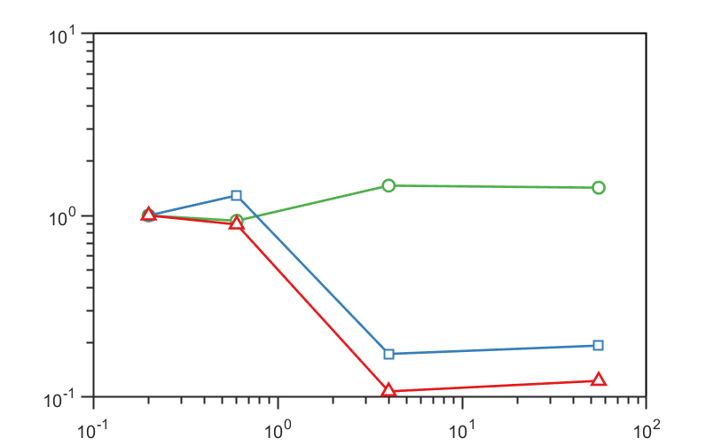
A molecular model of cell fate decision captures stiffness dependent resistance in non-small cell lung cancer
a.
Measured
Molecular Model
Predicted
Rates
Division
Quiescence
Apoptosis
Rates
Δ Proliferation
Δ Quiescence
Δ Apoptosis
b.
c.
55 kPa
4 kPa
0.6 kPa
0.2 kPa
τ fit
Population Doublings
Probability
Stiffness (kPa)
Time (h)
G1 time (h)
d.
Total Cell Pop.
0.2 kPa
e.
Division Rate
Mitotic Pop.
Quiescent Rate
Quiescent Pop.
Apoptosis Rate
Population Doublings
Fractional Change
Time (h)
Stiffness (kPa)

Slide 2
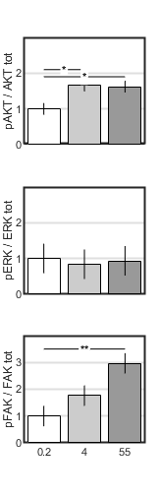












Stiffness
0.2 kPa
4 kPa
55 kPa
Erlotinib (1 μM)
-
+
-
+
-
+
pAKT
pERK
pFAK
cyclo b
Stiffness (kPa)

Slide 3
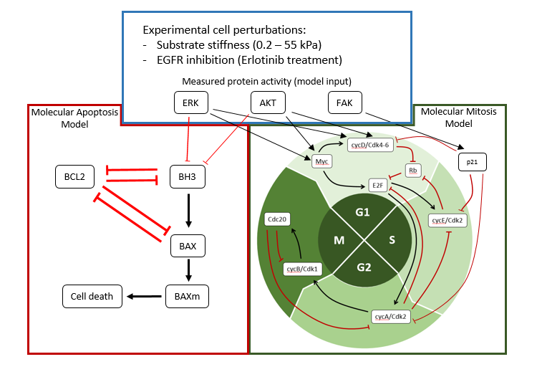
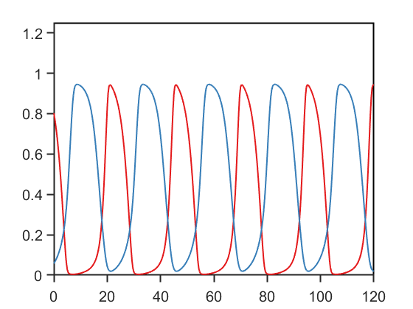
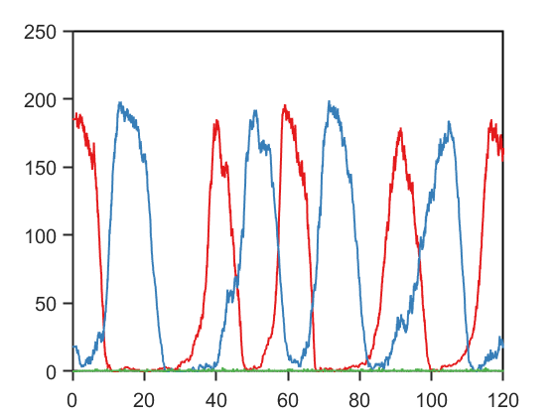
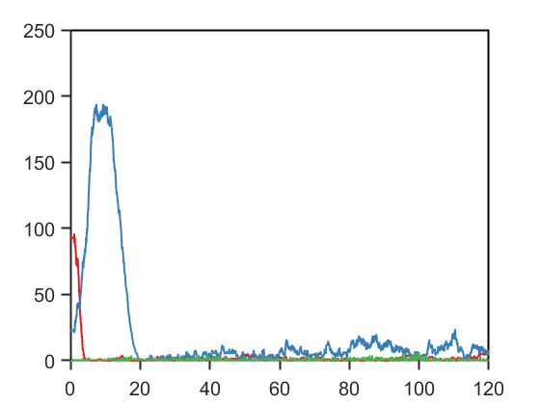
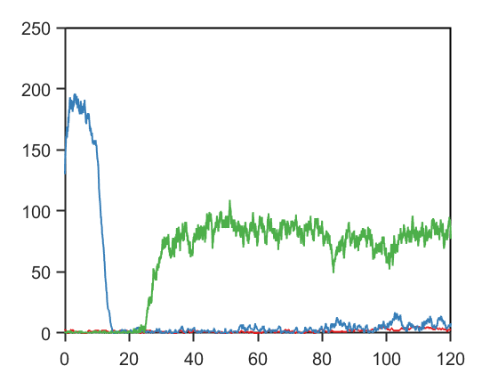
G1
S-G2-M
Concentration (μM)
Particle Number
Time (h)
Time (h)
Particle Number
Particle Number
Time (h)
Time (h)
Notes:
Combination in vitro / in silico

Slide 4
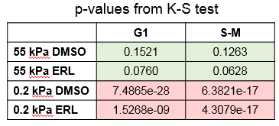
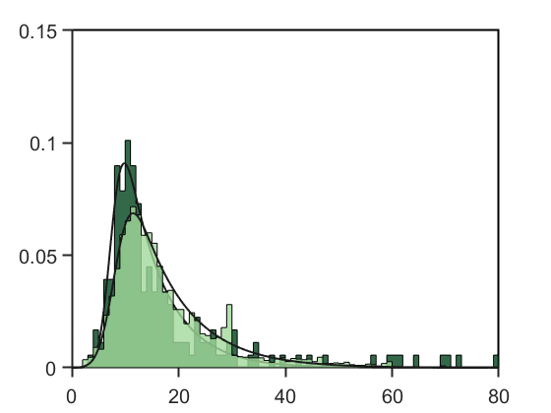

Slide 5
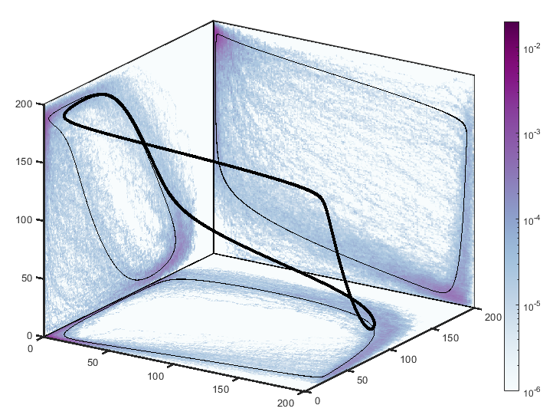
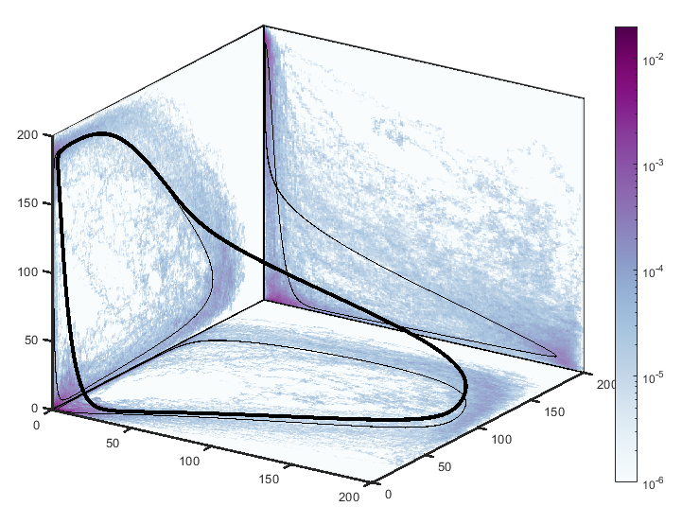
CycE
p21
Rb
E2F
Cdc20
Time (h)
Cdc20
Time (h)
CycE
CycA
CycE
CycA

Slide 6
Predicted division, death, and quiescence rates with population dynamics

