Slide 1
QuLearnLabs AI-SEQ
PQC Learning Module

Slide 2

What is Post-Quantum Cryptography (PQC)?
Definition and importance in modern security.
Post-quantum cryptography (PQC) is quantum resistant cryptography based on algorithms implemented in “classical” computers ( in the same way as RSA, DH, and ECDSA)
to be secure against attacks by both classical and quantum computers
It is different from quantum cryptography or quantum key distribution (QKD)
$8 Trillion is the total global cybercrime cost
$4.45 Million is the average cost of a single data breach worldwide

Slide 3
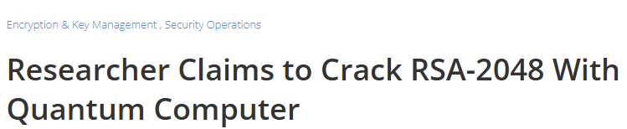

The Threat of Quantum Computing
Shor’s Algorithm and its impact on RSA/ECC
Shor’s algorithm, developed by Peter Shor in 1994 while at AT&T Bell Labs, is a quantum algorithm designed to factorize large integers and solve discrete logarithm problems efficiently because is exponentially faster than classical methods
“2048-bit RSA key → cracked in hours.”
Grover’s Algorithm and its effect on symmetric cryptography
In the world of cryptography, symmetric systems like AES (Advanced Encryption Standard) and hash functions like SHA-256 are the workhorses of data security, encrypting everything from bank transactions to medical records But the rise of quantum computing introduces a challenge: Grover’s algorithm.
Developed by Lov Grover in 1996, this quantum algorithm doesn’t break symmetric cryptography outright—like Shor’s does to RSA—but it weakens its strength, forcing us to rethink key sizes and future-proofing strategies because Grover’s algorithm finds a specific item in an unsorted list faster than any classical method → this “list” could be all possible keys for an encryption system

Slide 4
Why PQC Matters Now?
"Harvest Now, Decrypt Later" attacks.
HNDL refers to a strategy where attackers collect encrypted data today—using classical cryptography like RSA, ECC, or AES—knowing it’s secure against current classical computers.
They store this data, waiting for future quantum computers to crack it with algorithms like Shor’s or Grover’s.
The timeline for quantum computing advancements.
PQC replaces classical cryptography with algorithms resistant to quantum attacks, neutralizing the HNDL threat:
Quantum Resistance:
Algorithms like CRYSTALS-Kyber (key exchange) and CRYSTALS-Dilithium (signatures) use lattice-based problems—no known quantum algorithm (Shor’s or Grover’s) can solve them efficiently.
NIST’s standards (e.g., FIPS 203–205, finalized 2024) ensure PQC withstands future quantum computers.
Proactive Defense:
Encrypting with PQC today means data harvested in 2025 stays secure, even if quantum computers arrive in 2035.
Example: A Kyber-encrypted healthcare record from 2025 remains unreadable, unlike an RSA-encrypted one.

Slide 5
Difference Between QKD and PQC
Quantum Key Distribution (QKD) vs. cryptographic algorithms.
Aspect | Quantum Key Distribution (QKD) | Cryptographic Algorithms (Classical/PQC)
Basis | Physics (quantum mechanics) | Mathematics (computational hardness)
Quantum Resistance | Inherent—immune to Shor’s/Grover’s | Classical: Vulnerable; PQC: Resistant
Key Sharing | Secure via quantum channel | Via algorithms (e.g., RSA, Kyber)
Hardware | Quantum devices (e.g., photon sources) | Standard computers
Range | Limited (~100–1,000 km) | Unlimited (e.g., internet)
Use Case | High-security key exchange (e.g., banks) | General encryption (e.g., web, IoT)
Examples | BB84, E91 protocols | RSA, AES, Kyber, Dilithium
Adoption (2025) | Niche (e.g., government, research) | Widespread (classical); emerging (PQC)

Slide 6
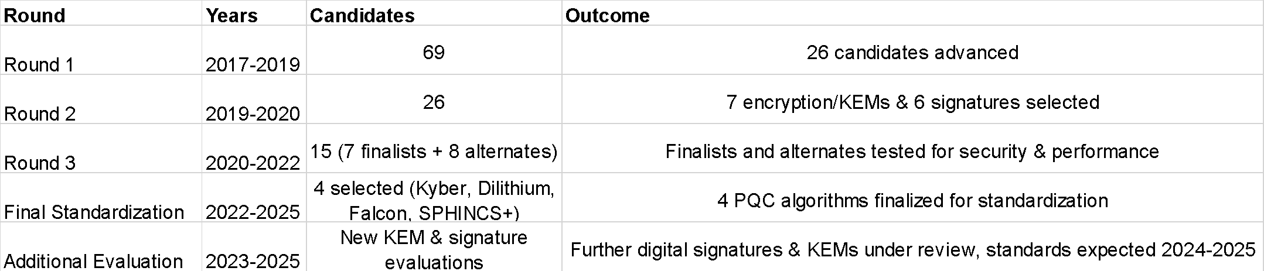

The NIST Standardization Process
Rounds of evaluation (2016-2025) from US National Institute of Standards and Technology (NIST)
🔹 Finalized Algorithms (July 5, 2022)
NIST selected the following 4 algorithms for standardization:
1️⃣ Public-Key Encryption / Key Exchange Mechanisms (KEMs)
✅ Kyber (Lattice-based) – Chosen for general encryption and key establishment.
2️⃣ Digital Signatures
✅ Dilithium (Lattice-based) – Chosen for high security & efficiency.
✅ Falcon (Lattice-based) – Alternative for more compact signatures.
✅ SPHINCS+ (Hash-based) – Alternative for conservative security need

Slide 7
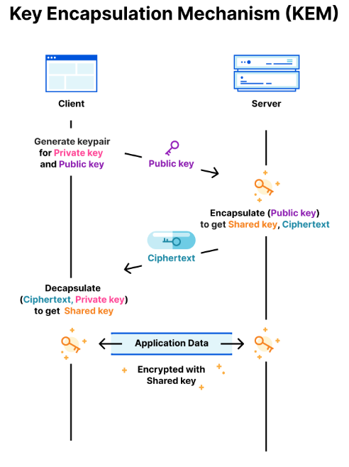
Key Categories of PQC Algorithms
Key Encapsulation Mechanisms (KEMs):
Based on the Learning With Errors (LWE) problem, which is consideredquantum-resistant because Shor’s algorithm cannot efficiently solve it.
Key Generation:
  A public-private key pair is generated using structured lattices.
  The public key is shared, while the private key is kept secret.
Encapsulation (Encryption):
  The sender generates a random secret value (session key).
  This session key is encrypted using the recipient’s public key.
  The encrypted key is sent to the recipient.
Decapsulation (Decryption):
  The recipient decrypts the key using their private key.
  Both parties now share the same session key, enabling secure encrypted communication.
✅ Quantum-Safe: Resistant to attacks by quantum computers.
✅ Efficient: Faster than RSA and ECC, even on resource-constrained devices.
✅ Scalable: Works well in modern network architectures.
✅ Compact Keys: Smaller than other post-quantum alternatives.

Slide 8
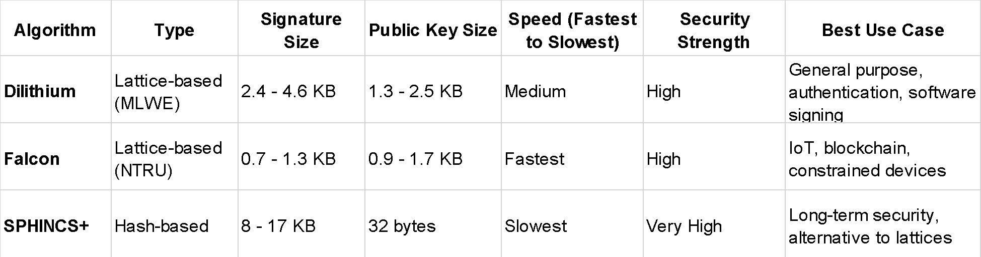
Key Categories of PQC Algorithms
Digital Signature Algorithms:
  CRYSTALS-Dilithium, Falcon, SPHINCS+: Features and security properties
Key Takeaways:
Falcon has the smallest signature size and is the fastest in performance, making it ideal for IoT and blockchain applications.
Dilithium is balanced between security and efficiency, making it the recommended choice for general use, including authentication and software signing.
SPHINCS+ is not lattice-based and offers a very high security level (due to its hash-based design) but has a larger signature size and is slower.

Slide 9






Real-World Applications of NIST-Approved Algorithms
Where and how these algorithms are being deployed
1. Secure Messaging Platforms
Signal: In 2023, Signal introduced Post-Quantum Extended Diffie-Hellman (PQXDH), incorporating CRYSTALS-Kyber for enhanced security against quantum attacks
Apple's iMessage: In February 2024, Apple announced plans to upgrade iMessage with a new PQC protocol called "PQ3," aiming to mitigate risks from future quantum computers and "harvest now, decrypt later" attack scenarios
2. Cloud Services and VPNs
Amazon Web Services (AWS): AWS integrated CRYSTALS-Kyber into their Key Management Service (KMS) in 2020, offering a hybrid post-quantum key exchange option for TLS connections
PureVPN: In April 2022, PureVPN partnered with Quantinuum to incorporate quantum-resistant encryption keys into their VPN services, enhancing security against future quantum threats
3. Hardware and IoT Devices
Honeywell: In 2023, Honeywell collaborated with Quantinuum to integrate quantum-hardened keys into smart utility meters, strengthening device security against cyberattacks
4. Financial Institutions
LGT Financial Services: Plans to implement NIST's PQC algorithms into their mobile applications by 2025 to safeguard against future quantum threats

Slide 10
Finance Sector
Financial institutions handle sensitive data and high-value transactions that must remain secure for decades, making them early movers in PQC implementation.
Recent real-world deployments in banking and payments include:
A) Central Banks (MAS & Banque de France) – In 2024, the Monetary Authority of Singapore (MAS) and Banque de France jointly trialed PQC safeguards for financial communications. The experiment used a plugin for Microsoft Outlook that combined classical and post-quantum algorithms to digitally sign and encrypt emails between the two institutions​
Specifically, they employed NIST’s lattice-based CRYSTALS-Dilithium (signature) and CRYSTALS-Kyber (encryption) algorithms, successfully exchanging quantum-safe signed email messages​
​
This real-world test highlighted practical considerations beyond just algorithms – the banks noted that updating underlying infrastructure (PKI, digital certificates, key exchange protocols) is also crucial for widespread PQC adoption​
Following the secure email trial, MAS and BdF announced plans to extend PQC to critical financial transactions, including cross-border payment networks, to ensure future payment security against quantum threats​
.

Slide 11
Finance Sector
B) Banco Sabadell (Commercial Banking) – Spain’s Banco Sabadell completed a four-month pilot integration of PQC into its banking infrastructure in late 2024. In collaboration with Accenture and QuSecure, the bank used QuSecure’s cryptographic orchestration software along with open-source PQC libraries to modernize its encryption systems without major hardware changes​
​
The pilot introduced quantum-resistant algorithms into a range of bank operations – from securing payment transactions to protecting sensitive customer data – all running in parallel with existing cryptography​
Sabadell’s CISO noted the project allowed the bank to assess the impact of adopting PQC technologies on its infrastructure, demonstrating that quantum-safe encryption can be implemented efficiently even in complex, large-scale financial IT environments​t
This pilot is seen as a blueprint for other banks, showing how encryption agility can future-proof financial data against quantum attacks​

Slide 12
Healthcare Sector
Healthcare organizations are beginning to implement PQC to safeguard medical records, clinical data, and device communications, which often need to remain confidential for the lifetime of a patient.
Given the high value of healthcare data and the “harvest now, decrypt later” threat, quantum-resistant encryption is becoming a critical imperative
Otio (Healthcare SaaS Data Security) – Otio, a digital healthcare software provider, is an early adopter of PQC to protect patient data. Anticipating quantum risks, Otio partnered with QuSecure to deploy “QuProtect,” a post-quantum cryptography solution, across its platform​
This implementation enabled Otio to secure data in transit between healthcare applications and cloud servers using PQC algorithms, without requiring any changes to the existing applications or workflow
In practice, QuProtect acts as a crypto-agile layer, seamlessly inserting lattice-based encryption and quantum-safe key exchanges into Otio’s data streams. The result is end-to-end quantum-resilient protection for sensitive health information (e.g. patient records, diagnostics data) as it flows through APIs and networks.
Otio’s successful rollout of quantum-resistant encryption has set a benchmark for healthcare data security, proving that complex health IT systems can be retrofitted with PQC in a non-disruptive way​
This proactive move not only secures their clients’ data against future decryption attempts, but also positions Otio as a leader in safeguarding healthcare PII in the quantum age​

Slide 13
Internet of Things (IoT)
The IoT ecosystem – from smart devices to 5G networks – faces unique challenges in adopting PQC due to device constraints and scale. Nevertheless, several pioneering projects have implemented PQC to safeguard IoT data and communications
A) SoftBank (Telecom/IoT Networks) – SoftBank Corp. in Japan partnered with SandboxAQ to pilot PQC in its telecommunications infrastructure. Engineers stress-tested various communication channels (web traffic, media streaming, etc.) using NIST’s new PQC algorithms to evaluate performance impact​
By comparing current elliptic-curve encryption against lattice-based quantum-resistant protocols (e.g. NIST-approved algorithms), SoftBank determined it could integrate PQC into existing mobile and IoT networks without sacrificing performance​
​
After months of testing (measuring latency, connection rates, CPU/memory use), the team proved their network could handle a migration to PQC, informing SoftBank’s strategy to protect billions of connected devices against future quantum attacks​
B) Telefónica & Halotech (Quantum-Encrypted IoT Devices) – In October 2024, Telefónica Tech and Halotech Digital Services introduced “TU Quantum Encryption,” an IoT connectivity solution with built-in PQC. The system was showcased using Halotech’s Halo smart safety devices (helmets and bracelets equipped with sensors and SOS alerts) which connect via low-power NB-IoT/LTE-M network
By integrating post-quantum encryption through Telefónica’s Kite IoT platform, the devices gained an extra layer of security to protect critical telemetry data (location, environmental sensor readings) against future quantum decryption attempts​
This quantum-ready communication ensures that even in safety-critical environments (mining, industrial, healthcare settings), IoT data can be transmitted securely over 5G/LPWAN with quantum-resistant protection​
​

Slide 14
Challenges in Adopting PQC in These Industries
Technical hurdles
IoT: Resource Constraints
Challenge: IoT devices (e.g., smart sensors, thermostats) are low-power, with limited memory and processing microcontrollers, RAM). PQC algorithms like Kyber use larger keys (1 KB) and signatures (2-4 KB for Dilithium) compared to RSA (~256 bytes), straining device capabilities.
Impact: Slow encryption, higher energy use, or incompatibility with existing protocols (e.g., MQTT, CoAP).
Example: A smart lock using AES-128 struggles to adopt Kyber without a hardware upgrade.
Healthcare: Integration with Legacy Systems
Challenge: Medical devices (e.g., pacemakers, EHR systems) and hospital networks often run outdated software (e.g., Windows XP) or proprietary protocols, incompatible with PQC’s larger key sizes and new libraries (e.g., OpenQuantumSafe).
Impact: Retrofitting is costly and risks disrupting patient care; hybrid approaches (classical + PQC) add complexity.
Example: An ECG monitor using ECC can’t switch to Dilithium without firmware updates, risking downtime.
Finance: Performance and Scalability
Challenge: Financial systems (e.g., HFT platforms, blockchain) demand high-speed transactions. PQC algorithms, while efficient (e.g., Kyber’s speed), are slower than RSA/ECC due to larger computations and key sizes, potentially delaying trades or increasing latency.
Impact: Balancing security with millisecond-level performance is tough; infrastructure upgrades (e.g., HSMs) are needed.
Example: A stock exchange using RSA for TLS handshakes faces slowdowns with Kyber, affecting trade volume.

Slide 15
Challenges in Adopting PQC in These Industries
Regulatory Hurdles
IoT: Evolving Standards and Compliance
Challenge: Regulations like the EU’s Cyber Resilience Act (CRA, 2024) mandate secure IoT lifecycles but don’t yet specify PQC, leaving manufacturers uncertain. NIST’s standards are U.S.-centric; global harmonization (e.g., ETSI, ITU) lags.
Impact: OEMs delay adoption, fearing non-compliance or redesign costs if rules shift.
Example: A smart meter maker hesitates on Kyber, awaiting CRA’s quantum-safe clarity.
Healthcare: Strict Data Protection Laws
Challenge: Laws like HIPAA (U.S.) and GDPR (EU) require long-term data protection but don’t mandate PQC yet. Transitioning risks temporary non-compliance if systems falter (e.g., during hybrid phases).
Impact: Hospitals prioritize current rules over future-proofing, slowing PQC uptake.
Example: A clinic using AES-256 delays Dilithium adoption, unsure if it meets GDPR’s “adequate protection” vague standard.
Finance: Rapid Regulatory Push
Challenge: Bodies like the Monetary Authority of Singapore (MAS) and EU’s DORA (2025) urge quantum readiness, but timelines are tight (e.g., NIST’s 2035 goal). PCI DSS v4.0.1 demands crypto inventories, yet PQC isn’t fully specified.
Impact: Banks face pressure to act fast, risking costly missteps without clear guidance.
Example: A credit card issuer scrambles to map RSA usage for PCI compliance, unsure how Kyber fits.

Slide 16
Real-World Applications Conclusion
Across IoT, finance, and healthcare, real-world implementations of post-quantum cryptography are accelerating.
These case studies highlight a common theme: crypto-agility and proactive upgrades are vital to stay ahead of quantum threats. Organizations are leveraging lattice-based schemes like Kyber for encryption and Dilithium for signatures, often in hybrid combinations with classical crypto, to fortify their systems. Technical trials – from IoT device networks to banking systems – show that PQC can be deployed with minimal performance trade-offs while significantly extending the security lifetime of data and communications.
Crucially, industry collaboration and standardization are emerging alongside these deployments. Initiatives such as updated EMV payment standards, telecom PQC guidelines, and sector-specific roadmaps (e.g. in finance via FS-ISAC and in healthcare via HHS guidance) are helping to align vendors and stakeholders on quantum-safe practices.
The advancements in securing data, transactions, and connections showcased here demonstrate that the transition to PQC is well underway. By learning from early adopters and case studies, organizations in all sectors can develop their PQC migration strategies now, ensuring that sensitive information remains protected against the coming quantum computing revolution​.

Slide 17



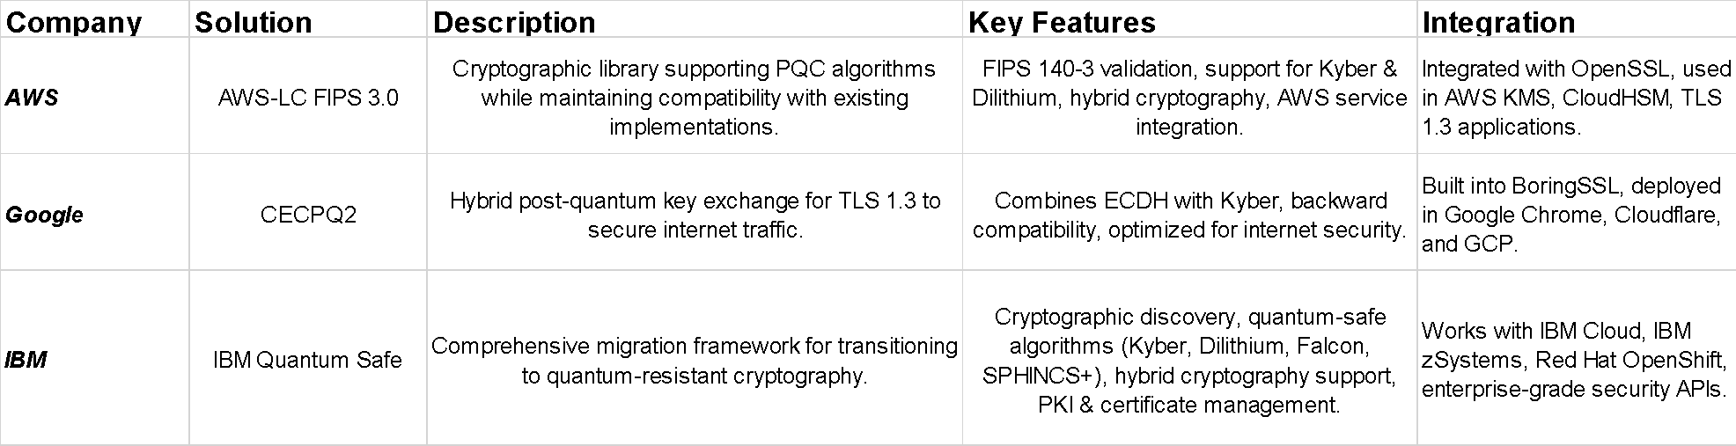
Overview of PQC Tools
Big Tech Providers

Slide 18
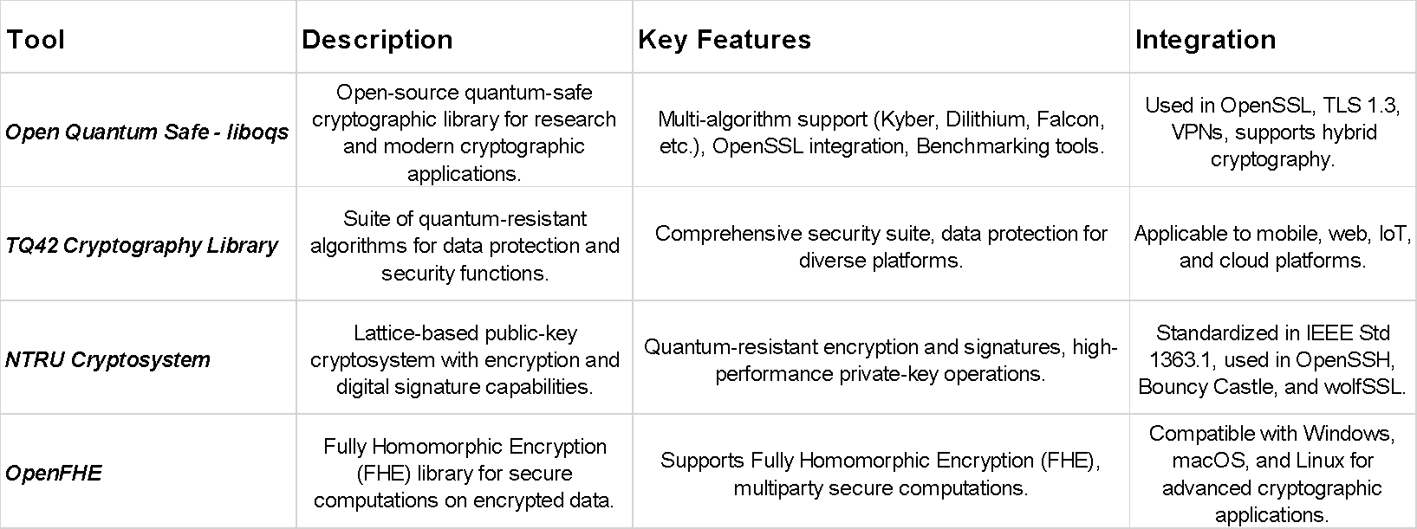
Overview of PQC Tools
Open Source

Slide 19
Hands-On Implementation Guide (Part 1)
How to integrate PQC in TLS 1.3
TLS 1.3 secures the web with ECDH and ECDSA—quantum-weak. PQC swaps these for Kyber (key exchange) and Dilithium (signatures), keeping AES-256 for data (upsized vs. Grover’s).
Hybrid setups (ECDH + Kyber) ease transition. Update OpenSSL, issue PQC certs, and test—e.g., a bank site stays quantum-safe.
Challenges: bigger keys (~1 KB) slow things; old clients balk. By March 2025, prototypes (e.g., OQS) lead the way.
1. Replace Key Exchange with PQC KEMs
Current: TLS 1.3 uses Diffie-Hellman (DH) or ECDH for key exchange—Alice and Bob share a secret over an insecure channel. Shor’s cracks these.
PQC Approach: Use a Key Encapsulation Mechanism (KEM) like CRYSTALS-Kyber (FIPS 203, ML-KEM):
Server sends a Kyber public key.
Client encapsulates a random secret with it, sending the ciphertext.
Server decapsulates using its private key, deriving the shared secret.
2. Update Digital Signatures with PQC Algorithms
Current: Certificates are signed with RSA, ECDSA, or EdDSA—Shor’s breaks these.
PQC Approach: Use CRYSTALS-Dilithium (FIPS 204, ML-DSA) or SPHINCS+ (FIPS 205, SLH-DSA):
Certificate authorities (CAs) issue X.509 certificates signed with Dilithium.
Server signs handshake messages (e.g., CertificateVerify) with its Dilithium private key.
Client verifies with the public key.
3. Keep Symmetric Encryption (with Adjustments)

Slide 20
Hands-On Implementation Guide (Part 2)
Using Kyber in hybrid key exchange
In a hybrid setup, Kyber pairs with a classical method (e.g., ECDH) to derive a single shared secret. Here’s the process:
1.Classical Key Exchange (ECDH):
Client and server each generate an ECDH key pair (e.g., X25519, ~32 bytes each).
They exchange public keys over the network.
Both compute a shared secret (e.g., SECDHS_{ECDH}S_{ECDH}, 32 bytes) using their private key and the other’s public key.
Vulnerable to Shor’s in the future.
2.PQC Key Exchange (Kyber):
Server generates a Kyber key pair (public key ~1 KB, private key ~2-3 KB).
Server sends its Kyber public key to the client.
Client generates a random secret (e.g., 32 bytes), encapsulates it with the Kyber public key, and sends the ciphertext (~1 KB) back.
Server decapsulates the ciphertext with its Kyber private key, recovering the secret (e.g., SKyberS_{Kyber}S_{Kyber}).
Quantum-resistant.
3.Combining Secrets:
Both parties combine SECDHS_{ECDH}S_{ECDH} and SKyberS_{Kyber}S_{Kyber} using a Key Derivation Function (KDF), like HKDF (HMAC-based KDF):
Input: SECDH∣∣SKyber∣∣contextS_{ECDH} || S_{Kyber} || contextS_{ECDH} || S_{Kyber} || context (concatenation with handshake metadata).
Output: A single shared secret (e.g., 32-byte session key).
Security: The final key is secure as long as at least one method (ECDH or Kyber) remains unbroken.

Slide 21
Implementing Dilithium in Digital Signing Processes
How it enhances authentication security.
CRYSTALS-Dilithium is a lattice-based digital signature scheme, standardized as ML-DSA in NIST’s FIPS 204 (2024).
It’s designed to be quantum-resistant, replacing classical signatures like RSA and ECDSA, which Shor’s algorithm can break. Dilithium ensures data authenticity and integrity—e.g., proving a message or software update comes from a trusted source.
Key Sizes:
Public Key: ~1.3–2.5 KB (depending on security level: Dilithium2, 3, or 5).
Private Key: ~2.5–4.8 KB.
Signature: ~2.4–4.6 KB.
Security: Based on the hardness of lattice problems (e.g., Short Integer Solution), immune to Shor’s.
How Dilithium Works as a Digital Signature
Digital signatures verify a message’s origin and integrity.
a)Key Generation:
A party (e.g., server) generates a Dilithium key pair:
Private key (secret, ~2.5–4.8 KB): Used to sign.
Public key (~1.3–2.5 KB): Shared to verify.
Done once, stored securely (e.g., in a Hardware Security Module, HSM).
B)Signing: The server hashes a message (e.g., “Update v1.0” → SHA-256 digest).
Using its Dilithium private key, it generates a signature (~2.4–4.6 KB) tied to the hash.
The signature and message (or hash) are sent to the client.
C) Verification: The client uses the server’s Dilithium public key to verify the signature against the message’s hash.
If valid, the message is authentic and unaltered; if not, it’s rejected.

Slide 22
Testing and Benchmarking PQC Implementations
Evaluating security and performance
​Recent studies have evaluated the security and performance of Post-Quantum Cryptography (PQC) implementations, providing valuable insights
1. Benchmarking PQC in TLS Protocols
A study assessed the integration of PQC algorithms into the Transport Layer Security (TLS) protocol, focusing on hybrid key exchanges combining classical and quantum-resistant methods. Key observations include:
Impact of Packet Loss: Packet loss rates above 3-5% significantly affect PQC algorithms that require fragmentation across multiple packets, particularly those based on unstructured lattices.
Latency Considerations: In real-world network conditions, the inherent latency often masks the computational delays introduced by PQC algorithms, suggesting that network factors play a crucial role in perceived performance.
2. Performance on Constrained Devices
The suitability of PQC algorithms for devices with limited resources, such as ARM Cortex-M4 microcontrollers, has been investigated. Findings indicate:
Algorithm Suitability: Certain PQC algorithms are more adaptable to constrained environments, with performance metrics varying based on the specific implementation and optimization techniques employed.
Benchmarking Frameworks: Tools like pqm4 have been utilized to benchmark these algorithms, providing standardized performance assessments on devices like the STM32L4R5ZI microcontroller.
3. Hardware Acceleration of PQC Algorithms
Research into hardware implementations of PQC algorithms, such as BIKE, has provided insights into:
Performance Metrics: State-of-the-art software and hardware implementations have been evaluated, highlighting the resource utilization and efficiency of PQC algorithms when deployed on hardware accelerators.
These findings underscore the importance of evaluating both security and performance when implementing PQC algorithms across various platforms and applications.

Slide 23
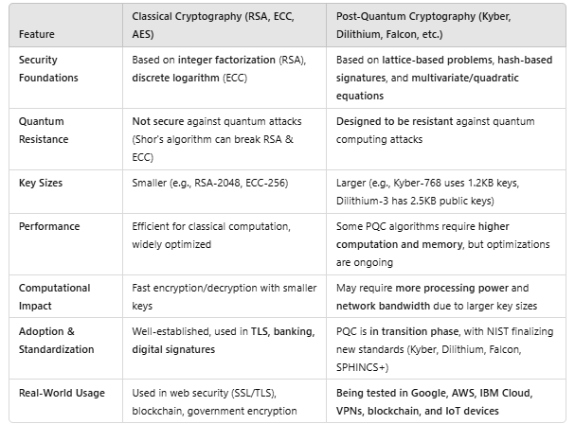
Key Differences Between Classical and PQC
Key Takeaways:
• Classical cryptography is efficient but vulnerable to future quantum computers.
• PQC offers long-term security, but performance optimizations are needed for real-world deployment.
• Hybrid approaches (combining classical & PQC) are being used for a smooth transition.

Slide 24
Hybrid Cryptography Approach
Why Use a Hybrid Cryptographic Approach?
✅ Quantum Resistance: Protects against quantum computers while maintaining classical security.
✅ Backward Compatibility: Ensures systems remain compatible with classical infrastructure.
✅ Gradual Transition: Allows organizations to migrate without immediately replacing classical cryptography
✅ Risk Mitigation: Avoids potential weaknesses in newly standardized PQC algorithms.
Some examples :
A) Hybrid TLS
Hybrid TLS (Transport Layer Security) integrates both Elliptic Curve Diffie-Hellman (ECDH) (classical key exchange) and Kyber (quantum-resistant key encapsulation mechanism - KEM) to secure encrypted connections.
-ECDH: Provides backward compatibility for existing systems.
-Kyber: Ensures security against future quantum attacks.
B) Real-World Use Cases
Google & Cloudflare: Deployed CECPQ2, a hybrid TLS using Kyber + ECDH for secure web browsing.
AWS: Integrated PQC-ready TLS for cloud security.
VPN Providers: Using hybrid cryptography to protect long-term secure communications.
C) Key Takeaways
Hybrid TLS (Kyber + ECDH) is the best approach for gradual migration to PQC
OpenSSL (OQS-OpenSSL) provides easy implementation of hybrid cryptographic mechanisms
Organizations should adopt hybrid models today to ensure long-term security.

Slide 25
Future-Proofing Cryptographic Infrastructures 1/2
1. Adopt Post-Quantum Cryptography (PQC)
What: Replace vulnerable algorithms with NIST-standardized PQC (e.g., CRYSTALS-Kyber for key exchange, Dilithium for signatures).
How: ▪ Integrate into TLS 1.3, VPNs, and SSH (e.g., Kyber in hybrid key exchange).
  ▪ Use libraries like OpenQuantumSafe (OQS) in software stacks.
Why: Lattice-based PQC resists Shor’s; protects against HNDL.
Example: A bank swaps RSA for Kyber, securing transactions to 2040.
2.Implement Hybrid Cryptography
What: Combine classical (e.g., ECDH) and PQC (e.g., Kyber) methods.
How: ▪ Dual key exchange: S_{ECDH} + S_{Kyber} via KDF (e.g., HKDF) into one session key.
▪ Dual signatures: ECDSA + Dilithium on certificates.
Why: Ensures compatibility with 2025 systems while adding quantum resistance; hedges against PQC flaws.
Example: An IoT device uses ECDH+Kyber, working with old and new clients.
3.Increase Symmetric Key and Hash Sizes
What: Use AES-256 (or higher) and SHA-512 instead of AES-128/SHA-256.
How: Update protocols and hardware to support larger keys (e.g., AES-256 in TLS 1.3).
Why: Grover’s halves strength (e.g., AES-256 → 128-bit), but 2^{128} steps remain impractical; future-proofs symmetric crypto.
Example: A healthcare database upsizes to AES-256, safe for 50 years.
4.Leverage Quantum Key Distribution (QKD)
  What: Share keys via quantum mechanics (e.g., BB84 protocol).
  How: Deploy QKD over fiber or satellite for ultra-secure key exchange, paired with AES.
  Why: Physics-based security, immune to computational attacks (quantum or classical).
  Limits: Niche use (e.g., banks, governments) due to hardware and range (~100–1,000 km).

Slide 26
Future-Proofing Cryptographic Infrastructures 2/2
5.Build Crypto-Agility
What: Design systems to swap algorithms easily.
How: ▪ Modular software (e.g., OpenSSL plugins for new algorithms).
▪ Regular audits and updates (e.g., NIST’s Round 4 PQC candidates).
Why: Adapts to new threats or standards (e.g., if Kyber’s broken, switch to BIKE).
Example: A smart city updates IoT crypto yearly without replacing devices.
6.Plan Migration Strategically
What: Gradual shift from classical to PQC.
How: ▪ Inventory current crypto (e.g., RSA in finance TLS).
▪ Test PQC in pilots (e.g., Dilithium in healthcare certs).
▪ Deploy hybrid, then full PQC (e.g., NIST’s 2035 goal).
Why: Minimizes disruption; meets regulations (e.g., EU’s DORA).
Example: A hospital phases in Kyber over 5 years.
Challenges
Technical: Larger PQC keys (e.g., Kyber ~1 KB vs. ECC 32 bytes) strain IoT; legacy systems resist change.
Regulatory: No global PQC mandate yet; compliance (e.g., HIPAA, GDPR) lags.
Adoption: Costs and inertia slow rollout (March 2025).
Status (March 2025)
• PQC: NIST standards (FIPS 203–205) are live; OQS, Cloudflare test Kyber/Dilithium.
• Quantum: IBM’s 433-qubit Osprey advances, but fault-tolerant systems are 5–20 years off.
• Future: Hybrid and crypto-agility lead; QKD grows in niche sectors.
Future-proofing stops HNDL breaches—e.g., a 2025 medical record decrypted in 2035—or financial chaos from cracked trades. It’s proactive security for a quantum world.

Slide 27
Regulatory & Compliance Frameworks
As quantum computing threatens classical cryptography (e.g., RSA, ECC via Shor’s algorithm), regulatory and compliance frameworks are evolving to address this shift. NIST’s PQC standards—FIPS 203 (ML-KEM/Kyber), FIPS 204 (ML-DSA/Dilithium), and FIPS 205 (SLH-DSA/SPHINCS+)—provide quantum-resistant algorithms finalized in August 2024.
These intersect with frameworks like GDPR, ISO/IEC 27001, and PCI-DSS, which govern data security across industries (e.g., finance, healthcare, IoT), though none explicitly mandate PQC yet as of March 2025.
NIST PQC Standards (FIPS 203, 204, 205)
Purpose:
o FIPS 203: Key encapsulation (Kyber) for secure key exchange.
o FIPS 204: Digital signatures (Dilithium) for authentication.
o FIPS 205: Alternative signatures (SPHINCS+) for long-term integrity.
• Compliance Role: U.S. federal agencies must adopt FIPS-approved crypto (per FISMA); private sectors use them for NIST-aligned standards (e.g., FIPS 140-3 validation).
• Status: Mandatory for U.S. government post-2024; voluntary elsewhere, but a benchmark for quantum readiness (e.g., TLS 1.3 updates).
• Relevance: Counters “Harvest Now, Decrypt Later” by ensuring future-proof encryption.
GDPR (General Data Protection Regulation)
Scope: EU regulation (2018) for data protection, applicable to any organization handling EU residents’ data.
ISO/IEC 27001
Scope: International standard (latest 2022) for Information Security Management Systems (ISMS), widely adopted across sectors.
PCI-DSS (Payment Card Industry Data Security Standard)
Scope: Standard (v4.0.1, 2024) for securing cardholder data in finance, enforced by payment brands (e.g., Visa).

