Slide 1
Interpretability of Deep Learning Algorithms of Chemistry
<number>

Slide 2
Interpretability - In mathematical logic, is a relation between formal theories that expresses the possibility of interpreting or translating one into the other.
<number>

Slide 3
Wave function approximations
Deep Neural Network
Interpretability?
Shot-by-shot “learning” of chemical systems
HF
DFT
CI
CC
Grand-scale learning of chemical systems
Can we interpret DNN as another
wave function approximation/method?
validating/invalidating
the DNN approach
<number>

Slide 4
Starting somewhere: What does SchNet Learn
SchNet provides accurate energy predictions
How does it learn about the connection between geometry ---> energy. (This is something that was thought to be perserved for solving wave function in B.O approximation)
4

Slide 5
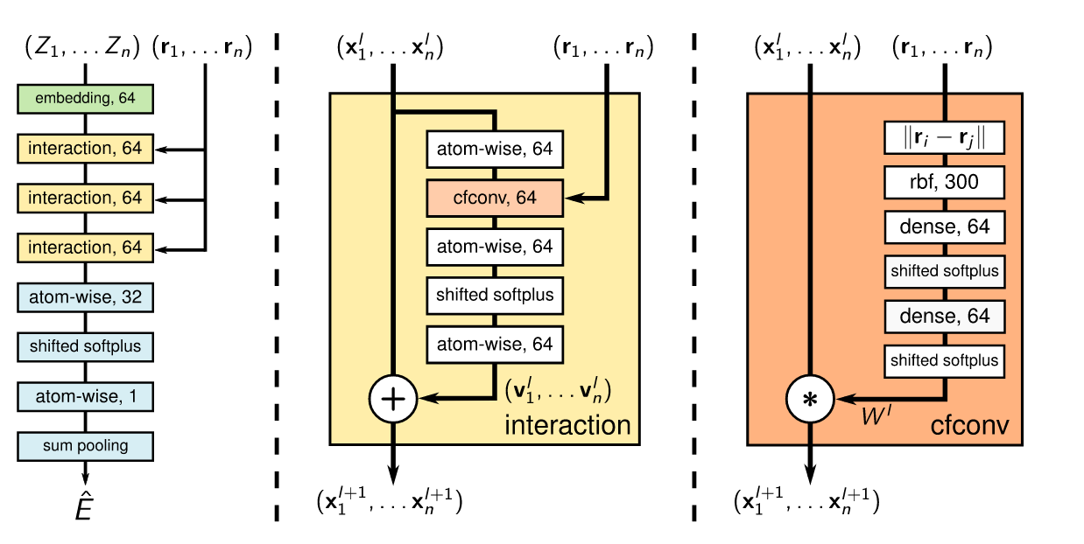
SchNet
4

Slide 6
A) PCA for dimensionality reduction
4

Slide 7
Procedure
Cut SchNet information at a particular layer
Run PC analysis
Sampled 10,000 molecules of QM9 database
7

Slide 8
A) PCA for dimensionality reduction
7

Slide 9
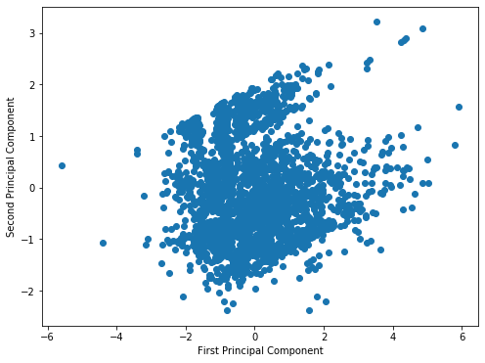
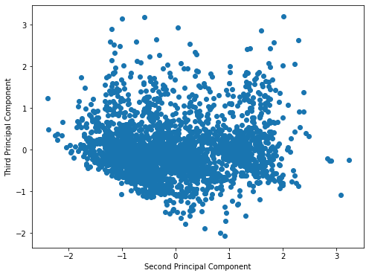
Average atomization energy of C, H, and O ONLY
Clustering, and division is between OH and CO for both graphs. Molecules with only OH groups on them is the smaller cluster, with the border being contaminated by CO and OH hybrid molecules.
7

Slide 10
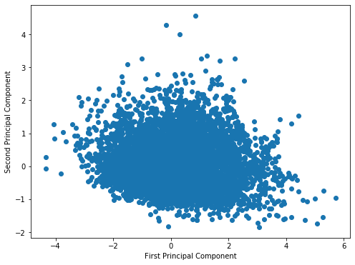
Average atomization energy of C, H (allowing other elements) illustrates just how crude
this method is for obvious reasons.
7

Slide 11
B) 1-atom PCA
Each atom in SchNet is represented by a vector as it passes through the network
“Cut” anywhere in the network and do PCA for a single defined element (like the first oxygen in each list)
11

Slide 12
A) PCA for dimensionality reduction
11

Slide 13

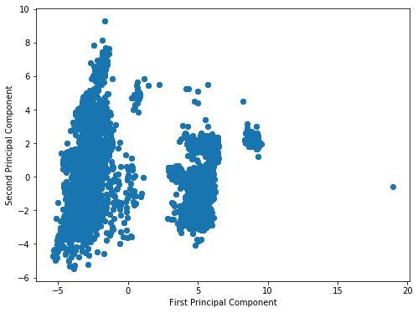
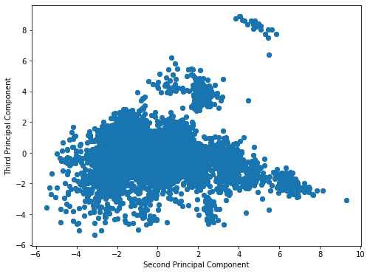
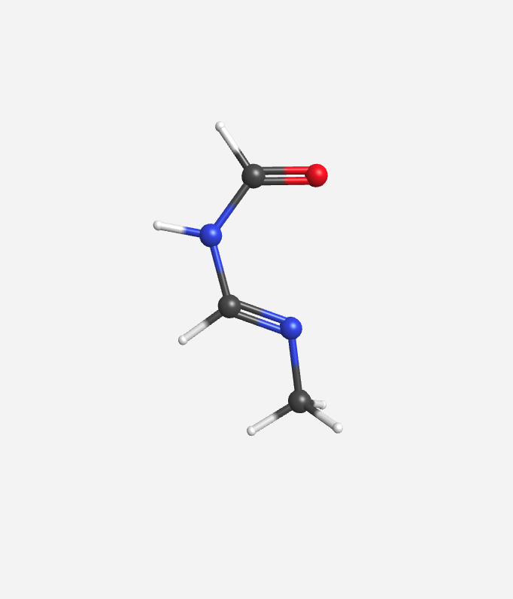
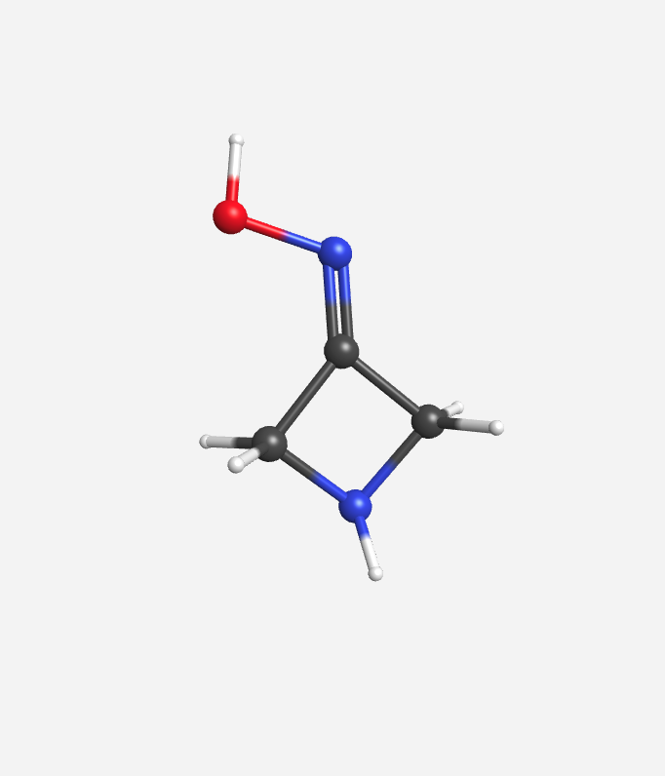
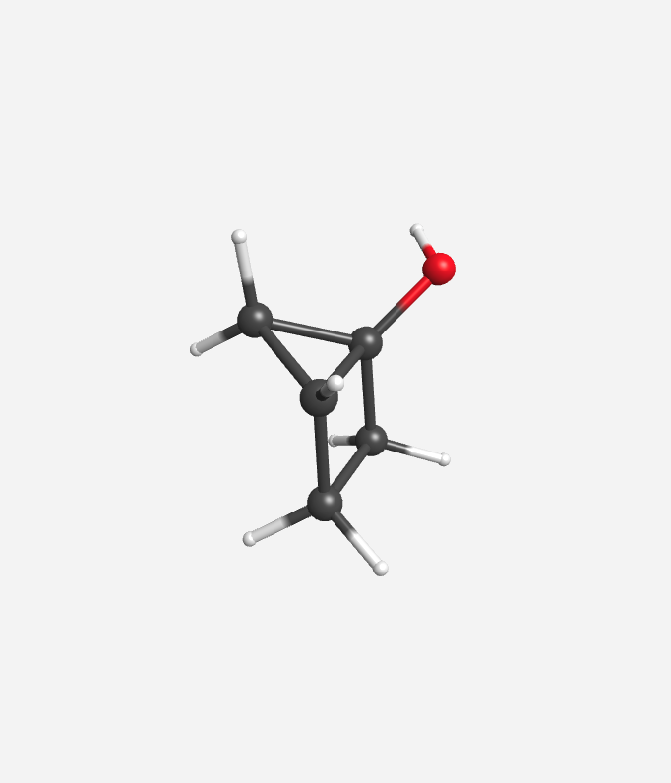
Atom = O
Layer = Embedding (30)
Clustering b/w
OC/OH/ON
Clustering b/w
OC/OH/ON
11

Slide 14
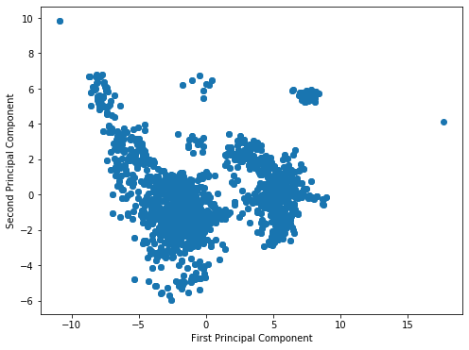
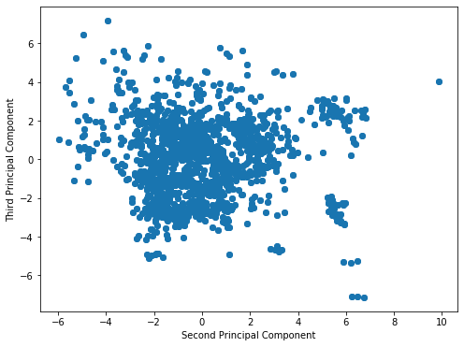
Atom = O
Layer = After 3 Interaction blocks (30)
Clustering b/w
(OC,OH)/ON
Lots of overlap b/w (OC,OH)
Clustering b/w
OC/OH/ON
11

Slide 15
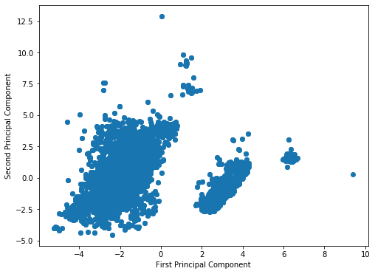
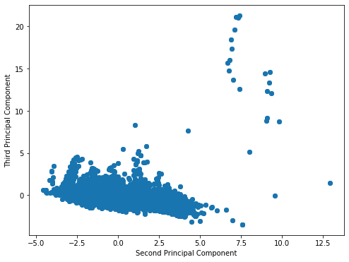
Atom = O
Layer = Softplus (15)
NOTEWORTHY THAT IT RECOGNIZES CHEMICAL BONDS NOT PROXIMITY
Same idea, more PCs, do not provide any new information
11

Slide 16
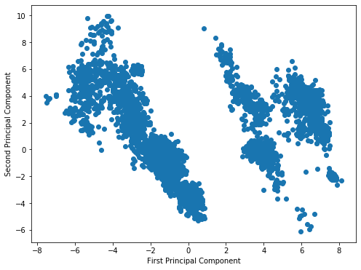
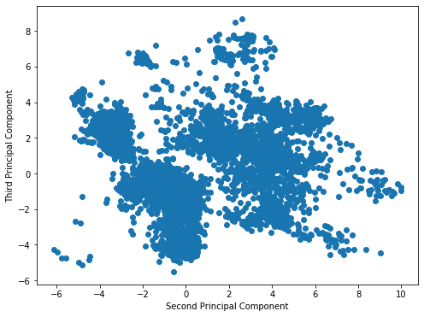
Atom = H
Layer = Embedding (30)
This second graph shows something interesting once you start labelling
11

Slide 17
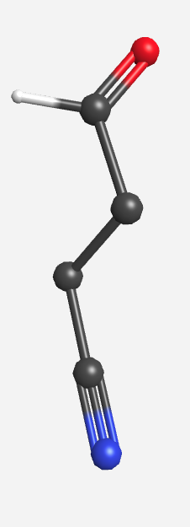
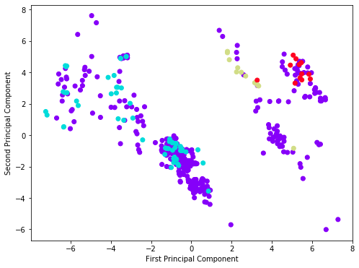
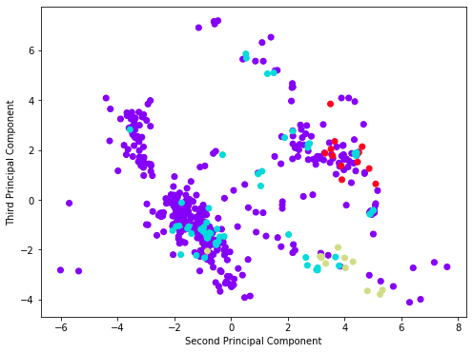
Atom = H
Layer = Embedding (30)
H-C
H-N
H-O
Interestingly, when it starts mixing the new structures are based on atoms further away than the first bond! This may be powerful for classification purposes.
11

Slide 18
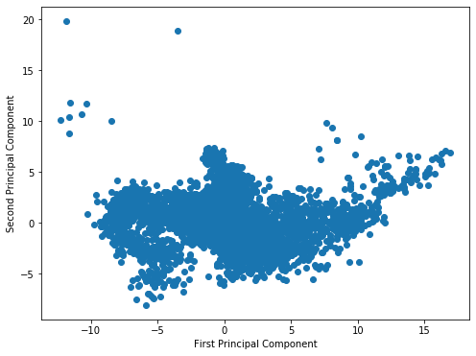
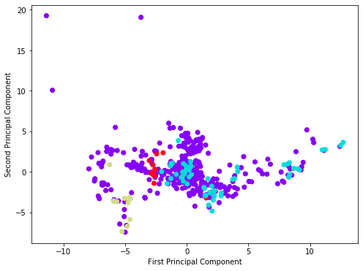
Atom = H
Layer = After 3 Interaction blocks (30)
H-C
H-N
H-O
<number>

Slide 19
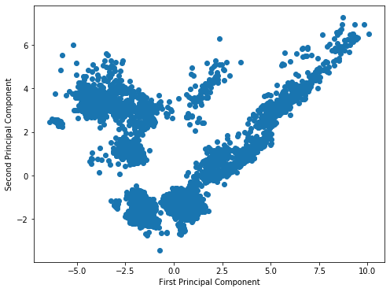
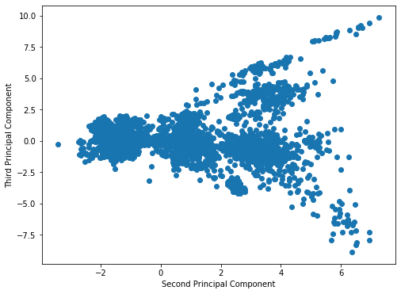
Atom = H
Layer = Softplus (15)
With the second graph giving the ability to look into further bonds. HAS TO BE CONFIRMED
<number>

Slide 20
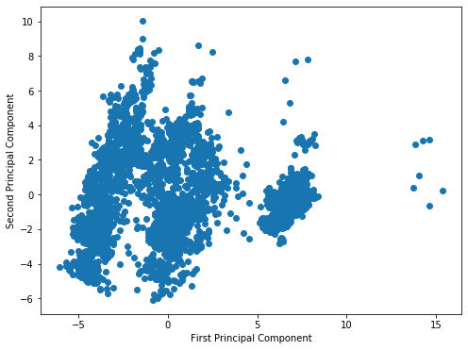
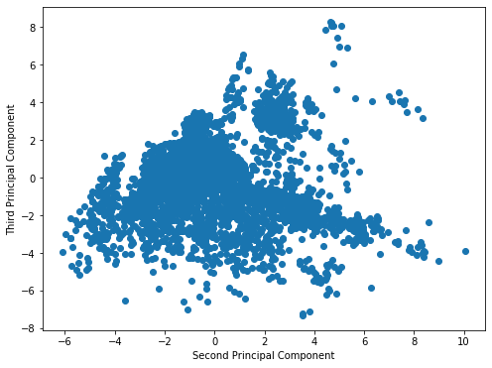
Atom = N
Layer = Embedding (30)
<number>

Slide 21
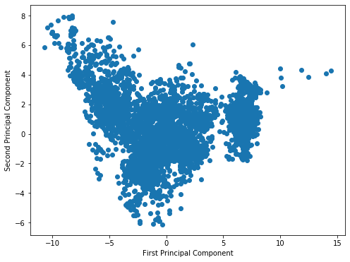
Atom = N
Layer = After 3 Interaction blocks (30)
<number>

Slide 22
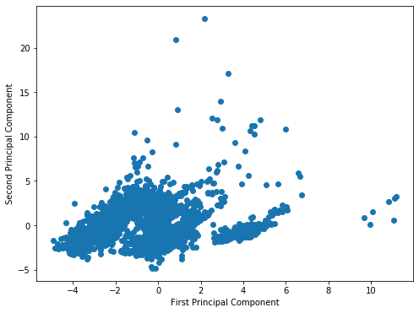
Atom = N
Layer = Softplus (15)
<number>

Slide 23
Atom = N
Layer = Softplus (15)
<number>

Slide 24
Conclusions
There is evidence of chemically informed decisions in SchNet. It may be able to recognize local bond neighborhood and thus the functional group.
All layers so far predict same categorization.
There needs to be an efficient method of labelling the functional groups. Ongoing project with Mai Hyung.
Main issue: How to introduce the whole molecule into an appropriate analysis? We tried to use CMEs but we concluded that would not work.
We are now looking into Laplacian Graphs and Fiedler Vectors
<number>

