Slide 1



NetSquid Coding Exercise
QCE23
SEPTEMBER 17, 2023
TUT04 — Hardware Architecture for Quantum Networks

Slide 2
NetSquid Exercises
The instructions and starter code for this tutorial are available at:
https://github.com/QuTech-Delft/qce23-hardware-architecture-for-quantum-networks

Slide 3
NetSquid Exercises
Clone the repository:
git clone https://github.com/QuTech-Delft/qce23-hardware-architecture-for-quantum-networks.git
Install the pre-requisites with:
python3 -m pip install --extra-index-url https://pypi.netsquid.org -r requirements.txt
Go into the `src` directory
cd src
Run exercise N (1, 2, or 3) with:
python3 hw-arch-tutorial.py N

Slide 4

NetSquid in 10 minutes
Visit https://docs.netsquid.org
Go to “NetSquid in 10 minutes” using the navigation menu on the left-hand side.
Complete the Quick Start to get a basic introduction to NetSquid concepts.

Slide 5
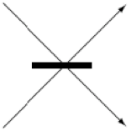
Detectors
Create two photons in the number state.
Inject photons into qin0 and qin1 of a Detector object.
Vary the visibility between 0 and 1 and observe the outcomes.
NetSquid does not model the photon waveform, so photon distinguishability is included via the visibility parameter.
At visibility 1, one of the detectors will always click twice – there will never be an event where both detectors click.
At visibility 0, half of the time both detectors will click, and the other half of the time only one detector will click twice.
For an explanation of the observed detection pattern, you can look up the Hong-Ou-Mandel effect on Wikipedia.
qin0
A
qin1
B

Slide 6
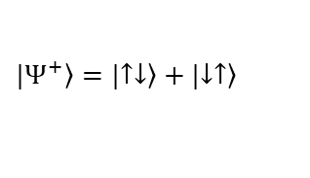
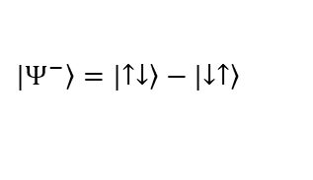
Heralded entanglement
$$|\left.Ψ^{+}\right\rangle =|\left.↑↓\right\rangle +|\left.↓↑\right\rangle$$
Use the provided spin_photon_generator to create spin qubits entangled with photons as explained in the lecture.
Set the visibility of the detector to 1.0.
Inject the photons and obtain the outcome.
Can you infer the resulting Bell state of the matter qubits from the detector outcome?
Can you verify the Bell state by measuring the matter qubits?
A
qin0
qin1
B
$$|\left.Ψ^{−}\right\rangle =|\left.↑↓\right\rangle −|\left.↓↑\right\rangle$$

Slide 7
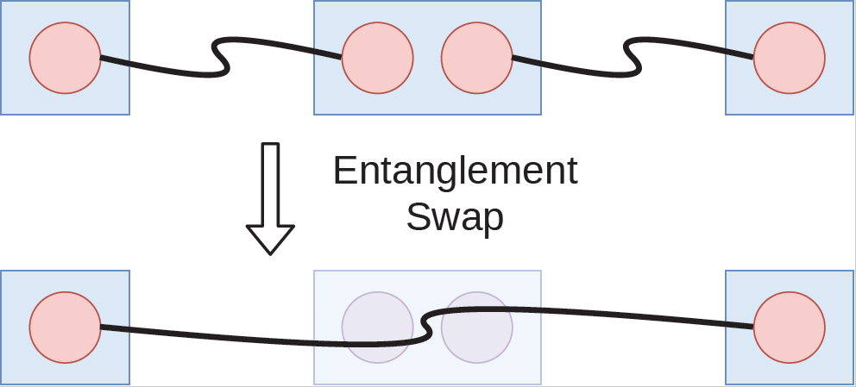
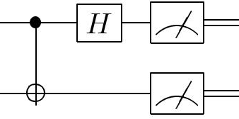
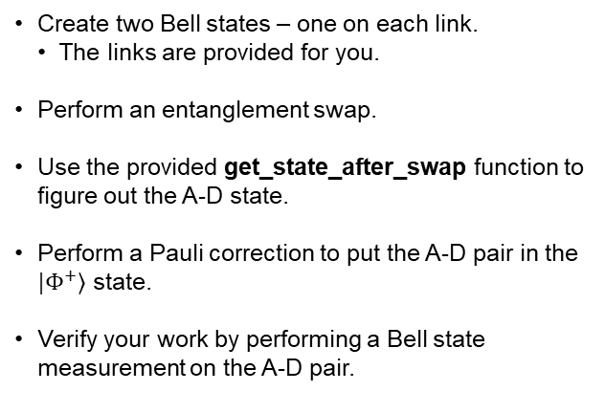
Entanglement swapping
Create two Bell states – one on each link.
The links are provided for you.
Perform an entanglement swap.
Use the provided get_state_after_swap function to figure out the A-D state.
Perform a Pauli correction to put the A-D pair in the $|\left.Φ^{+}\right\rangle$ state.
Verify your work by performing a Bell state measurement on the A-D pair.
A
B
C
D

