Slide 1
NetSquid Setup
TUT04 - Hardware architecture for Quantum Networks
IEEE Quantum Week 2023

Slide 2

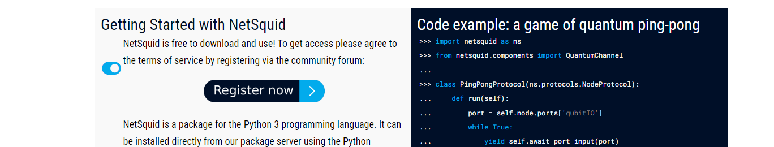
Browse to netsquid.org: click Register now

Slide 3
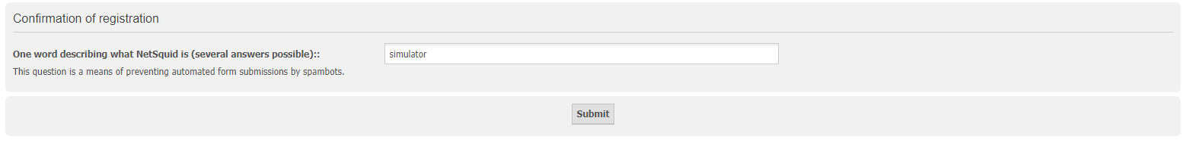
NetSquid Registration
Read the terms
Click 'I agree' if you do
Fill in your details and submit
Open your email (check spam) and verify your account

Slide 4
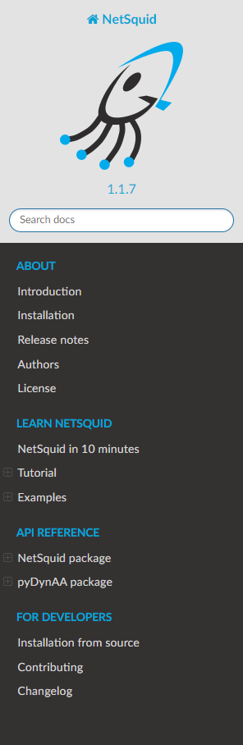
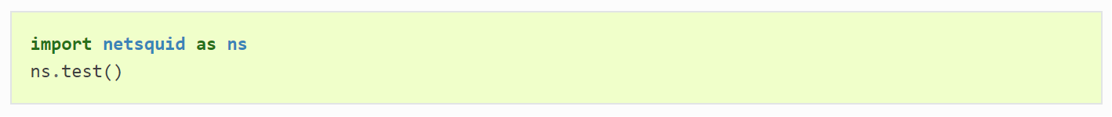
Installation
Go to https://docs.netsquid.org/latest-release/ and login with your credentials
Browse to the installation page.
For Windows, see next slide.
For Linux
Ensure you have python 3.10: “python --version"
Upgrade pip: “pip3 install --upgrade pip”
Install netsquid using your credentials
Verify your installation is working:
For Mac
Join your friend that has either Windows or Linux..

Slide 5
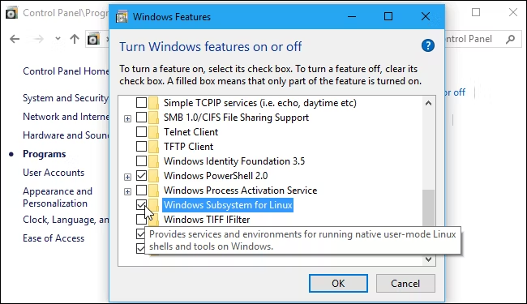
Installation for Windows
Configure WSL
Ensure you're using the 64-bit version of Windows.
Head to Control Panel > Programs > Turn Windows Features On Or Off.
Enable the "Windows Subsystem for Linux" option
Restart your computer
Open the Microsoft Store and search for "Linux" in the store.
To install a Linux distribution click the "Get" or "Install" button. If you're not sure which environment to install, choose Ubuntu.
Open Ubuntu, check the python version: “python –version”.
Install pip if needed: https://pip.pypa.io/en/stable/installation/
Install NetSquid through:
Verify your installation is working

