Slide 1


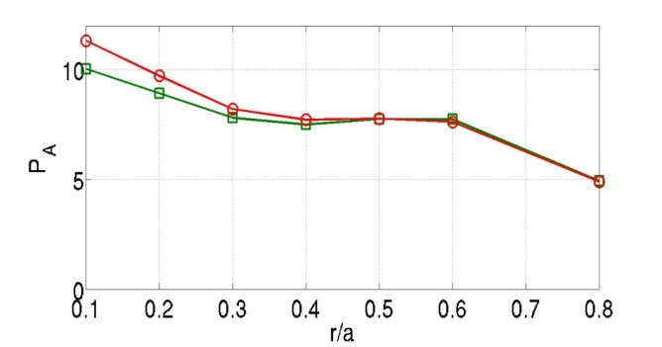
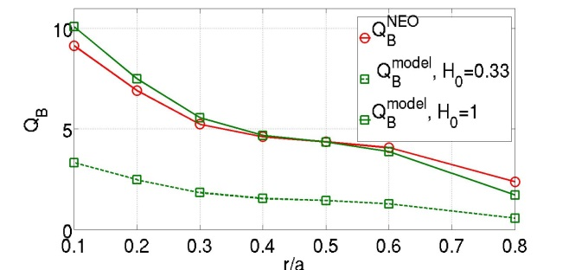
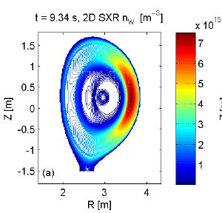
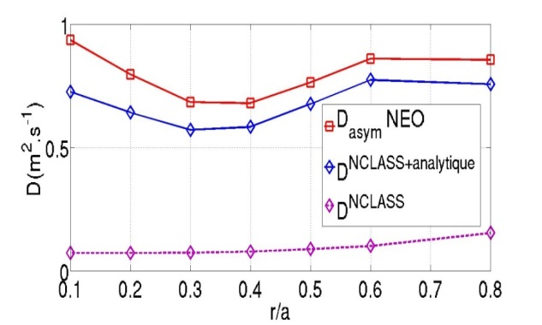
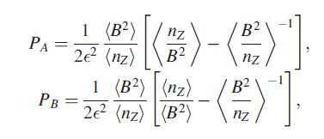
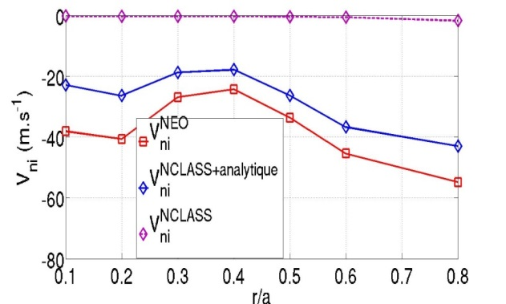
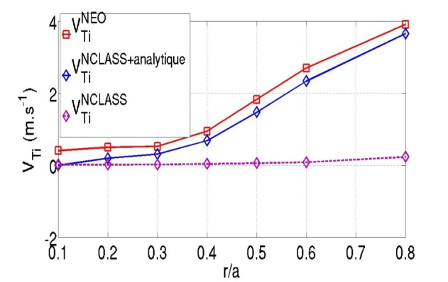
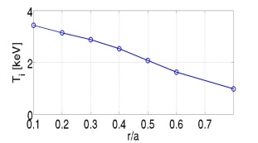
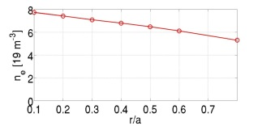
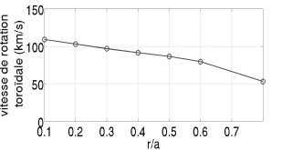
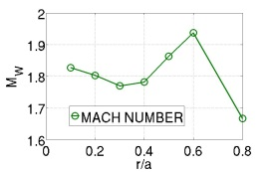
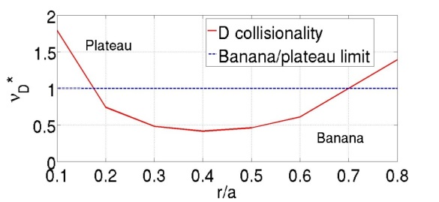
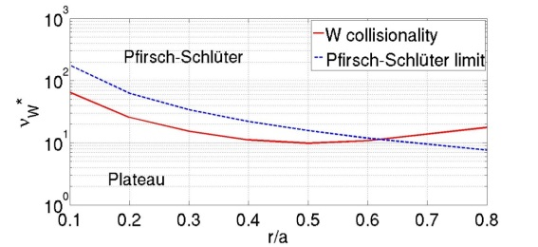





EFFICIENT PREDICTION OF
POLOIDAL ASYMMETRIES IMPACT ON
HEAVY IMPURITY NEOCLASSICAL TRANSPORT
S. Breton¹ , F.J. Casson², C. Bourdelle¹, C. Angioni³, E. Belli⁴, Y. Camenen⁵, J. Citrin^{6,1}, X. Garbet¹, Y. Sarazin¹, the JET contributors*
EUROfusion Consortium, JET, Culham Science Centre, Abingdon, OX14 3DB, UK
¹ CEA, IRFM, F-13108 Saint Paul-lez-Durance, France. - 2 CCFE, Culham Science Centre, Abingdon, Oxon, OX14 3DB, UK - 3 Max-Planck-Institut für Plasmaphysik, Garching, Germany - 4 General Atomics, PO Box 85608, San Diego, CA 92186-5608, USA - 5 Aix-Marseille Université, CNRS, PIIM UMR 7345, 13397 Marseille Cedex 20, France - 6 FOM Institute DIFFER: Dutch Institute for Fundamental Energy Research, PO Box 6336, 5600 HH Eindhoven, The Netherlands - *See the Appendix of F. Romanelli et al., Proceedings of the 25th IAEA Fusion Energy Conference 2014, Saint Petersburg, Russia
SUMMARY :
3. JET pulse : P_{A} Q_{B}
W heavy impurity : if accumulation, radiative losses → need to understand and control mechanisms of W accumulation
Hence to model the time evolution of W transport self-consistently with background profiles using the transport solver JETTO [4] with QuaLiKiz [1] for turbulent transport and NCLASS [2] or NEO [3] for neoclassical transport.
In RF heated and/or rotating plasmas, W poloidal asymmetries can increase by up a factor 10 the W neoclassical transport [5].
NEO accounts for poloidal asymmetries, but ~80 times slower than NCLASS →Instead of NEO, NCLASS + analytical formula to account for W poloidal asymmetries with less computation time ?
Limits of analytical formula of W neoclassical transport with poloidal asymmetries : W in Pfirsch-Schlüter, D in banana, W Mach number ~1
Realistic limits : W in Pfirsch-Schlüter or D in banana : enough.
Formula to be implemented in JETTO
13%
W Pfirsch-Schlüter or D banana : enough to get good agreement
At small r/a : D and W both plateau, out of the validity domain of the analytical formula, fails in reproducing NEO
H₀=0,33 not right : H₀~1
26%
Green : calculated analytically
Red : extracted from NEO
1. Analytical formula : neoclassical flux for W :
4. Reconstruction
With poloidal asymmetries [5] :
Emergence of purely geometric coefficients P_{A} and P_{B}
$$\left\langle Γ_{Z}\right\rangle =−D∇n_{Z}+Vn_{Z}$$
V$=V_{ni}+V_{Ti}$
H₀
Q_{B}
$$V_{ni}=DCN\frac{R}{Lni}$$
$${ΓPS}_{W}^{}=\frac{ZD_{c}}{R}\left[\left(\frac{1}{Z}\frac{R}{L_{nZ}}−\frac{R}{Lni}+\frac{1}{2}\frac{R}{LTi}\right)P_{A}−0,33f_{c}P_{B}\frac{R}{LTi}\right]$$
$$V_{Ti}=DCT\frac{R}{LTi}$$
Inputs
Calculated by NCLASS
Analytically calculated
Not always applicable : generalization
40%
Very important to account for poloidal asymmetries
Inward convection due to density peaking underestimated in core
Impact of such mismatch to be tested in JETTO predictive runs NEO vs NCLASS+analytical formula.
Formula valid with W in Pfirsch-Schlüter regime and D in banana regime, with W in the trace limit M_{W}≈O(1)
2. JET pulse : profiles and collisionalities
Pulse 85308, baseline. I_{P} =2.5MA and B=2.7T. NBI 19.1MW. Experimental profiles averaged over 10.35s-10.85s, plotted against NEO radial coord.
Red : NEO
Blue : NCLASS combined with analytical Pa and Pb
Purple : NCLASS only
References
[1] Bourdelle et al. Physics of Plasmas, 2007
[2] E. Belli and J. Candy, Plasma Physics and Controlled Fusion, 2008
[3] W. A. Houlberg, Physics of Plasmas, 1997
[4] G. Cenacchi and A. Taroni, JET Internal report, vol. JET-IR(88)03, 1988.
[5] C. Angioni et al. Physics of Plasmas, 2015.
No radial range where assumptions of the formula are matched

