Slide 1
A MOBILE APPLICATION FOR MANAGING THE TROTRO TRANSPORT SYSTEM IN GHANA

Slide 2
Introduction
In some developed cities in the Africa and the world as a whole, means of transportation includes small boats, taxis, buses and trains to commute people in the city.
In Ghana, the commonest means of transporting people in the urban space is the use of “Trotro". This is made up of minivan and buses which can accommodate between 9 and 21 passengers at a time.
The Trotro ply on most of the main roads of the city, stopping at various bus stops to either pick up passengers or drop off passengers who have arrived at their location. The passenger is therefore required to pay an amount as the cost for being transported from his location to his destination.
This has also being companied by its’ own associated problems.

Slide 3
Problem Definition
The following problems are identified with the Trotro system
Lack of adherence to standards for commercial cars per DVLA Standards
Passengers fight with drivers and the mates on cost of transporting them
Drivers picking up passengers at anywhere even when there is no bus stop
Drivers aborting trips per their discretions leaving passengers stranded.
Difficulties in getting Trotro at peak periods
Drivers and their mates fight over sales made. Same with the drivers and car owners

Slide 4
AIM
The aim of this project is to develop a mobile application that will help manage the front end between the passengers and Drivers and Trotro conductors.

Slide 5
OBJECTIVES
The objectives of the project is to
identifying Trotro on route and board them
request Trotro before it reaches its destinations.
use of a suitable payment mode for the Trotro
adhere to the Trotro standards set by the DVLA

Slide 6
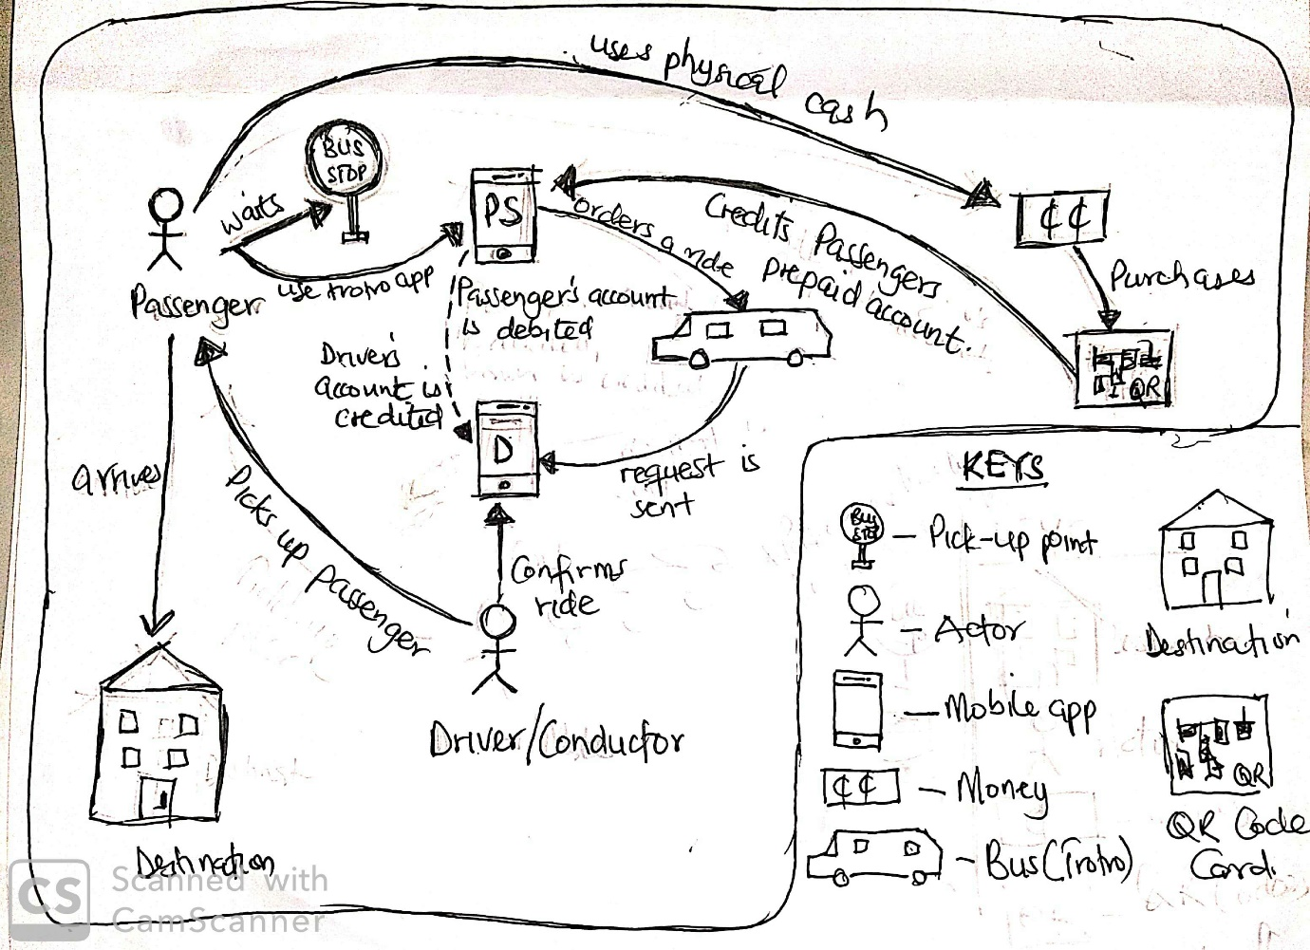
DESIGN AND IMPLEMENTATION
Rich Picture of the proposed system

Slide 7
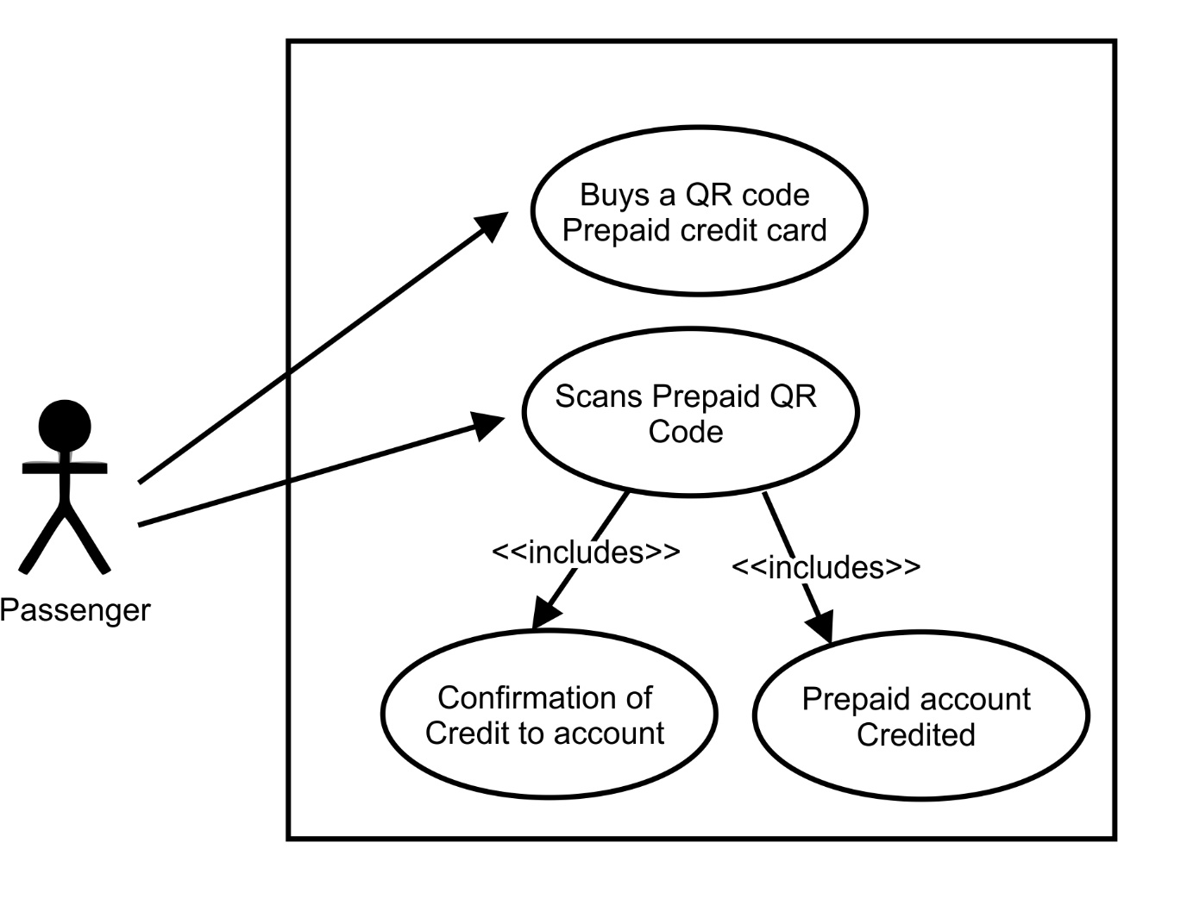
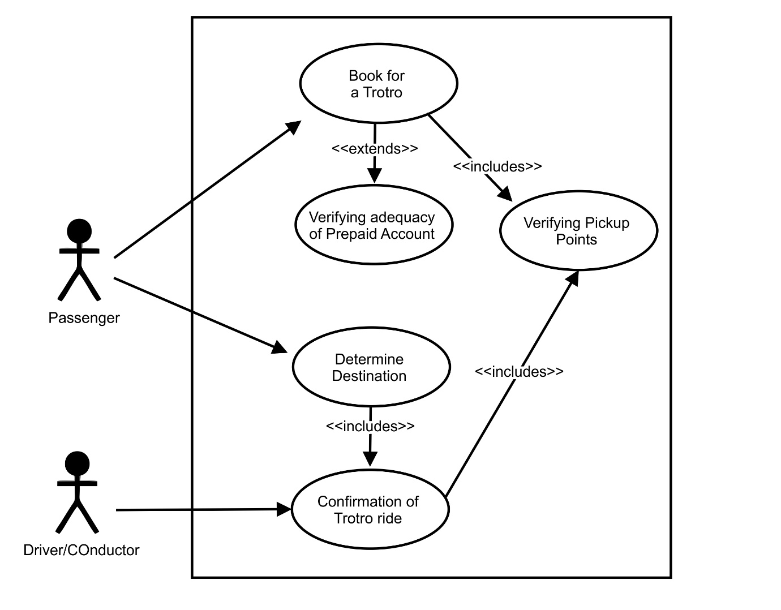
Use Case Diagram

Slide 8
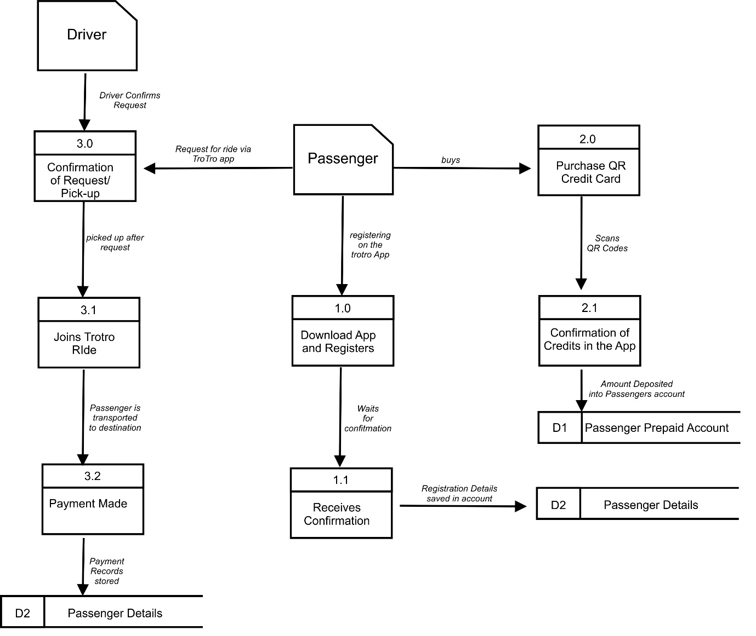
Data Flow Diagram

Slide 9
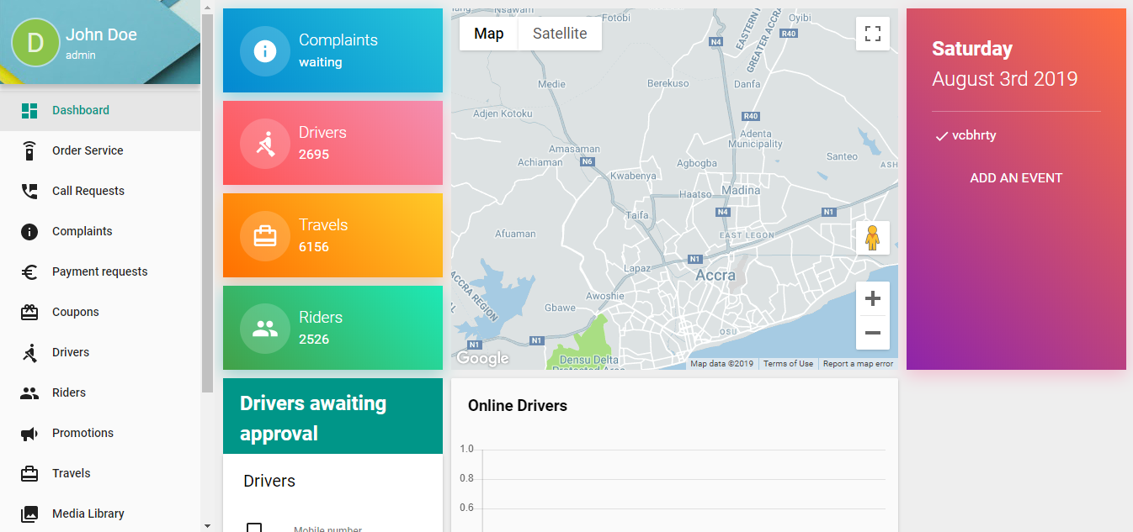
Screen-prints of Design

Slide 10
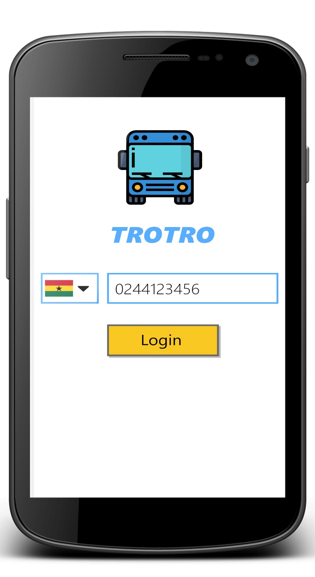
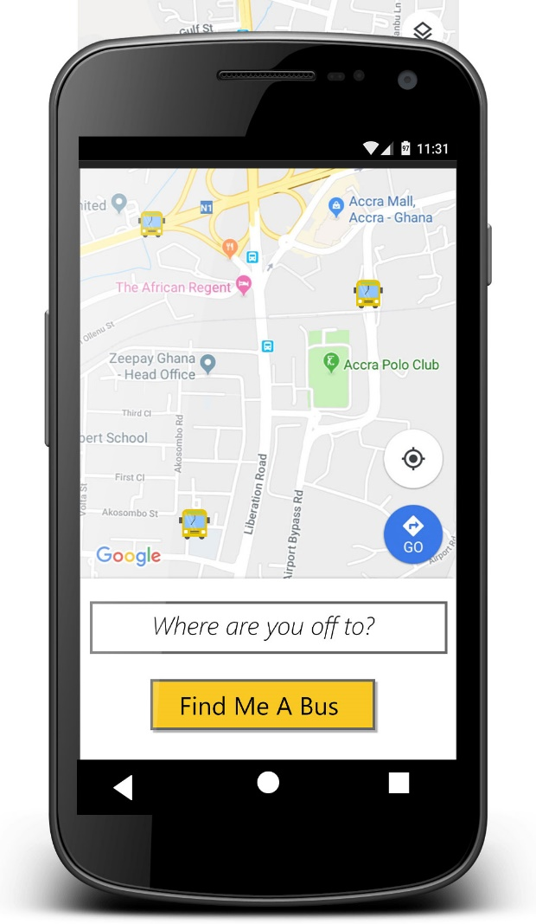

Slide 11
