Slide 1


EE3014 Assignment: Applications of Digital Signal Processing
Quach Tri Dung
6-April-2017

Slide 2
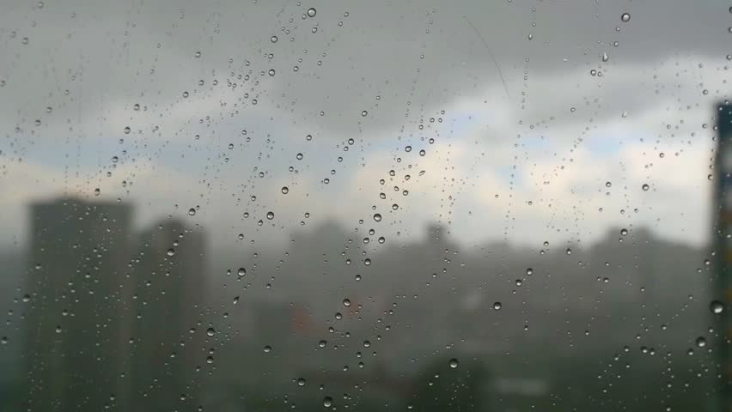
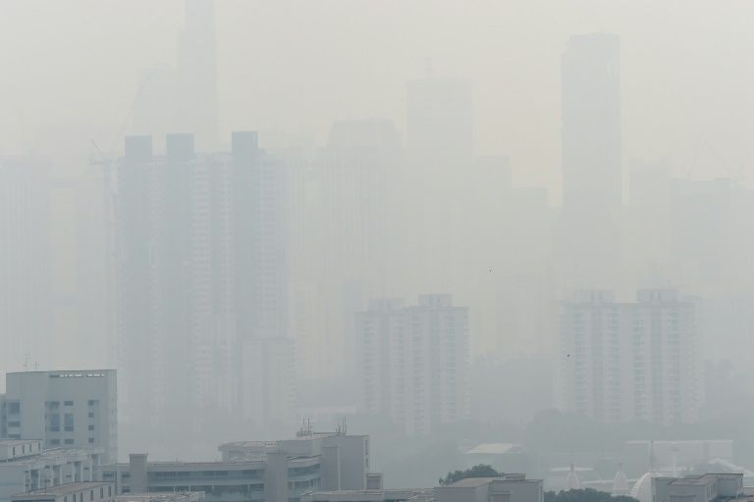
Non-invasive imaging through scattering layer
Problem:
->> See through it !!!

Slide 3
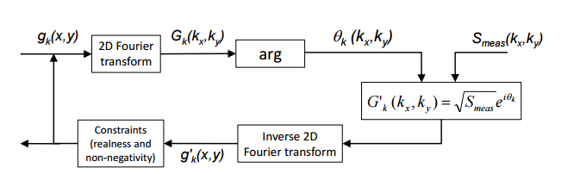


Phase Retrieval Algorithm
How?
Power Spectrum: Fourier transform amplitude of the image’s autocorrelation
They are from EE3014 bro
Wow! Those terms all sound familiar

Slide 4
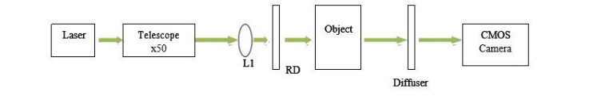

Experiment
In the laboratory:
Blurred Glass
Objects
In real life:

Slide 5
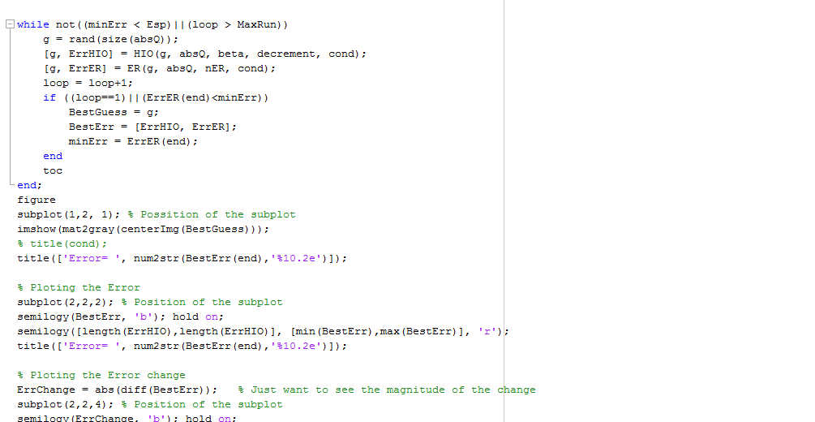
Implementation
Seems so complicated...
Only about 90 lines bro

Slide 6
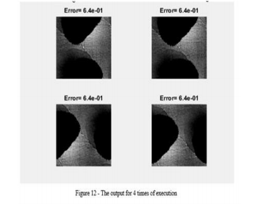
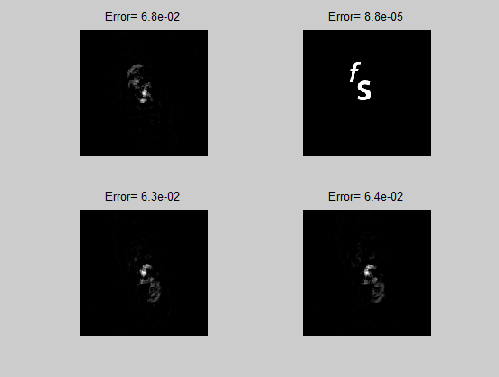
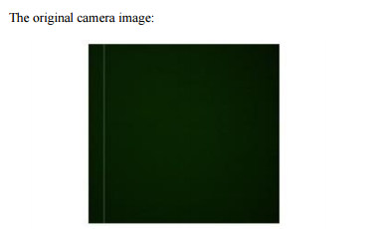

Results
Original Image
Output

Slide 7
References
THANK YOU FOR LISTENING!
Github: https://github.com/Quach2502/EE3014Presentation
Bertolotti, J.et al. Non-invasive imaging through opaque scattering layers. Nature 491, 232–234 (2012)
Ori Katz, Pierre Heidmann, Mathias Fink and Sylvain Gigan, “Non-invasive single-shot imaging through scattering layers and around corners via speckle correlation”, Nature Photon.8, 784-790 (2014)

