Slide 1


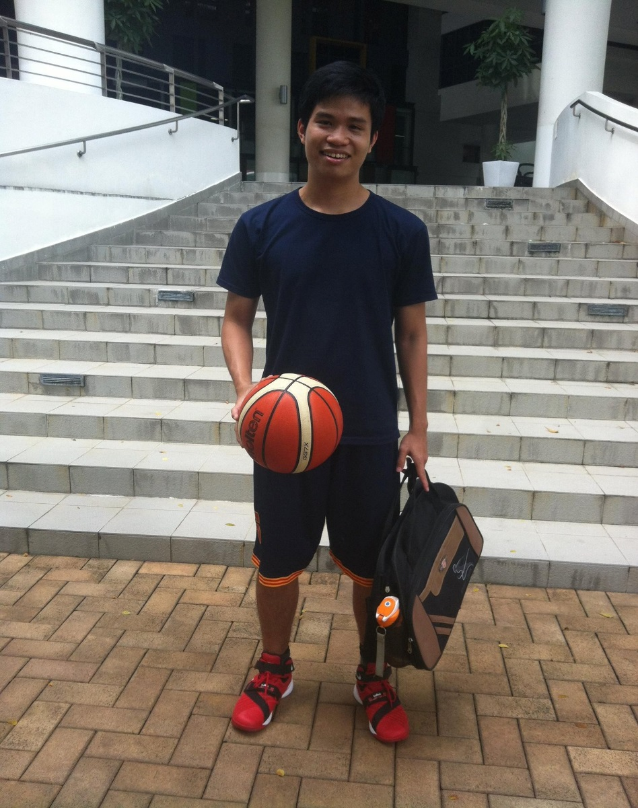






Quach Tri Dung ( Quach)
Nanyang Technological University (NTU)
Electrical and Electronic Engineering ( EEE)
July 2018
Software Automation Ops / Brown Team / Vault
Yogeshwar Gandhe

