Slide 1
Event name 2014
Title slide: main title can extend over one or two lines
Presenter Name
Presenter Title

Slide 2
Section/chapter title slide

Slide 3
Title and content slide (1 column)
First-level bullet style text is set in black, single spaced, Frutiger Next LT W1G 32pt. font.
Second-level bullet style text is set in black, single spaced, Frutiger Next LT W1G 25pt. font.
Third-level bullet style text is set in black, single spaced, Frutiger Next LT W1G 22pt. font.
Fourth-level bullet style text is set in black, single spaced, Frutiger Next LT W1G 19pt. font.
Fifth-level bullet style text is set in black, single spaced, Frutiger Next LT W1G 17pt. font.

Slide 4
Title and content slide (2 column)
First column text is set in black, single spaced, Frutiger Next LT W1G 32 pt. font.
Second column bullet-style text is set in black, single spaced, Frutiger Next LT W1G 22pt. font.
Duis aute irure dolor in reprehenderit in voluptate velit esse cillum dolore eu fugiat nulla pariatur.
Excepteur sint occaecat cupidatat non proident, sunt in culpa qui officia deserunt mollit anim id est laborum.

Slide 5
Keyword slide

Slide 6
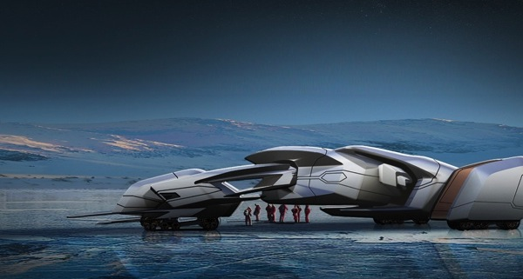

Title, text, and image slide
First column text is set in black, single spaced, Frutiger Next LT W1G 25pt. font.
Always be sure to include an image credit when applicable. The DAM is the source for this information. Image credit is available in the metadata of each image archived on the DAM.
Image courtesy of Michal Jelinek
Image courtesy of Jay Shuster

Slide 7
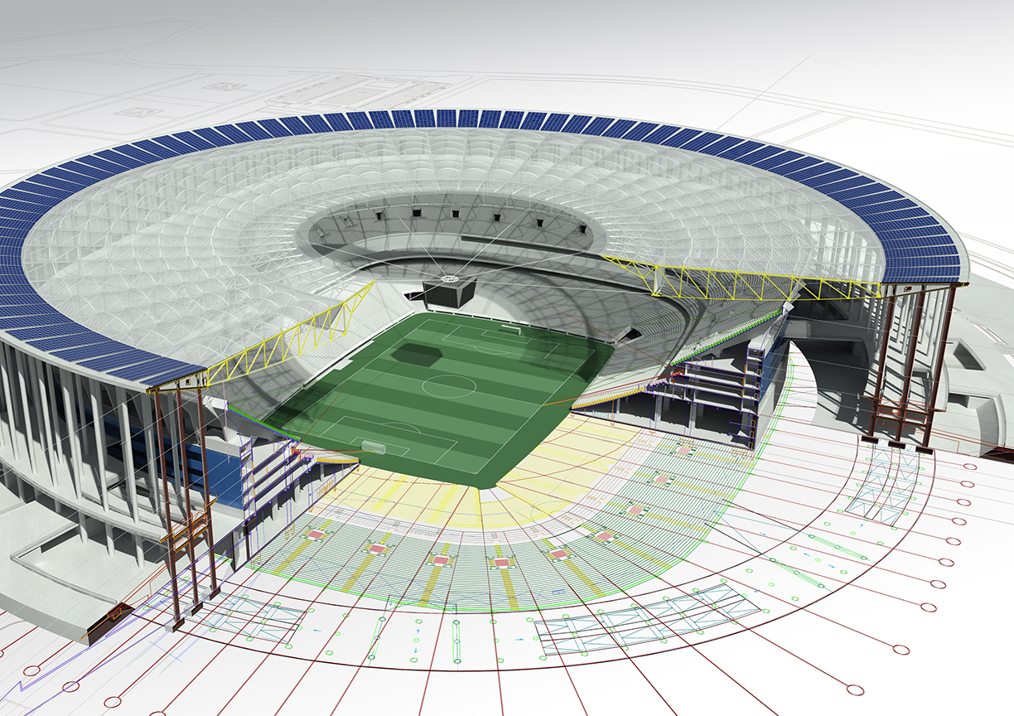
Instructional text box (remove in your presentation)
Slide showing full screen image (for placement only) with credit, 1,280 pixels by 720 pixels. To customize for your presentation, change background image and associated credit.
Image courtesy of Castro Mello Architects

Slide 8
Stacked column chart example

Slide 9
Stacked line chart example

Slide 10
Exploded pie chart example

Slide 11
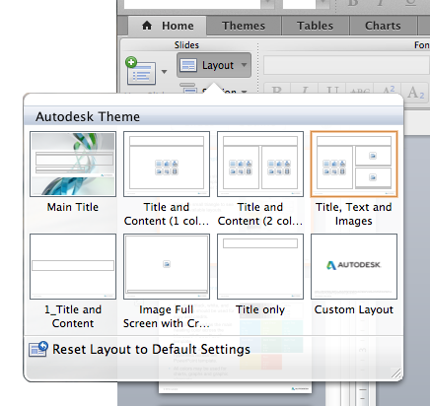
Slide layout templates
Access the built-in slide layouts for this template on the Home tab under Slides > Layout.
Click the small triangle to see all the available layouts.

Slide 12
Autodesk corporate colors
Autodesk black, white, and gray tones should be used for copy and credits.
Sky blue is used as the main heading color across the Microsoft® PowerPoint® template.
Dark teal is used for hyperlinks across the PowerPoint template.
All colors may be used for charts, graphs, and graphic elements.
Black
R 0
G 0
B 0
White
R 255
G 255
B 255
Sky Blue
R 6
G 150
B 215
Light Green
R 135
G 188
B 64
Light Teal
R 50
G 188
B 173
Dark Blue
R 24
G 88
B 168
Dark Green
R 0
G 94
B 48
Dark Teal
R 0
G 114
B 114
Yellow
R 255
G 204
B 0
Red
R 255
G 51
B 0

Slide 13
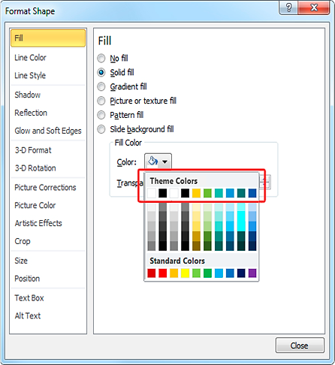
Autodesk theme colors
Access the custom built-in color-theme colors for this template by accessing the color modification tool.
Autodesk black, white, light blue, light green, light teal, dark blue, dark green, and dark teal are preset under Theme Colors.
The PowerPoint default gray tones can also be used within your layouts.

Slide 14
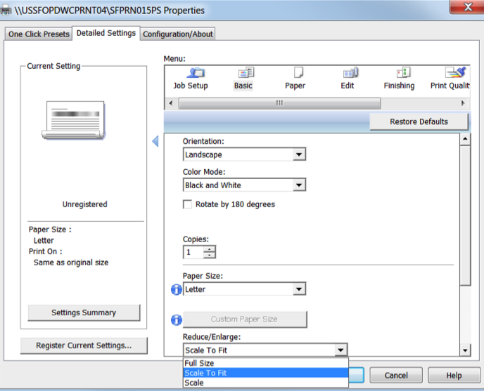
Printing
Remember to click the “Scale to fit paper” checkbox in the printing properties.
Grayscale is the preferred output setting for sustainability reasons.
Printing in color will retain the appearance of your slides.

Slide 15
Additional resources
Images and video content
DAM
Branding and editorial guidelines
Marketing Guidelines Site

