Slide 1
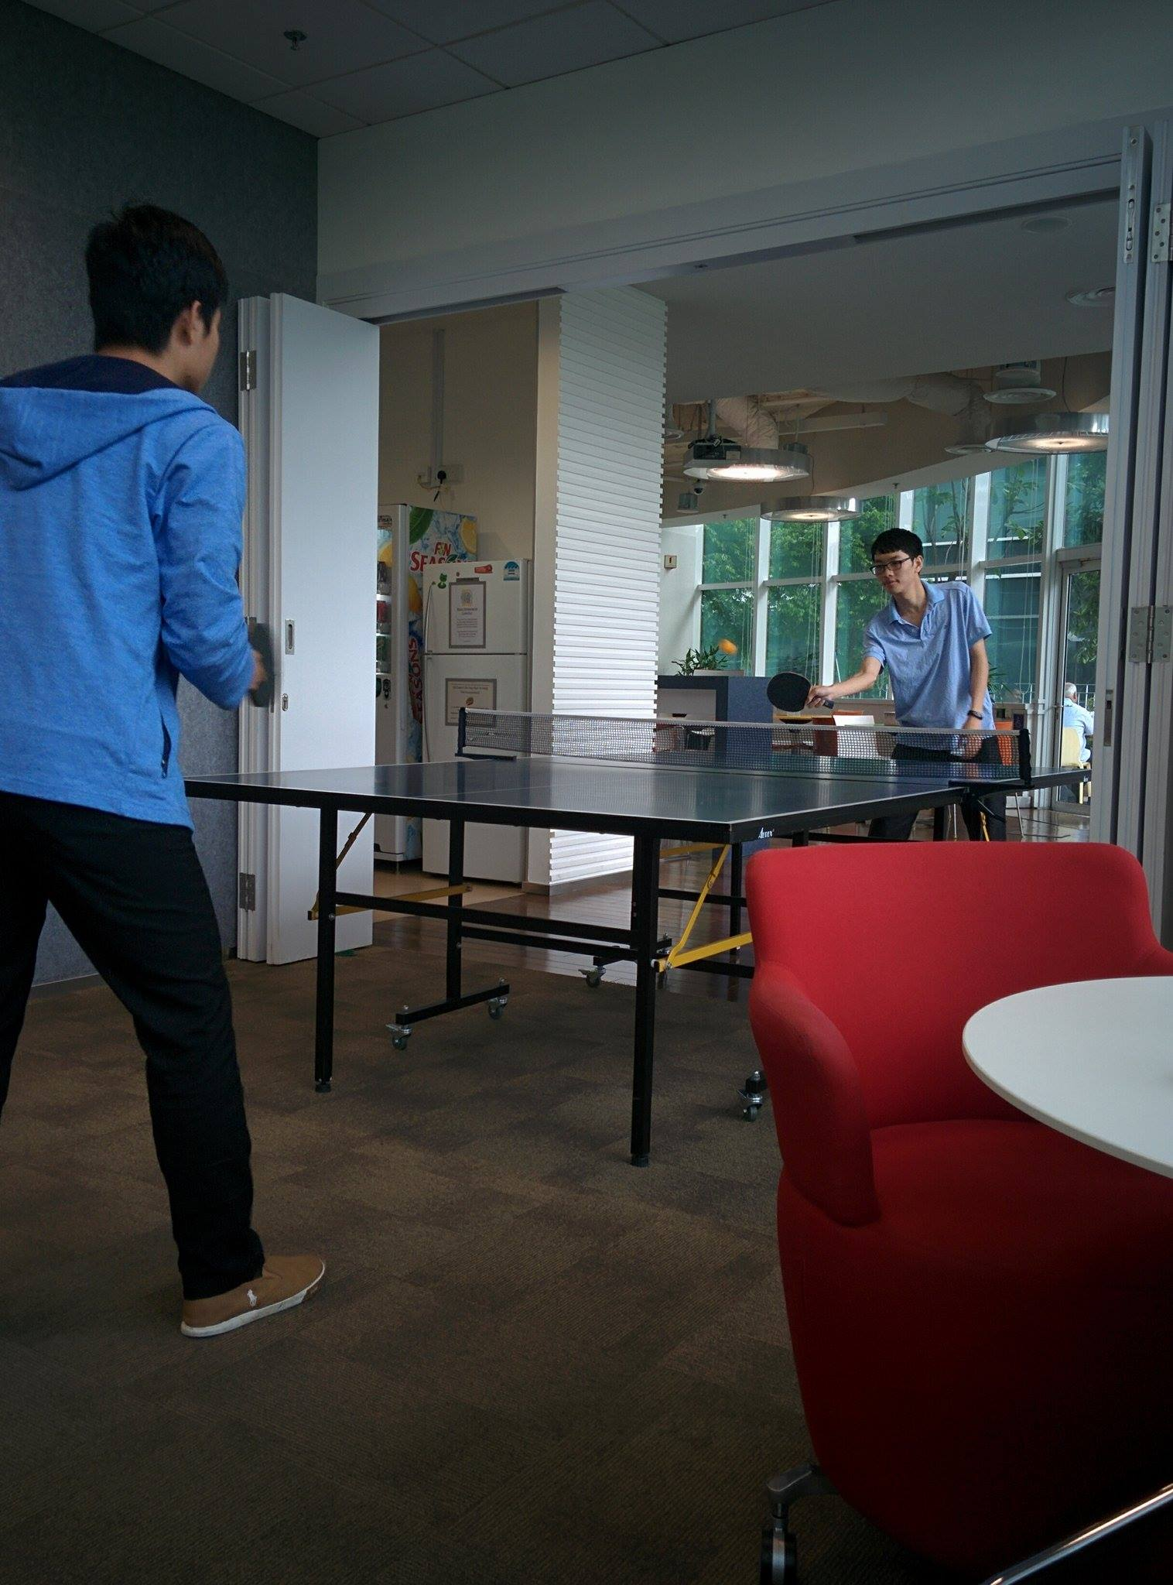
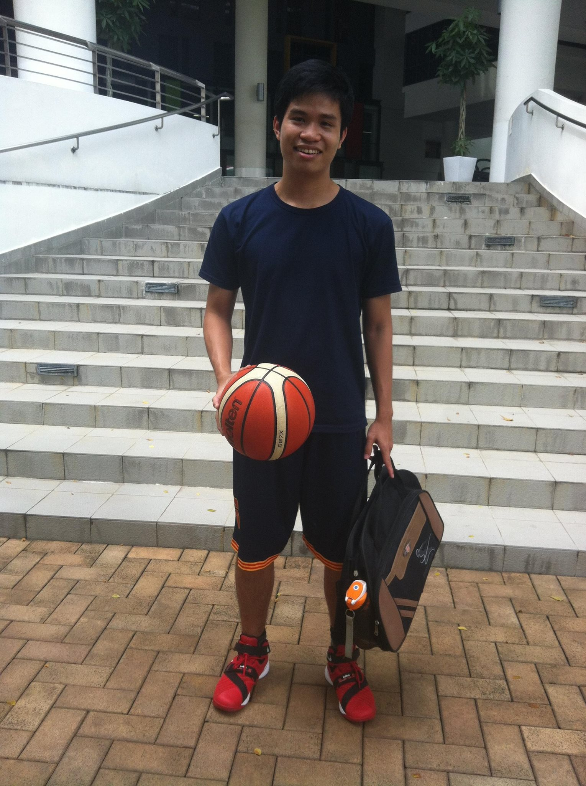









Quach Tri Dung( Quach )
Nanyang Technological University( NTU)
Electrical and Electronic Engineering (EEE)
July 2018
Ping Pong ☺
Software Automation Ops/ Brown Team/ Autodesk Vault
Tarun Gupta
Yogeshwar Gandhe

Slide 2





Project Summary
About Autodesk Vault:
, , ……
VAULT CLIENT VAULT SERVER
Quality Assurance:
+ Perform test for the new build.
+ Increase the automated testing coverage of the product:
White-box unit test automation
Black-box user interface automation

Slide 3
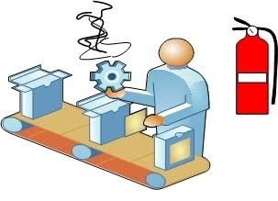
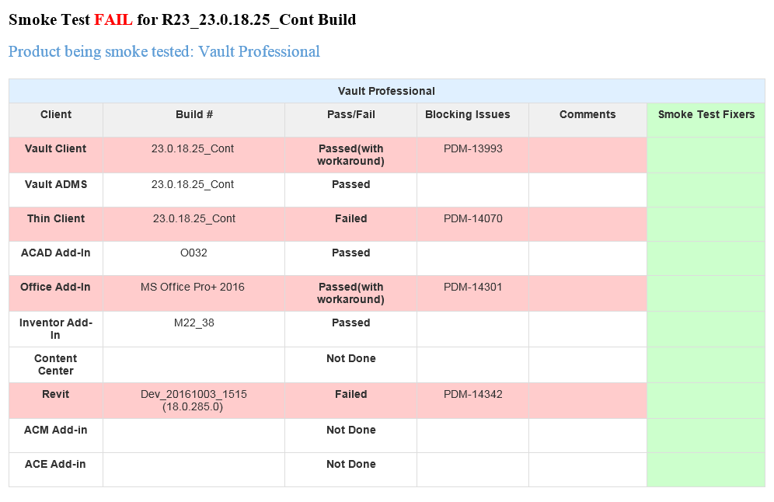
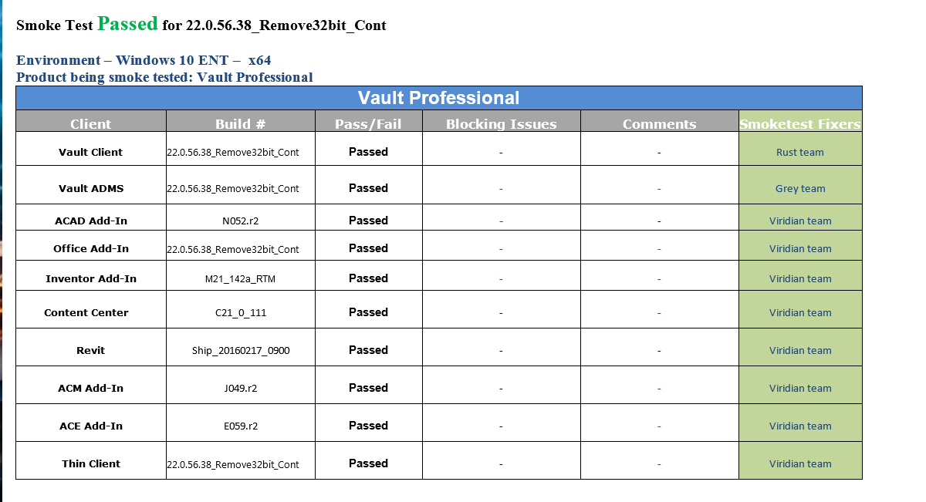


Smoke Test
Description
Create a new clean machine
Smoke test
Construct the report
Team, a new build is out. Let’s do smoke test.
Yes, Sir.

Slide 4
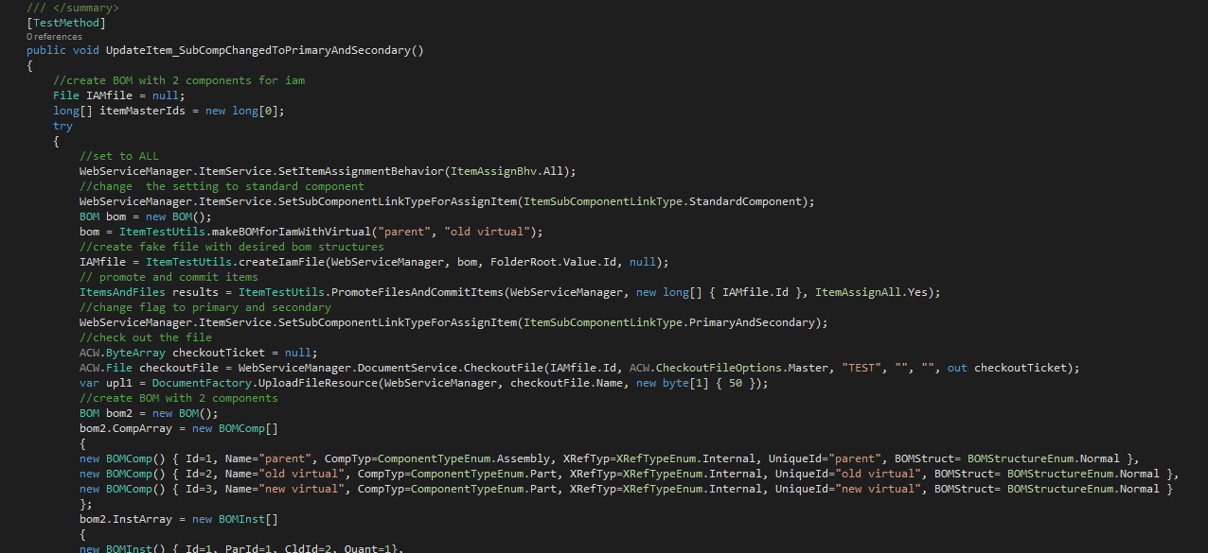


API Test
JIRA
Understanding
Code API test
Code Review
Team, new API tests are on JIRA.
Yes, Sir.

Slide 5
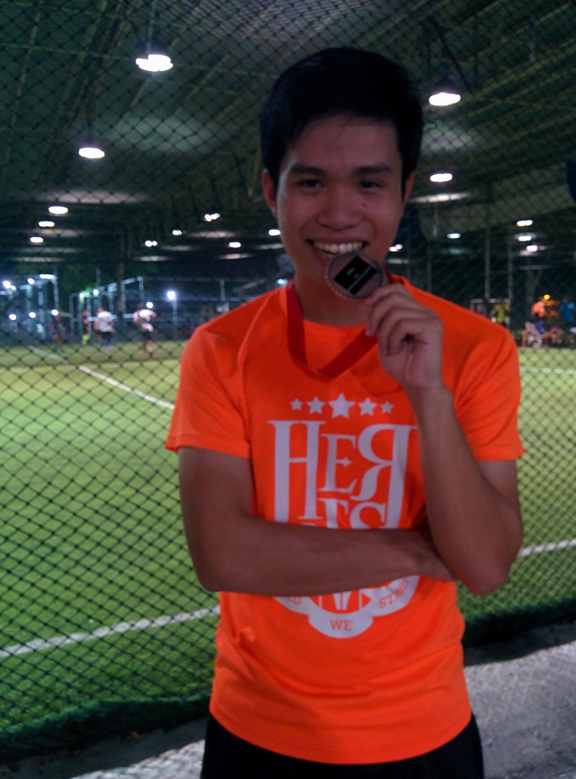
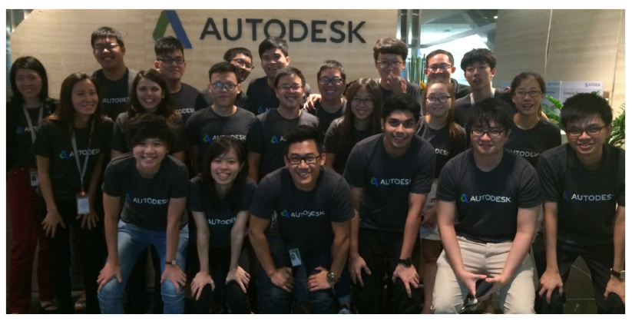



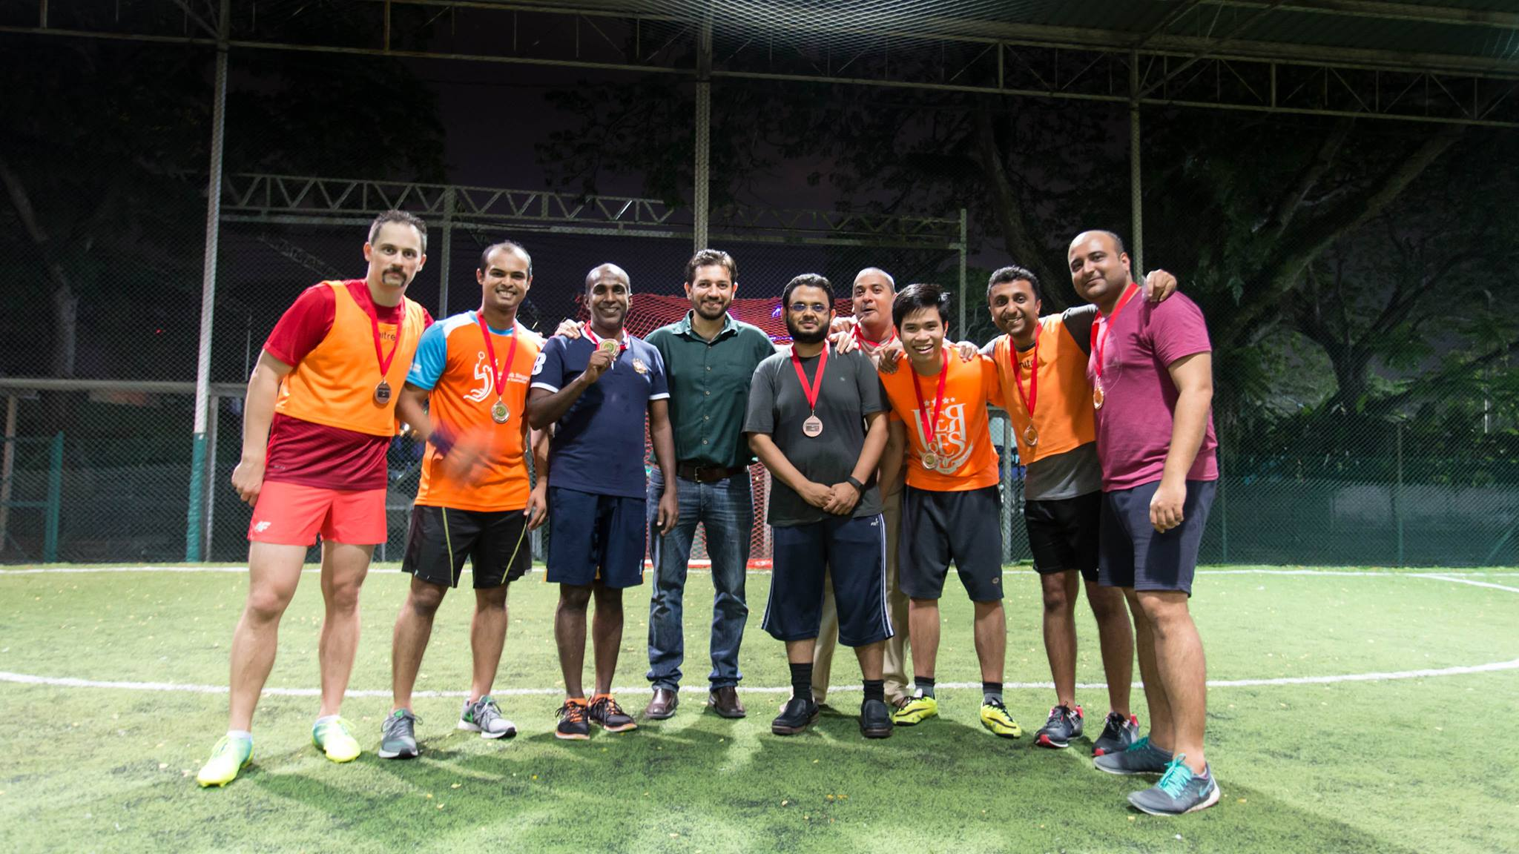



What I’ve received
C#, Fiddler 4, VCS Perforce P4V, Smart Git….
Code reviews with senior developers
Good friends
How the industry works
Interesting activities after working hours
Ping Pong ☺

