Slide 1
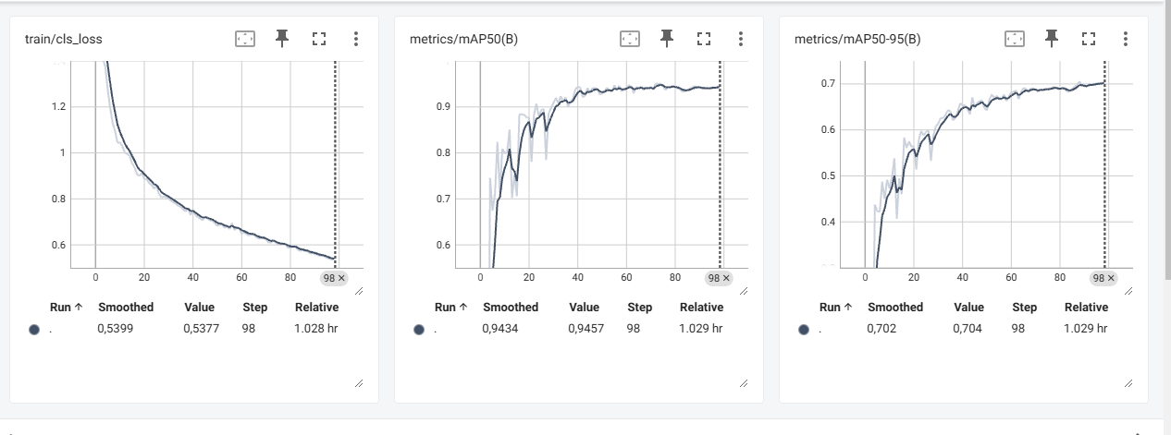
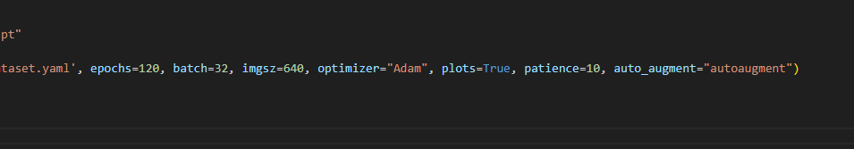
Train: flame 3939
normal 3800
Val: flame 507
normal 500

