Slide 1
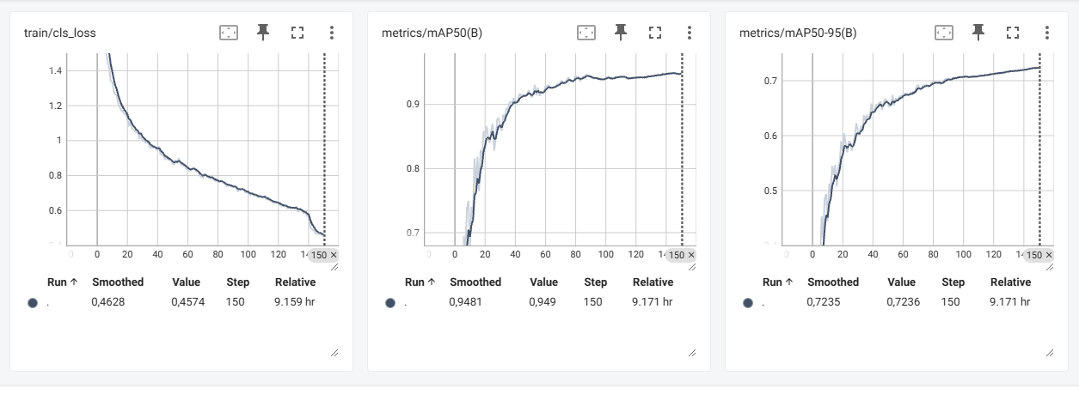
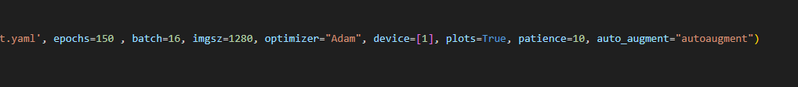
Train: flame 4339
normal 3800
Val: flame 547
normal 500

