Slide 1
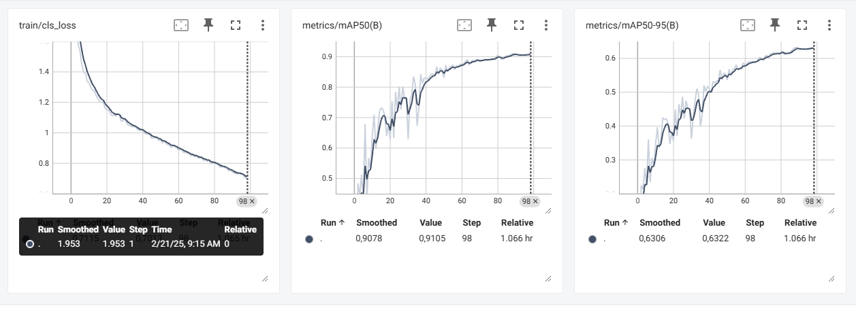
Train: smoke 3866
flame 3926
Val: smoke 501
Flame 502

