Slide 1
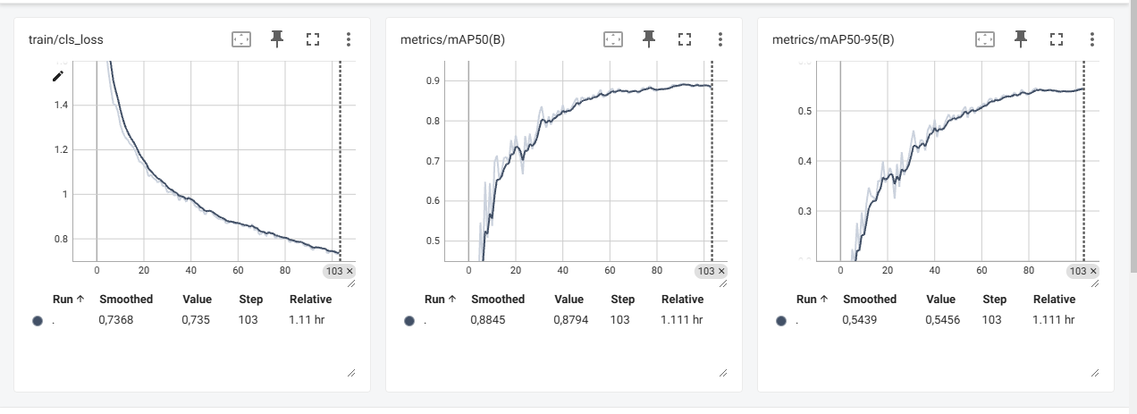
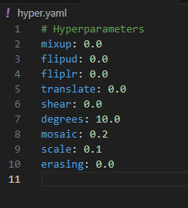

Train: smoke 3866
flame 3926
Val: smoke 496
Flame 502

