Slide 1
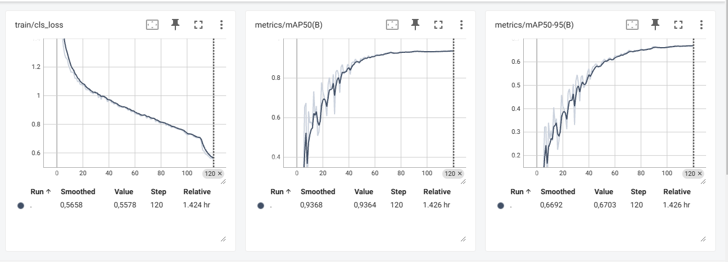
Train: smoke 8434
Val: smoke 1035

