Slide 1
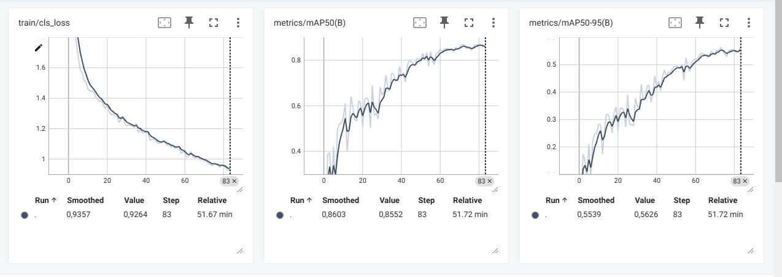
Train: smoke 3872
normal 3713
Val: smoke 472
normal 493

