Slide 1
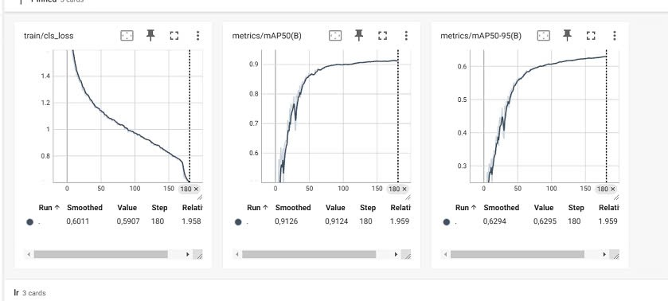
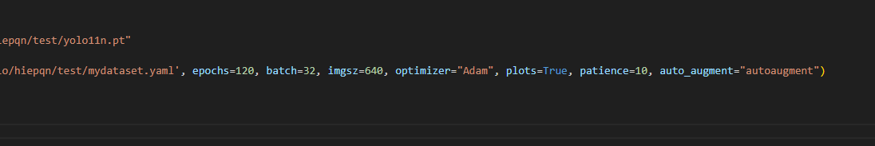
Train: smoke 5036
flame 4738
Val: smoke 625
Flame 598

