Slide 1
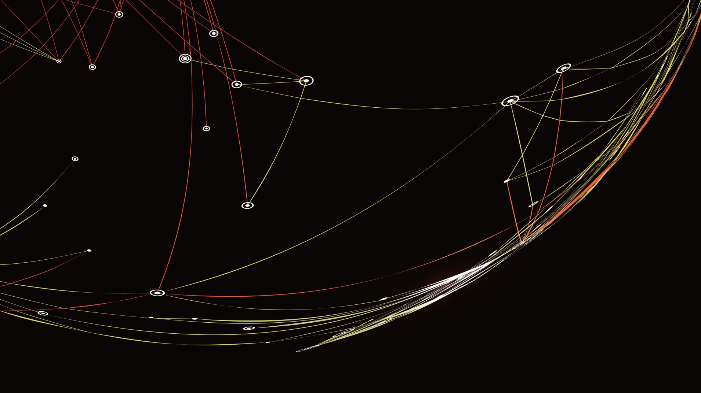
Microgrid
Tiziano Scimone (TL)
Nicola Canti
Elettra Veronica Deiana
Leonardo Scotti

Slide 2
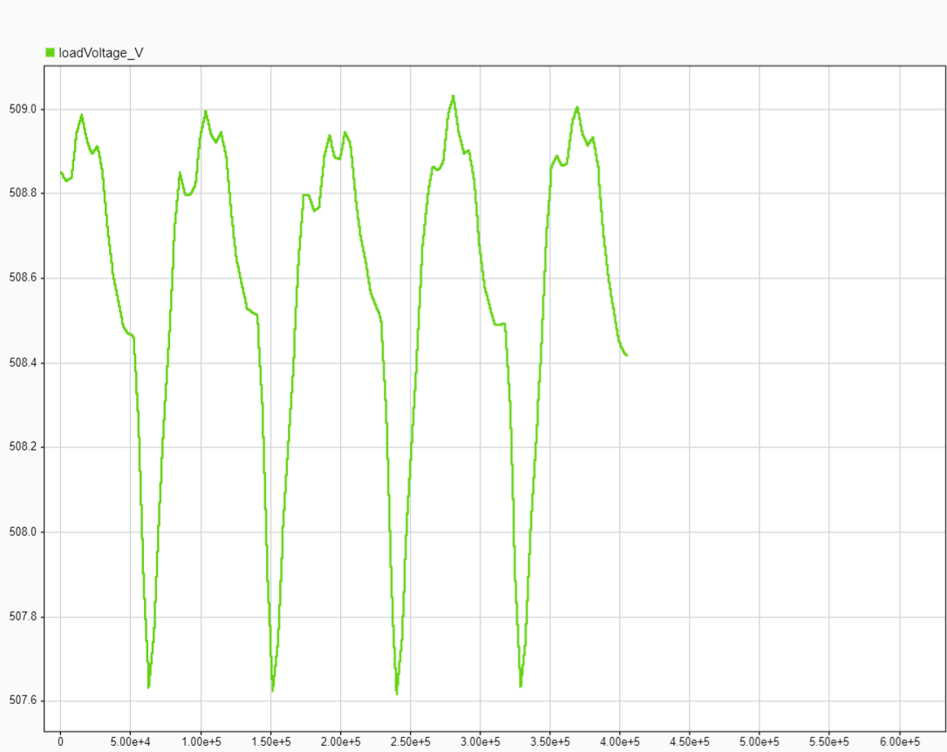
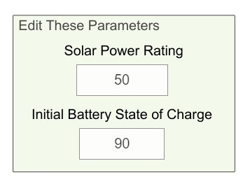
Task 1: Ideal System
By Trial and Error methods the above values were selected to meet the required objectives.

Slide 3
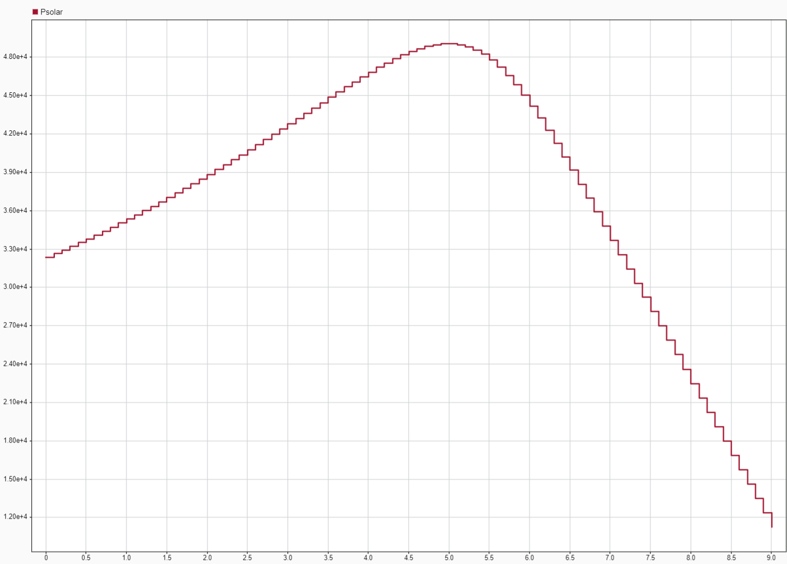
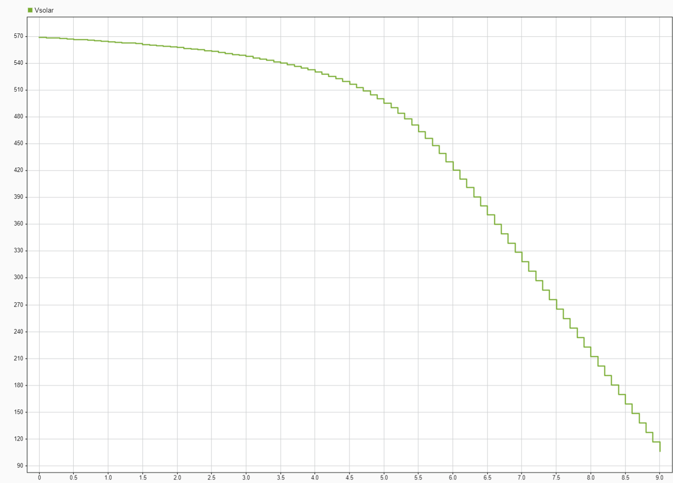
Task 2: Maximum Power Transfer
To find the solar cell specific maximum power point at 0,51V and 5,2W we did a sweep of the load resistance down to 0 Ohms.
We found thus the optimal number of cells to be 1000 because of the 510V requirement.
The 10 parallel strings were then chosen because of the 50kW requirement.

Slide 4
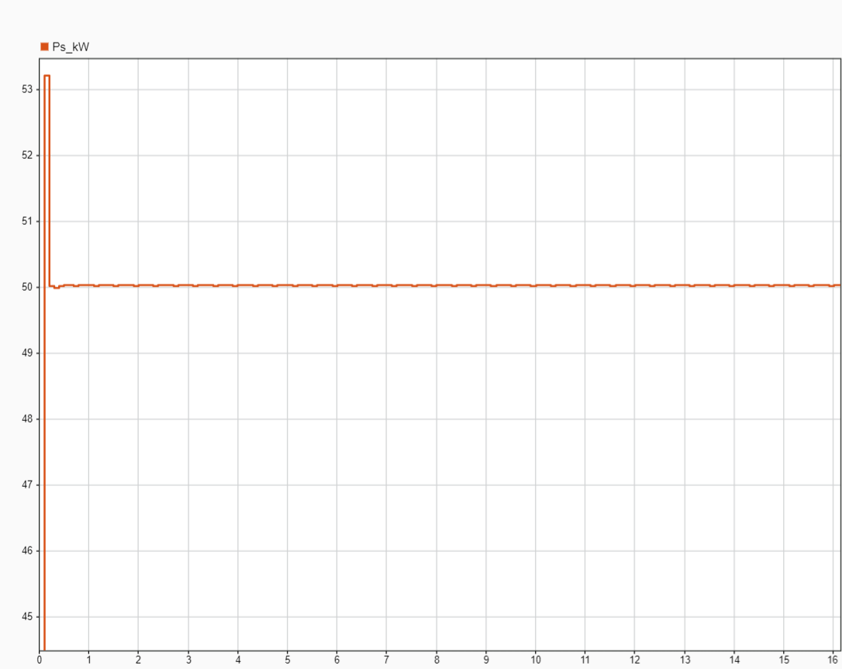
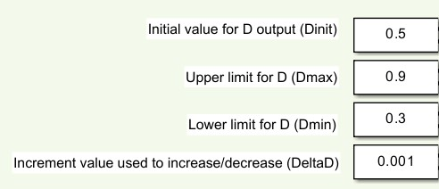
Task 3: Maximum Power Point Tracking (MPPT)
In order to tune the MPPT algorithm the following parameters were modified:
Dmax and Dmin were chosen to constrain the boundaries of the duty cycle value, and the DeltaD to allow fine variations by the controller, while still considering possible hardware limitations.

Slide 5
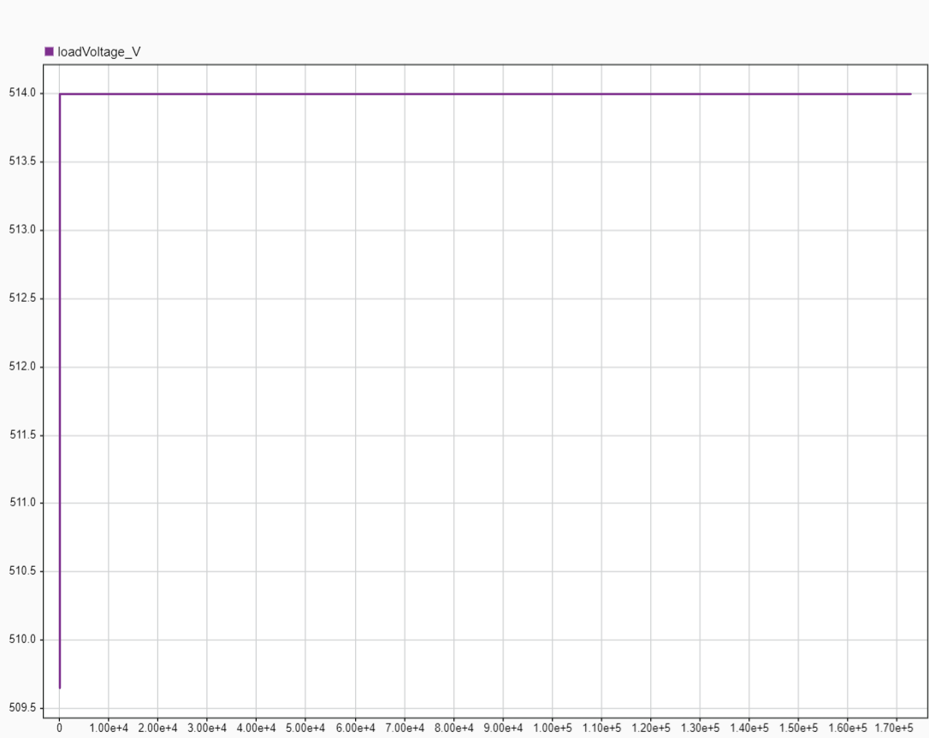
Task 4: Battery Voltage Control
To account for the load voltages requirements the Voltage Set Point was set to 514V.
To achieve better performances the fixed step integrator’s properties were set as follows:
Gain: 5e-4
Initial Condition: 0.455
In addition the output was saturated with the following boundaries:
Upper limit: 0.95
Lower limit: 0.05

Slide 6
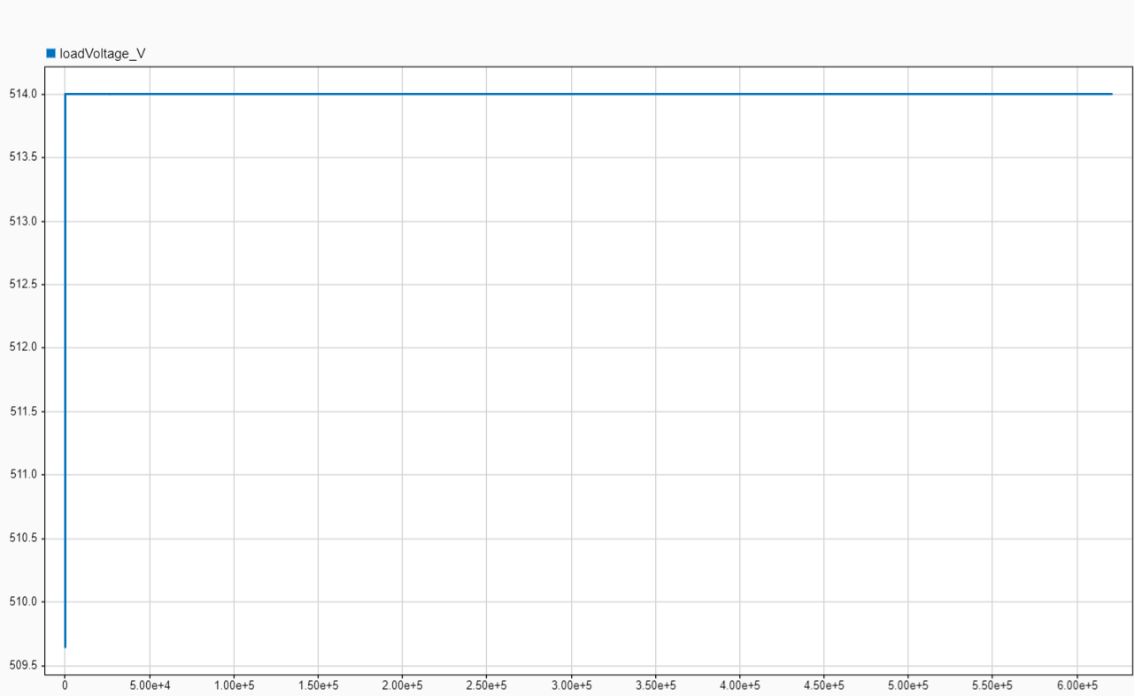
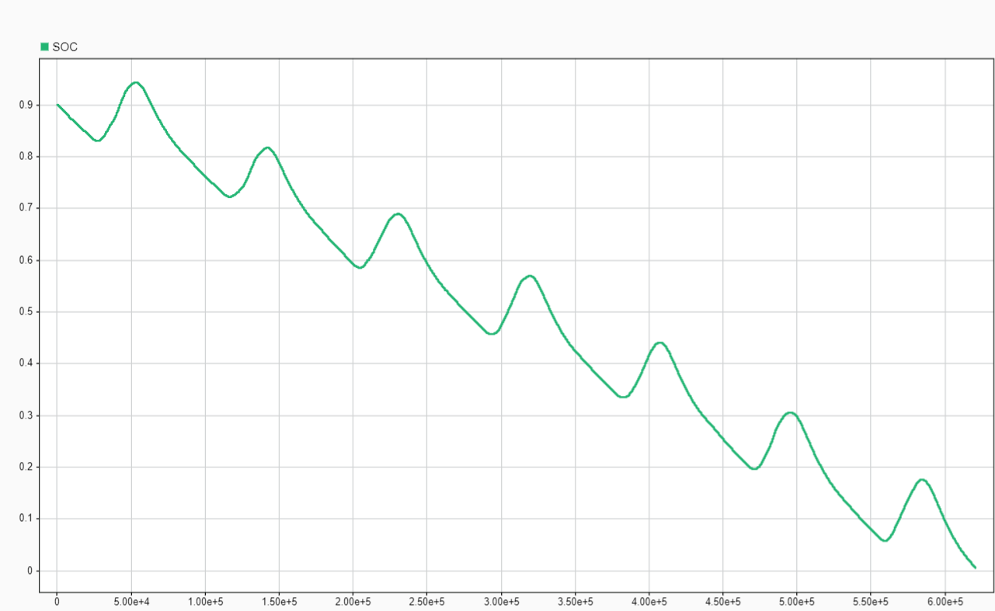
Task 5: Full System
Following the instructions, we implemented all previous tasks results into the complete system and ran the simulation.
SOC stayed positive throughout the entire 7-sol period.
Voltage stayed consistent within the 500-520V margin.

Slide 7
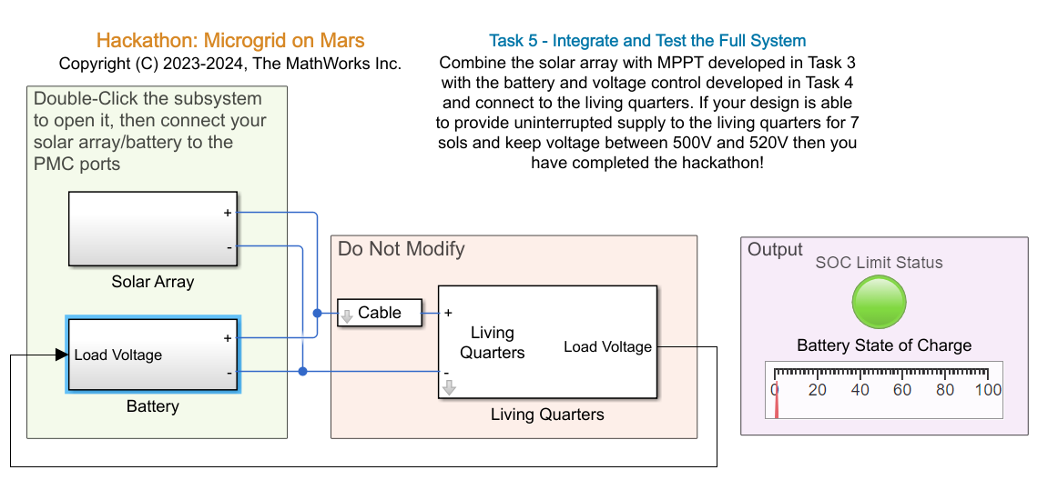
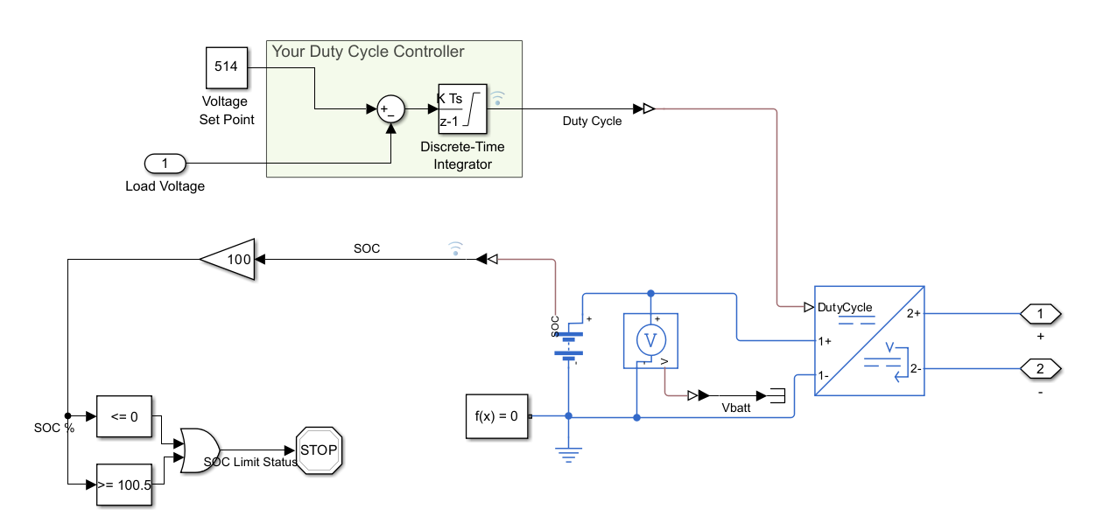
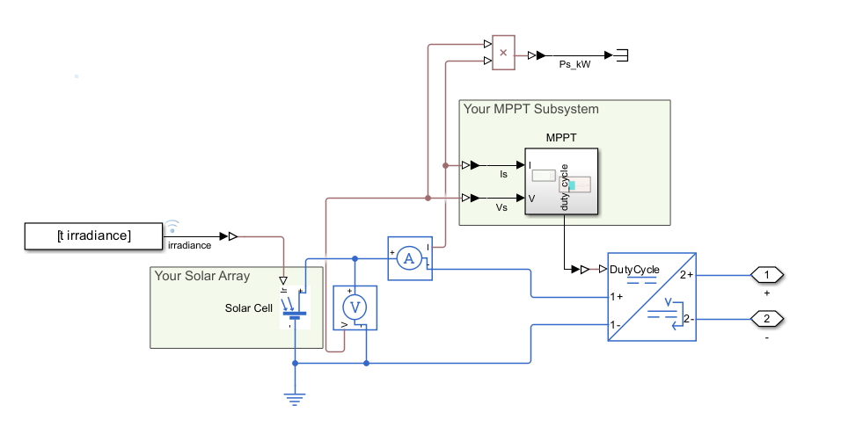
Task 5: Full System
Following the instructions, we implemented all previous tasks results into the complete system and ran the simulation.
SOC stayed positive throughout the entire 7-sol period.
Voltage stayed consistent within the 500-520V margin.

