Slide 1
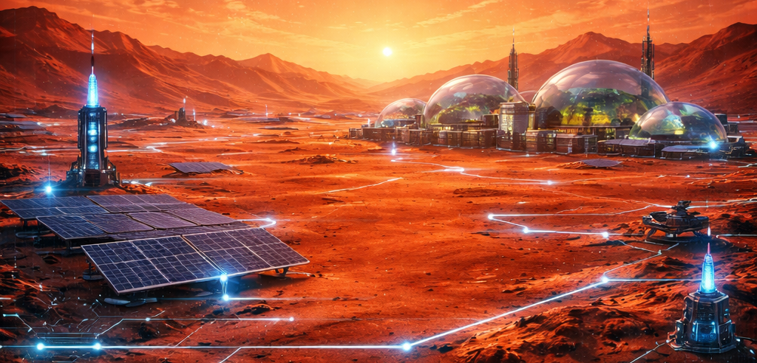
Welcome to
MATLAB HackaTOn
Mission on Mars

Slide 2

Agenda
Problem Statement
What to Expect Today
Agenda
Submitting Projects
Winners announcement
Resources to participants

Slide 3
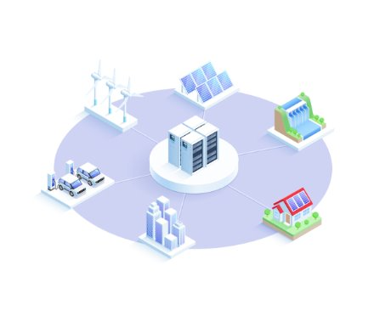
Problem Statement : Create a Microgrid on Mars!
Microgrids are localized grids designed to provide electricity to a small geographic area, such as a university campus, a hospital complex, or a business center, and are necessary for establishing permanent stations for space exploration.
They can function independently by using local energy generation sources, which often include renewable resources like solar panels, wind turbines, and energy storage systems like batteries.
As our engineers stationed on Mars, it's your job to develop a new microgrid system that will provide power to your station!

Slide 4

Agenda
[11:00 AM]: Welcome Presentation
[11:15 AM-3:00 PM]: Teams develop solutions and demos
[03:00 PM]: Participants submit projects + demos
[04:00 PM] : winners announcement!

Slide 5
Submission Guidelines
Projects must be submitted to Devpost
You will need to create a Devpost project in order to submit
Submissions are due by TODAY 3:00 P.M
Submissions must be on GitHub, MATLAB Drive, Google Drive, File Exchange, or some similar online repository that can be made public.
It must contain your team's project and a brief (<5 minutes) demo of this project
The demo may be a video, slide deck, essay, or any presentation that you believe best allows you to showcase your project.
Only one submission per team is required

Slide 6
Judging
Solution Quality
Design Space Exploration (10 Points)
Maximum Power Transfer (10 Points)
Develop Maximum Power Point Tracking (MPPT) Control (10 Points)
Battery Voltage Control (10 Points)
Integrate and Test the Full System (10 Points)
Creativity: Interesting delivery methods, innovative and creative solutions (15 Points)
MATLAB/Simulink Mastery: Knowledge and execution (25 Points)
Clarity: Message is clear and well-communicated (10 Points)
Best Use of MATLAB & Presenting Quality

Slide 7

Technical Resources for Participants
GitHub repository with:
Starter Code
Detailed Instructions
Judging and scoring criteria
Devpost page for submitting your projects

Slide 8




Tips for getting started
Find your team first! Have someone start your Devpost project.
Talk through the problem conceptually before anyone begins development – have a plan.
Delegate tasks once you have a plan so all team members are working on different pieces of the final project.

Slide 9
Questions?

Slide 10
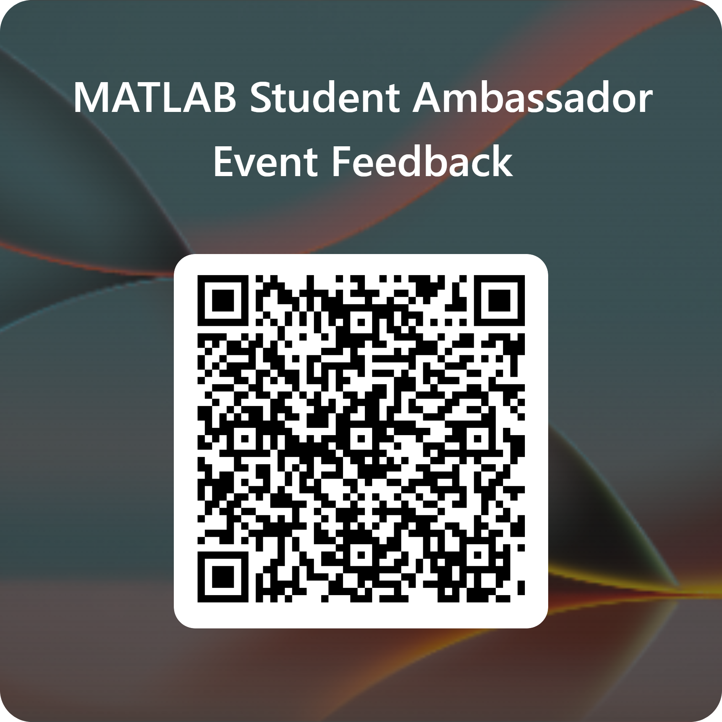

Slide 11
Survey!
Please fill out this survey while you wait!
This will help us know what went well and what didn't, and how we can improve our events in the future
Thank you!
Replace this with a QR code to your survey.
This can be made using any online service, such as https://www.qr-code-generator.com/

