Slide 1

Group X
6xxxxxxxx21 Name Surname
6xxxxxxxx21 Name Surname

Slide 2


Slide 3
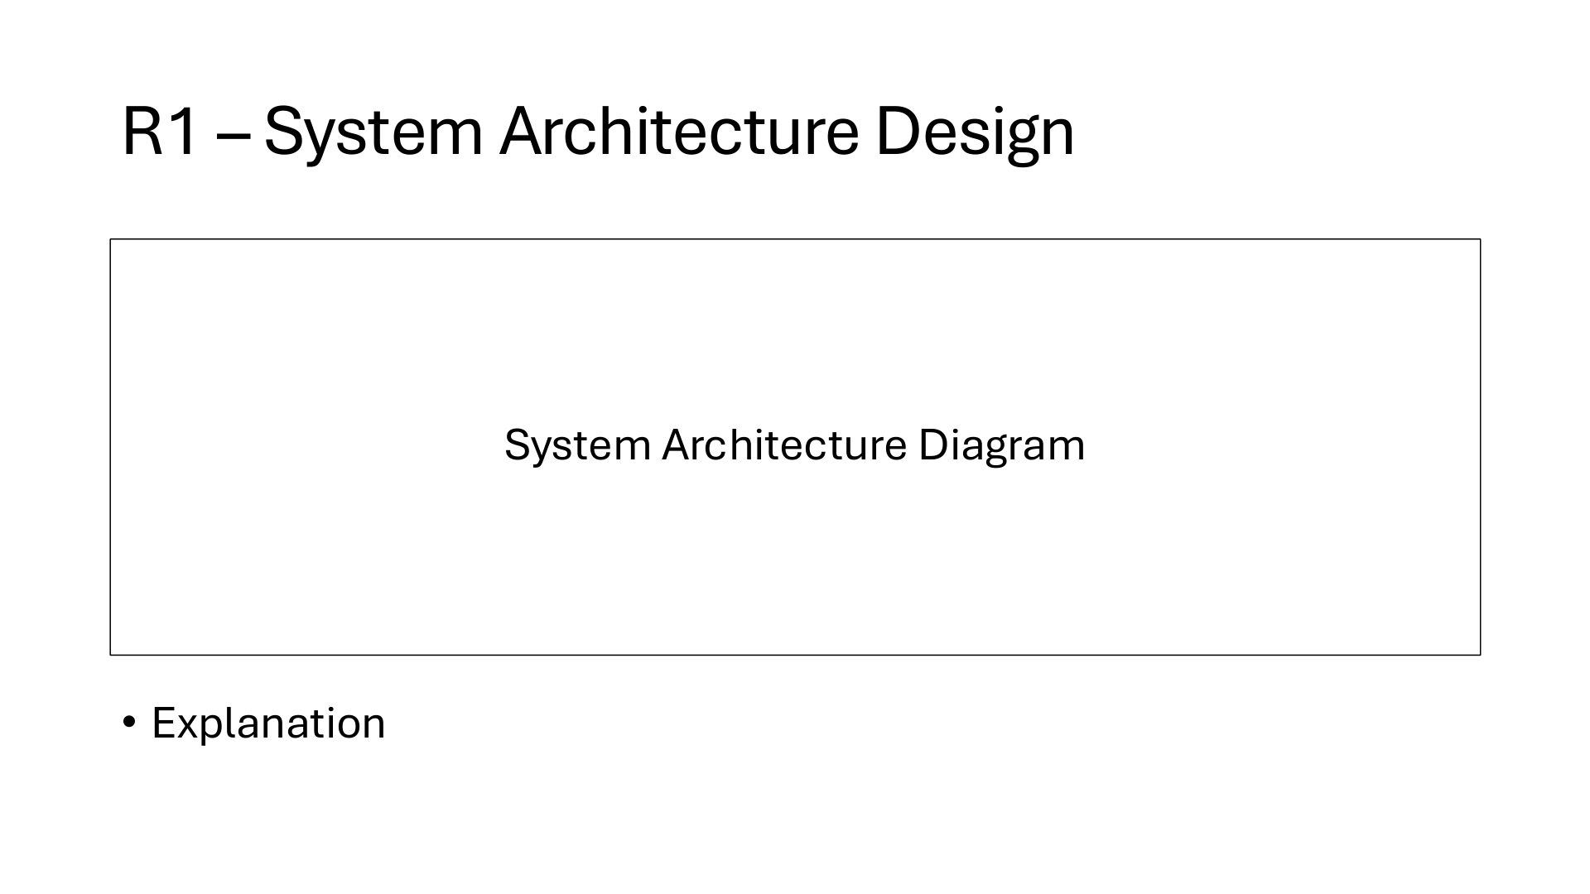
Browser A
Gemini
HTTPS
Traefik
HTTPS/WSS
Python server
/ws :8080
Browser B
Ollama
:11434
Two laptops reach Oracle through Traefik. Chat uses one /ws connection. Each summary selects Gemini or local Qwen; Gemini failure retries locally.

Slide 4
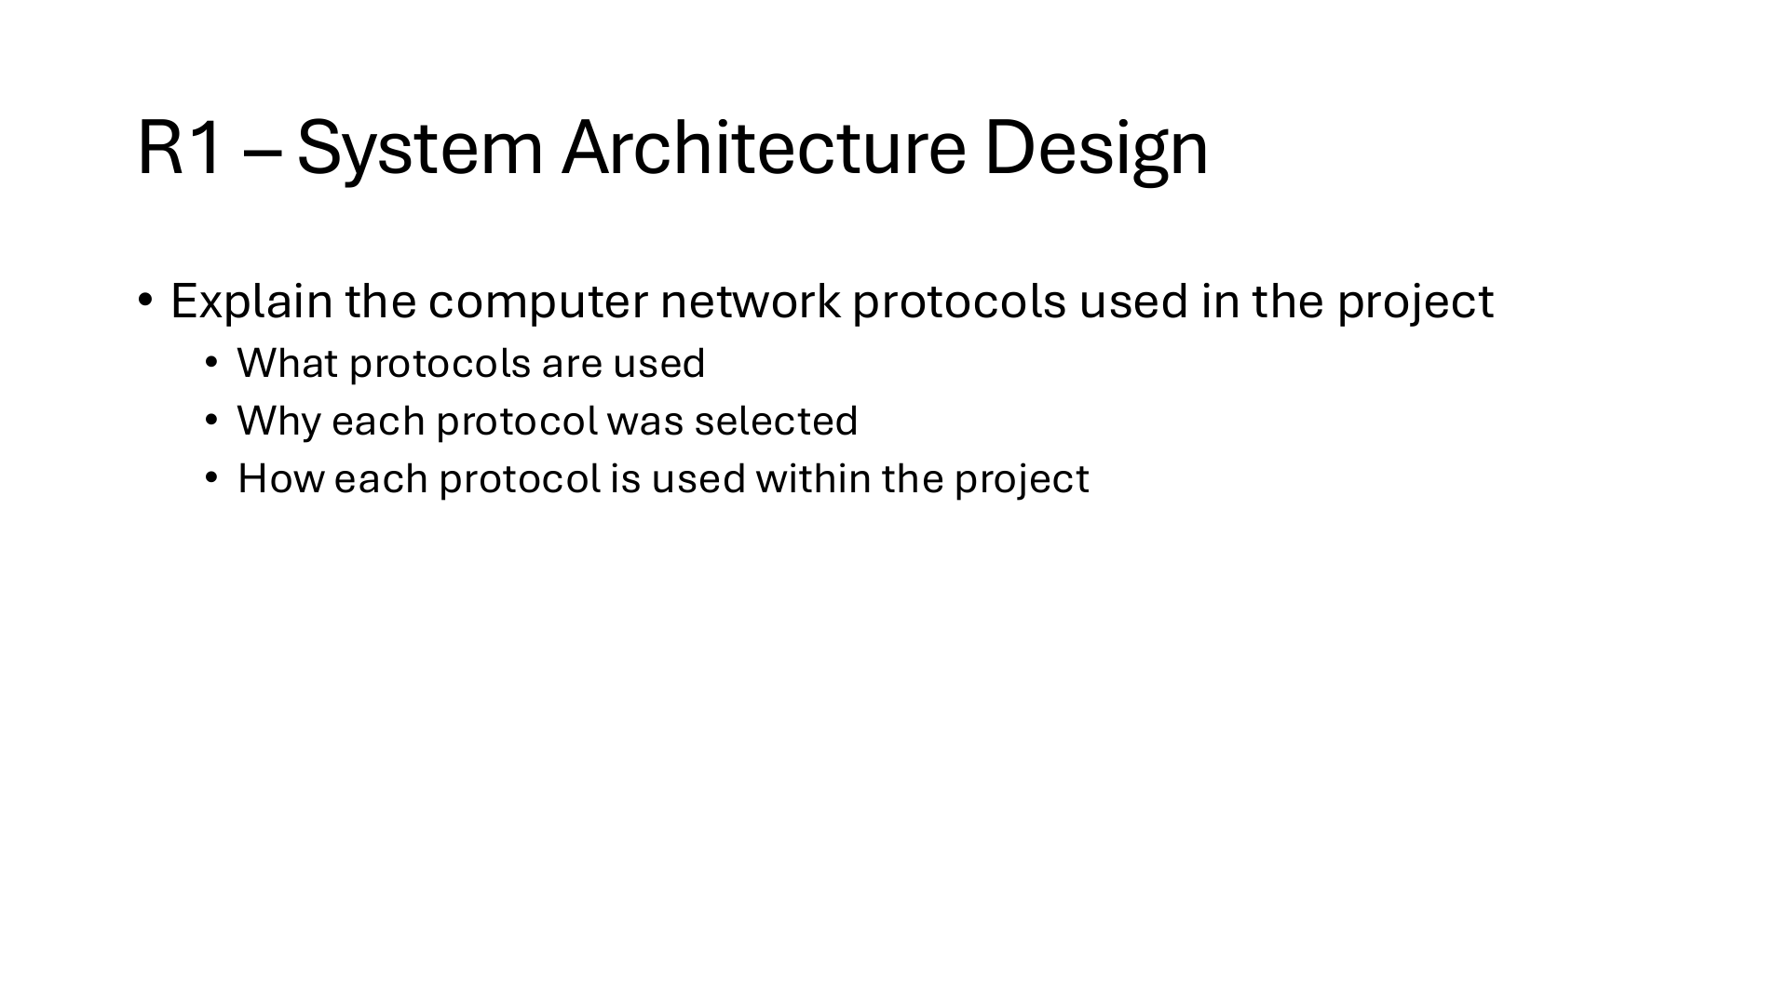
TCP: reliable, ordered transport under HTTP and WebSocket.
HTTPS/WSS: encrypt browser traffic through Traefik on port 443.
WebSocket /ws: one persistent channel for chat, files, and receipts.
JSON: command and event format within WebSocket frames.
Internal HTTP: server to Ollama; HTTPS: server to Gemini.
SSH: GitHub Actions connects to Oracle for deployment.

Slide 5
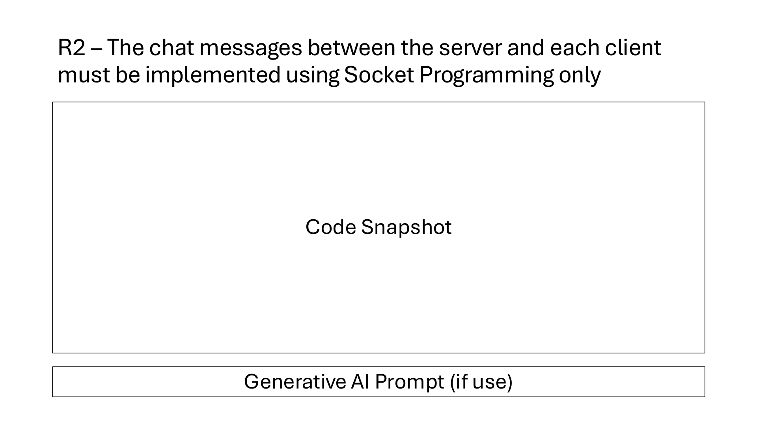
server.py / WebSocket transport
def create_app():
app = web.Application()
app['chat_server'] = ChatServer()
app.router.add_get('/ws', ws_handler)
return app
async def ws_handler(request):
server = request.app['chat_server']
socket = web.WebSocketResponse(heartbeat=30.0)
await socket.prepare(request)
session = UserSession(socket=socket)
server.sessions[session.id] = session
try:
async for msg in socket:
if msg.type == WSMsgType.TEXT:
await server.dispatch(session, msg.data)
finally:
await server.disconnect(session)
Prompt: Build a single /ws endpoint; route JSON frames to a central dispatcher.

Slide 6


Slide 7
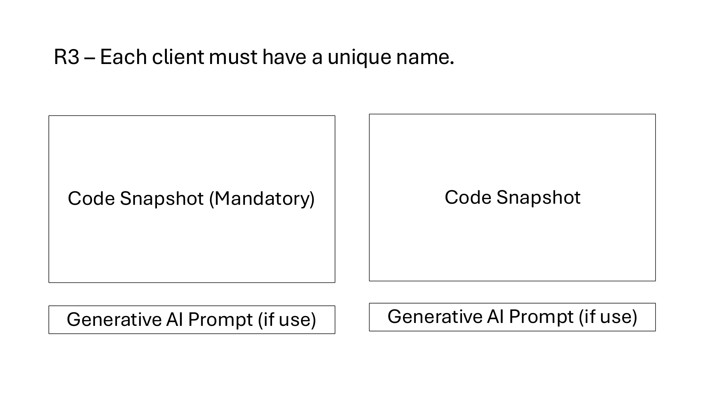
server.py:38-49
class RegisterCmd(BaseModel):
"""Validates client registration (R3)."""
type: Literal["register"] = "register"
name: str
@field_validator("name")
@classmethod
def validate_name(cls, value: str) -> str:
trimmed = value.strip()
if not (1 <= len(trimmed) <= 24) or not NAME_PATTERN.fullmatch(trimmed):
raise ValueError("Use 1–24 letters, numbers, spaces, dots, underscores or hyphens.")
return trimmed
server.py:259-274
dead = [s for s in list(self.sessions.values()) if s.socket.closed]
for s in dead:
await self.disconnect(s)
if any(s.name.casefold() == cmd.name.casefold() for s in self.sessions.values() if s.id != session.id):
raise ValueError("That name is already connected. Choose another.")
if len(self.sessions) >= 100:
raise ValueError("The server is full. Try again later.")
session.name = cmd.name
await self.send(session, {
"type": "welcome",
"id": session.id,
"name": session.name,
"ai_model": AI_MODEL,
Validate a 1-24 character username with Pydantic.
Reject active duplicate names, ignoring case.

Slide 8
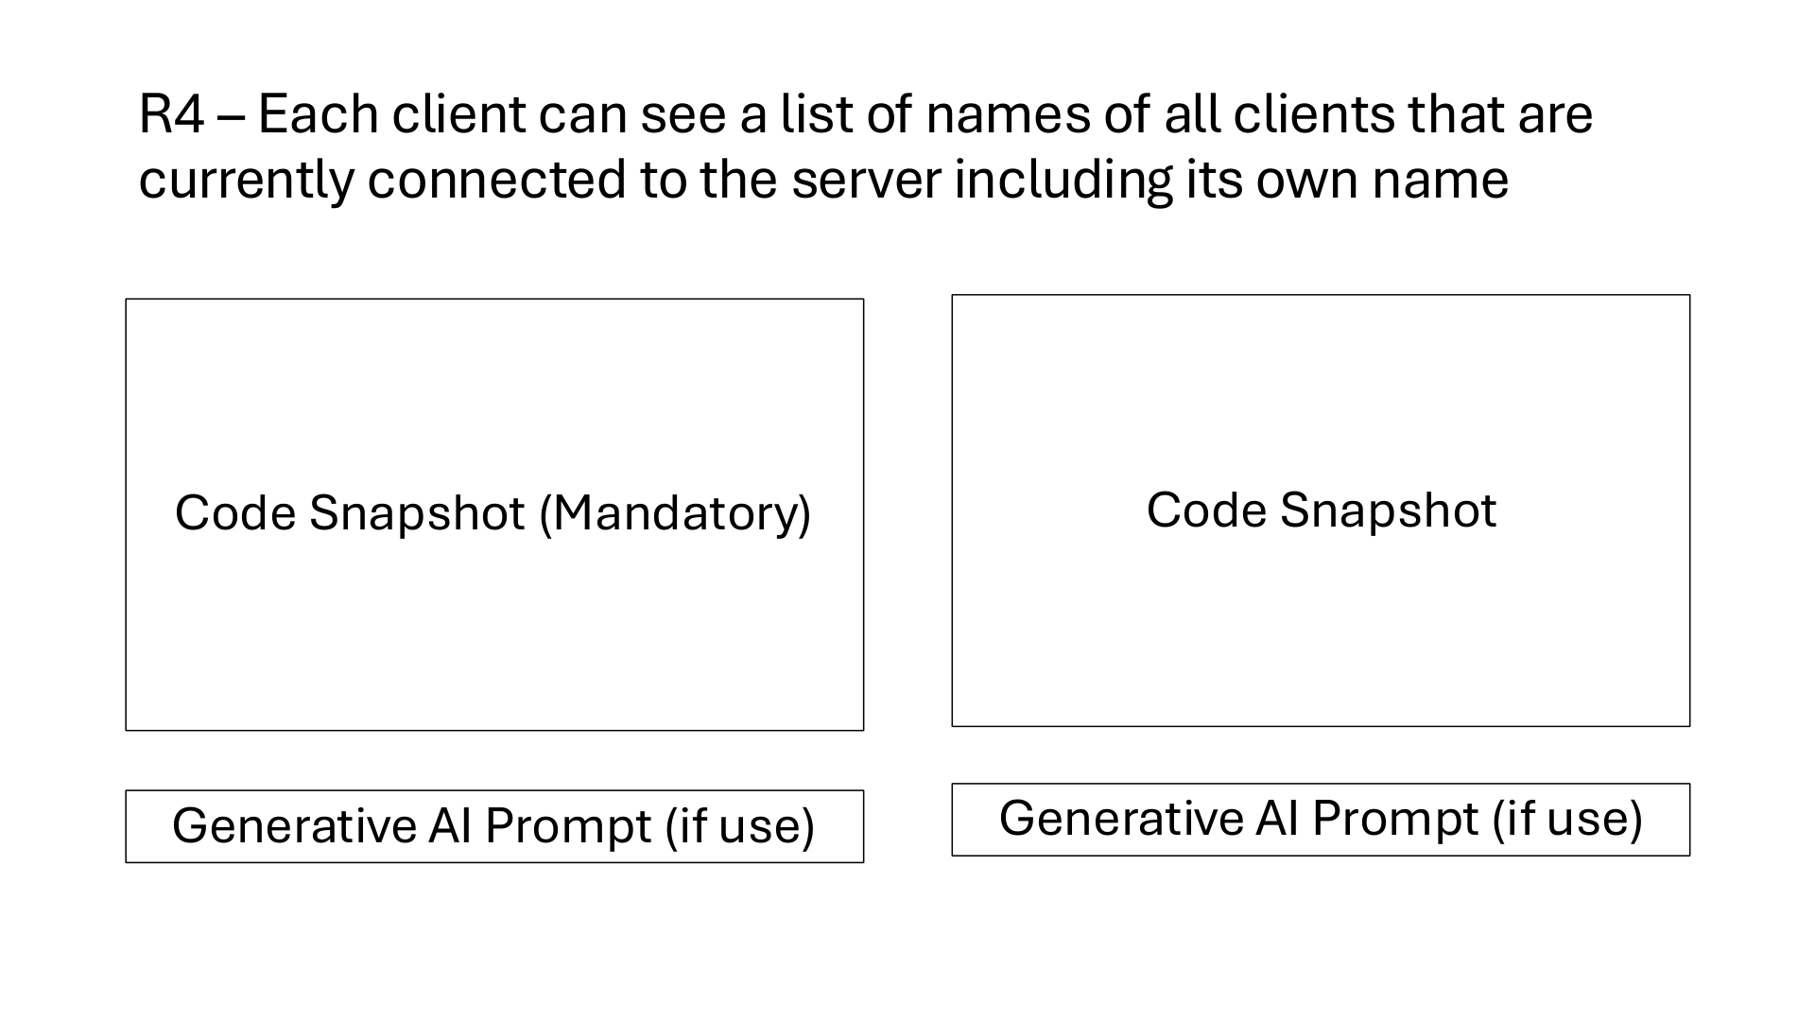
server.py:242-249
async def broadcast_presence(self):
"""Broadcast online users and active groups to all clients (R4, R9)."""
await self.broadcast({
"type": "state",
"users": [{"id": s.id, "name": s.name} for s in self.sessions.values() if s.name],
"groups": [self.describe_room(r) for r in self.rooms.values() if r.kind == "group"],
})
static/app.js:117-122
case "state":
state.users = data.users || [];
state.groups = data.groups || [];
renderSidebar();
if (state.activeRoomId) renderHeader();
break;
Broadcast every connected user's name in real time.
Update the browser list when a state event arrives.

Slide 9
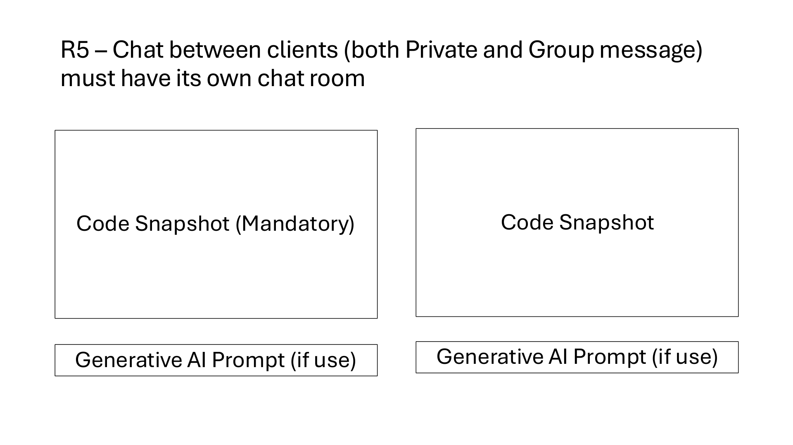
server.py:279-292
async def handle_open_private(self, session: UserSession, data: dict):
"""R5: Open or create an isolated 1-on-1 private room for two clients."""
cmd = OpenPrivateCmd(**data)
peer = self.sessions.get(cmd.peer)
if peer is None or peer.id == session.id:
raise ValueError("Choose another online user.")
members = {session.id, peer.id}
room = next((r for r in self.rooms.values()
if r.kind == "private" and r.members == members), None)
if room is None:
if len(self.rooms) >= 100:
raise ValueError("Room limit reached.")
room = ChatRoom(
server.py:234-240
async def open_room(self, session: UserSession, room: ChatRoom):
"""Deliver room metadata and message history to a client."""
await self.send(session, {
"type": "room",
"room": self.describe_room(room),
"messages": list(room.messages),
})
Create or reuse a private room for two sessions.
Send room metadata and recent history to clients.

Slide 10
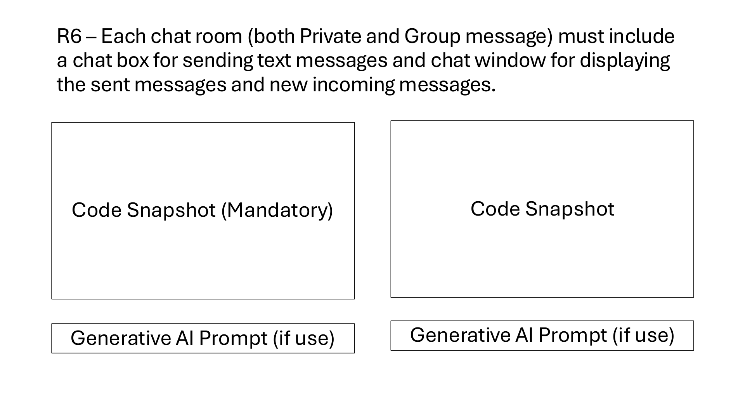
server.py:78-89
class MessageCmd(BaseModel):
"""Validates sending a text message (R6, R7, R11)."""
type: Literal["message"] = "message"
room: str
text: str = Field(min_length=1, max_length=4000)
@field_validator("text")
@classmethod
def validate_text(cls, value: str) -> str:
trimmed = value.strip()
if not (1 <= len(trimmed) <= 4000):
raise ValueError("Messages must contain 1–4000 characters.")
server.py:340-353
message = {
"id": uuid.uuid4().hex,
"room": room.id,
"sender": session.id,
"name": session.name,
"timestamp": time.time(),
"kind": "message",
"text": cmd.text,
"read_by": [],
"delivered_by": [],
}
room.messages.append(message)
await self.broadcast({"type": "message", "message": message}, room.members)
Validate message text and keep 100 per room.
Send each new message to its room members.

Slide 11
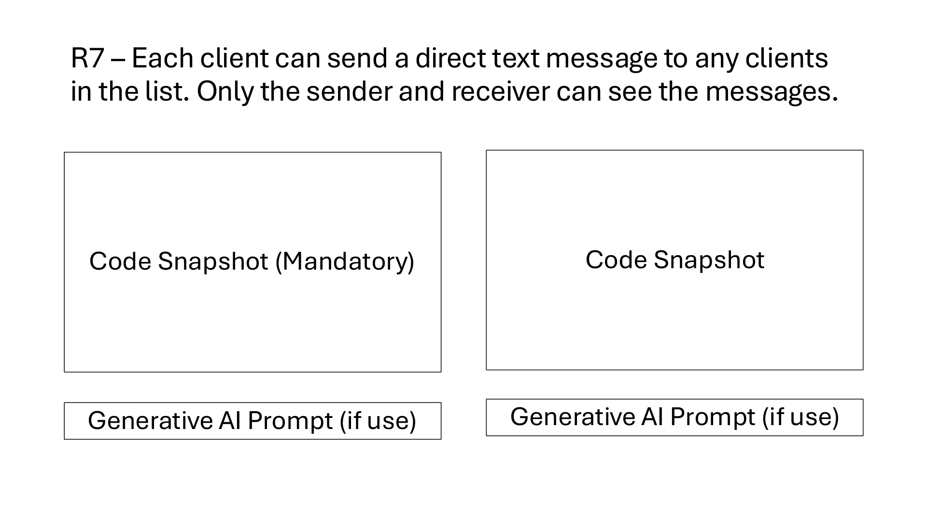
server.py:227-232
def authorized_room(self, session: UserSession, room_id: str) -> ChatRoom:
"""Check that the room exists and the user is an authorized member."""
room = self.rooms.get(room_id)
if room is None or session.id not in room.members:
raise ValueError("Join this room before using it.")
return room
server.py:347-353
"text": cmd.text,
"read_by": [],
"delivered_by": [],
}
room.messages.append(message)
await self.broadcast({"type": "message", "message": message}, room.members)
Check room membership before accepting a message.
Deliver a private message only to its two peers.

Slide 12
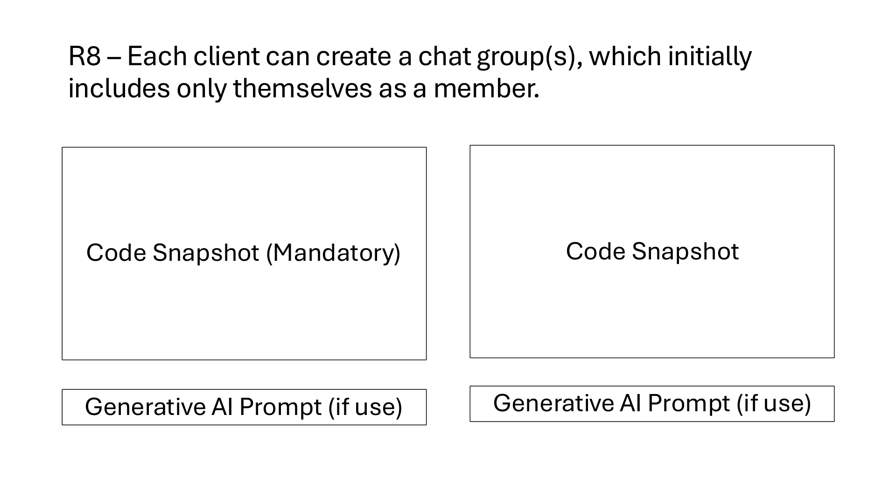
server.py:58-69
class CreateGroupCmd(BaseModel):
"""Validates creating a chat group (R8)."""
type: Literal["create_group"] = "create_group"
name: str = Field(min_length=1, max_length=40)
@field_validator("name")
@classmethod
def validate_name(cls, value: str) -> str:
trimmed = value.strip()
if not (1 <= len(trimmed) <= 40):
raise ValueError("Group names must contain 1–40 characters.")
return trimmed
server.py:303-318
async def handle_create_group(self, session: UserSession, data: dict):
"""R8: Create a chat group with only the creator as member."""
cmd = CreateGroupCmd(**data)
if len(self.rooms) >= 100:
raise ValueError("Room limit reached.")
room = ChatRoom(
id=uuid.uuid4().hex,
kind="group",
name=cmd.name,
members={session.id},
names={session.id: session.name}
)
self.rooms[room.id] = room
await self.open_room(session, room)
await self.broadcast_presence() # R9: everyone sees new group and members
Validate the new group's name and length.
Start each group with only its creator inside.

Slide 13
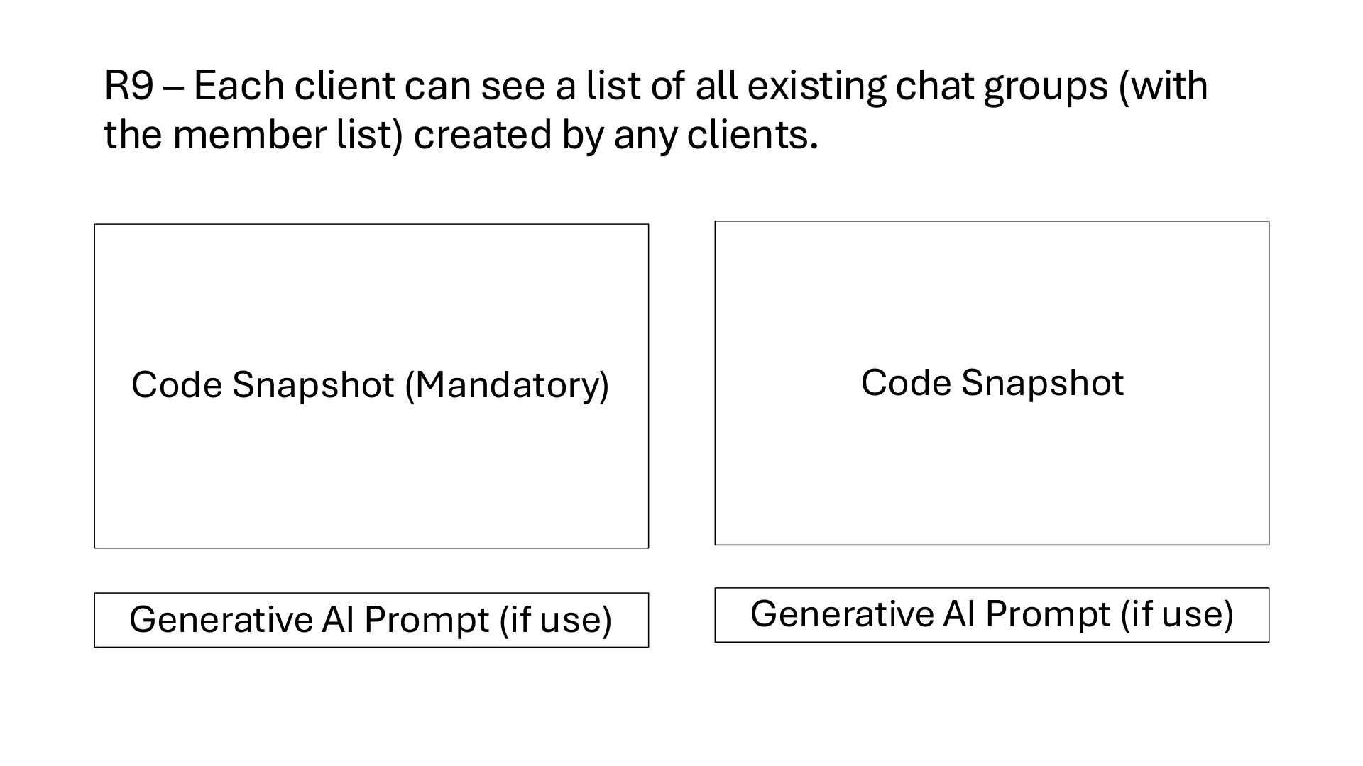
server.py:215-225
def describe_room(self, room: ChatRoom) -> dict:
"""Helper to serialize room metadata for clients."""
return {
"id": room.id,
"kind": room.kind,
"name": room.name,
"members": [
{"id": mid, "name": room.names.get(mid, "")}
for mid in sorted(room.members)
],
}
static/app.js:230-239
for (const g of state.groups) {
const joined = g.members.some((m) => m.id === state.me?.id);
const li = document.createElement("li");
const row = document.createElement("div");
row.className = `group-row${g.id === state.activeRoomId ? " active" : ""}`;
row.title = g.members.length ? `Members: ${g.members.map((m) => m.name).join(", ")}` : "No members yet";
const label = document.createElement("span");
label.textContent = `# ${g.name} (${g.members.length})`;
row.appendChild(label);
Include every group's current member names.
Show group members when hovering over its row.

Slide 14
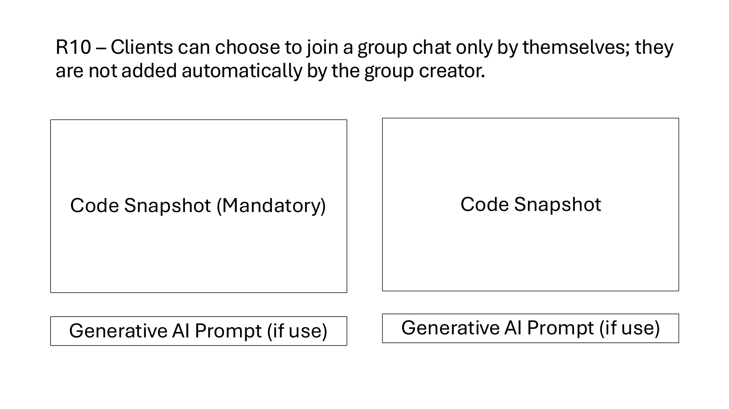
server.py:72-76
class JoinGroupCmd(BaseModel):
"""Validates joining an existing group (R10)."""
type: Literal["join_group"] = "join_group"
room: str
server.py:320-330
async def handle_join_group(self, session: UserSession, data: dict):
"""R10: Voluntary self-join group chat."""
cmd = JoinGroupCmd(**data)
room = self.rooms.get(cmd.room)
if room is None or room.kind != "group":
raise ValueError("This group does not exist.")
room.members.add(session.id)
room.names[session.id] = session.name
await self.open_room(session, room)
await self.broadcast_presence() # R9: updated member list broadcast
Require an explicit Join command from the user.
Add only the requesting session to the group.

Slide 15
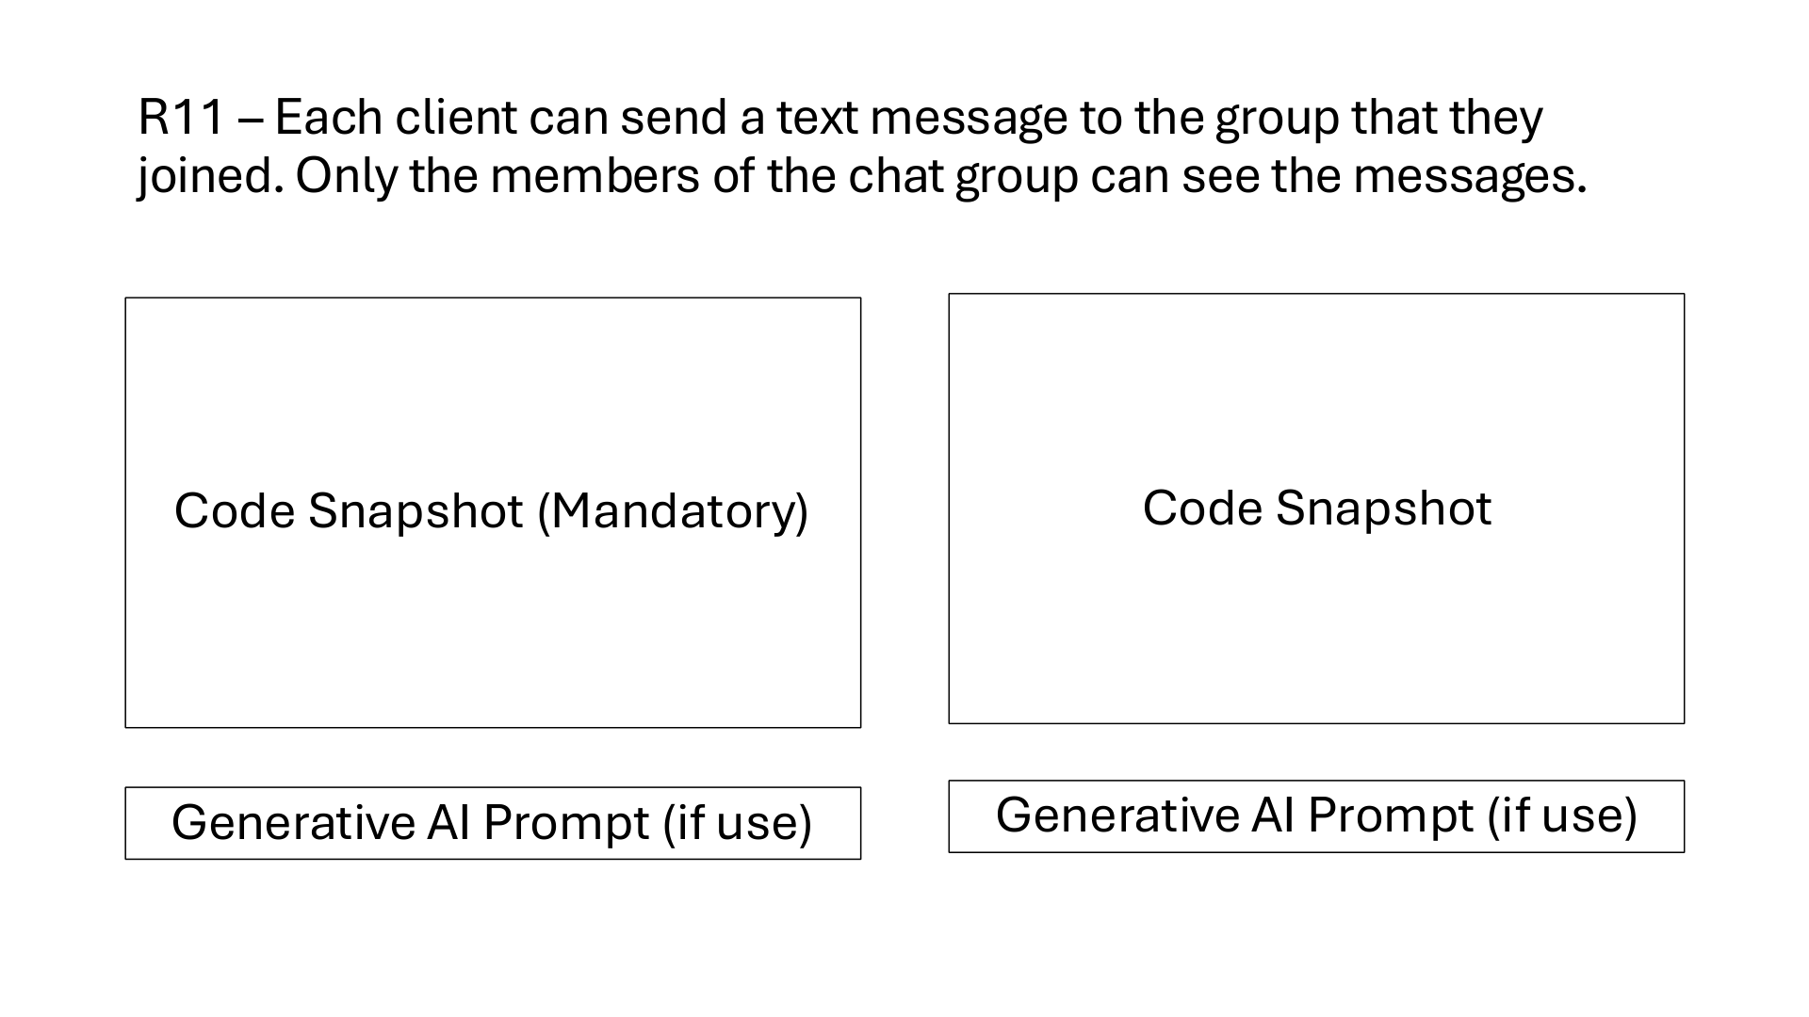
server.py:227-232
def authorized_room(self, session: UserSession, room_id: str) -> ChatRoom:
"""Check that the room exists and the user is an authorized member."""
room = self.rooms.get(room_id)
if room is None or session.id not in room.members:
raise ValueError("Join this room before using it.")
return room
server.py:342-353
"room": room.id,
"sender": session.id,
"name": session.name,
"timestamp": time.time(),
"kind": "message",
"text": cmd.text,
"read_by": [],
"delivered_by": [],
}
room.messages.append(message)
await self.broadcast({"type": "message", "message": message}, room.members)
Reject text from users who have not joined.
Broadcast group messages to members only.

Slide 16


Slide 17
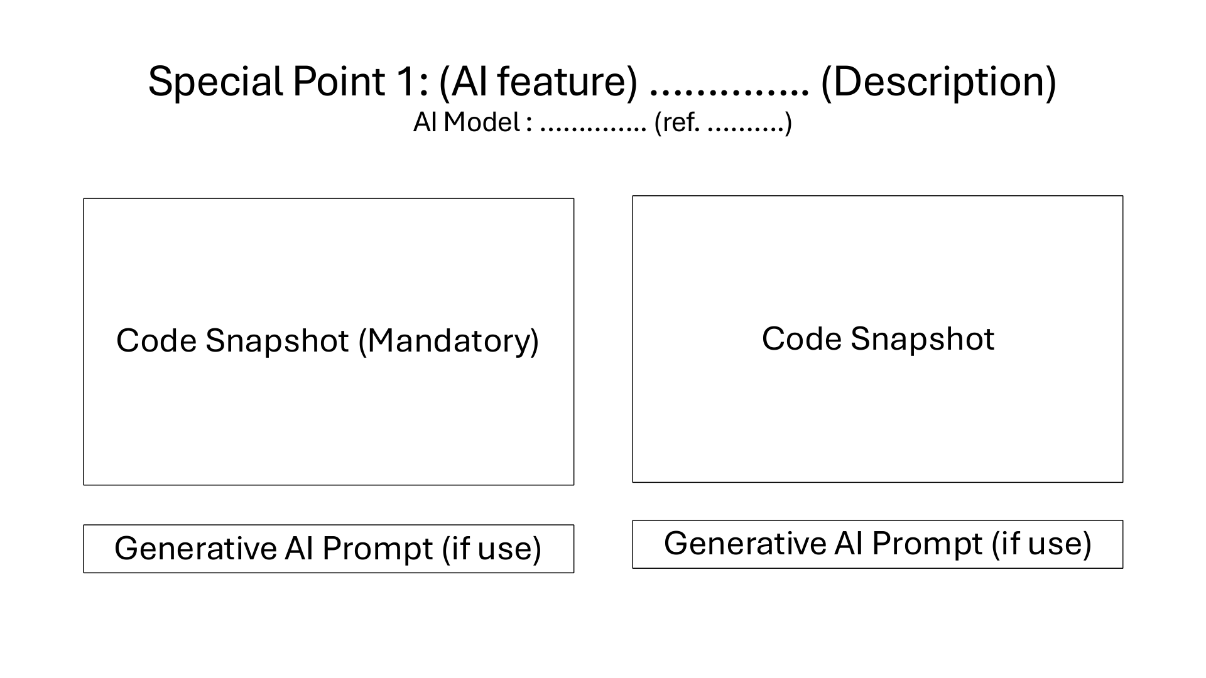
Special Point 1: AI chat summaries
AI models: Gemini 3.5 Flash-Lite; Qwen2.5 0.5B (Ollama)
Model refs: ai.google.dev/gemini-api/docs/models/gemini-3.5-flash-lite | ollama.com/library/qwen2.5:0.5b
server.py:138-142
class SummarizeCmd(BaseModel):
"""Validates requesting AI room summary (Special 1)."""
type: Literal["summarize"] = "summarize"
room: str
provider: Literal["gemini", "ollama"] = "gemini"
server.py:435-439,471-477
backends = ("gemini", "ollama") if provider == "gemini" and GEMINI_API_KEY else ("ollama",)
for backend in backends:
model = GEMINI_MODEL if backend == "gemini" else OLLAMA_MODEL
try:
if backend == "gemini":
# ...
await self.send(session, {"type": "summary", "room": room_id,
"text": text[:6000], "model": model})
break
except Exception:
if backend == "ollama":
raise
logging.warning("Gemini summary failed; retrying with Ollama", exc_info=True)
Build a room summary with Gemini or Qwen.
If Gemini fails, retry with local Qwen.

Slide 18
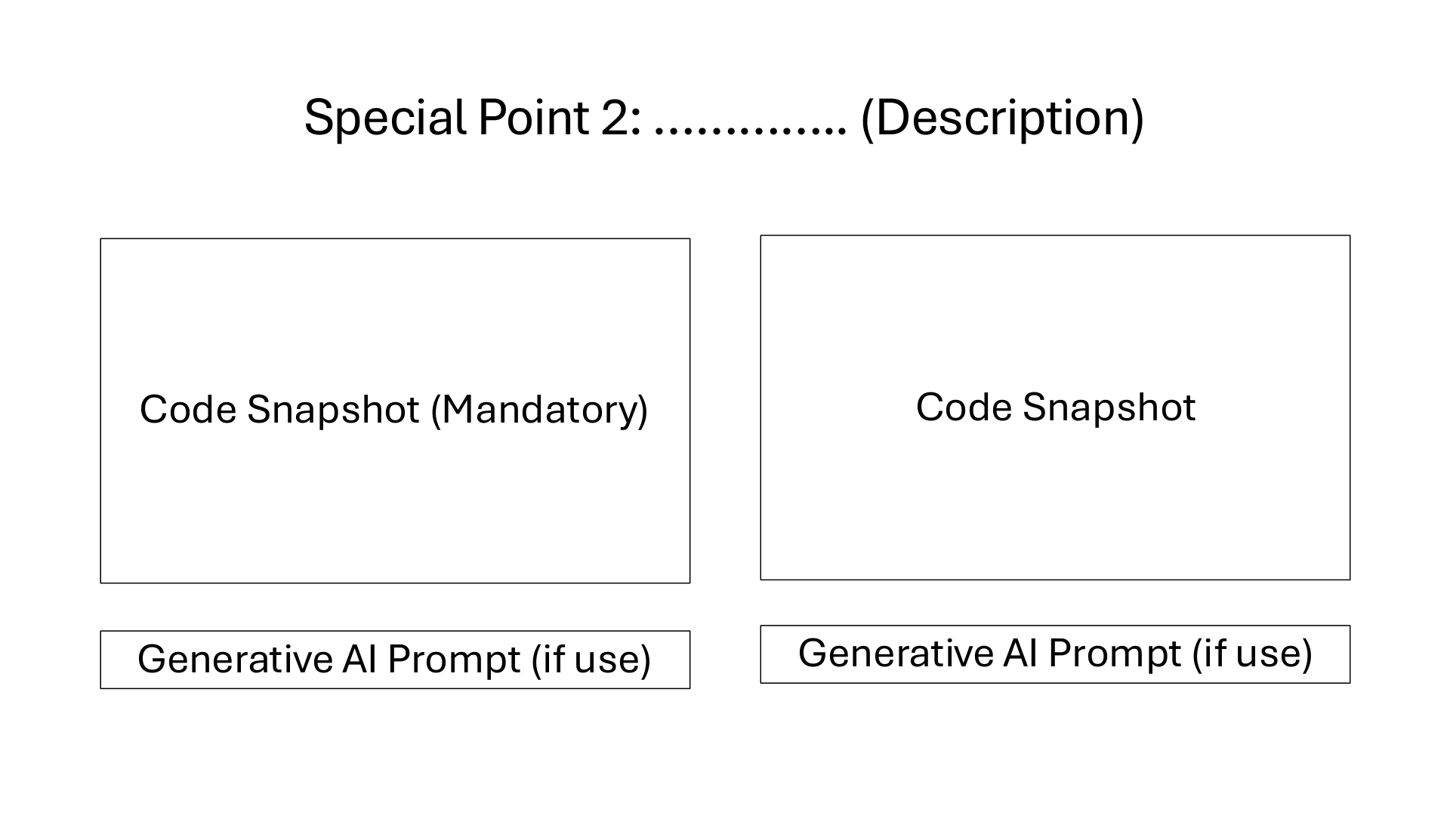
Special Point 2: WebSocket file sharing
server.py:93-105
class FileCmd(BaseModel):
"""Validates Base64 file payload through WebSocket (Special 2)."""
type: Literal["file"] = "file"
room: str
filename: str
data: str
file_bytes: int = 0
@field_validator("filename")
@classmethod
def validate_filename(cls, value: str) -> str:
if not (1 <= len(value) <= 120) or "/" in value or "\\" in value or any(ord(c) < 32 for c in value):
raise ValueError("Invalid file name.")
server.py:363-378
if room.kind == "private" and not room.members <= self.sessions.keys():
raise ValueError("This user disconnected. Open a new chat when they return.")
message = {
"id": uuid.uuid4().hex,
"room": room.id,
"sender": session.id,
"name": session.name,
"timestamp": time.time(),
"kind": "file",
"filename": cmd.filename,
"data": cmd.data,
"bytes": cmd.file_bytes,
"read_by": [],
"delivered_by": [],
Validate Base64 contents and the 256 KiB limit.
Send the file in WebSocket frames to members.

Slide 19

Special Point 3: Delivery and read receipts
server.py:124-135
class ReceiptCmd(BaseModel):
"""Validates delivery and read receipt status updates (Special 3)."""
type: Literal["read", "received"]
room: str
ids: list[str] = Field(max_length=100)
@field_validator("ids")
@classmethod
def validate_ids(cls, value: list[str]) -> list[str]:
if any(not isinstance(i, str) for i in value):
raise ValueError("Invalid read receipt.")
return value
server.py:384-401
async def handle_receipt(self, session: UserSession, data: dict):
"""Special 3: Update delivery and read receipts for room messages."""
cmd = ReceiptCmd(**data)
room = self.authorized_room(session, cmd.room)
receipt_field = "read_by" if cmd.type == "read" else "delivered_by"
for message in room.messages:
if (message["id"] in cmd.ids and session.id in room.members
and session.id != message["sender"]
and session.id not in message[receipt_field]):
message[receipt_field].append(session.id)
await self.broadcast({
"type": "receipt",
"room": room.id,
"id": message["id"],
"read_by": message["read_by"],
"delivered_by": message["delivered_by"],
}, room.members)
Track received and read message IDs.
Broadcast receipt updates to room members.

Slide 20

Special Point 4: Oracle cloud deployment
compose.oracle.yml:6-16
networks:
- default
- proxy
labels:
traefik.enable: "true"
traefik.docker.network: eventory-production_default
traefik.http.services.relay.loadbalancer.server.port: "8080"
traefik.http.routers.relay.rule: Host(`${APP_DOMAIN:-relay.161.118.238.148.sslip.io}`)
traefik.http.routers.relay.entrypoints: websecure
traefik.http.routers.relay.tls: "true"
traefik.http.routers.relay.tls.certresolver: letsencrypt
scripts/deploy.sh:17-21,28-29
printf '%s' "$registry_token" | docker login ghcr.io -u Quackudy --password-stdin >/dev/null
unset registry_token
compose=(docker compose -f compose.yml -f compose.oracle.yml)
previous=$(cat .image 2>/dev/null || true)
export APP_IMAGE="$image"
# ...
exit 1
fi
Route the app through existing Traefik TLS.
Build, push, SSH deploy, and check health.

