Slide 1

Consumer Shopping Behavior
An Analytical Project for Retail Strategy Optimization

Slide 2

EXECUTIVE SUMMARY
Unlocking Sales: Key Drivers in Consumer Behavior
This analysis of 3,900 transaction records decodes customer shopping patterns to improve sales strategy and customer loyalty. We identified that Subscription Status and Age Group are critical indicators of revenue potential.

Slide 3
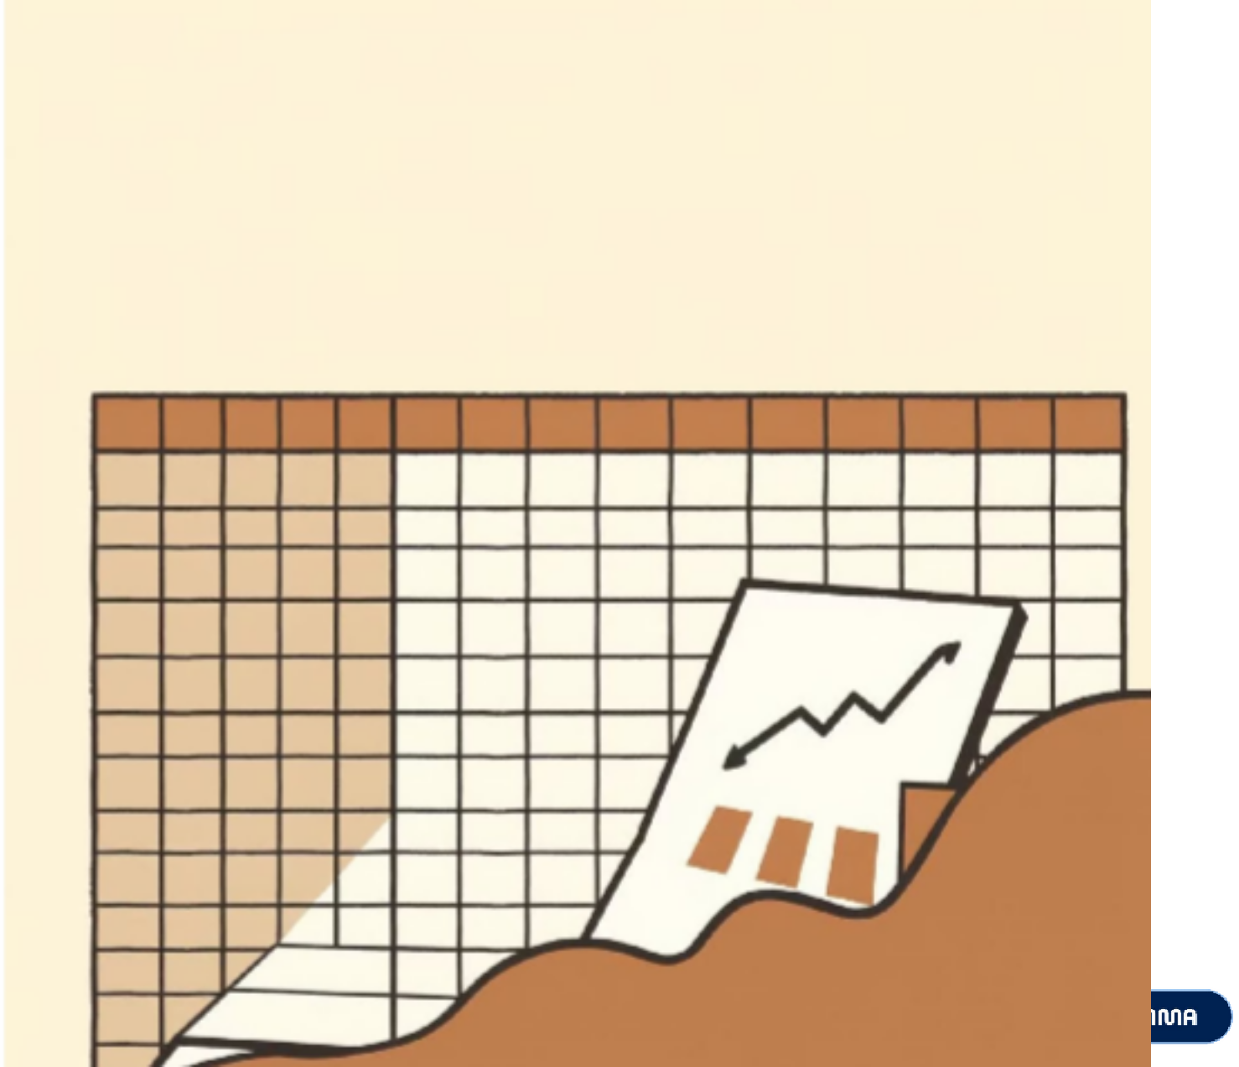

Understanding Our Customer Data
DATASET OVERVIEW
The analysis was built on a comprehensive dataset of 3,900 customer shopping records, providing a rich foundation for identifying patterns and trends.
Rows: 3,900 individual shopping records
Columns: 18 distinct features
Key Features Examined:
Customer Demographics: Age, Gender, Location, Subscription Status
Purchase Details: Item Purchased, Category, Purchase Amount, Season, Size, Color
Shopping Behavior: Discount Applied, Promo Code Used, Previous Purchases, Frequency of Purchases, Review Rating, Shipping Type
Missing Data Note: Only 37 values were missing in the 'Review Rating' column, which were carefully handled during data preparation.

Slide 4
DATA PREPARATION IN PYTHON
From Raw Data to Actionable Insights
A meticulous data preparation process was crucial to ensure accuracy and consistency, transforming raw data into a clean, structured format ready for analysis.
Data Loading & Initial Exploration
Dataset imported using pandas, with
df.info()
and
.describe()
providing
initial structural and statistical insights.
Handling Missing Values
Missing 'Review Rating' values were imputed using the median of each category to preserve data integrity and prevent loss.
Standardization
for seamless integration
All column names were converted to
snake_case
and queryability within the SQL database.
Feature Engineering
New columns like 'age_group' and 'purchase_frequency_days' were created to enable deeper, more segmented analysis.
Data Consistency & Integration
Redundant 'promo_code_used' column was dropped, and the cleaned DataFrame was loaded into MySQL for SQL analysis.

Slide 5



Unveiling Critical Revenue Disparities
SQL DATA ANALYSIS RESULTS
Our SQL analysis uncovered a significant gender gap in revenue contribution, highlighting key areas for strategic intervention.
Revenue Disparity by Gender
There is a substantial difference in revenue generated by gender. Male customers contribute more than double the revenue compared to female customers.
Male Customer Revenue: $157,000
Female Customer Revenue: $75,000
Male
Female
Why This Matters: This suggests that either our product offerings heavily cater to a male audience, or our marketing efforts targeting women are significantly underperforming. Understanding this disparity is crucial for refining product development and marketing strategies.

Slide 6
The Loyalty Paradox: A Double-Edged Sword
SQL DATA ANALYSIS RESULTS
While excellent customer retention is evident, the high proportion of loyal customers points to potential stagnation in new customer acquisition.
80% Loyal Customers
Our segmentation analysis reveals that the vast majority of our customers (80%) are categorized as "Loyal," having made more than 10 purchases.
Unusual Retention vs. Acquisition
This high loyalty rate is unusual; typically, new customer acquisition tends to outpace the loyal segment. While indicating strong retention, it also suggests that new customer acquisition might be stagnant.
Under-Monetized Loyal Base
Despite their loyalty, this significant segment appears to be under- monetized. Strategies are needed to increase their average transaction value or frequency.
Why This Matters: This paradox highlights a need to balance nurturing existing loyal customers with reinvigorating efforts to attract and convert new buyers. Excellent retention is valuable, but growth requires both.

Slide 7
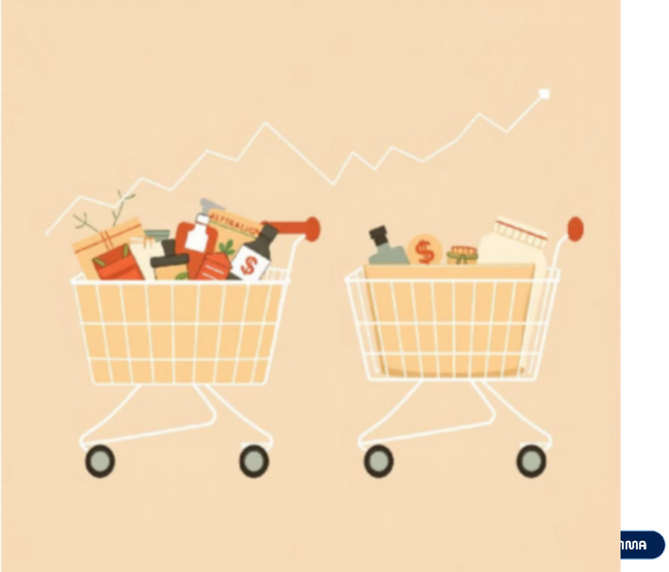
The Subscription Value Myth Debunked
SQL DATA ANALYSIS RESULTS
Our analysis challenges the assumption that subscribers inherently lead to higher average transaction values.
Subscribers vs. Non-Subscribers
Contrary to expectations, subscribers do not demonstrate a higher average spend per transaction than non-subscribers:
Average Spend (Subscribers): $59.49
Average Spend (Non-Subscribers): $59.87
Why This Matters: This finding indicates that our current subscription program primarily drives increased visit frequency rather than larger basket sizes. We need to re-evaluate the benefits and incentives of our subscription model to truly enhance customer lifetime value beyond just repeat visits.

Slide 8
SQL DATA ANALYSIS RESULTS
Identifying Our Primary Revenue Engines: Age Demographics
Focusing marketing efforts on the most profitable age groups can optimize ad spend and campaign effectiveness.
45%
35%
Young Adults (18-35)
This demographic represents a significant portion of our revenue, showing strong engagement and purchasing power.
Middle-Aged (36-55)
Another core revenue driver, this group often has established spending habits and brand loyalty.
15%
5%
Adult (56-65)
A smaller but still important segment, contributing consistently to overall revenue.
Old (66+)
This group currently contributes the least to revenue. Re-evaluating ad spend for this demographic could optimize ROI.
Why This Matters: By understanding which age groups are our primary revenue engines, we can strategically allocate marketing resources. This enables us to either cease wasting ad spend on less profitable demographics or specifically tailor campaigns to engage them more effectively.

Slide 9

Uncovering "Hero Products": Top-Rated Customer Favorites
SQL DATA ANALYSIS RESULTS
Identifying products with high customer satisfaction allows us to leverage social proof in marketing and enhance buyer trust.
Gloves: Consistently received the highest review ratings, indicating exceptional customer satisfaction.
Sandals: Another top-performing product, highly praised by customers for quality and value.
Coats: Strong positive feedback, making them a reliable choice for customer delight.
Jewelry: High-rated for design and quality, driving positive customer sentiment.
Dresses: A popular category with strong review ratings, appealing to a broad customer base.
Why This Matters: These "Hero Products" are powerful assets for marketing. Featuring them prominently in campaigns, especially through customer testimonials and visuals, can build trust with new buyers and reinforce our brand's reputation for quality.

Slide 10





Actionable Insights for Growth & Optimization
STRATEGIC RECOMMENDATIONS
Based on our findings, we propose a multi-faceted approach to optimize retail strategy, boost revenue, and enhance customer loyalty.
Boost Subscription Value
Re-evaluate and promote exclusive benefits for subscribers to drive higher engagement and basket sizes, not just visit frequency.
Enhance Loyalty Programs
Implement robust rewards programs to acknowledge and further incentivize repeat buyers, solidifying their transition into the "Loyal" segment.
Review Discount Policy
Analyze the impact of current discount strategies to ensure they effectively boost sales without excessively eroding profit margins.
Strategic Product Positioning
Feature top-rated and best-selling "Hero Products" prominently in marketing campaigns to leverage social proof and attract new customers.
Refine Targeted Marketing
Direct marketing efforts more intensely towards high-revenue age groups and express-shipping users for maximized ROI and conversion.

