Slide 1

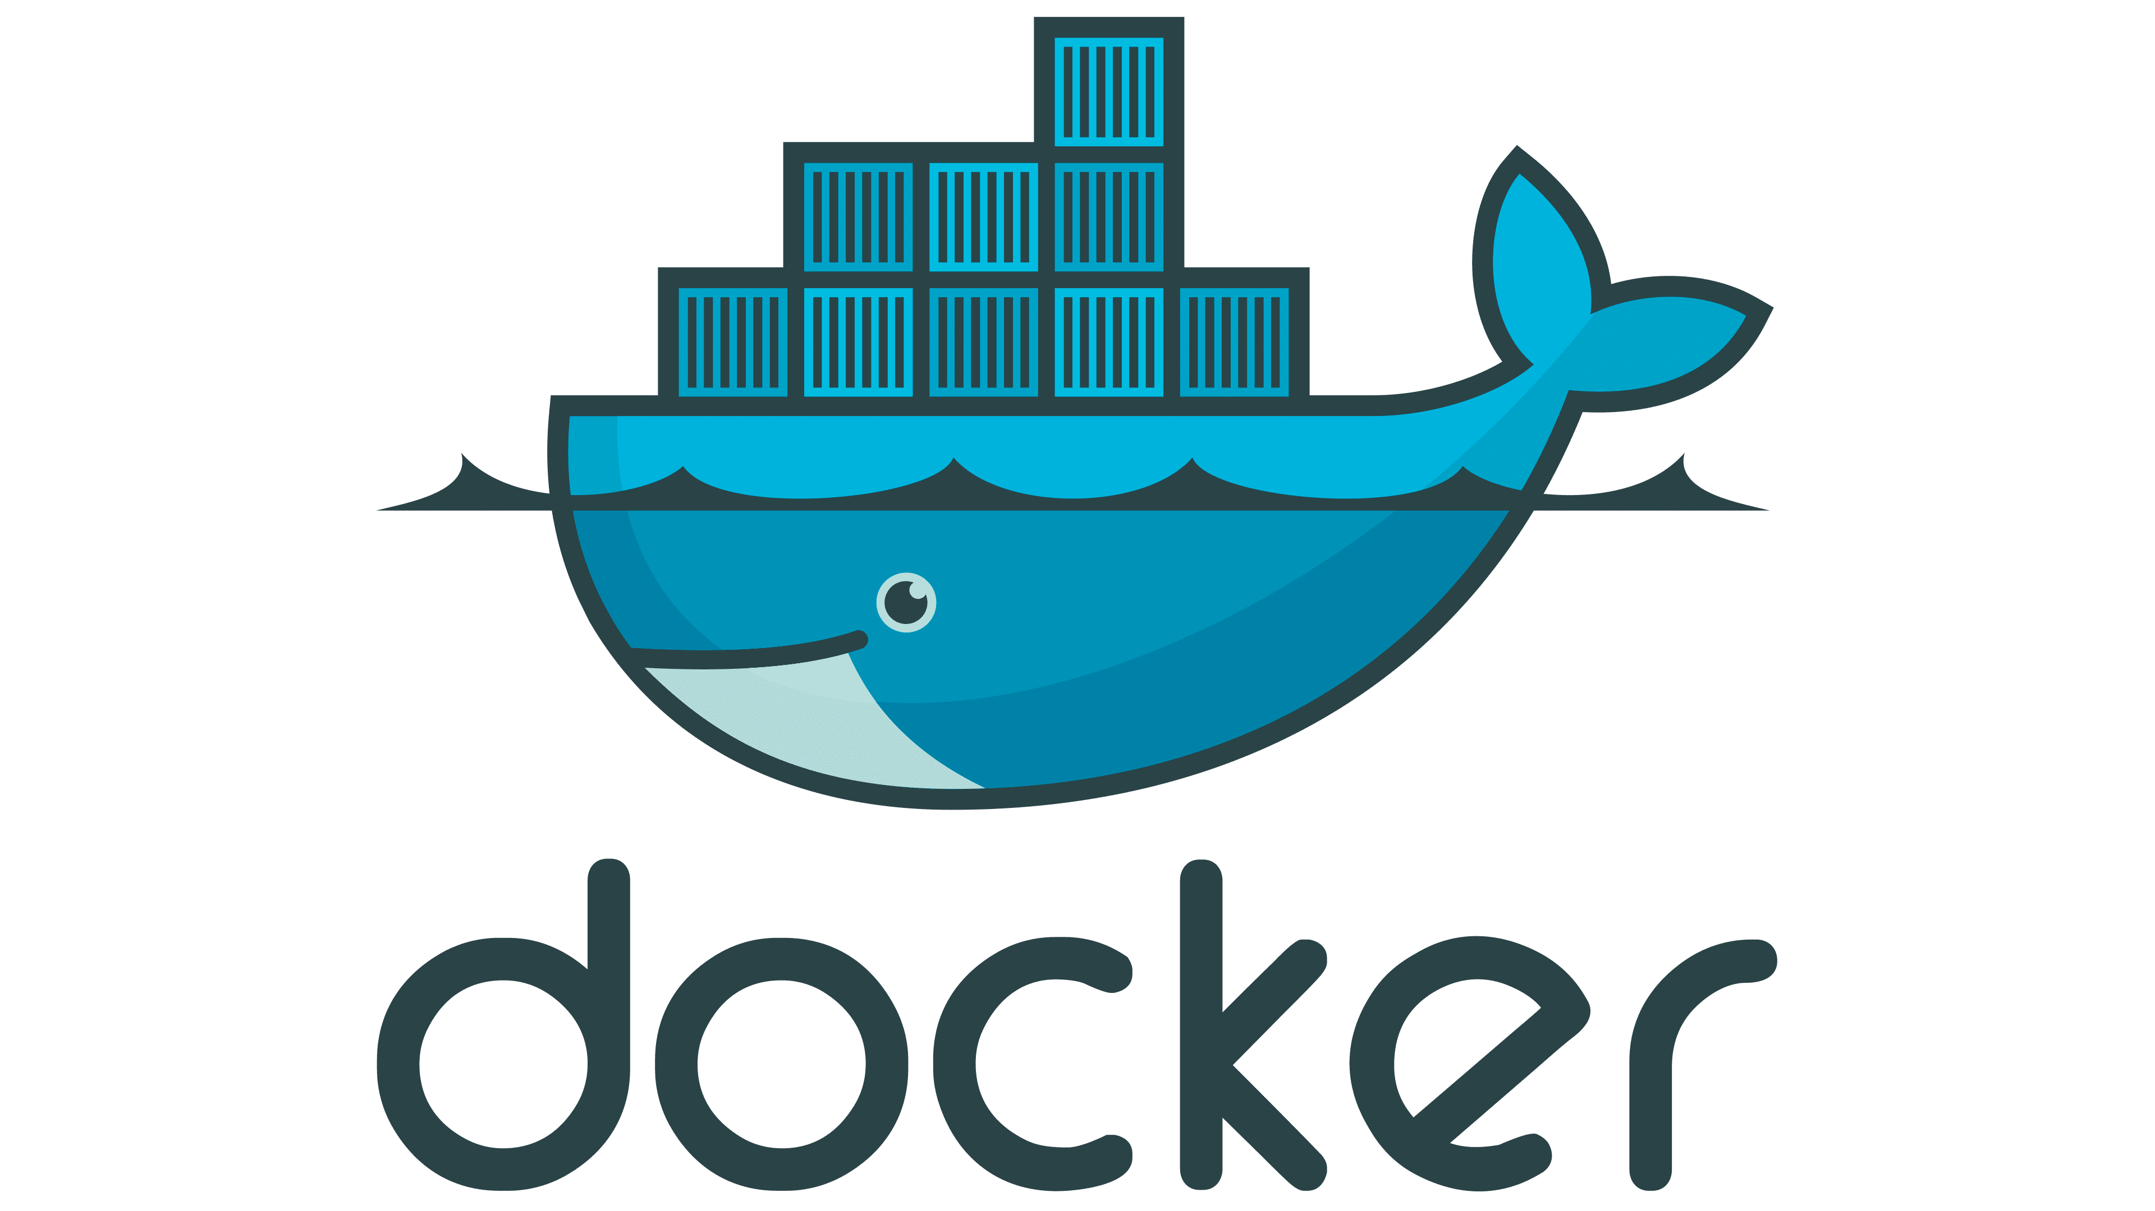
www.sscademy.com +918296373001

Slide 2
Topics
What are Containers
What is Docker
Docker Setup
Docker commands & concepts
Docker logs
Docker volumes
Docker Images
Entrypoint and CMD
Docker compose
Multi stage Docker file
www.sscademy.com

Slide 3

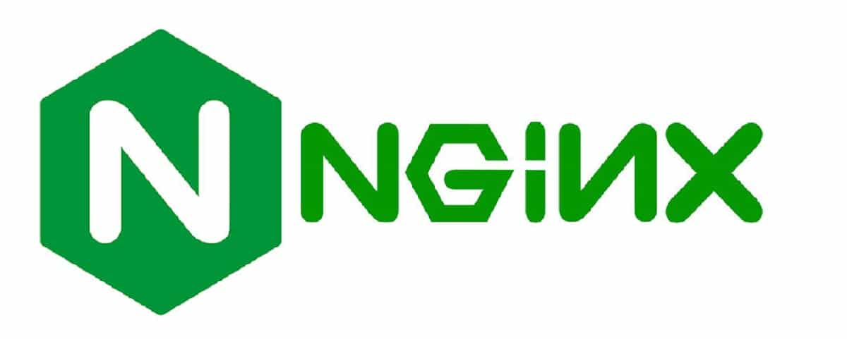

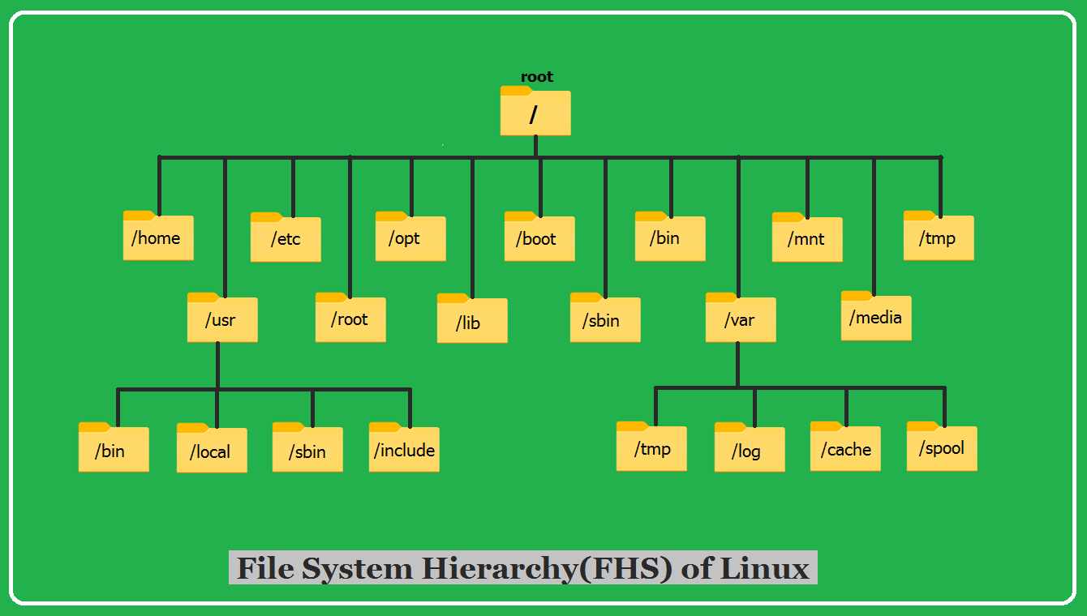
Linux Server
Tomcat
Linux Server

Slide 4
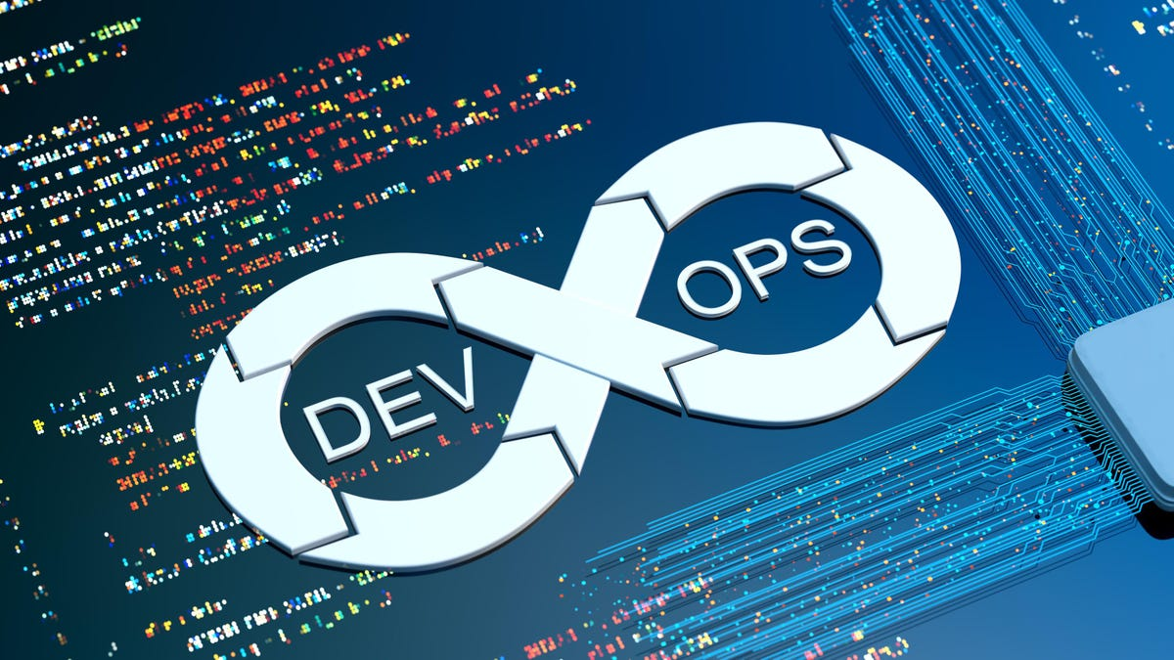
Isolation
Tomcat
Server 1
Server 2
Server 3
Network Switch
www.sscademy.com

Slide 5
Containers
Nginx Container
Linux Server
Apache Tomcat Container
MariaDB Container
Tomcat
Network
www.sscademy.com

Slide 6
Containers
Containers can be archived which we call as Image or container Image. Which we can ship it. The image which you have
Used on your local machine can be able to run on any environment like DEV, PRE-PROD, PROD.
One such tool which we can use to create containers is Docker.
www.sscademy.com

Slide 7
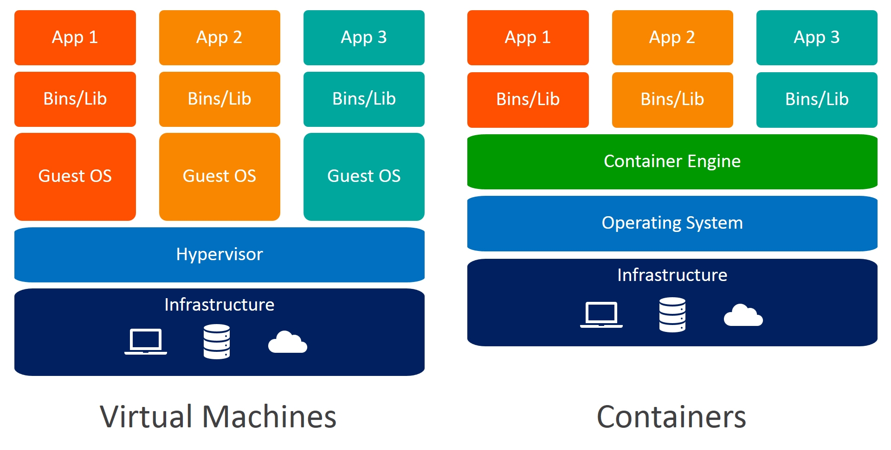
Difference Between Docker and Virtualisation
www.sscademy.com

Slide 8
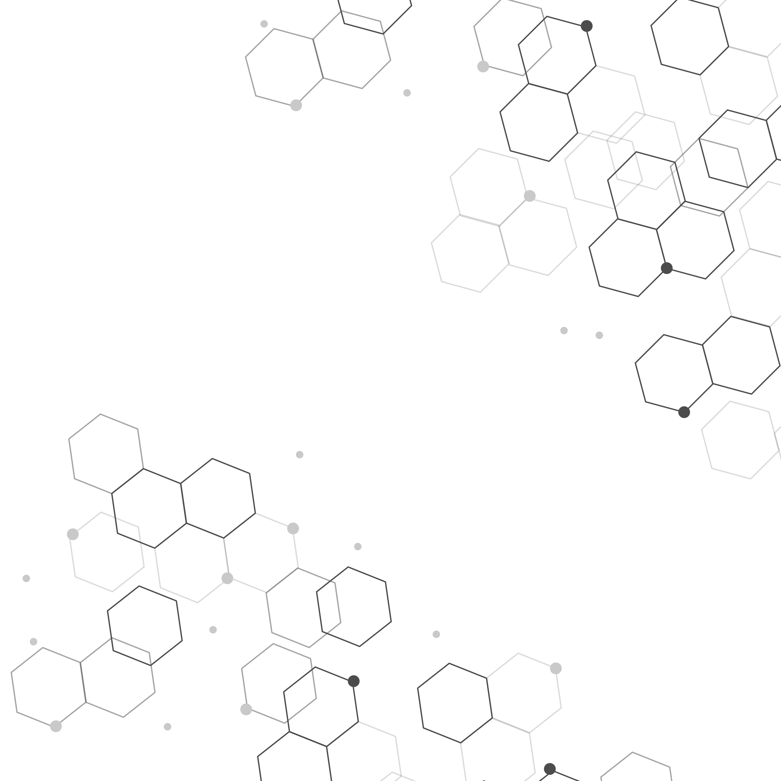
QUESTION & ANSWERS
www.sscademy.com

Slide 9



Contact us for more details
sales@sscademy.com
sales@sscademy.com
www.sscademy.com
+ 918296373001

