Slide 1
P331 GPIO expansion chips
schematic overview

Slide 2
P331
Uses GPIO expansion chips (XRA1403, by Exar)
  8 total
    4 for left channel
    4 for right channel
    For each channel, 1 chip is for front-panel input (mostly); remaining three chips are for output to control relays (7-segment LED is optional, handy for debug if wished to be implemented)
  https://www.digikey.com/products/en?keywords=1016-1723-5-ND
    Datasheet located here:
    https://www.exar.com/content/document.ashx?id=20785
  Each GPIO expansion chip has 16 signals (configurable as input or output using SPI bus commands listed in datasheet)

Slide 3
Because of so many GPIO expansion chips (mostly controlling relays and reading input switch positions), chip-selects are implemented in the design
  Implemented on PORT A of PIC
  Chip selects should be activated first, then data/commands are issues on SPI bus per XRA1403IG24-F Datasheet
  Note: we use “CS” for “chip select”
  Only one chip select active at a time…. Expansion chips are not SPI serial daisy-chained…

Slide 4
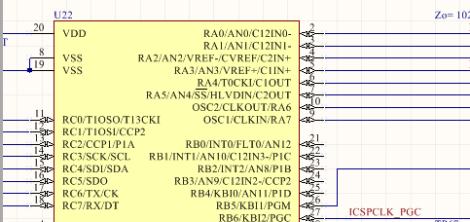
Micro Controller Unit (MCU) PIC chip close up PORTA for chip selects
CS 0 through 3
LEFT channel
CS 4 through 7
RIGHT channel

Slide 5
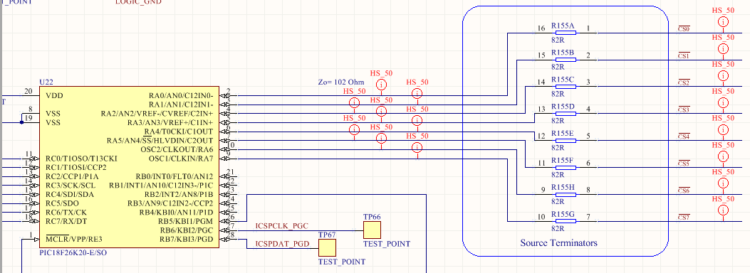
CHIP SELECTS on MCU schematic
CS 0 through 3
LEFT channel
CS 4 through 7
RIGHT channel
PIC 18F26K20

Slide 6
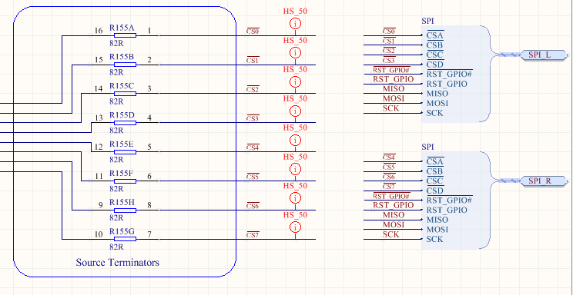
CHIP SELECTS on MCU schematic Bus connection to rest of PCB
CS 0 through 3
LEFT channel
CS 4 through 7
RIGHT channel
GPIO expansion chips are addressed one-at-a-time (i.e., only one chip select active at any one time). Expansion chips are NOT serially daisy-chained

Slide 7
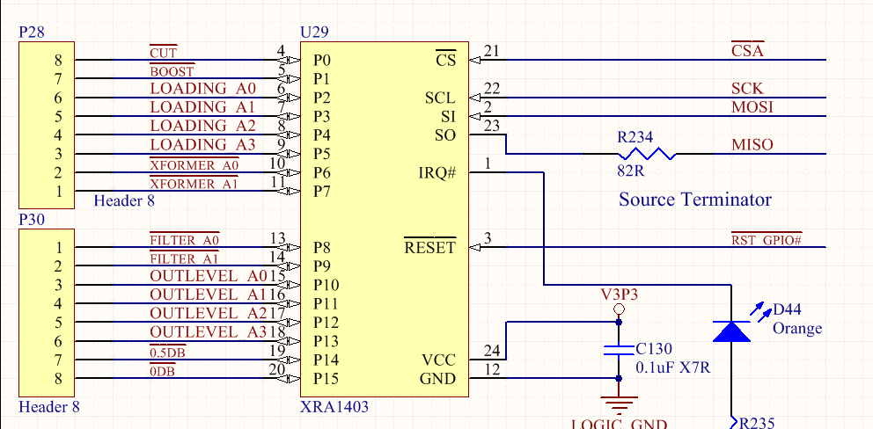
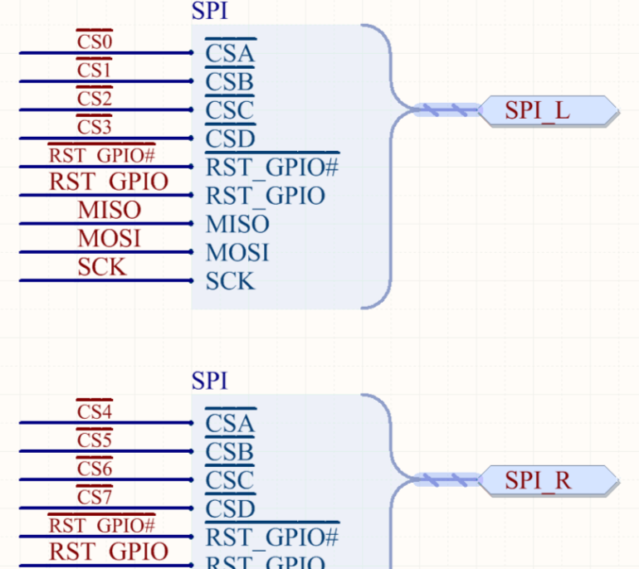
Exar GPIO expansion chip for Front Panel user Input on front panel switches
(Line Amp, Relay Drivers : SPI_GPIOs_RELAY_DRIVERS.SchDoc schematic page)
Note (logical) Ref Designators shown are not what is (physically) silkscreened on PCB
CS”A” (Chip Select “A”) is either CS 0 (Left Channel) or CS4 (Right Channel) on PORTA of PIC, when design is expanded into two-channel design

Slide 8
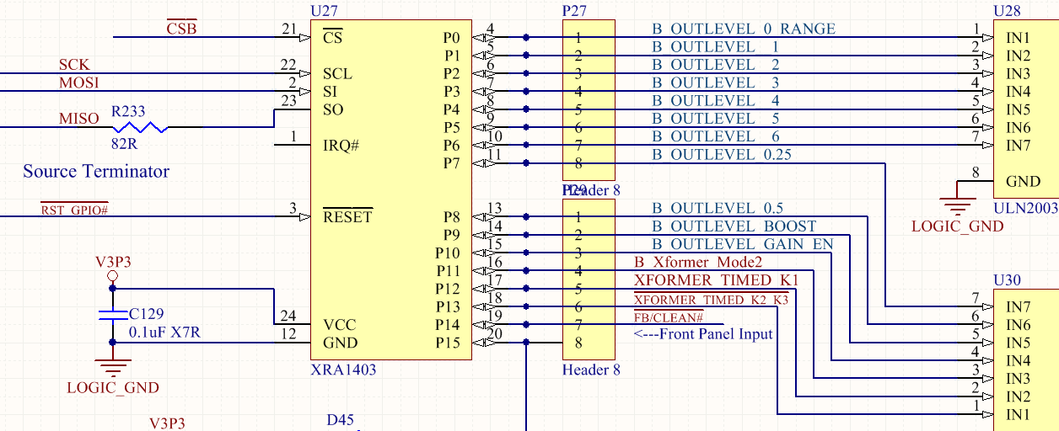
Next bank of Exar chips, GPIO expansion…
CS”B” is CS1 (Left ch.) or CS5 (right channel) on PORTA of PIC
Relay Drivers
This is an INPUT from front panel switches (we ran out of inputs on previous Input GPIO bank)

Slide 9
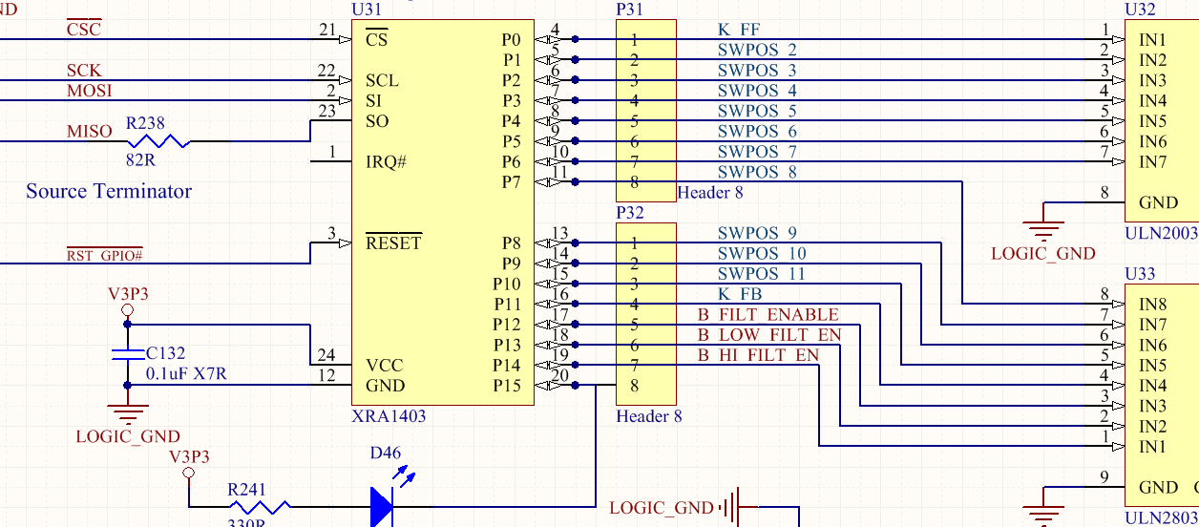
Next bank of Exar chips, GPIO expansion…
CS”C” is CS2 (Left ch.) or CS6 (right channel) on PIC
Relay Drivers

Slide 10
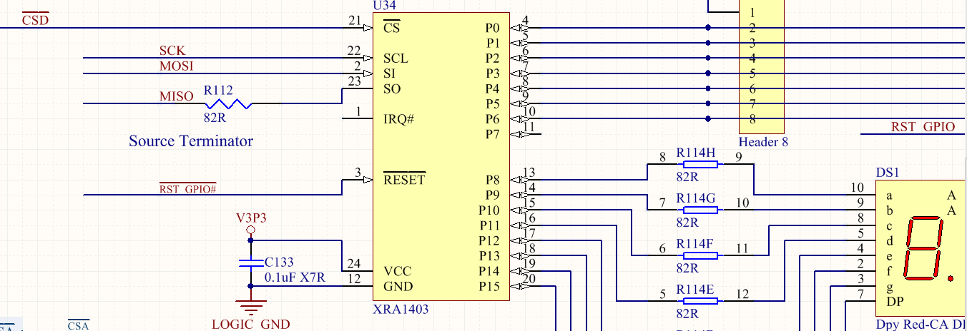
Last bank of Exar chips, GPIO expansion…
CS”D” is CS3 (Left ch.) or CS7 (right channel) on PIC
To relay drivers for Rear IO attenuator/pad
Optional 7-segment LED for debug

