Slide 1
P331 GPIO expansion chips
schematic overview

Slide 2
P331
Uses GPIO expansion chips (XRA1403, by Exar)
  8 total
    4 for left channel
    4 for right channel
    For each channel, 1 chip is for front-panel input (mostly); remaining three chips are for output to control relays (7-segment LED is optional, handy for debug if wished to be implemented)
  https://www.digikey.com/products/en?keywords=1016-1723-5-ND
    Datasheet located here:
    https://www.exar.com/content/document.ashx?id=20785
  Each GPIO expansion chip has 16 signals (configurable as input or output using SPI bus commands listed in datasheet)

Slide 3
Because of so many GPIO expansion chips (mostly controlling relays and reading input switch positions), chip-selects are implemented in the design
  Implemented on PORT A of PIC
  Chip selects should be activated first, then data/commands are issues on SPI bus per XRA1403IG24-F Datasheet
  Note: we use “CS” for “chip select”
  Only one chip select active at a time…. Expansion chips are not SPI serial daisy-chained…
  CHIPSELECTS ARE ACTIVE LOW

Slide 4
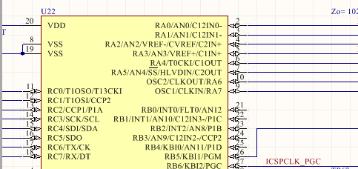
Micro Controller Unit (MCU) PIC chip close up PORTA for chip selects
CS 0 through 3
LEFT channel
CS 4 through 7
RIGHT channel

Slide 5
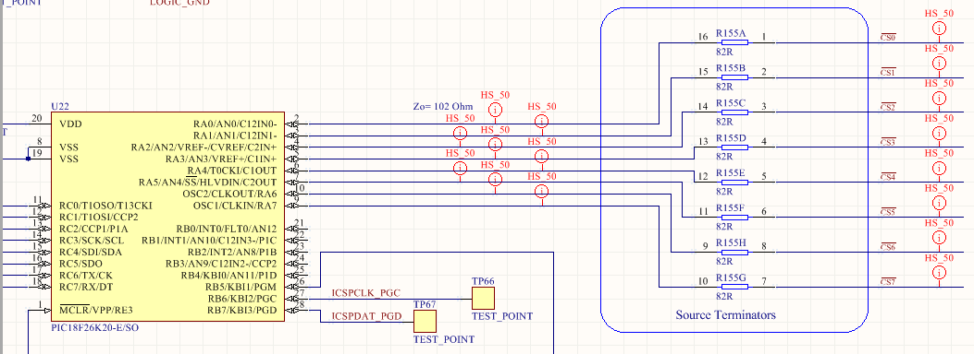
CHIP SELECTS on MCU schematic
CS 0 through 3
LEFT channel
CS 4 through 7
RIGHT channel
PIC 18F26K20

Slide 6
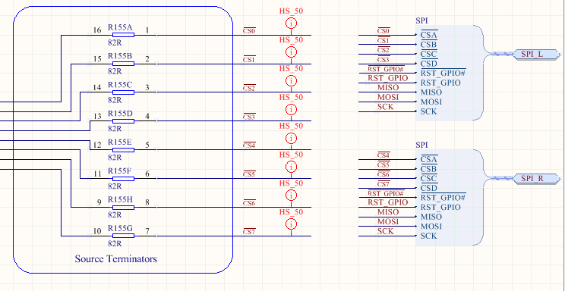
CHIP SELECTS on MCU schematic Bus connection to rest of PCB
CS 0 through 3
LEFT channel
CS 4 through 7
RIGHT channel
GPIO expansion chips are addressed one-at-a-time (i.e., only one chip select active at any one time). Expansion chips are NOT serially daisy-chained

Slide 7
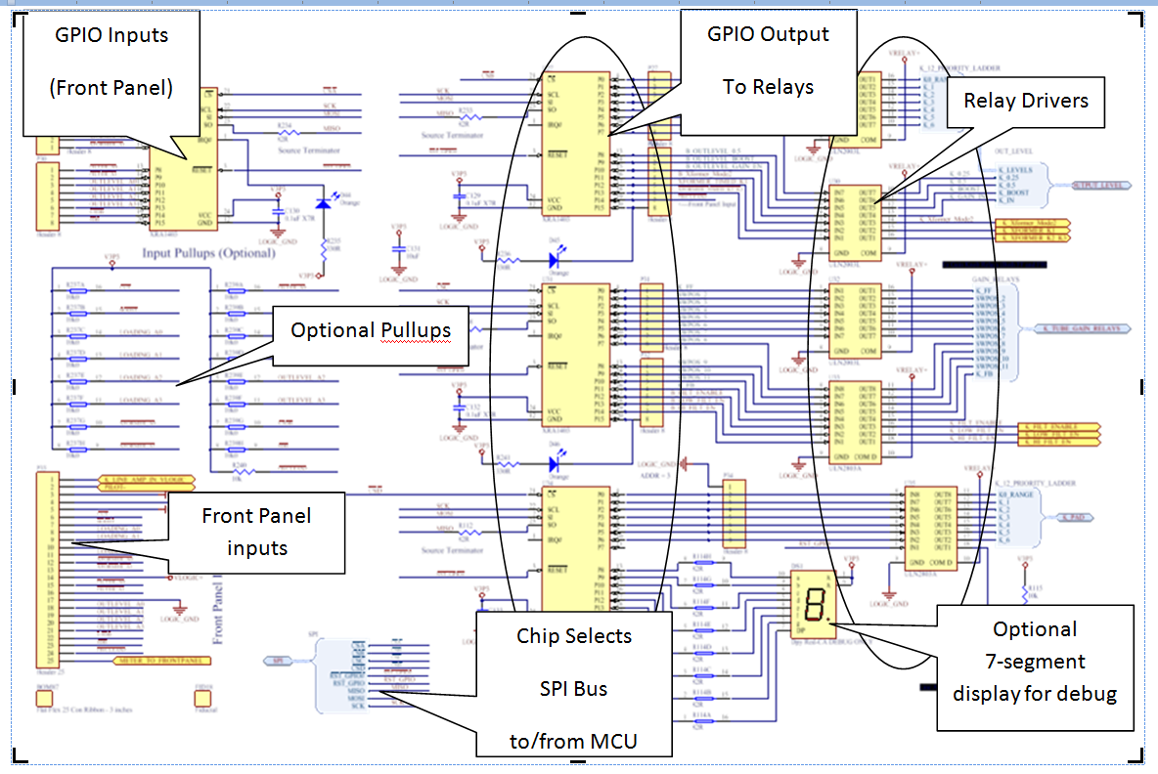
GPIO Expansion chips (logical, 1 channel shown)

Slide 8
Lets look at the inputs from front panel first…

Slide 9
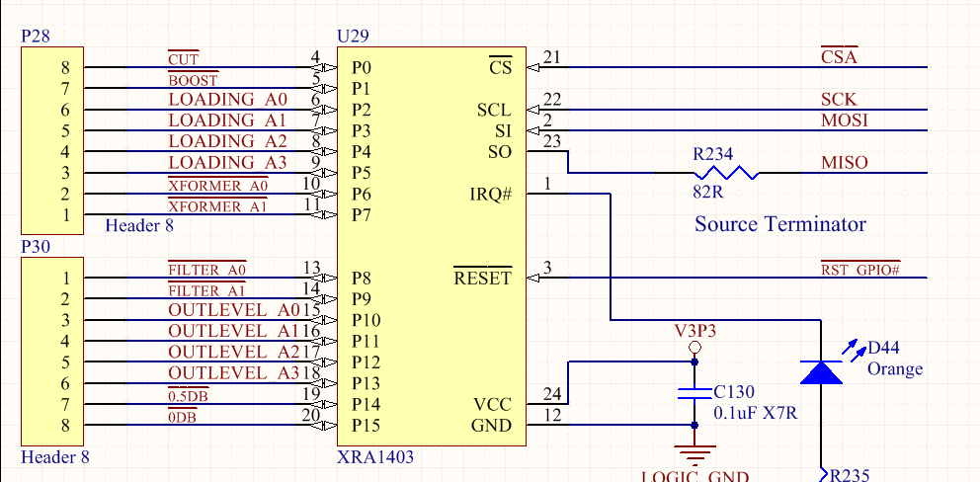
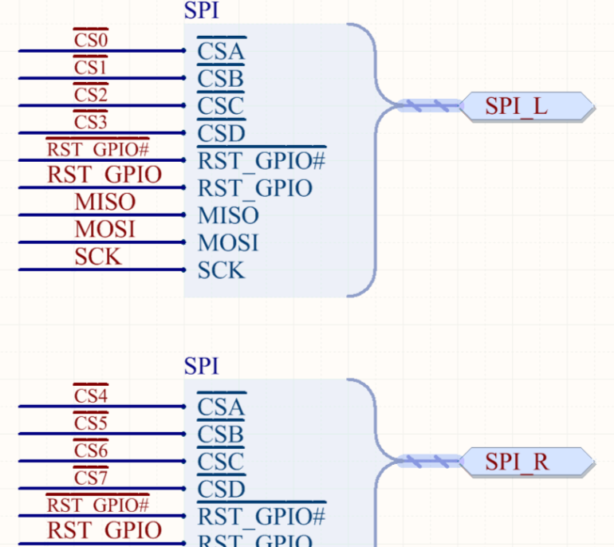
Exar GPIO expansion chip for Front Panel user Input on front panel switches
(Line Amp, Relay Drivers : SPI_GPIOs_RELAY_DRIVERS.SchDoc schematic page)
Note (logical) Ref Designators shown in these images are not what is (physically) silkscreened on PCB or in the physical PDF of schematic
CS”A” (Chip Select “A”) is either CS 0 (Left Channel) or CS4 (Right Channel) on PORTA of PIC, when design is (physically) expanded into two-channel design

Slide 10
Next bank… outputs (and one input)

Slide 11
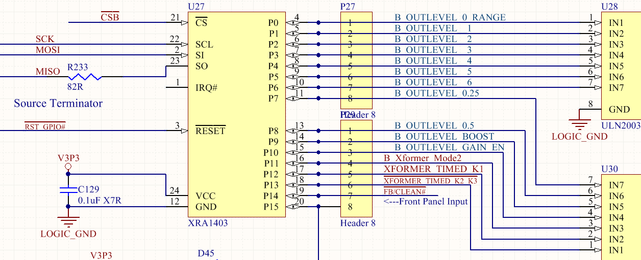
Output (and one input), GPIO expansion…
CS”B” is CS1 (Left ch.) or CS5 (right channel) on PORTA of PIC
Relay Drivers
This is an INPUT from front panel switches (we ran out of inputs on previous Input GPIO bank)

Slide 12
Configure this Exar GPIO expansion chip to have the one input from front panel switches, and the rest are outputs to relays….

Slide 13
Next bank… outputs

Slide 14
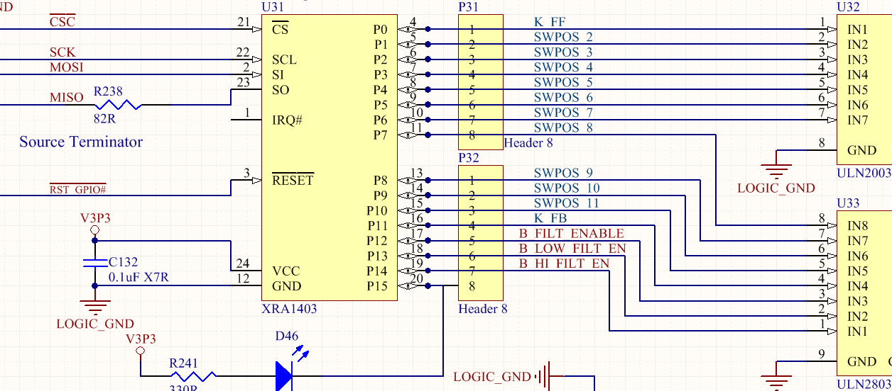
Next bank of Exar chips, GPIO expansion… Tube PCB 12-relays drivers and Rear IO filters (“Lift” Circuit)
CS”C” is CS2 (Left ch.) or CS6 (right channel) on PIC
Relay Drivers

Slide 15
Final Bank… Outputs

Slide 16
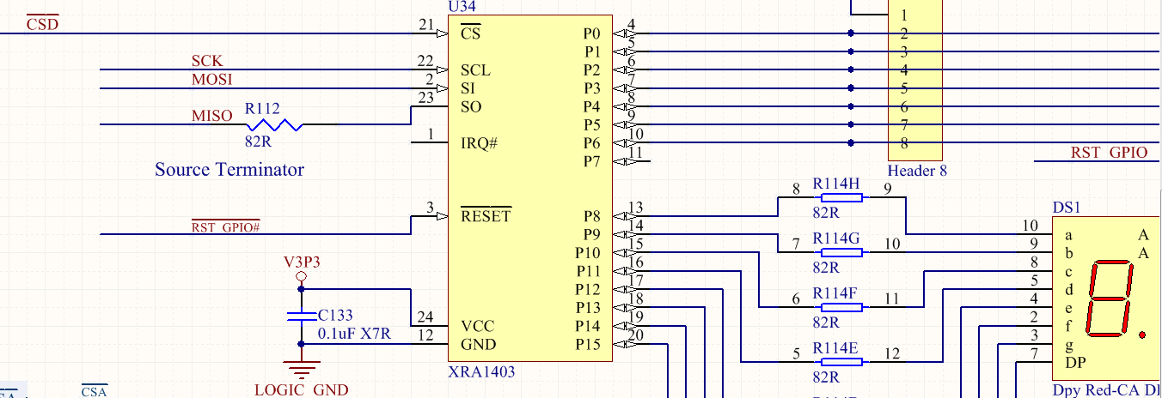
Last bank of Exar chips, GPIO expansion… Rear IO PAD relays
CS”D” is CS3 (Left ch.) or CS7 (right channel) on PIC
To relay drivers for Rear IO attenuator/pad
Optional 7-segment LED for debug

Slide 17
Typical Firmware Programming Example
With chip select set to appropriate GPIO expansion chip, one at a time:
Read front-panel input GPIO expansion chip to get switch positions
  Don’t forget to scan the one lone rogue input on that expansion chip that has 15 outputs but one input (we ran out of pins on the input expansion chip)
  Some rotary switches are 4-bit binary encoded, yet 0 through 11 (in binary) is used; this could be an unsigned byte or nibble or unsigned char in the firmware code…
  Other switches are either active high or low per schematic; this could be a typedef style of C-struct in the firmware…
Convert switch positions into relay 1’s or 0’s and output to GPIO
  Conversion method is highlighted previous programming word doc…
    Some are thermometer-code conversions, or in the case of a 7-relay ladder being controlled by a 12-position (binary nibble) input, a single bit-shifted unraveling… See logic tables in previous word doc for Firmware programming…
  Output these 1’s or 0’s to the GPIO by setting appropriate chip selects one-at-a-time and writing to the SPI bus
Lather, rinse, repeat for each stereo analog channel instantiation

Slide 18
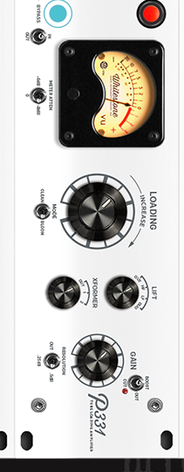
1. Read front-panel input GPIO expansion chip to get switch positions
CS”A” (Chip Select “A”) is either CS 0 (Left Channel) or CS4 (Right Channel) on PORTA of PIC
12position (4-bit encoded)
FB/CLEAN#
From other GPIO Expansion Chip
Note: “Lift” = “Filter”

Slide 19
2. Convert switch positions into relay 1’s or 0’s and output to GPIO
CS”B” is CS1 (Left ch.) or CS5 (right channel) on PORTA of PIC
12-position switch (4-bit encoded) CONVERTED to 7-relay (7-bit) output * (See next page)
Relay Drivers
FB/CLEAN#
TO input Scanning Operations
This is an INPUT from front panel switches (we ran out of inputs on previous Input GPIO bank); Don’t forget to read me too ☺

Slide 20
12-postion switches encoded as 4-bit, Converted to 7-bit (7-relay) ladder control truth table
(for output level (gain) and loading knob)
 | Energized?
SW POS | KRANGE | K1 | K2 | K3 | K4 | K5 | K6
1 | No | No | No | No | No | No | No
2 | Yes | No | No | No | No | No | No
3 | No | Yes | Yes | No | No | No | No
4 | Yes | Yes | Yes | No | No | No | No
5 | No | Yes | No | Yes | No | No | No
6 | Yes | Yes | No | Yes | No | No | No
7 | No | Yes | No | No | Yes | No | No
8 | Yes | Yes | No | No | Yes | No | No
9 | No | Yes | No | No | No | Yes | No
10 | Yes | Yes | No | No | No | Yes | No
11 | No | Yes | No | No | No | No | Yes
12 | Yes | Yes | No | No | No | No | Yes
Note that range (KRANGE, “K” is used for “coil” in relay-speak) is alternating every other switch position, just like in a binary count the LSb is always alternating… The other bits (K1 through K6) are doubled for each switch position. K1 follows same concept/pattern, but its bit is inverted for when lineamp is being powered up/down.

Slide 21
Next bank of Exar chips, GPIO expansion…
CS”C” is CS2 (Left ch.) or CS6 (right channel) on PIC
12-position LOADING switch CONVERTED to custom thermometer-code output * (See next page)
Relay Drivers

Slide 22
K_FF (Relay coil “K”, for Feed Forward mode)
K_FB = feedback mode
Switch positions 2 through 11 are thermometer code decoded from 4-bit binary value
  When switch is in position 2, then SWPOS2 is active… position 3, SWPOS3… position 4, SWPOS4… an so on to SWPOS11…
  K_FF and K_FB are special, and represent SWPOS1 (not shown) or SWPOS12 (not shown) depending upon clean (feedback) or bloom (feedforward) mode switch position…
  This was done to minimize logic and relay ($$$) component count, using electromechanical and analog circuit ladder relay logic combined with digital logic.

Slide 23
FF is feedforward (active in this table): FF =1 when FB/CLEAN# is High
FF
1 |  | SWPOS | 1 | 2 | 3 | 4 | 5 | 6 | 7 | 8 | 9 | 10 | 11 | 12
 |  | K_FF |  |  |  |  |  |  |  |  |  |  |  | 1
 |  | K2 |  | 1
 |  | K3 |  |  | 1
 |  | K4 |  |  |  | 1
 |  | K5 |  |  |  |  | 1
 |  | K6 |  |  |  |  |  | 1
 |  | K7 |  |  |  |  |  |  | 1
 |  | K8 |  |  |  |  |  |  |  | 1
 |  | K9 |  |  |  |  |  |  |  |  | 1
 |  | K10 |  |  |  |  |  |  |  |  |  | 1
 |  | K11 |  |  |  |  |  |  |  |  |  |  | 1
 |  | K_FB | 1 | 1 | 1 | 1 | 1 | 1 | 1 | 1 | 1 | 1 | 1 | 1
Essentially, FF = the raw, non-inverted FB/CLEAN# signal from the front panel switch

Slide 24
FF = 0 when FB/CLEAN# is low
FF
0 |  | SWPOS | 1 | 2 | 3 | 4 | 5 | 6 | 7 | 8 | 9 | 10 | 11 | 12
 |  | K_FF | 1 | 1 | 1 | 1 | 1 | 1 | 1 | 1 | 1 | 1 | 1 | 1
 |  | K2 |  | 1
 |  | K3 |  |  | 1
 |  | K4 |  |  |  | 1
 |  | K5 |  |  |  |  | 1
 |  | K6 |  |  |  |  |  | 1
 |  | K7 |  |  |  |  |  |  | 1
 |  | K8 |  |  |  |  |  |  |  | 1
 |  | K9 |  |  |  |  |  |  |  |  | 1
 |  | K10 |  |  |  |  |  |  |  |  |  | 1
 |  | K11 |  |  |  |  |  |  |  |  |  |  | 1
 |  | K_FB |  |  |  |  |  |  |  |  |  |  |  | 1

Slide 25
Pad and Tube relays have identical switch position implementation but different decoding schemes
Note that Rear IO attenuator/PAD (4-bit to 7-bit relay ladder) is tandem to TUBE PCB 12-relay thermometer coded relays just shown in prior slide truth table…
In other words, when switch position 7 (for example) is selected on Loading knob, both the attenuator/pad on Rear IO and 12-relays on Tube PCB should be set as they would for position 7
  The decoding/converting is different for these two relay ladder circuits on the two different PCBs, but switch position 1 through 12 are implemented in tandem to these two different relay ladders
  Position 1 means both ladders are set as they would be for position1 (with their different decoding methodologies shown in prior slides)
  Postion 2 means both ladders are set as they would be for position 2
  Positon 3 … and … so-on….
Attenuator/pad relay ladder (7 relays, Rear IO PCB)
Decode 4-bit to 7-bit
Front Panel
Loading Knob
4-bit
Decode 4-bit to custom Thermometer code
Tube PCB relay ladder (12 relays)

