Slide 1
Will They Default?
A Machine Learning and Cloud ETL project
By Quaid Scrivens

Slide 2
Purpose
To predict one’s likelihood of defaulting on their next credit card payment, in order to help banks better manage their risk.

Slide 3
Overview
Data source
Data cleaning/Transformation
Loading to AWS S3 bucket
Build ML models and compare
Outline most effective models
Load data to AWS Database

Slide 4

Data Source
Includes:
Age
Sex
Marital status
Education
CC Limit
6 months of CC payment status
6 months of CC bills
6 months of CC payments
Default status for 7th month

Slide 5
Cleaning and Transformation

Slide 6
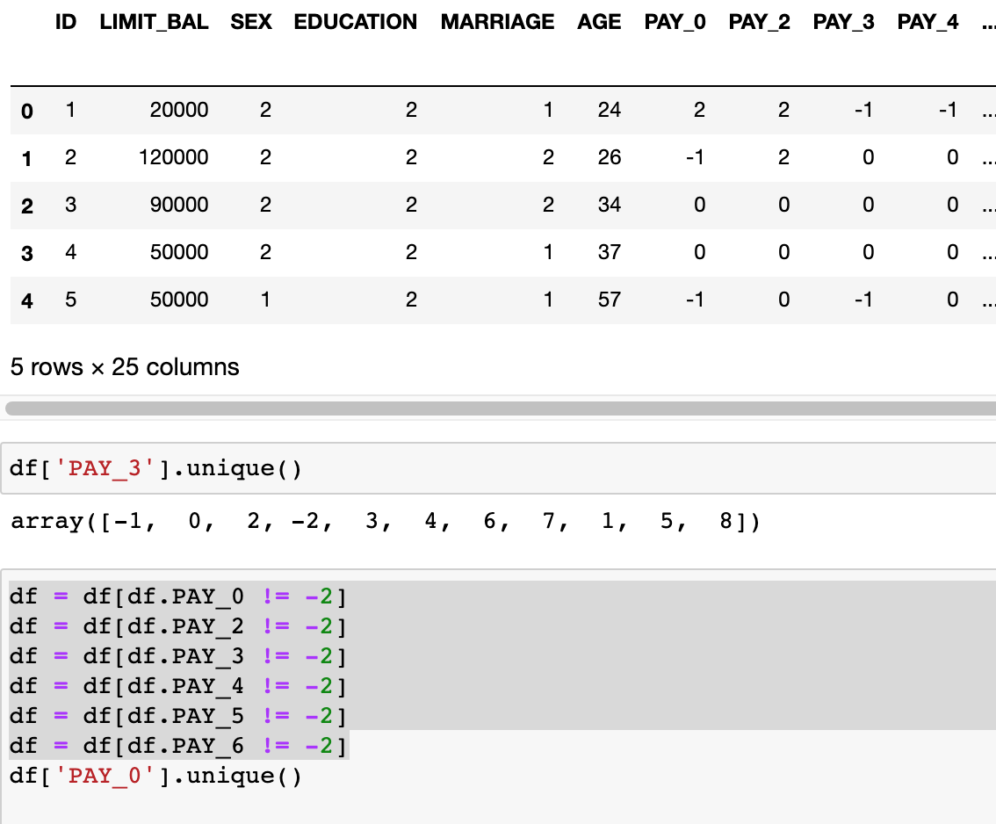
Remove entries that don’t make sense.

Slide 7
Cleaning and Transformation
For Education: 1 = High School, 2 = Bachelors, 3 = Graduate School, 4 = Other

Slide 8
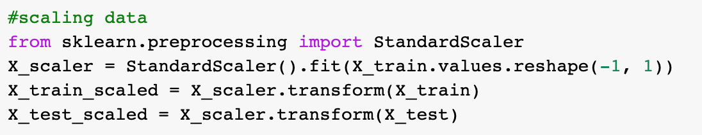
Cleaning and Transformation: Scaling

Slide 9
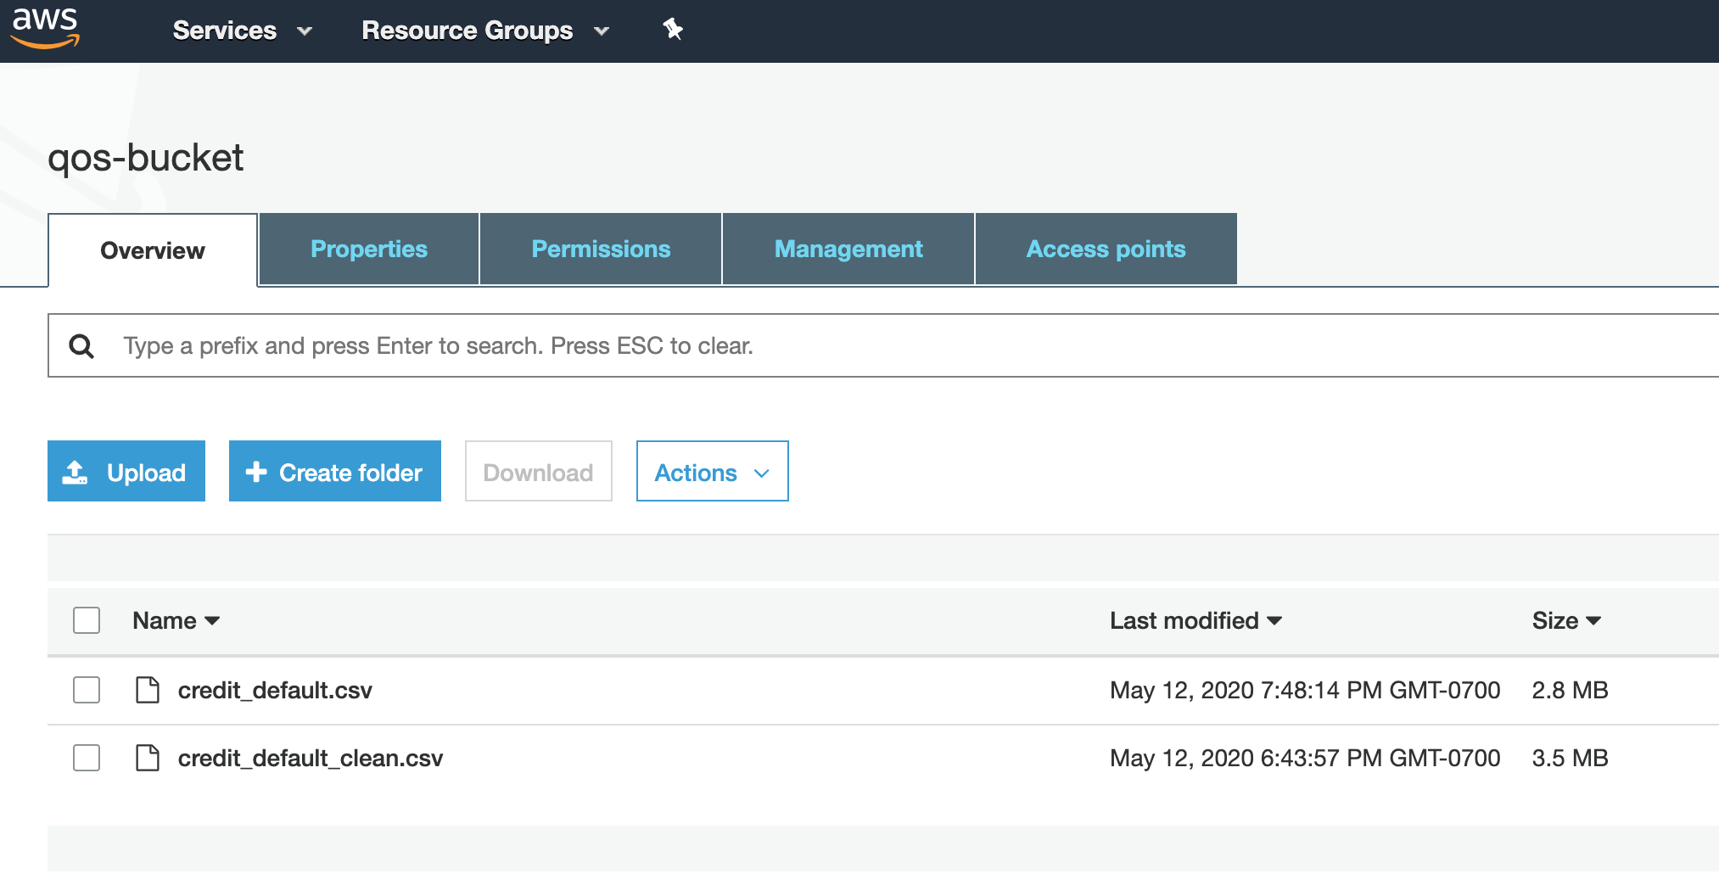
AWS Bucket

Slide 10
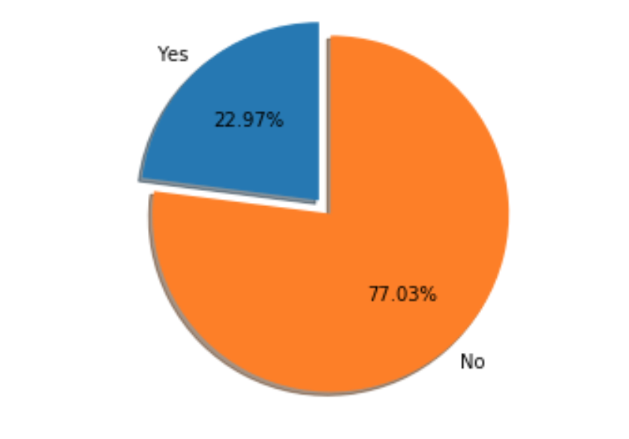
Machine Learning Models
Will Default on Next CC Bill
Logistic Regression
K Nearest Neighbor
Decision Tree
Random Forest
Extremely Randomized Trees
Microsoft Azure Automated ML

Slide 11
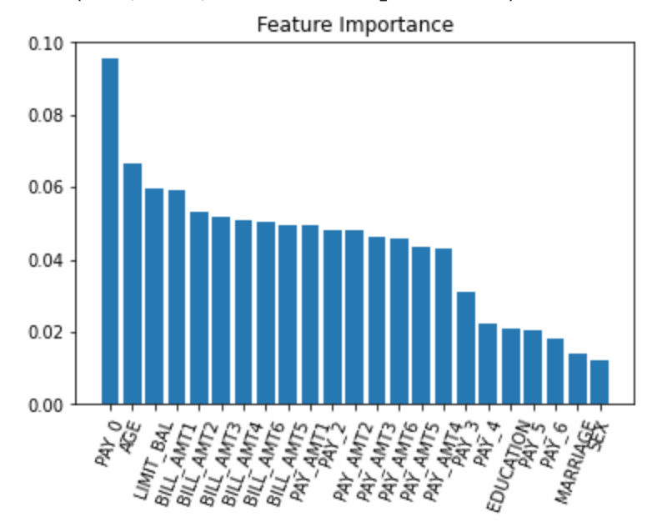
Feature Importance

Slide 12
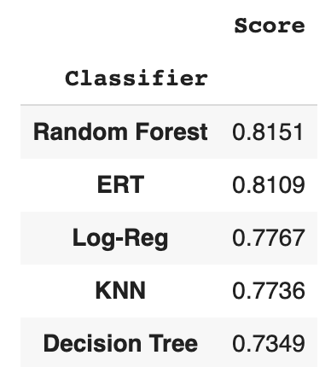
ML Classifier Scores

Slide 13
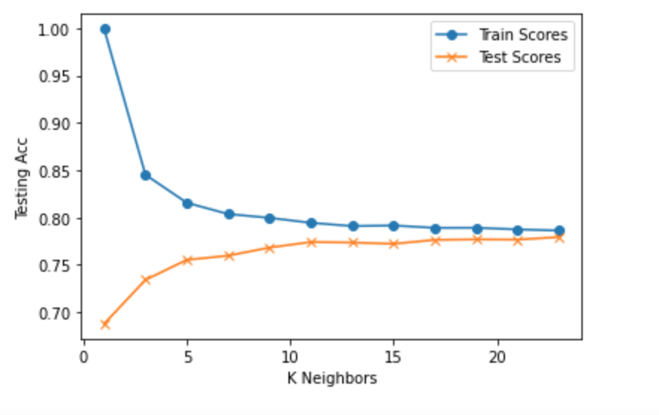
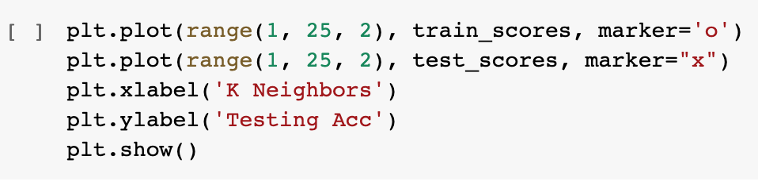
K Nearest Neighbor

Slide 14
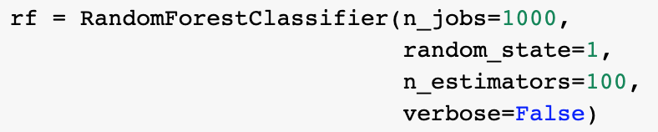
Random Forest: Parameters

Slide 15
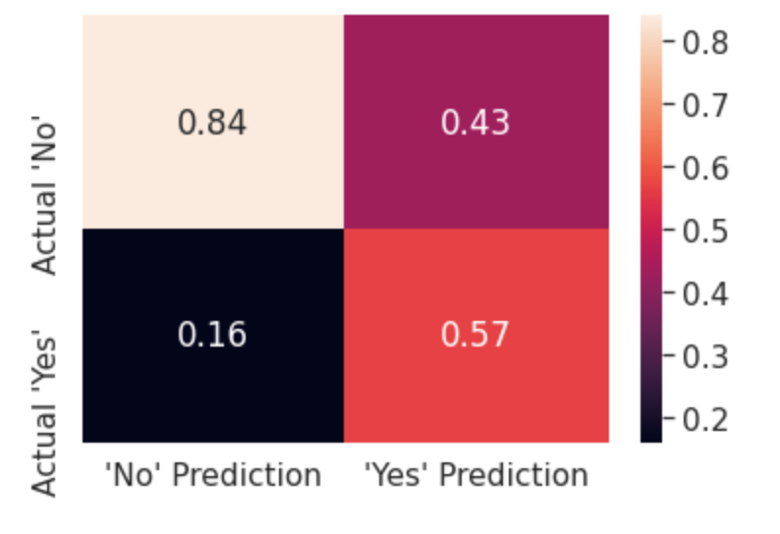
Random Forest
Confusion Matrix

Slide 16
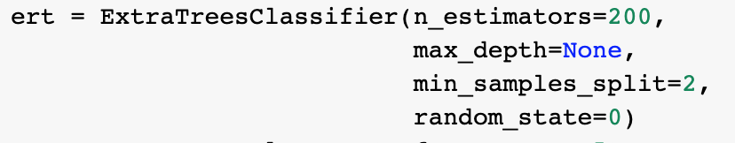
Extremely Random Forest
Lower Variance / Higher Bias

Slide 17
Microsoft Azure Automated ML
Process:
Load data to cloud platform.
Configure run
View Results

Slide 18
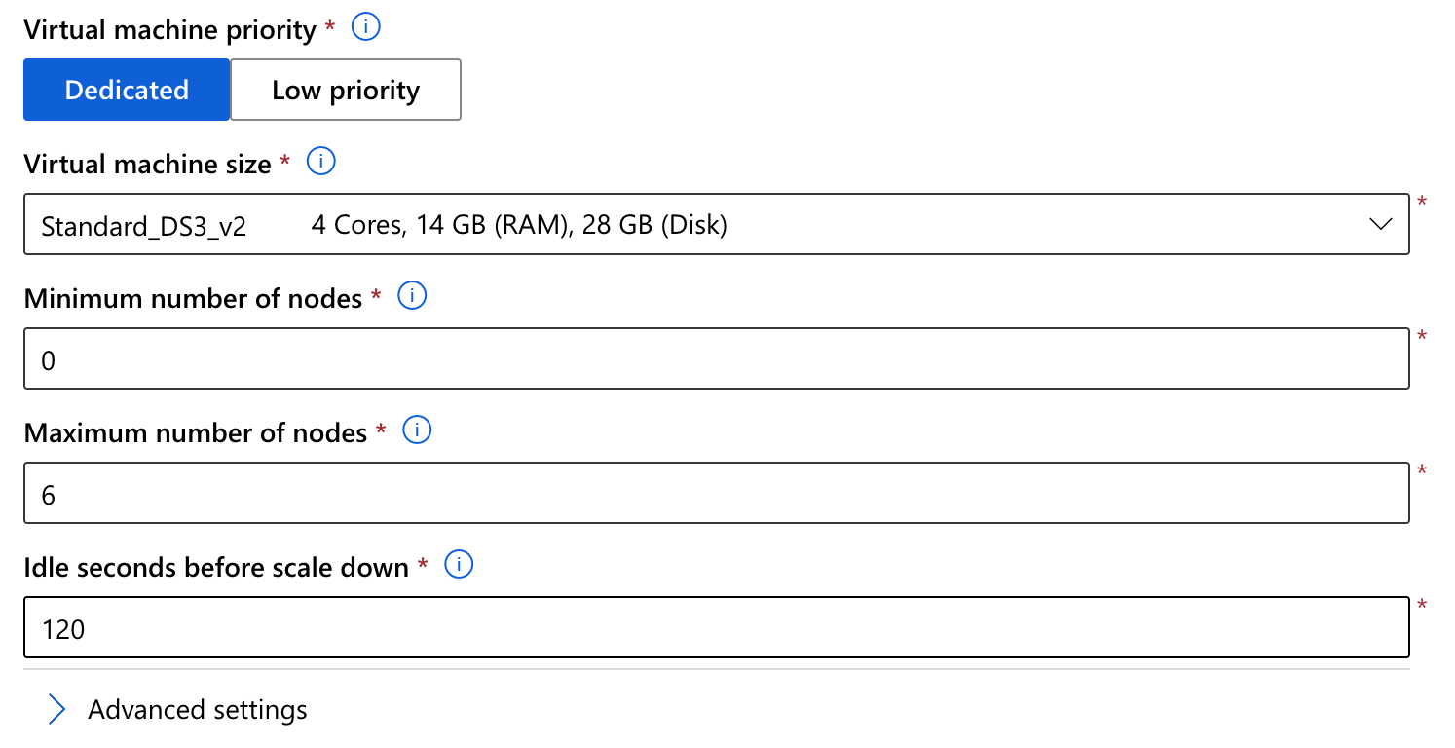
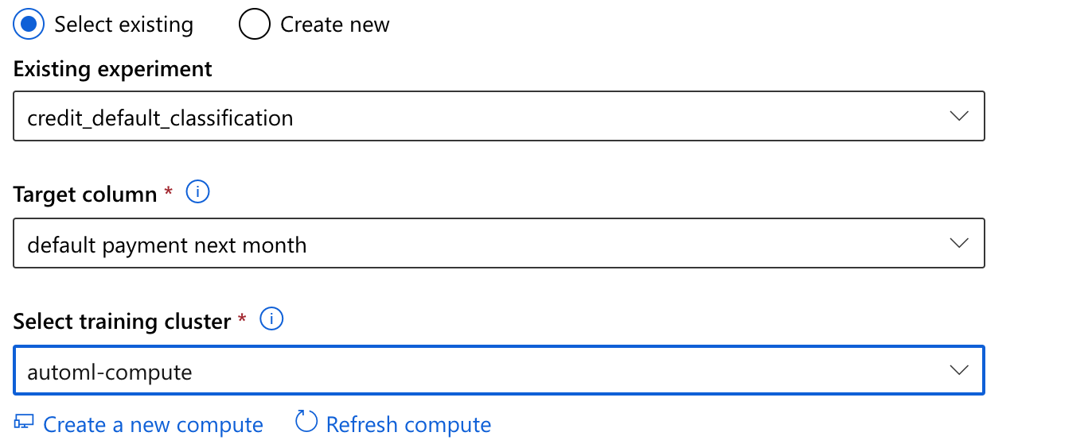
Azure: configuring run

Slide 19
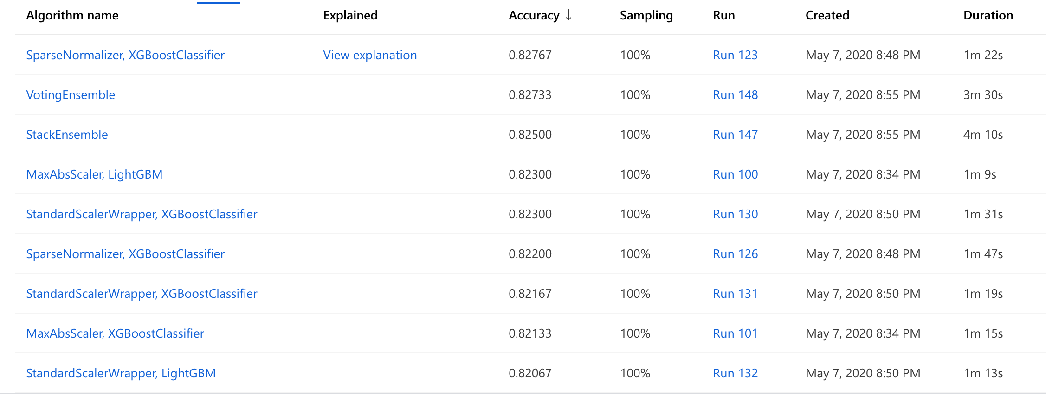
Azure: results

Slide 20
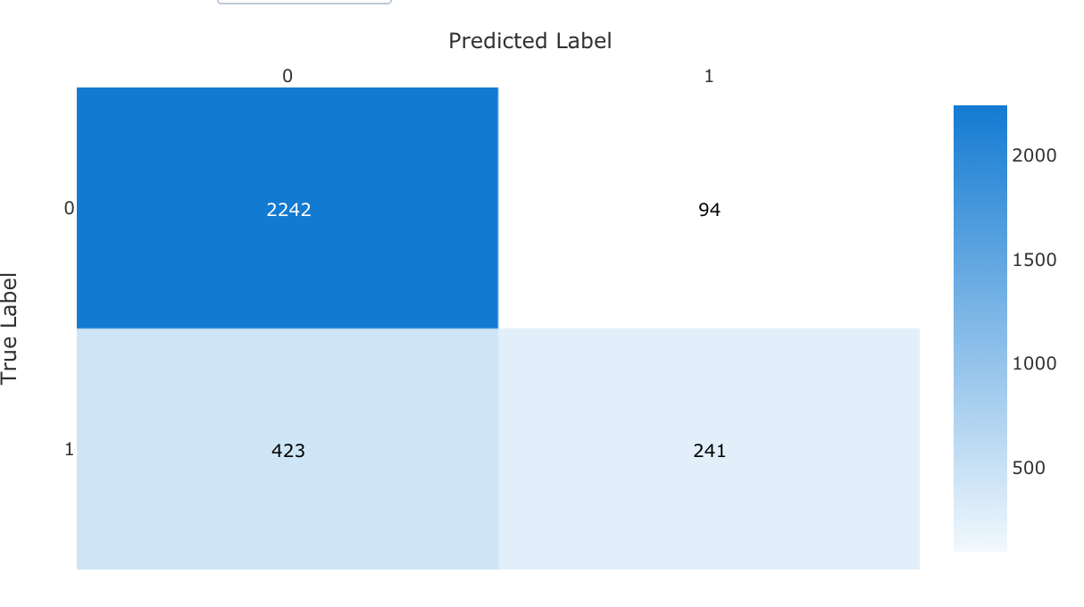
Azure: confusion Matrix
72% True positive
84% True negative

Slide 21
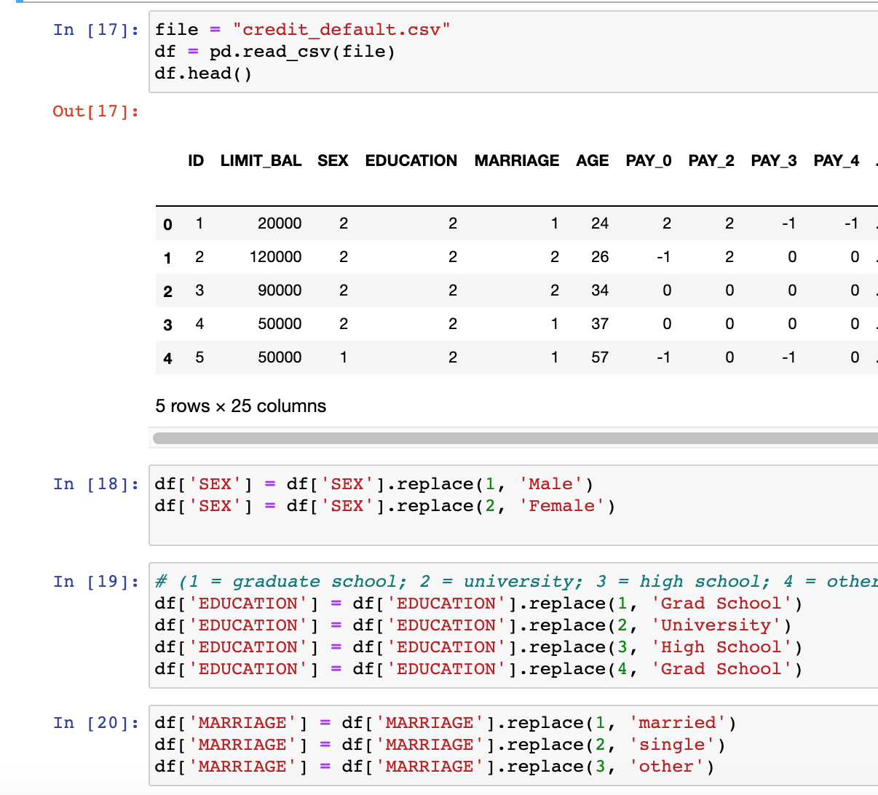
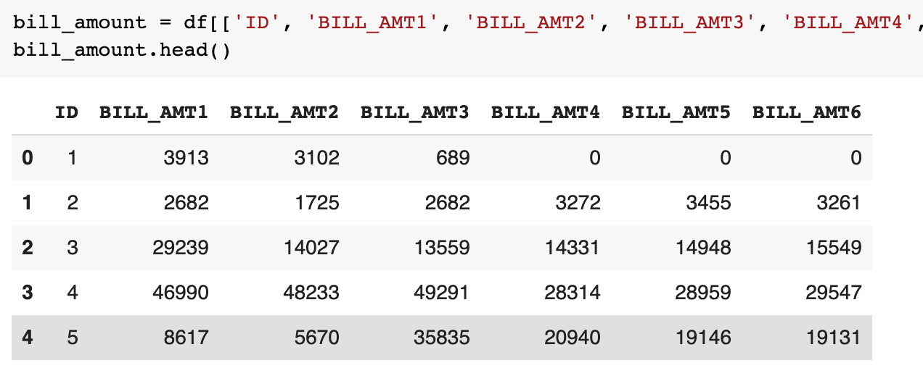
Loading to SQL: Transformation

Slide 22
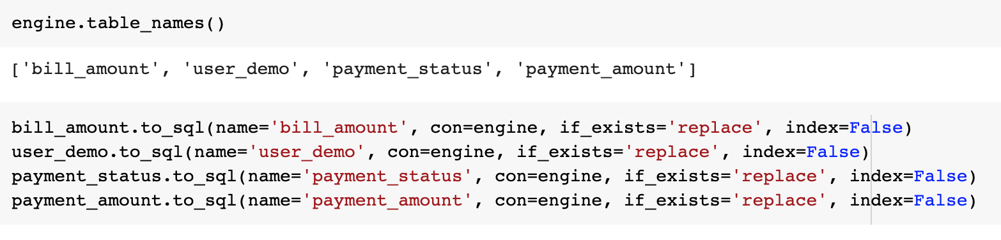
SQL: Load

Slide 23
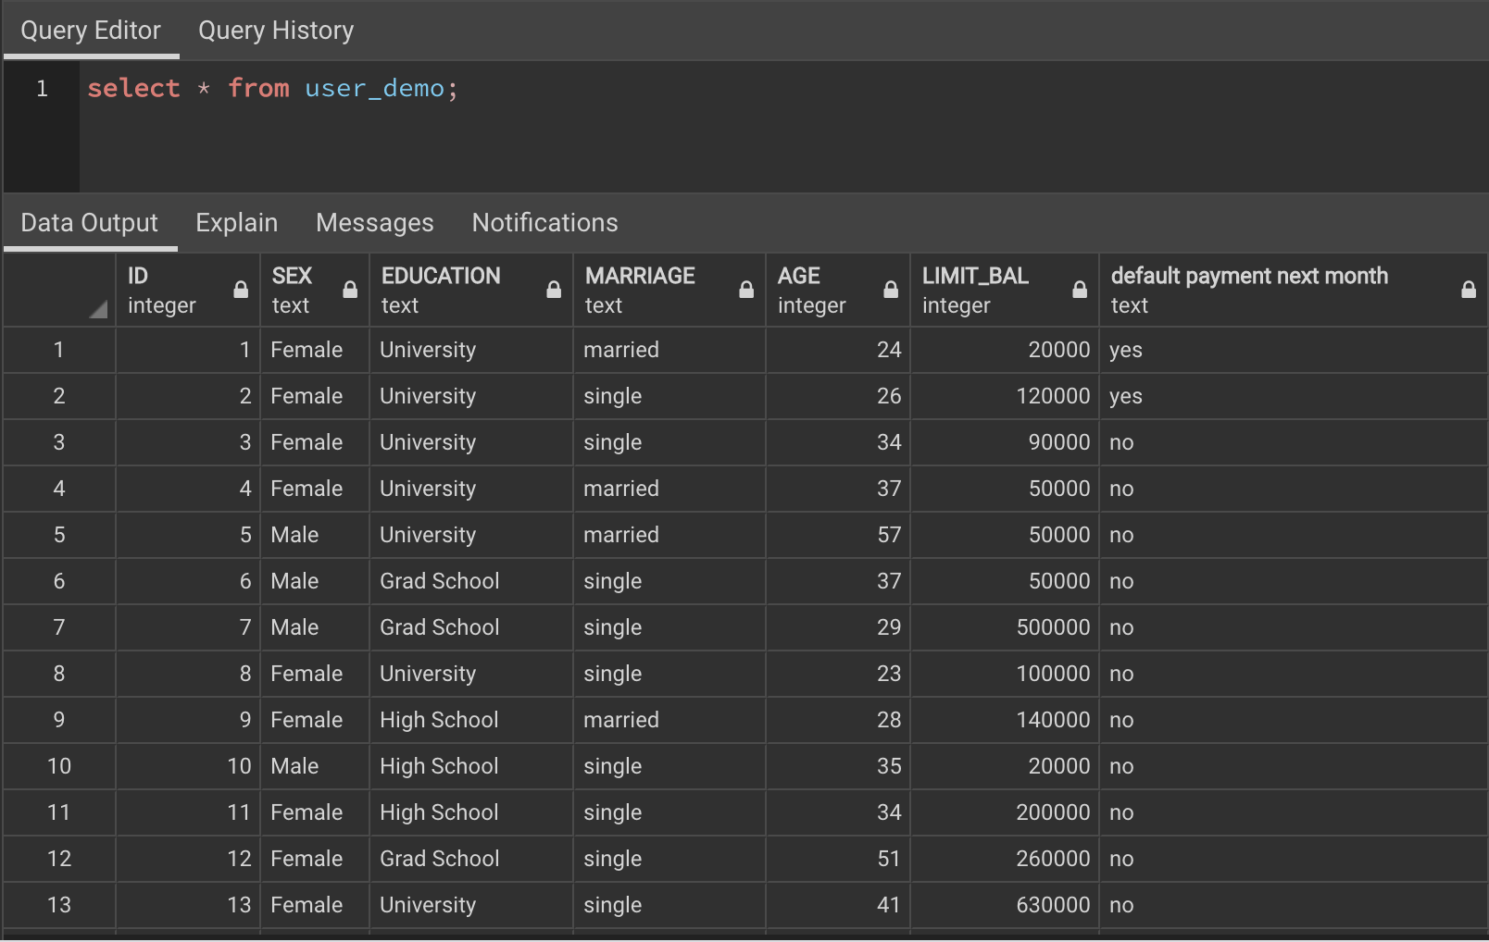
SQL: PGAdmin

Slide 24
Summary
Disproportional target column may cause unsatisfactory results.
Such data can result in poor feature importance and low accuracy.

Slide 25
What I would do differently
Look into ways to handle imbalanced data for classification problems.
Ex. Random oversampling of the minority and increasing the test size for ‘train test split.’

