Slide 1

s
Service Locator Pattern: Decoupling Your Code
The Service Locator pattern is a powerful tool in software development that allows you to decouple your code and achieve greater modularity and flexibility.

Slide 2

Introduction to the Service Locator Pattern
Definition and Purpose
Advantages and Use Cases
The Service Locator pattern is a creational pattern that provides a centralized registry of application services. It enables the reuse of services across an application and promotes loose coupling between objects.
The Service Locator pattern is useful in applications with complex object structures, where objects need to be created dynamically at runtime, and where testability is a concern. It can help to improve performance, reduce code duplication, and make maintenance tasks easier.
Real-life Example
A coffee shop can use the Service Locator pattern to manage its inventory and order fulfillment. A central registry can monitor the status of all supplies, such as cups, milk, and beans, and dispatch orders to the appropriate baristas as needed.

Slide 3
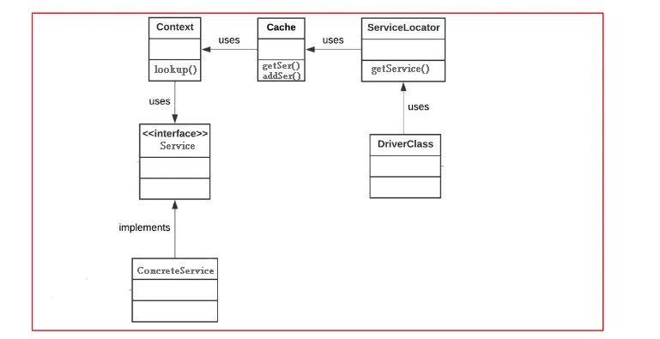

Slide 4
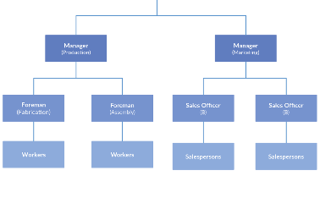
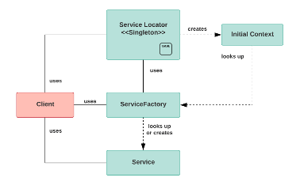
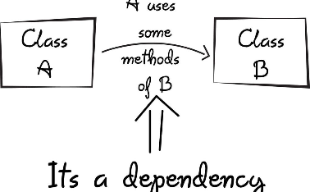
Structure of the Service Locator pattern
Components and their responsibilities
Key classes and relationships
Real-life Example
A transportation logistics company can use the Service Locator pattern to optimize delivery routes. The locator would manage a set of transportation service providers such as trains, ships, and trucks. It would resolve requests from the transportation coordinator to use a specific service for a given shipment.
The Service Locator pattern consists of a client, a locator, and a set of services. The client requests a service from the locator, which in turn provides the service from its registry. The services themselves are generally decoupled from the client and locator.
The Service Locator pattern typically involves three key classes: a Service locator, Service providers, and the Service interface. The Service locator manages a registry of Service providers. The locator is responsible for creating the providers and resolving client requests for the Service interface.

Slide 5
Implementing the Service Locator pattern
1
Step-by-step Guide
2
Best Practices and Common Pitfalls
3
Real-life Example
To implement the Service Locator pattern, you will need to:
When building a web application, a Service Locator could manage a set of data access objects (DAOs). Each DAO would implement a common Data Access interface. The application would use the Service Locator to retrieve the appropriate DAOs at runtime with a single point of entry for making changes to the registry.
When implementing the Service Locator pattern, it's important to consider the following best practices and pitfalls:
Create a Service interface.
Create one or more Service provider classes that implement the Service interface.
Use a central, singleton registry to manage Service providers.
Create a Service locator class that manages a registry of Service providers.
Avoid abuse of the Service Locator pattern, which can lead to unnecessary complexity and performance issues.
Add functionality to the Service locator to register and resolve Service providers.
Ensure thread-safety in your implementation.
Access providers via the locator from your client code to consume the services offered.
Only use it where required, as it can lead to code tangling with too many dependencies scattered all over the place.

Slide 6

Benefits and Drawbacks of the Service Locator Pattern
1
Benefits
Decoupling: Service Locator makes your code more loosely coupled and easier to test and maintain. Modularity: Your code's functionality is organized into separate modules for easy management and testing. Flexibility: Service Locator provides you greater flexibility in your business logic, as you can modify providers without affecting your client code.
Drawbacks
2
Increased Complexity: Service Locator code comes with its own set of classes/maps, and developers must manage the life-cycle of both the Service Locator registry of Service Providers and the services themselves. Potential Performance Impact: Service Locator can be overused, creating nested dependencies and impacting app performance.

Slide 7

Real-world Examples and Case Studies
Successful Implementation
Lessons Learned
Real-life Example
When implementing the Service Locator pattern, be sure to take into account versioning, logging, and thread-safety issues. Using dependency injection frameworks like Spring can simplify the setup and configuration processes. Also, be aware of the trade-offs between Service Locator and other design patterns, such as Factory, Dependency Injection, and Abstract Factory.
A financial services company implemented the Service Locator pattern to facilitate its trading platform. The company used a locator to keep track of a variety of data services, such as real-time market data feeds, historical data, and streaming data feeds. These providers could then be dynamically invoked by the trading application without affecting its core logic.
A large airline company implemented the Service Locator pattern to manage a fleet of airplanes that served different routes. The locator was used to manage a set of service providers such as airport gate availability, facility maintenance, and refueling services. The locator was also used to test and change these providers at runtime, without interrupting the clients.

Slide 8
Comparisons with Other Design Patterns
Pattern
Key differences
When to choose
Singleton
Service Locator helps to manage a set of Singleton objects and keeps the application decoupled from the actual Singleton implementations.
Choose Singleton when there is a single point of entry that has to be shared throughout. Choose Service Locator when a tightly coupled set of classes has to work with a loosely coupled set of services.
Factory
Service Locator is more flexible than a Factory in terms of handling a set of Services. It allows for Service registration, deregistration, and substitutions at runtime.
Choose Factory when you know which object you need to create ahead of time and want to centralize that code. Choose Service Locator when you want to decouple client code from the services that it calls.
Dependency Injection
Service Locator is a form of Dependency Injection (DI), but usually involves direct service location, not isolating what exactly is calling the services.
Use Dependency Injection when you want to choose exactly which Service object to use in your class instance, with minimal hardcoding and a lightweight Container. Use Service Locator when you want to simplify your service lookups throughout an application.

Slide 9
Summary
The Service Locator pattern is a powerful tool in software development. It provides a central registry of application services that can be reused across an application and promotes loose coupling between objects. Service Locator provides numerous benefits such as decoupling, modularity, and flexibility, but can also be complex and lead to performance issues.

Slide 10
