Slide 1
QualiMaster Configuration Tool
(Living document)

Slide 2
Overview
Aim: Consistent user-friendly configuration of real-time data analysis applications
Central concept: Data analysis pipeline, specifying the flow of stream data through algorithms
Algorithms with similar functionality are grouped into families. One member of the family is selected at runtime to perform an analysis task at best quality.

Slide 3
Technical Setup
The configuration tool utilizes EASy-Producer for
Modeling the configuration opportunities
Describing the actual configuration of data analysis pipelines
Validation of the configuration (Reasoning)
Instantiation of the pipelines into executable code (for Apache Storm, Apache Hadoop, reconfigurable hardware)
Thus, the configuration tool is also an Eclipse application, but hiding the Eclipse software development capabilities (Eclipse RCP)

Slide 4
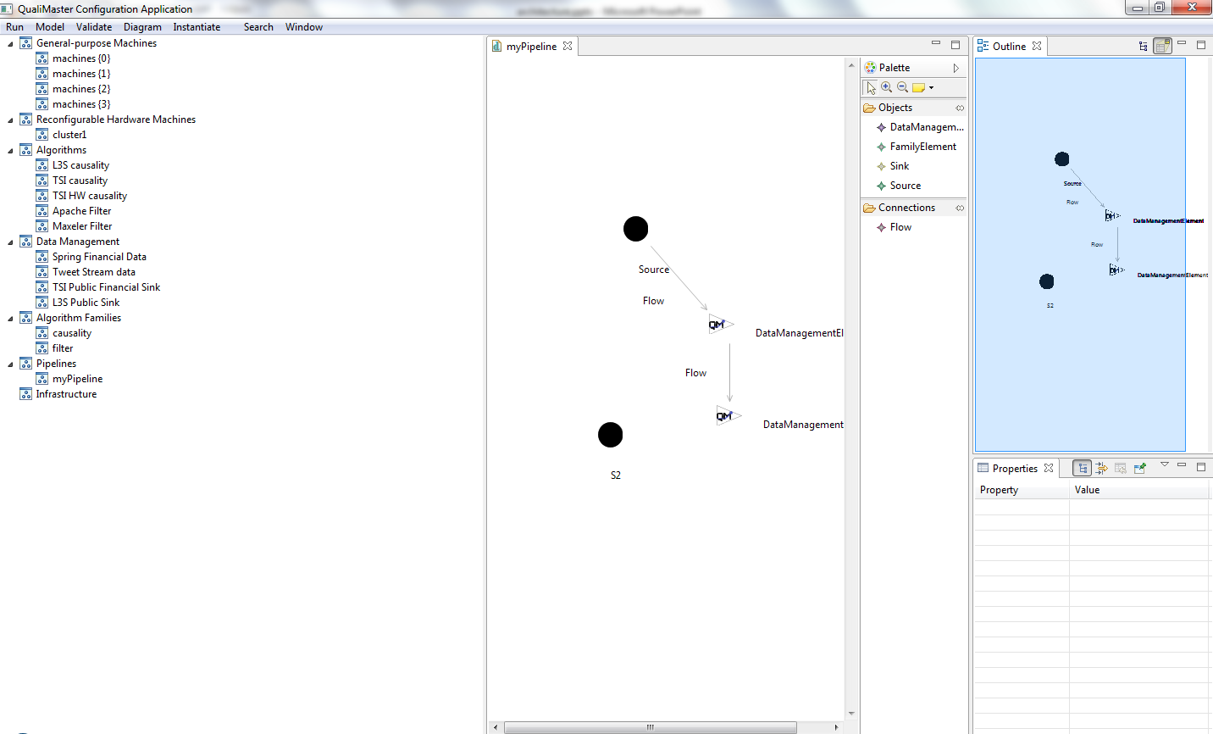
UI parts
Tree of configurable elements showing the overall structure of the configuration. Double click enables detail editors on the right side.
Detailed editor area, here the graphical
pipeline editor.

Slide 5
Overview
The configurable elements tree + view
Runtime infrastructure connection
Pipeline editor integration via tabbed views
The generated Pipeline editor
Variability model editors / input
Menu commands
Supporting dialogs
treeView
tabbedViews
pipeline editor
runtime
editors
commands
dialogs
qmApp
Change management
model
Application
Plugin.xml
EASy-Producer

Slide 6
Principles (1)
The configuration opportunities are driven by the underlying variability model in IVML.
The variability model may / will change during the project.
As far as possible, editors are built at runtime by reading the structure of the IVML model.
The graphical editor is derived from the IVML model and generated. The generated parts shall not be modified.
Meta-information about the IVML model are collected in one place, the class VariabilityModel.

Slide 7
Principles (2)
Separation of concerns
Keep UI parts and interactions in UI packages.
Do model manipulation in model packages, preferrably in ModelAccess / PipelineDiagramUtils
Do not use the change mechanism in model parts
Keep model characterization in VariabilityModel (to be generated later on from IVML)

Slide 8
Basics Variability Model
The IVML model encompasses
Hardware, reconfigurable hardware
Data management
Algorithms, algorithm families
Pipelines
Infrastructure
Each part ends with one or more collections of configured elements.
Some elements are directly contained in the collections, some are just referenced.

Slide 9
Mechanisms: Meta Information
model
IModelPart
Describes a model (e.g., „Data Management“)
The top-level collections
The provided datatypes
The possible values for references
IModelParts are defined in VariabilityModel

Slide 10
Mechanisms: Accessing the Models
model
IVML variability model
Through ModelAccess class
Only generic model operations such as consistently deleting an element
No UI interaction
PipelineDiagramUtils
Utility functions for accessing the pipeline models
Ecore-Representation (must be transferred into IVML)
Layout

Slide 11
Mechanisms: Opening an Editor
treeView
pipeline editor
editors
Editor input carries the
information to be displayed.
Editor / Input classes for
Configuration (EASy-Editor)
ModelPart (e.g., Infrastructure)
Variable (e.g., one Algorithm)
Pipeline
Configurable Elements View
Tree viewer
Context menus
Configurable Element
Holds IModelPart
editorId
Editor input
Via Eclipse
openEditor(editorId, input)
IEditorPart
Ask plugin.xml for
Implementing class
Plugin.xml

Slide 12
Special case: Pipeline editor
Pipeline.emf/pipeline.ecore describe pipeline structure (derived from IVML)
Editor is generated
Requires two files per pipeline (ecore, layout) before opening the editor.
Creating, renaming, deleting must consider this
Initial: Deferred UI Editor input handles dynamic creation

Slide 13
Obtaining an Editor Component
editors
EASy-Producer provides specific editor components
Components are created based on decision variable type
→ reuse them
Comply with
EASy conventions
AbstractVarModelEditor
EASy Editor parent
UIConfiguration
Relates configuration and editors
Access via ConfigurationTableEditorFactory
EASy Producer Editor Factory

Slide 14
Special case: Pipeline editor
The EASy editors shall also be used in the properties view of the pipeline editor
TabDescriptorProvider overrides generated components
Many classes are just defined to create the correct PropertyDescriptor which creates the editors
To be flexible, creation is hidden behind a factory. Factory must be configured in VariabilityModel.
See PipelineDiagramNodePropertyEditorCreator

Slide 15
Managing Changes
Adding, removing, changing elements may require updates in other editors
Adding a pipeline requires updates in the infrastructure editor (pipeline selection)
Central listener-based change manager
Tree view, editors, pipeline editors and tabbed views communicate in terms of changes
Similar mechanism for infrastructure connetion

Slide 16
ChangeManager (Tree-to-Editors)
treeView
editors
Configurable Elements View
Context menus
Also a listener but
disabled on self-events
Action
ChangeManager
register listener
notify listeners
ConfigurableElement
AbstractVarModelEditor
EditorInput
UIConfiguration
ModelAccess
EASy Producer Editor
Change flow

Slide 17
ChangeManager (Editors-to-Tree)
treeView
editors
Also a listener but
disabled on self-events
AbstractVarModelEditor
Commit (ChangeManager)
ChangeManager
register listener
notify listeners
UIConfiguration
Configurable Elements View
EASy Producer Editor
TreeView
ConfigurableElement
Change flow

Slide 18
Special case: Pipeline Editor
Property editors are created via EASy-Producer
EASy-Producer does not know ChangeManager
EASy editors may implement IUpdateListener
PipelineDiagramNodePropertyEditorCreator attaches an IUpdateLister which is also an IChangeLister and connects EASy with the ChangeManager
Connection is dissolved on disposing the editor

Slide 19
ChangeManager (Pipeline Properties)
treeView
editors
pipeline editor
Plugin.xml
Also a listener but
disabled on self-events
knows
PipelineDiagramNodeProperty EditorCreator
AbstractVarModelEditor
creates
ChangeManager
register listener
notify listeners
EditorUpdater / IUpdateListener
IUpdateProvider
Creates via factory
Configurable Elements View
EASy-Producer
Combo/TreeCellEditor
Change flow
GUIVariable
Flow goes also in opposite direction but needs further integration with generated pipeline editor

Slide 20
Infrastructure Connection
Central connection instance
Purpose: @Runtime
Send commands to infrastructure
Receive information from infrastructure
Handles multiple registered dispatchers
Informs multiple registered listeners

