Slide 1
Anno
Restructure Edit Publish
Login Register
Start a new ATI Project
Drag annotated Word or PDF here
Continue editing a saved ATI Project
Select File to add
Learn more about preparing an ATI Project
Learn more about ATI

Slide 2
Anno
Restructure Edit Publish
Login Register
Start a new ATI Project
Title
Other Contributors
Link to QDR Data

Slide 3


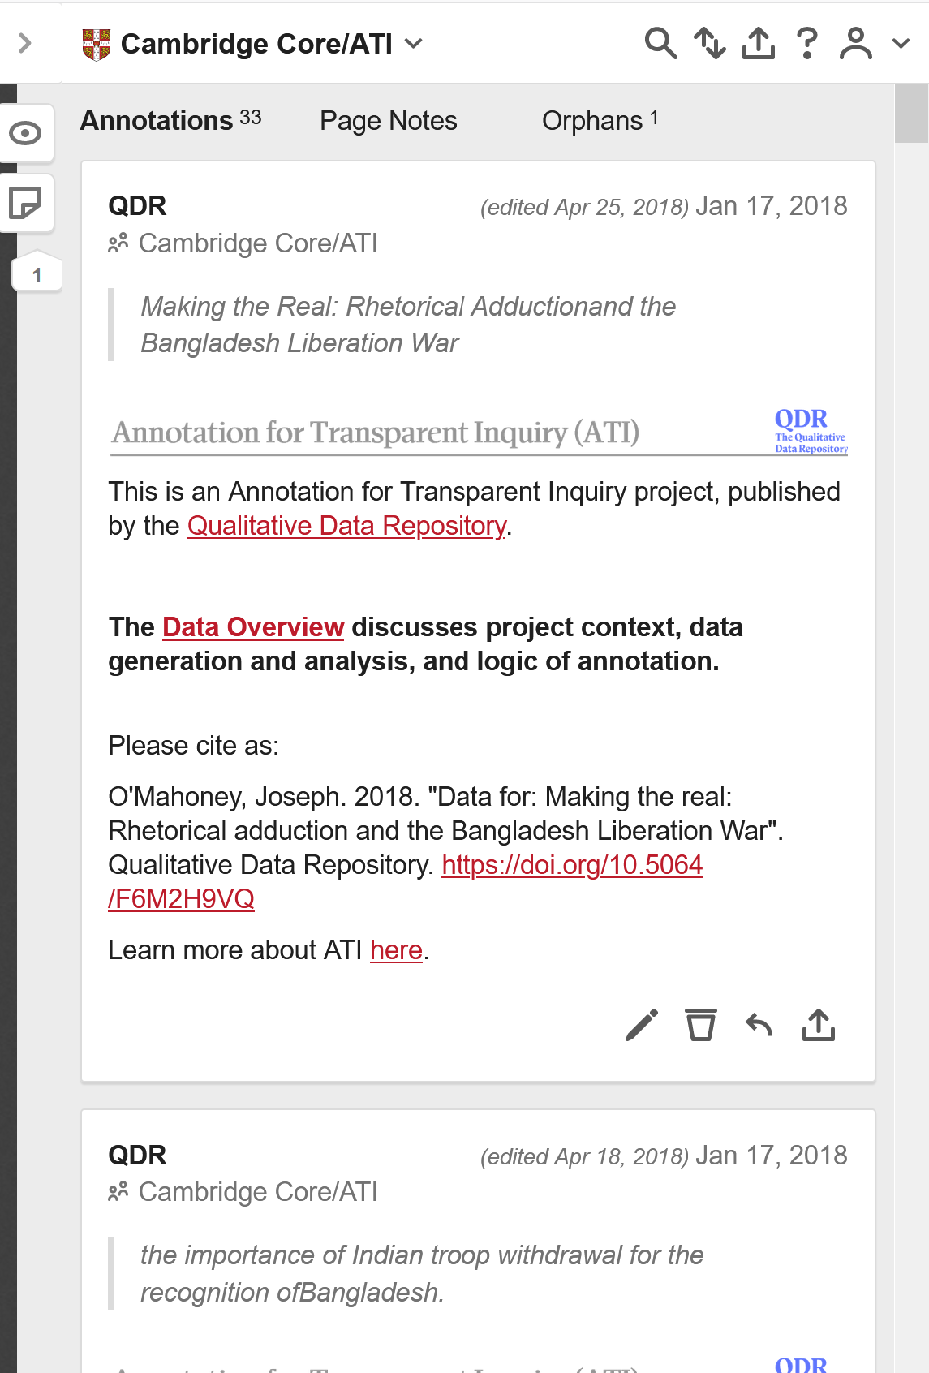
Export or publish project
Save project

