Slide 1

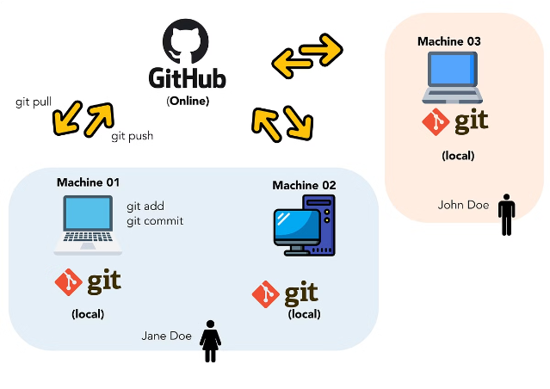
Git and GitHub

Slide 2
Introduction to Git
Git is a powerful version control system that enables software developers to track changes, collaborate on projects, and manage code repositories.

Slide 3
Git: Features
Repository
Commit
Branch
A repository is a storage space where your project's files and the entire revision history are kept, allowing you to track changes and collaborate with others.
A commit is a snapshot of your repository at a specific point in time, enabling you to save and track the changes made to your project.
A branch is a separate line of development, allowing you to work on different features or fixes in isolation, without affecting the main codebase.

Slide 4
Introduction to GitHub
GitHub is a web-based platform that integrates with Git, providing a centralized hub for developers to share, contribute, and manage their code.

Slide 5




GitHub: Features and Benefits
Repositories
GitHub provides a central place to store, manage, and share code repositories.
Forking and Pull Requests
Users can contribute to other repositories by forking and submitting pull requests.
Issues and Projects
GitHub offers tools for bug tracking, feature requests, and project management.
Continuous Integration
GitHub supports automated testing and deployment of code changes.

Slide 6
Workflow: Git and GitHub
Clone
1
Copy an existing Git repository to your local machine.
2
Branch
Create a new branch to work on a feature or fix, without affecting the main codebase.
Commit
3
Save your changes as a commit, creating a snapshot of your repository at that point in time.
4
Push
Upload your local commits to the remote GitHub repository.
Pull Request
5
Propose your changes for review.
6
Merge
Project Maintainer will Merge the code if required.

Slide 7



Git vs. GitHub: Understanding the Difference
Git
GitHub
Relationship
A distributed version control system for tracking changes in source code.
A web-based hosting service that uses Git for version control and collaboration.
Git is the underlying technology, while GitHub adds a layer of collaboration, hosting, and management on top of Git.

Slide 8
Use Cases and Best Practices
Use Cases
Best Practices
Benefits
Open source projects
Commit often, with clear messages
Applying Git and GitHub best practices can streamline development, improve code quality, and foster effective collaboration within your team.
Collaborative software development
Use branches for feature development
Documentation and versioning
Regularly pull updates to avoid conflicts
Review code before merging

Slide 9
Summary and Next Steps
Git
A powerful version control system for tracking changes in source code.
GitHub
A web-based platform that integrates with Git, providing a centralized hub for collaboration, code sharing, and project management.
Workflow
Typical Git and GitHub workflow includes cloning, branching, committing, pushing, and submitting pull requests.
Best Practices
Commit often, use branches, regularly pull updates, and review code to streamline development and improve code quality.
To get started with Git and GitHub, we recommend exploring the official documentation, participating in online communities, and practicing with hands-on projects.

Slide 10
Thank You.

