Slide 1


WEEK 1 · DAY 1
What is a Gen AI Application?
Understanding the thing we're about to test — in plain English.
Quality Thought · Gen AI Testing for Manual Testers
Quality Thought · Gen AI Testing · Week 1 · Day 1
1

Slide 2




TODAY'S SESSION
What we'll cover today
What Gen AI really is
The plain-English idea behind the hype
How an LLM 'thinks'
Why it guesses words, not looks them up
Parts of a Gen AI app
The pieces you'll point your tests at
Where you fit in
What's new and different for a tester
Quality Thought · Gen AI Testing · Week 1 · Day 1
2

Slide 3

THE BIG IDEA
Gen AI is a very well-read assistant
Picture an intern who has read almost everything on the internet.
Ask a question and they answer instantly — in any style, any language. They can write, summarize, translate and explain.
But here's the catch: they sometimes sound confident even when they're wrong.
In one line
“Gen AI creates new content (text, code, images) instead of just storing and fetching it.”
Quality Thought · Gen AI Testing · Week 1 · Day 1
3

Slide 4

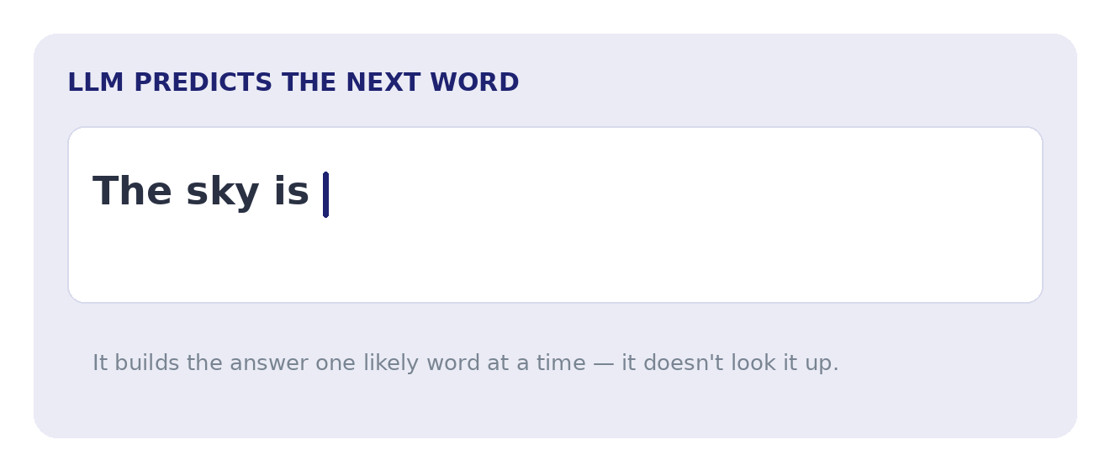
HOW IT WORKS
It predicts the next word — like autocomplete
The phone analogy
Watch it build the answer
Your phone suggests the next word as you type.
An LLM does the same — but far more powerful, building whole answers one word at a time.
For testers: it generates a likely answer — it doesn't look one up. So answers can vary or be wrong.
Animated — plays in slideshow mode
Quality Thought · Gen AI Testing · Week 1 · Day 1
4

Slide 5
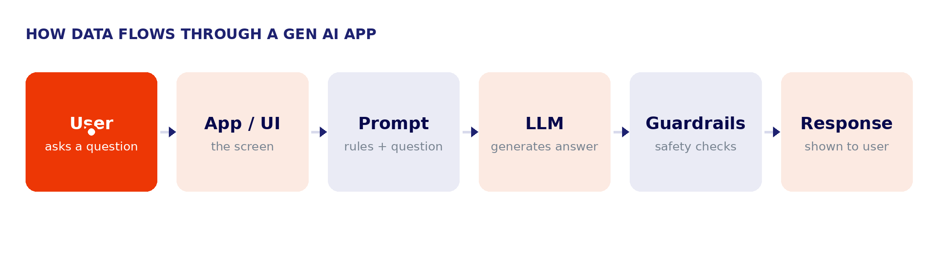
THE MOVING PARTS
What's inside a Gen AI application
Each part is something you can test — and each part can fail in its own way.
Quality Thought · Gen AI Testing · Week 1 · Day 1
5

Slide 6

A REAL EXAMPLE
A customer-support chatbot in action
Customer asks: “Where is my order #1234?”
1
App / UI — takes the typed question
2
Prompt — adds rules: 'be polite, only use our order data'
3
LLM — writes a friendly, helpful reply
4
Guardrails — checks no private data leaks to the wrong user
5
Response — 'Your order #1234 ships tomorrow — here's the tracking link.'
Quality Thought · Gen AI Testing · Week 1 · Day 1
6

Slide 7

WHY IT'S DIFFERENT
Gen AI is not like normal software
Traditional software
Gen AI software
Follows fixed rules: if X, then Y
Same input → same output, every time
You know the exact expected result
Test with: assertEquals (exact match)
Learns patterns — it generates answers
Same input → answer can change
You know what 'good' looks like, not exact words
Test with: meaning, facts, safety — not exact match
Quality Thought · Gen AI Testing · Week 1 · Day 1
7

Slide 8




YOUR ROLE
Where do you fit as a tester?
Same instincts as always — pointed at new kinds of problems. This week we'll learn to catch each of these:
Made-up answers
Different each time
Can be tricked
States false facts confidently ('hallucination')
The same question can give different replies
Clever inputs make it break its own rules
May leak information
Bias or unsafe content
Slow or costly
It could reveal data it shouldn't
Replies can be unfair or inappropriate
Big answers can be slow and expensive
Quality Thought · Gen AI Testing · Week 1 · Day 1
8

Slide 9

LESSON OUTCOMES
What you can now do
Explain, in simple words, what a Gen AI application is
Describe how an LLM produces answers (predicting words)
Name the parts of a Gen AI app and what each one does
Explain why testing Gen AI is different from normal software
Quality Thought · Gen AI Testing · Week 1 · Day 1
9

Slide 10

QUICK CHECK
Check your understanding
Q1.
In your own words, what does a Gen AI application do that normal software doesn't?
Q2.
An LLM mostly... (a) looks answers up in a database, or (b) predicts the next word to build an answer?
Q3.
Name any two parts of a Gen AI application.
Q4.
Why can't we test a Gen AI answer with an exact-match check?
Quality Thought · Gen AI Testing · Week 1 · Day 1
10

Slide 11
QUICK CHECK
Answers
A1.
It creates new content (answers, text, summaries) instead of only storing and fetching fixed data.
A2.
(b) It predicts the next word, one at a time, to build the answer.
A3.
Any two of: User, App/UI, Prompt, LLM, Guardrails, Response.
A4.
Because the same question can give different wording each time — so we check meaning, facts and safety, not an exact string.
Quality Thought · Gen AI Testing · Week 1 · Day 1
11

Slide 12
BEFORE NEXT SESSION
Your 30-minute lab + what's next
Today's mini-lab (30 min)
Coming up next
Open any AI chatbot (ChatGPT, Claude, or local Ollama).
Ask it 10 different questions and save each reply.
Mark one answer that surprised you — good or bad.
Write 2 lines: what did you notice about how it answers?
Save notes in your GitHub: week1/day1-notes.md
Day 2 — Key Terminology
The words you'll use all course: tokens, context window, temperature, embeddings, hallucination — each with a simple analogy.
Quality Thought · Gen AI Testing · Week 1 · Day 1
12

