Slide 1
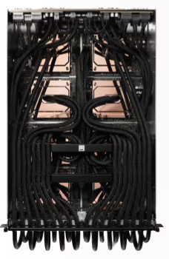
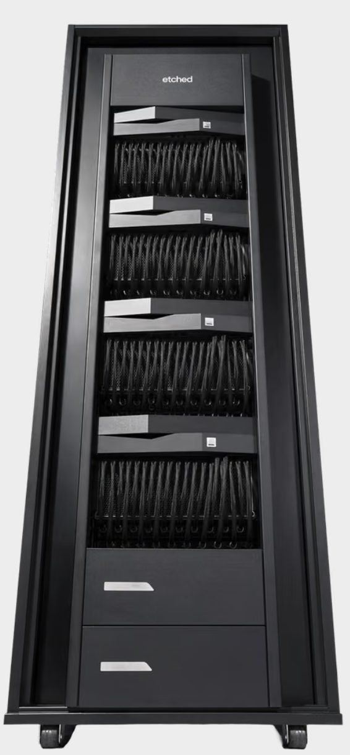
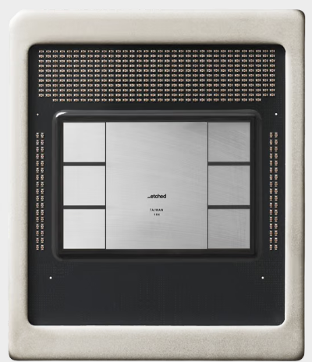
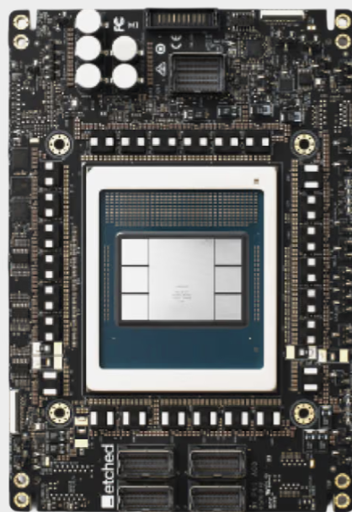
32x Ramp
2026-W34
54.8%
FATP L10 2U/4U
FATP L10 6U
Rack L11
@Sigurd
ASIC
@Pega
PCBA L6
ASIC
4U
SMT / ICT
HTT
ASSY
SFT
Runin
ASSY
HPB & VBB & PV1 & PDB
2U
4%
21.7%
WST
MLT
Provision
32.5% reported
PV1
FAT
FT
7.4%
ASSY
11.3%
SFT
VBB
84.3% *
SLT
Flash/ BFT
2U
5.3%
Runin
W34: FT no activities.
Decision: Skip SLT
L6 Accu Yield W34: 54.8% W33 : 35.6%
10.5%
ASSY
Pack

Slide 2

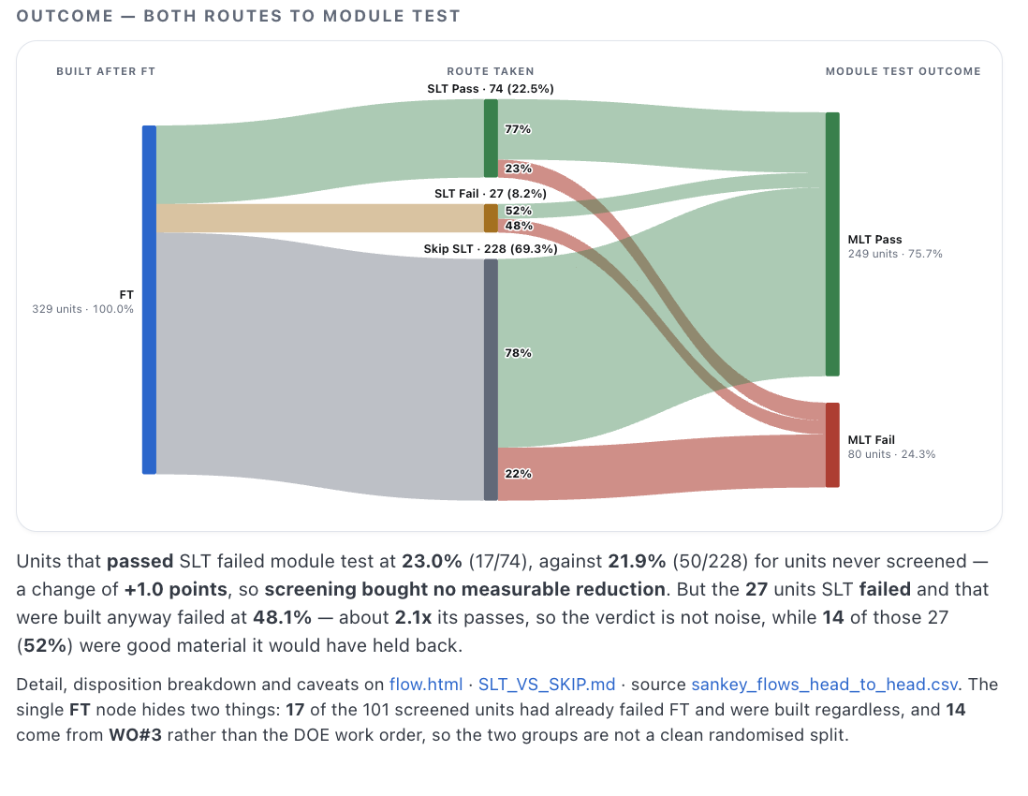
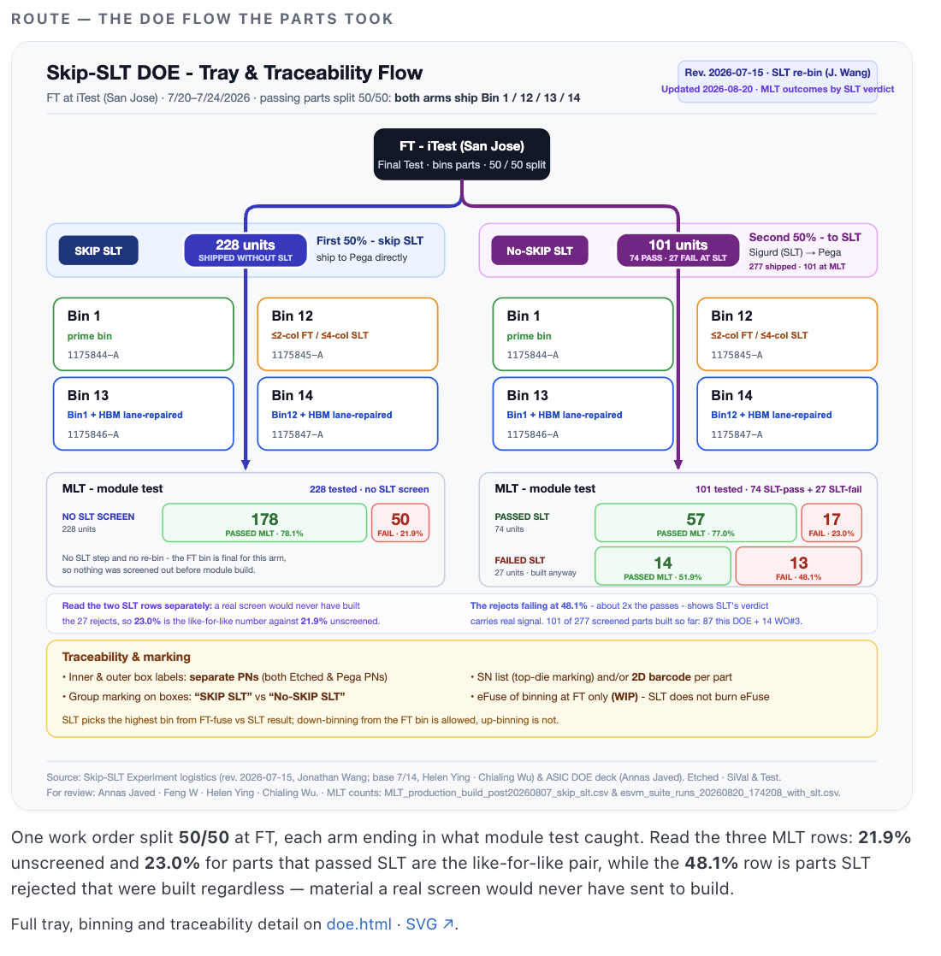
Ready for Review
P0 | MP build blocker & No RC or solution identified. | Dedicated DRI & Target Closure Timeline & Weekly Deep Dive.
P1 | Not MP build blocker & No RC or solution identified. | Dedicated DRI & Estimated Closure Timeline & Weekly Deep Dive.
P2 | Not MP build blocker. Root Cause identified & CA validated with limited data. Backlog. | Attend the matter upon resource availability.
Need Updates
Ski SLT Data
Conclusion: SLT might be skipped
Details: go/slt-ft
https://literate-telegram-2y3e9lz.pages.github.io/index.html
Confidential

Slide 3
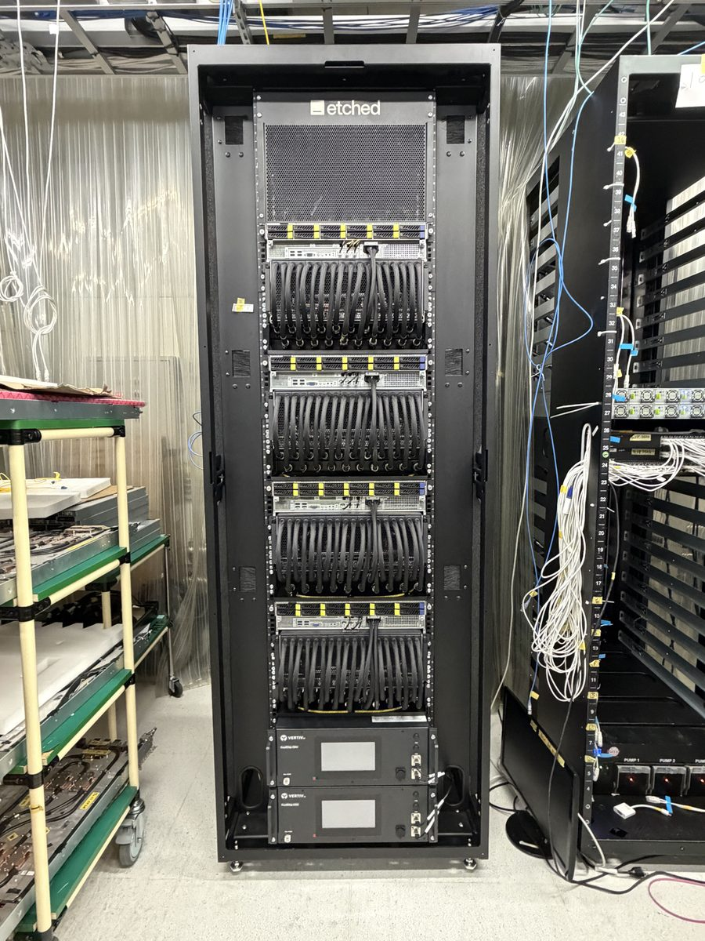
32x Rack2
2026-W34
Assembled, not yet fully tested: the controllers have no L11 run against this serial. Provisioning and rack test are still ahead of it.

Slide 4
Retest — recovery from the bonepile
2026-W34 · 2026-08-17 to 2026-08-23 · L6 module line
Asked: “what % of first-pass-failed units are recovered from the bonepile and added back to production flow”
MLT
first-pass yield 71.2% · 350 units
HTT
first-pass yield 77.1% · 265 units
10.0%
10 of 100 first-pass failures came back
0.0%
0 of 68 first-pass failures came back
What brought them back
7 same software release — the first failure did not reproduce
3 a different release — a fix released the unit
90 still in the bonepile
What brought them back
Nothing has been recovered yet.
68 still in the bonepile
Most of what comes back at MLT passes on the build it failed on, so the recovery we have is mostly first failures not reproducing rather than fixes landing.
Nothing has come back at HTT: all 68 first-pass failures are still out.
Counted per station against each unit's first attempt this week, the same population the first-pass yield uses — so first-pass failures and yield reconcile. A module that failed MLT and later passed MLT is recovered here even if it then failed HTT; the all-hands page counts recovery per stage and reads lower for MLT + HTT for that reason.

