Slide 1
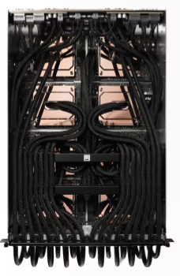
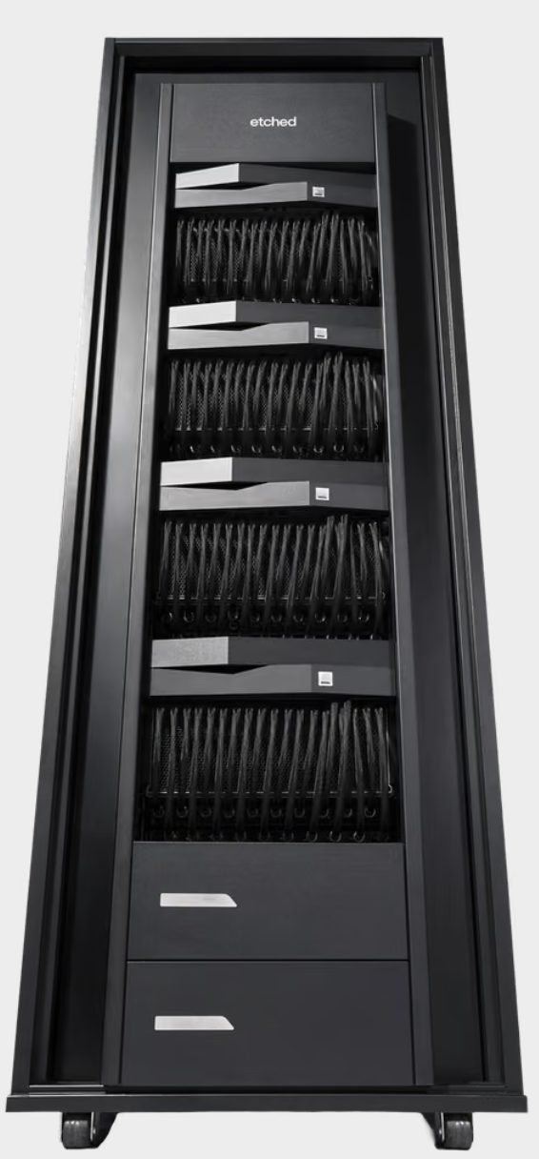
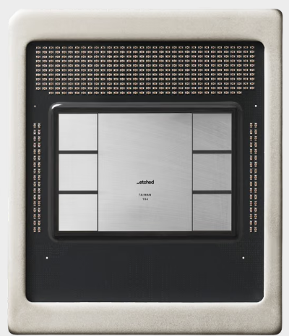
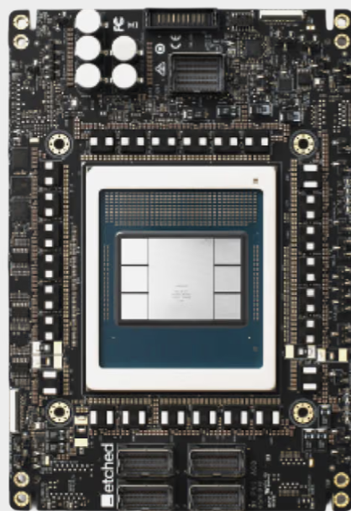
32x Ramp
2026-W34
54.8%
FATP L10 2U/4U
FATP L10 6U
Rack L11
@Sigurd
ASIC
@Pega
PCBA L6
ASIC
4U
SMT / ICT
HTT
ASSY
SFT
Runin
ASSY
HPB & VBB & PV1 & PDB
2U
4%
21.7%
WST
MLT
Provision
32.5% reported
PV1
FAT
FT
7.4%
ASSY
11.3%
SFT
VBB
84.3% *
SLT
Flash/ BFT
2U
5.3%
Runin
W34: FT no activities.
Decision: Skip SLT
L6 Accu Yield W34: 54.8% W33 : 35.6%
10.5%
ASSY
Pack

Slide 2

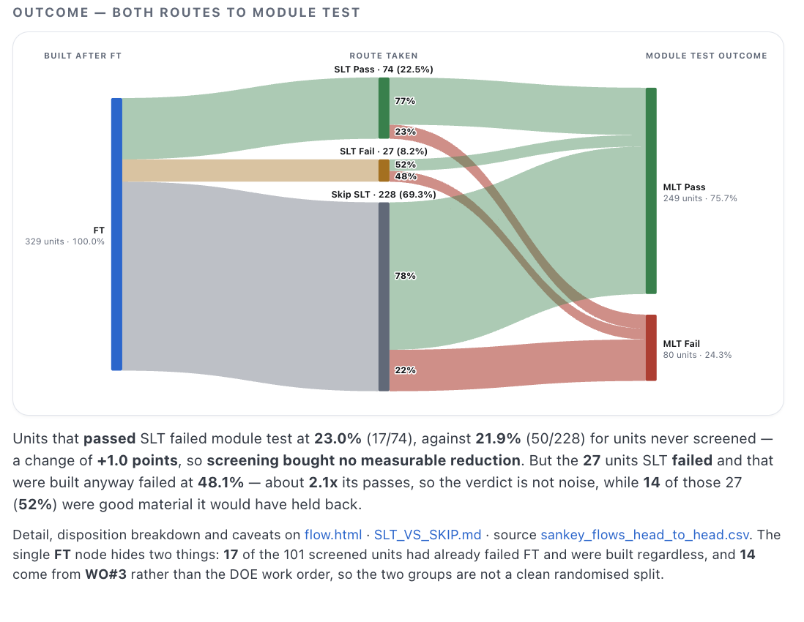
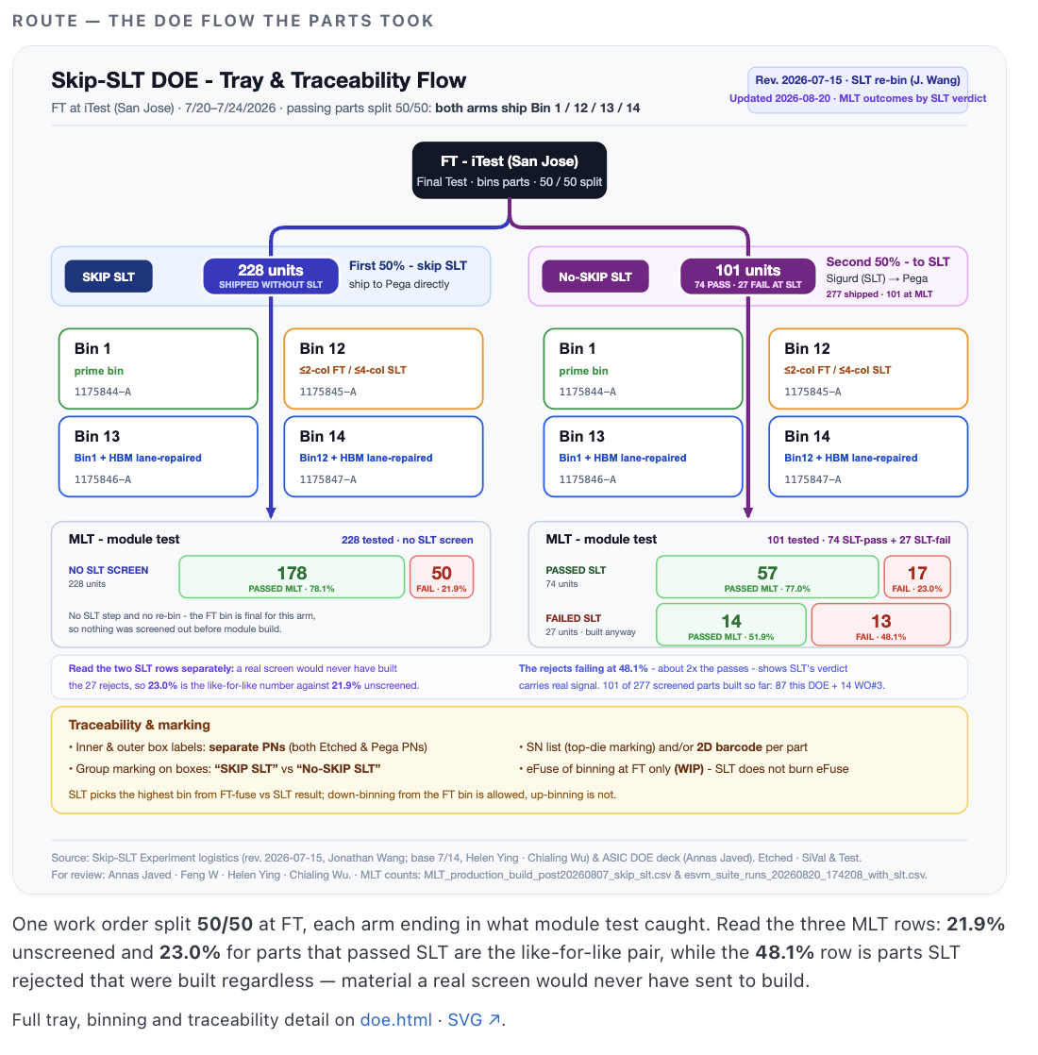
Ready for Review
P0 | MP build blocker & No RC or solution identified. | Dedicated DRI & Target Closure Timeline & Weekly Deep Dive.
P1 | Not MP build blocker & No RC or solution identified. | Dedicated DRI & Estimated Closure Timeline & Weekly Deep Dive.
P2 | Not MP build blocker. Root Cause identified & CA validated with limited data. Backlog. | Attend the matter upon resource availability.
Need Updates
Ski SLT Data
Conclusion: SLT might be skipped
Details: go/slt-ft
https://literate-telegram-2y3e9lz.pages.github.io/index.html
Confidential

Slide 3
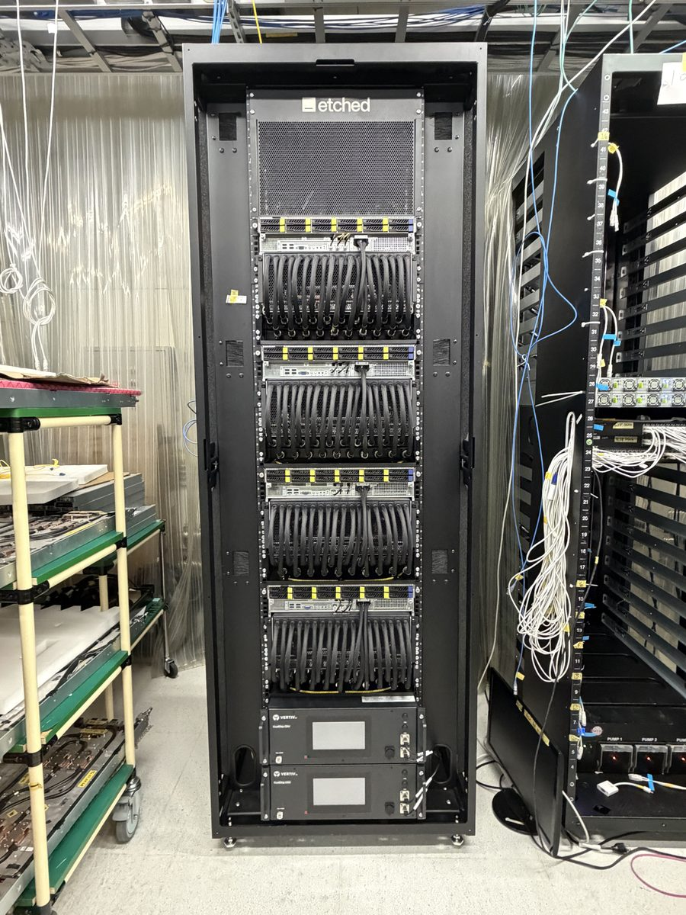
32x Rack2
2026-W34
Assembled, not yet fully tested: the controllers have no L11 run against this serial. Provisioning and rack test are still ahead of it.

