Slide 1
How to read this
three numbers, and why the table on the next pages is broken out by test step
1. Capacity
How many units a step can put through in a week.
Counted here as units and runs at each step: 407 step-visits across 573 runs this week. Runs exceed visits because a unit can occupy a station more than once — which is why capacity and retest are the same conversation.
Why it matters. It sets the schedule. A station cannot ship what it cannot test, and every re-run is a slot a new unit did not get.
2. Yield
The share of units that pass.
First-pass yield counts units that passed on their first attempt (65.5% at MLT). Yield after retest counts units that passed eventually (74.6%). The gap between them is work done twice.
Why it matters. It sets how many units you must start to ship one. At a rolled 35.6% through MLT and HTT, roughly three modules are started for every one that comes out clean first time.
3. Retest
The share of units that had to be run again.
19.7% of units at MLT and 27.6% at HTT came back for a second run — 45 and 47 units. Not the same as failures: a unit can be re-run and pass, and most are.
Why it matters. It is where yield loss turns into capacity loss. Recovering a unit on the second try protects the shipment and costs the station time it will not get back.
Why it is broken out by test step: a line ships at the rate of its worst step, not its average — so the only useful version of these three numbers is one per step, in the order a unit travels.

Slide 2
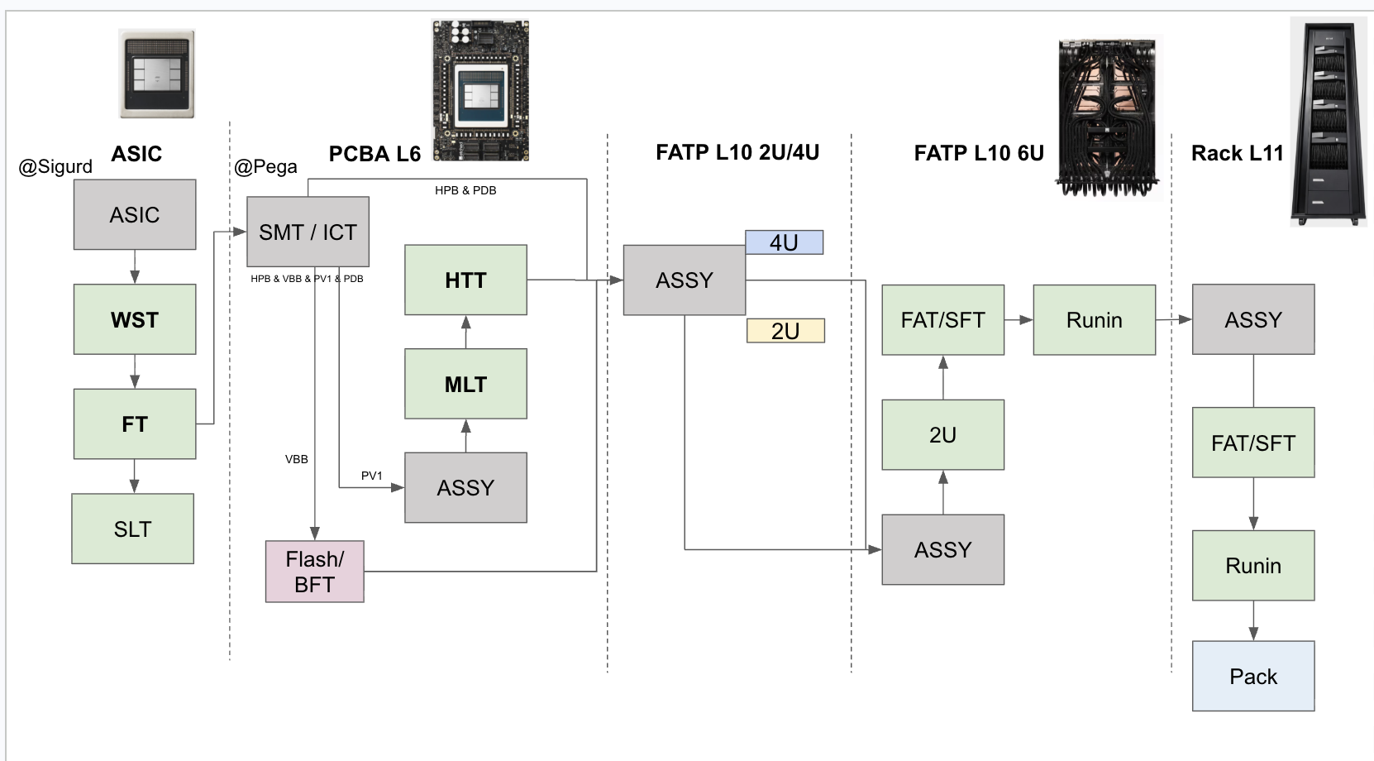
Production test flow — yield and quantity
2026-W33 · 2026-08-10 to 2026-08-16, week still running · UTC · first-pass yield and units, under each step
Rolled first-pass
35.6%
MLT × HTT
Through the line
407 units
573 runs across 7 steps
54.3% 170 units
Reading the numbers
A percentage is a first-pass yield: units that passed at their first attempt that week.
A count means no yield is reported. L10 FAT, L10 SFT, L10 RIN, L10 2U, L11 Test are chassis and rack level and in bring-up — a percentage over three units swings 33 points on one of them.
WST and FT are reported by Sigurd. VBB is drawn for the flow and left out of the yield view.
Source: pega2 – pega5 (ESVM), one row per unit.
35.3% reported
FAT 2u · SFT 1u quantity only
1 unit quantity only
65.5% 228 units
84.3% reported
3 units quantity only
2 units quantity only
at Sigurd — not collected here
VBB — outside the yield view
counted with FAT / SFT

Slide 3
Every step, with the retest rate
2026-W33 · retest rate is the share of units that had to be run again
Test step
Units
Runs
First pass
After retest
Retest rate
Top failure
WST reported
35.3%
Sigurd, as of 2026-08-14
FT reported
84.3%
Sigurd, as of 2026-08-14
MLT pega3
228
279
65.5%
74.6%
19.7%
45 of 228 units re-run
SohuPowerVirusTestCase
HTT pega3
170
234
54.3%
68.8%
27.6%
47 of 170 units re-run
SohuRdqsSweepTrainingTestCase
L10 FAT pega4
2
15
quantity only
—
—
chassis and rack level, in bring-up — quantity only
SohuHostRebootTestCase
L10 SFT pega4
1
6
quantity only
—
—
chassis and rack level, in bring-up — quantity only
SohuLlama70bHp8ForwardIteratedTestCase
L10 RIN pega4
1
4
quantity only
—
—
chassis and rack level, in bring-up — quantity only
RunInStress
L10 2U pega4
3
19
quantity only
—
—
chassis and rack level, in bring-up — quantity only
BmcCheck
L11 Test pega5
2
16
quantity only
—
—
chassis and rack level, in bring-up — quantity only
CheckSohuServerNoErrorLogTestCase
Rolled first-pass across MLT × HTT: 35.6%
Steps under 20 first-time units report counts only. Full unit-level source data, every serial and release with a link to its run: 32x-production.i.etched.com/week.html#week=2026-W33

Slide 4
What's next
against the programme's own gates — coverage, then stability, then efficiency; a station clears one before the next is worth measuring
a
Develop and maintain full coverage for L6
Gate: Coverage
What good looks like. Full, maintained coverage at L6 — every board, every condition, and the suite kept in step as releases land. Coverage is the first gate and the only one L6 has the volume to be measured against today.
Owner. SW team leads define and execute the content; production involved.
Why now. MLT and HTT are the only steps with enough volume to read, and they are where the line loses most of its units: first pass 65.5% and 54.3%, recovered to 74.6% and 68.8% by re-running 45 and 47 units.
b
Speed up development of multiple L10 test units
Gate: Volume, before any gate
What good looks like. More L10 units, sooner. Not to improve the yield — to make a yield exist. Until L10 is running tens of chassis a week, its coverage cannot be judged, its stability cannot be measured, and its efficiency is not yet a question.
Owner. Production, with the L10 station owners.
Why now. L10 ran 7 units across its four steps all week — 2 at FAT, 1 at SFT, 1 at RIN, 3 at 2U. That is why every L10 box on this deck says quantity only: there is no yield to read, and no gate can be measured on single digits.
The ordering is the point. Measuring stability before coverage tells you a suite repeats — including repeating what it never tested; measuring efficiency before stability buys stations to fix flakiness. L6 is at the first gate with the volume to prove it; L10 is not yet at a gate at all.

Slide 5
Appendix — where the data comes from
every figure on this deck traces to one of these; the first one lists the units behind it
This week, unit by unit
Source data for 2026-W33 — every DUT serial, software release, verdict and a link to its run
32x-production.i.etched.com/week.html#week=2026-W33
Every week since collection began, one row each
32x-production.i.etched.com/weekly.html
The rest of the dashboard
Daily tracker — the line's own MLT/HTT tabs, rebuilt from pega3
32x-production.i.etched.com/dailyexcel.html
L10 daily tracker — FAT, SFT, RIN, 2U from pega4
32x-production.i.etched.com/l10.html
Station yield, from the controllers
32x-production.i.etched.com/direct.html
Station yield, from OCP Logs — and the measured gap between them
32x-production.i.etched.com/index.html
Run drill-down, any serial or test name
32x-production.i.etched.com/runs.html
Production test flow, with coverage
32x-production.i.etched.com/flow.html
Upstream of the dashboard
The controllers themselves — ESVM login admin / admin
pega2:3000 · pega3:3000 · pega4:3000 · pega5:3000
OCP Logs / EOS, the other side of the discrepancy
ocplogs.core.etched.com
WST and FT — Sigurd's STDF and SPLM, asked for weekly in #production-test-eng
strata6.sv9.i.etched.com:8235 · splm.i.etched.com
This deck, the pipeline that built it, and every archived week
github.com/etched-ai/factory_data_analysis · weekly/2026-W33/
All addresses are on the factory network. The dashboard rebuilds hourly; the archived copy of 2026-W33 under weekly/ does not change.

